Slide 1
Docker intro
2018-3-16
Notes:
Vagrant Box:
https://bitbucket.org/inftec/vagrant-playground/branch/docker-demo
VM: \\192.168.0.200\Public\2014-12-18 Workshop Docker
DEPRECATED:
Preparation:
Windows: Install boot2docker: https://github.com/boot2docker/boot2docker
Optional: Clean images and containers from installation
Pull required Images
docker pull ubuntu
docker pull training/webapp

Slide 2
Agenda
What is Docker? & WHY ?
Registry Images and Containers
image build practice
Hands-On Workshop

Slide 3
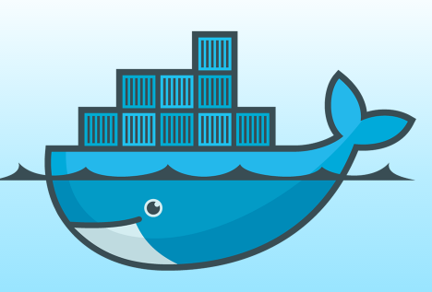

What is Docker ?
Docker是一款轻量级容器的管理引擎软件。云计算时代，可以帮助用户轻松实现分布式应用的“Build, Ship, Run”。

Slide 4
Docker History
2013-03: Releases as Open Source
2013-09: Red Hat collaboration (Fedora, RHEL, OpenShift)
2014-03: 34th most starred GitHub project
2014-05: JAX Innovation Award (most innovative open technology)

Slide 5
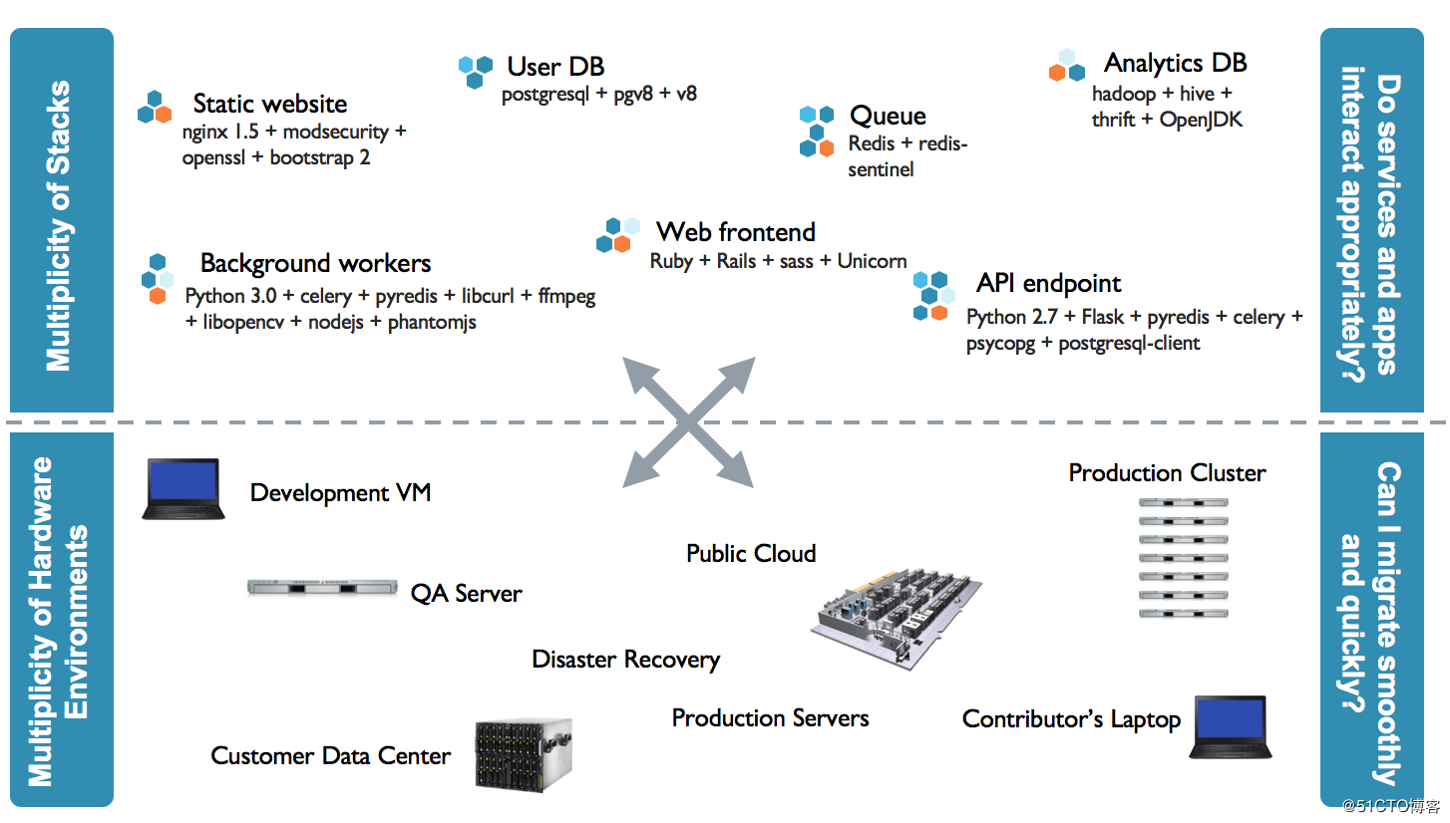
Why Docker ?

Slide 6
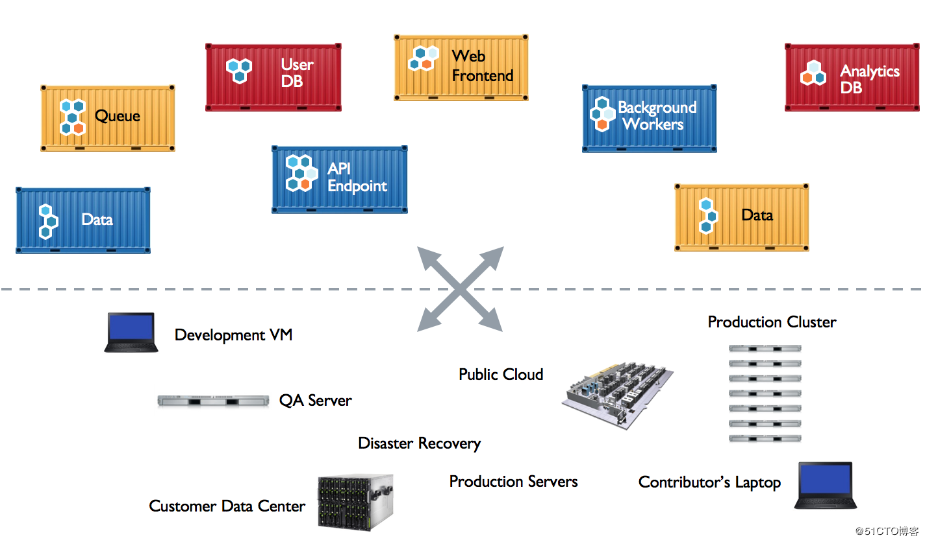
Why Docker ?

Slide 7
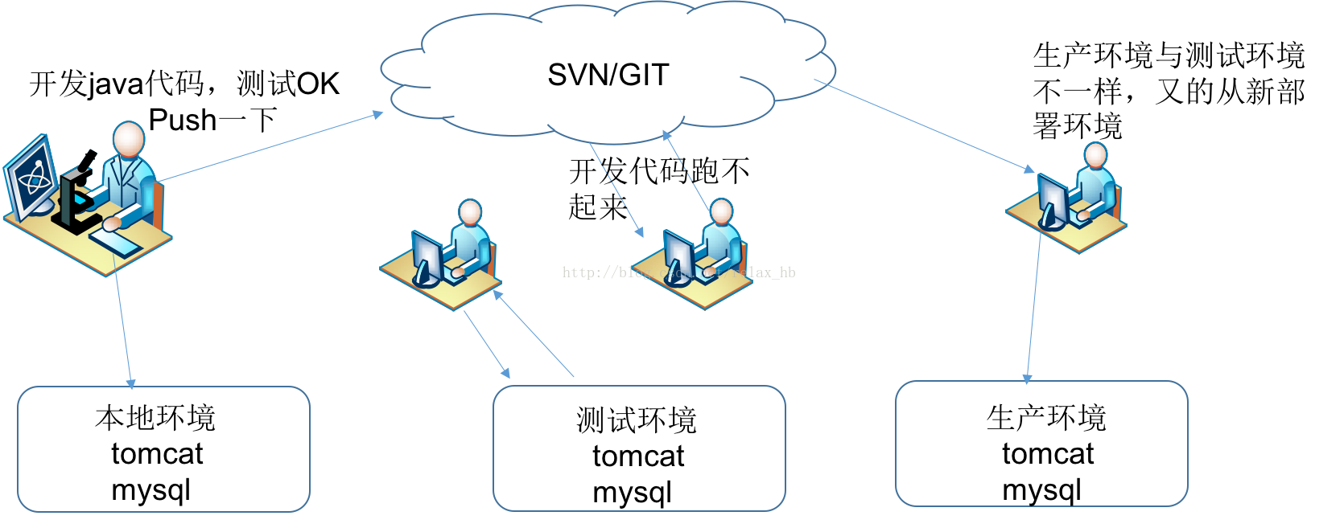
Before use Docker

Slide 8
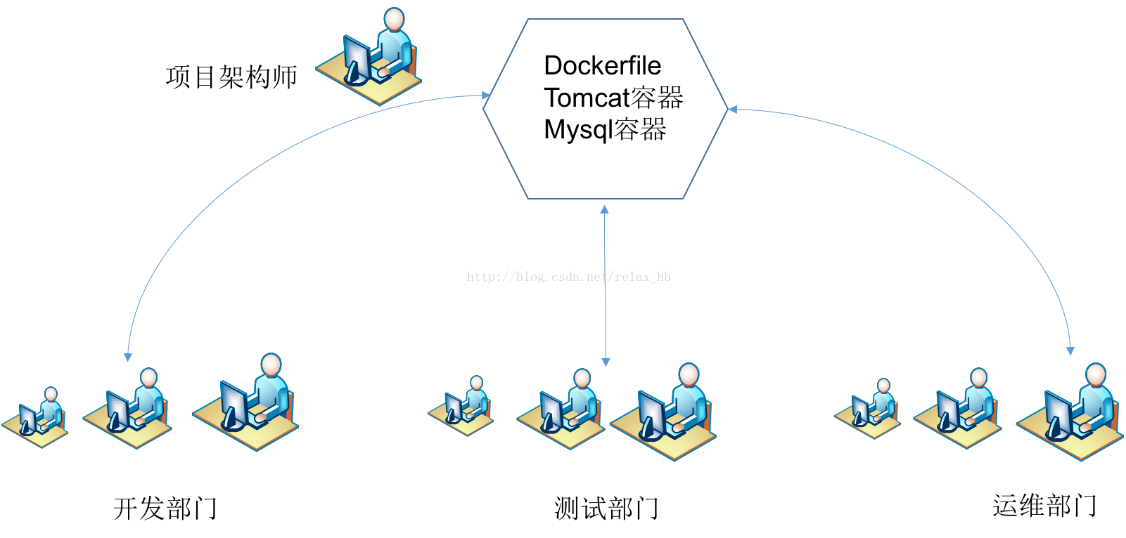
After use Docker

Slide 9
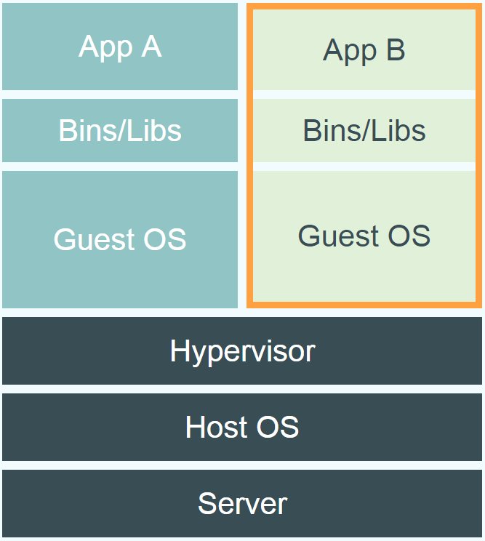
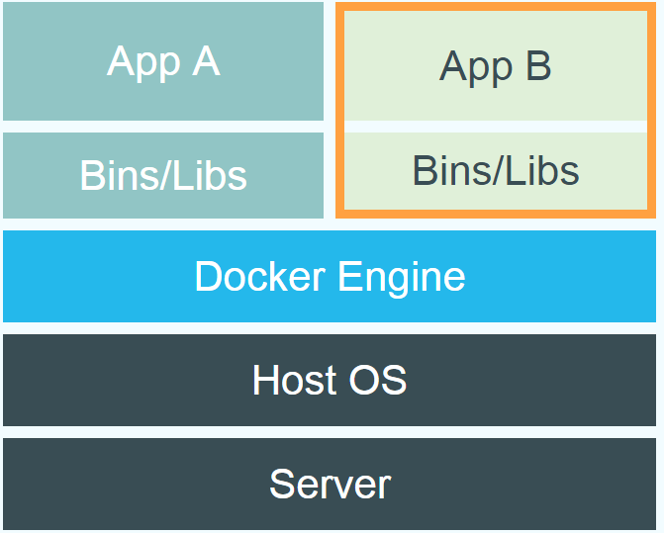
Docker vs. Virtual Machine
Source: https://www.docker.com/whatisdocker/
Notes:
Virtual Machines
Each virtualized application includes not only the application - which may be only 10s of MB - and the necessary binaries and libraries, but also an entire guest operating system - which may weigh 10s of GB.
Docker
The Docker Engine container comprises just the application and its dependencies. It runs as an isolated process in userspace on the host operating system, sharing the kernel with other containers. Thus, it enjoys the resource isolation and allocation benefits of VMs but is much more portable and efficient.
Docker provides base images that contain OS installations we can start from: The OS is not more than an application running on the Kernel...

Slide 10
Advantages:
更高效的利用系统资源
更快的启动速度
一致的运行环境
更方便的持续交付和部署 [CI/CD]
更轻松的迁移
更轻松的维护和扩展

Slide 11
Hello World
example:
docker run ubuntu:latest echo Hello World
docker images [-a]
docker ps –a
Notes:
Immediately exits
docker ps
docker ps –a
Re-attach: docker start –i stoic_wozniak
docker commit –m «message» containerId imageName(e.g. mytest/test1:1.0)
New Image
docker images

Slide 12
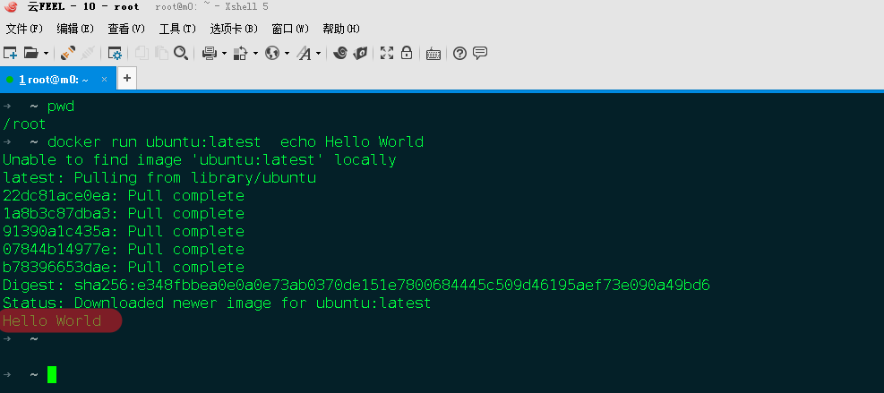
Hello World
Notes:
Immediately exits
docker ps
docker ps –a
Re-attach: docker start –i stoic_wozniak
docker commit –m «message» containerId imageName(e.g. mytest/test1:1.0)
New Image
docker images

Slide 14
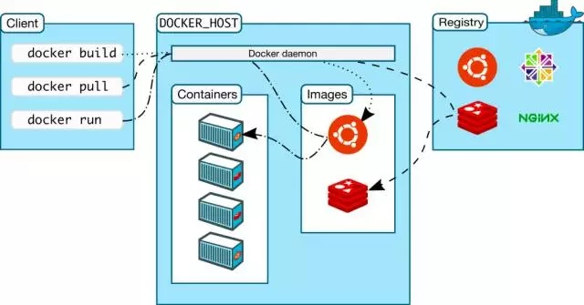
Docker in a nutshell

Slide 15
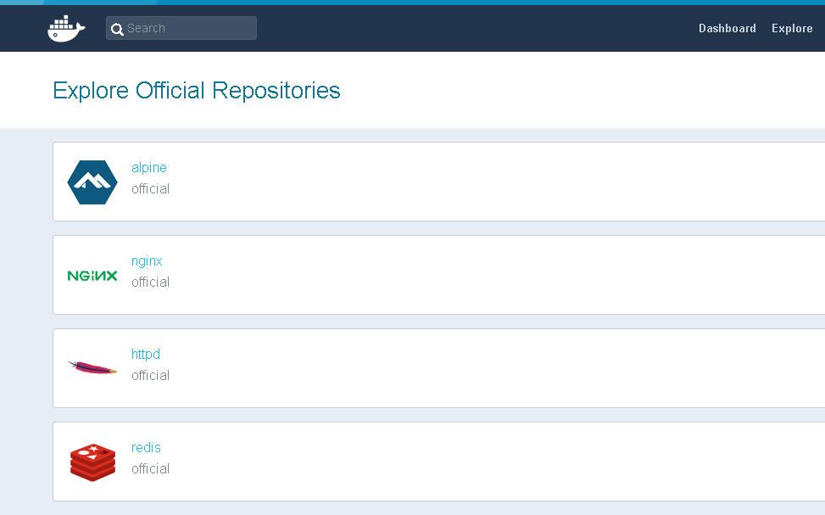
Terminology - Registry
负责构建，存储，分发镜像

Slide 16
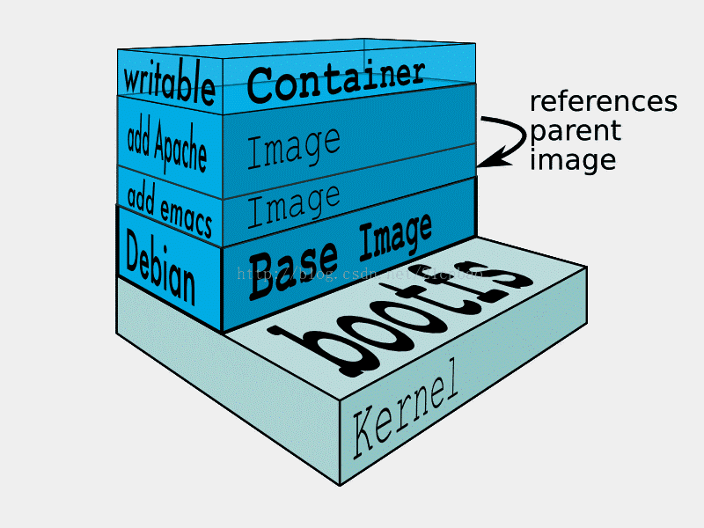
Terminology - Image

Slide 17
Terminology - Image
Persisted snapshot that can be run
search: search images
pull: Download image from repository
images: List all local images
run: Create a container from an image and execute a command in it
tag: Tag an image
rmi: Delete a local image

Slide 18
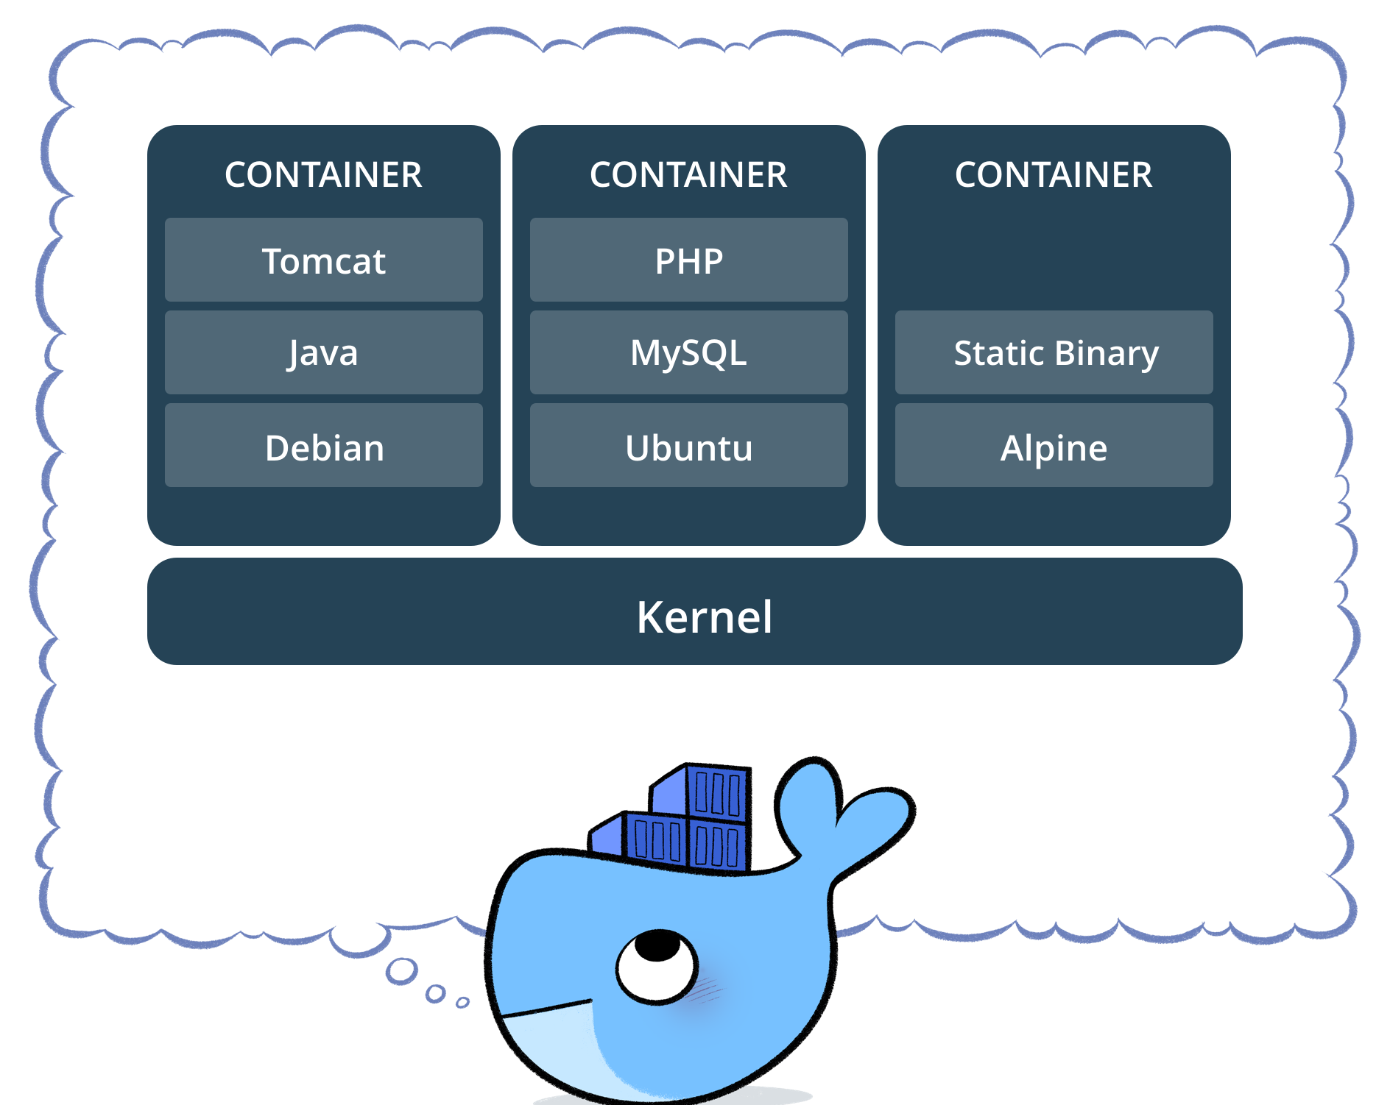
Terminology - Container
Notes:
docker run --rm to remove container after termination

Slide 19
Terminology - Container
Runnable instance of an image
ps: List all running containers
ps –a: List all containers (incl. stopped)
top: Display processes of a container
start: Start a stopped container
stop: Stop a running container
pause: Pause all processes within a container
rm: Delete a container
commit: Create an image from a container
Notes:
docker run --rm to remove container after termination

Slide 20
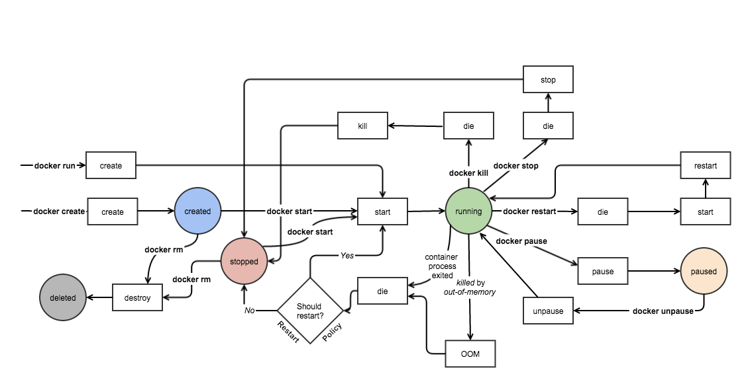
Terminology - Container
Notes:
docker run --rm to remove container after termination

Slide 21
Image vs. Container
Base Image
ubuntu:latest
run
Container
cid1
base image
cmd → new state
New Image
iid1
commit
Container
cid1
run
Container
cid2
Container
cid3
Container
cid4

Slide 22
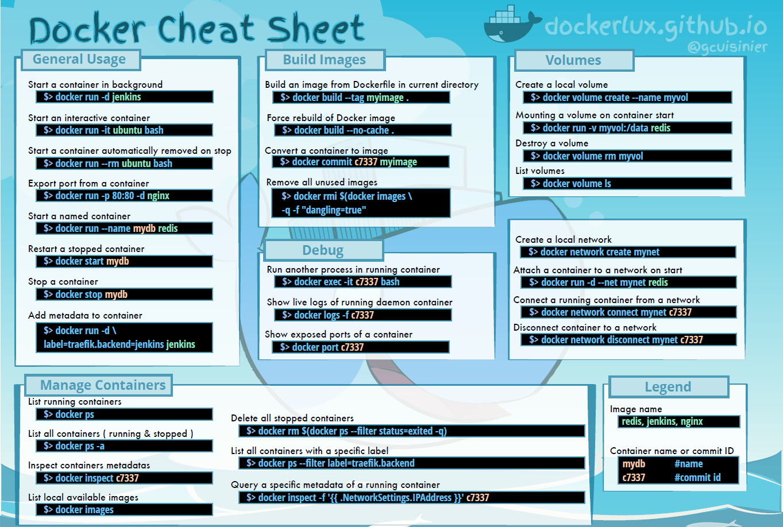

Slide 24
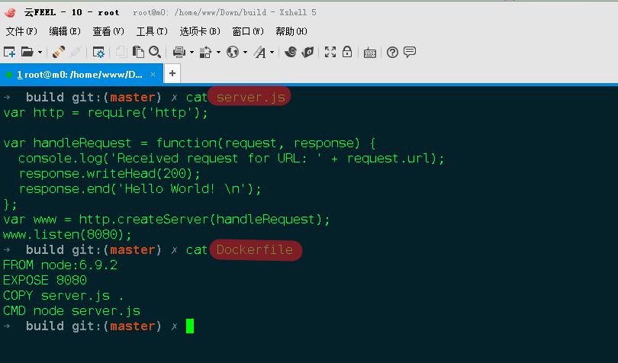
Build image

Slide 25
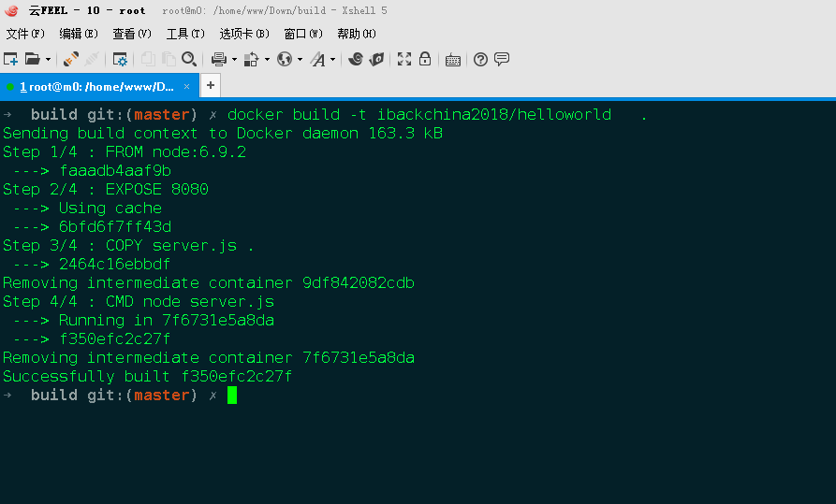
Build image

Slide 26
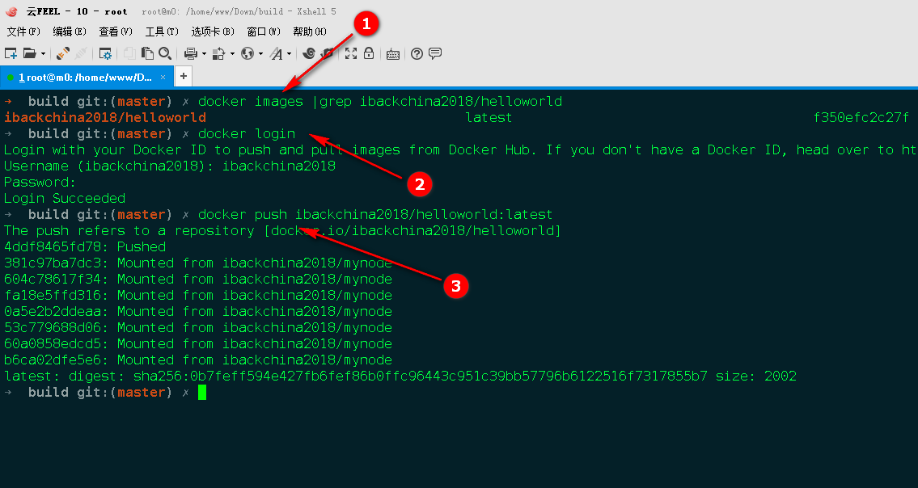
Build image

Slide 27
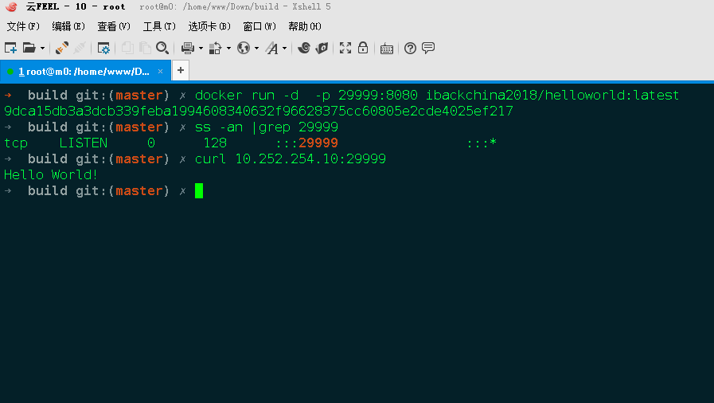
Run container

Slide 28
Build image - 2
登录 hub.docker.com
创建automated build
选择github.com上的源码 triger并构建
docker hub上查看构建出来的镜像

Slide 29
Q & A

