Slide 1
DB2® Linux®, UNIX®, Windows® 基础和 Data Studio
Data Management Emerging Partnerships and Technologies
IBM Toronto Lab
Summer/Fall 2009

Slide 2
课程内容
DB2 简介
DB2 版本及其特点
DB2 结构和用户
实例
IBM 数据服务器客户端
表空间
缓存池
安全性
SAMPLE 数据库
数据输入/输出
IBM Data Studio

Slide 3


DB2 9.7 Linux, Unix, Windows介绍
2009年6月19号正式发布
多平台支持
  Linux, UNIX (AIX, HP-UX)
  Windows 2000, XP, 2003, Vista, 2008
  Solaris
共享同样的代码 “DB2 is DB2 is DB2”
  不同平台见不需要迁移
  新版本在所有平台上同时发布

Slide 4




DB2 9.7版本及功能扩展包
企业级
服务器版本
工作组
服务器
版本
包括多种功能扩展包(存储优化功能包, 性能优化功能包等), Informix, 客户端, 驱动程序, DB2 Connect, Extenders,及其它更多功能
Express
版本
Express-C
版本
个人版
大型企业
DB2 Everyplace
版本
中小型企业, 独立软件开发商, 部门，测试及系统开发
企业级
数据库
开发版本

Slide 5
DB2 企业级版本
针对重型工作负载和大型数据仓库设计
没有内存使用限制
没有处理器限制
支持Linux, UNIX, Windows, zLinux平台
包括以下功能 pureXML, HADR, Online REORG, Homogenous Federation, DB2 Governor, MQT, MDC, Query Parallelism, Connection Concentrator, Table Partitioning.
提供以下可扩展的高级功能:
    存储优化功能 (Storage Optimization Feature)
    高级访问控制功能 (Advanced Access Control Feature)
    性能优化功能 (Performance Optimization Feature)
    同源复制功能 (Homogenous Replication Feature)
    测量数据管理功能 (Geodetic Data Management Feature)
Notes:
Available add-ons include Storage Optimization Feature, Advanced Access Control Feature, Performance Optimization Feature, Geodetic Data Management Feature, Homogeneous Replication Feature

Slide 6
DB2 9.7 企业级版本附加功能特点
存储优化
  行压缩，索引压缩，临时表压缩以及XML压缩
高级访问控制
  基于标签访问控制提供的粒度控制能力
性能优化
  提供工作负载管理服务和一系列用来优化 DB2 数据服务器性能的报告和工具
  包括查询巡视器，工作负载管理，性能专家工具 (Express, Workgroup, Enterprise)
同源复制
  使用Q-复制原理，来提供基于查询的高速复制功能来达到分散，组合及同步数据的目的
测量数据管理
  Geodetic Extender:按照地理测量学的原理设计，将地面作为球体对待，从而消除投影和地球曲面等造成数据的不精确
Notes:
IBM Homogeneous Replication Feature provides high speed queue-based replication services to distribute, consolidate, and synchronize data in support of live reporting, high availability, and query offload applications. The homogeneous replication feature allows you to copy data on a regular basis to multiple DB2 or IDS remote databases. It uses Q replication. The homogeneous replication feature is part of a larger IBM solution for replicating data in small and large enterprises.
The Performance Optimization feature is unique to DB2 Enterprise. This feature pack includes the Workload Management capabilities first introduced in DB2 9.5. By default, all DB2 9.7 activity occurs in the DB2 WLM default classes and workloads; to customize these objects you need to purchase this feature pack. The Performance Optimization Feature Pack also includes the DB2 Performance Expert. The DB2 Performance Expert simplifies performance management and tuning. It offers DBAs a consistent view into their instances, subsystems, databases, and applications for the DB2 data server upon which it is installed also includes as set of detailed reports about SQL, database and buffer pool activity with trend analysis and what-if hypothesis testing for optimal performance evaluation, and more.
With the growing scrutiny on database security, and corporate compliance, it’s great that DB2 has the Advanced Access Control feature pack. By providing label-based access control, access to DB2 data can be controlled with granularity at the table column and row level. LBAC controls access to table objects by attaching security labels to them. Users attempting to access an object must have its security label granted to them. When there's a match, access is permitted; without a match, access is denied and data is hidden This feature pack also enables DB2 to be considered for some government and top secret type installations. For example, this capability was required in DB2 by a large U.S. military defense contractor before they could use it.
The Geodetic Data Management feature pack provides spatial analysis with consideration for the curvature of the earth (which is the main differentiator from the free Spatial Extender that's part of every DB2 9 edition). The Geodetic Data Management Feature is used for advanced analytics that need to minimize the distortion caused by projections of the earth's surface; it’s especially useful for military defense applications, weather applications, and so on.
DB2 Storage Optimization is turning out to be a winner with customers since it’s introduction in DB2 9. In DB2 9.7, it has been improved to include compression of indexes and temporary space. It provides storage compression services to optimize the performance and footprint of your data via: Row Level Compression, Index Compression, Temp Compression, Backup Compression services

Slide 7
SQL 简介
DB2支持查询关系型数据的SQL语言
同样也支持查询XML数据的XQUERY语言
SQL四种语句类型:
数据定义语言 (DDL)
  定义数据对象的属性
  例如. CREATE, ALTER, DROP, TRANSFER OWNERSHIP
数据管理语言 (DML)
  用来返回，添加，编辑和删除数据
  例如. SELECT, INSERT, UPDATE, DELETE

Slide 8
SQL 简介
数据控制语言 (DCL)
  控制数据库和数据对象的访问
  例如. GRANT, REVOKE
事务控制语言 (TCL)
  将一组DML语句组合到事务中来集中地应用到一个数据库或者因为错误而处于未完成的状态
  例如. COMMIT, ROLLBACK, SAVEPOINT

Slide 9
DB2 处理机制
DB2 引擎 (db2sysc)
  在内存中，主引擎处理程序(db2sysc)以进程模式存在
  引擎分派单元(Engine Dispatchable Units - EDU )负责执行各种任务
  进程模型的优势:
    增加数据库性能
    节省内存资源
DB2 代理 (db2agent)
  EDU作为应用程序的代理，负责执行各种任务，包括处理数据库应用程序请求
  DB2 engine保持多个代理存在来保证当有服务请求时能够及时响应
  两种主要代理方式: 协调代理, 子代理
Notes:
In DB2, there is one main DB2 process known as the DB2 Engine (db2sysc), which works using a threaded model, wherein threads called Engine Dispatchable Units (EDU) are loaded to perform various tasks. For example, EDU’s exist for prefetching data pages into buffer pools (db2pfchr), retrieving data (db2agent), and managing incoming TCP/IP connections (db2tcpcm), among many others. Note that there are still a few other processes that DB2 loads, such as db2acd for managing health and automatic maintenance, but many tasks that were previously handled in separate processes are now handled by EDU threads.
By using a threaded model, performance is increased because there is less overhead required to maintain multiple threads in memory than if we were to maintain multiple processes. As well, context switching between threads is much faster than between processes.
Another benefit of the threaded model is that we use less memory. All threads share the same address space and each thread has a lower memory footprint than if we were to use processes.
Agents are EDU’s that carry out the requests made by a client application. Each connected application is served by exactly 1 coordinator agent and possibly, a set of subordinator agents or subagents.
A coordinator agent is the initial agent to which a local or remote application connects. There is one coordinator agent dedicated to each database connection or instance attachment. In partitioned databases, additional agents (called subagents) can then be enlisted by the coordinator agent to speed up SQL processing. Subagents are selected from the agent pool and are returned there when their work is done.

Slide 10
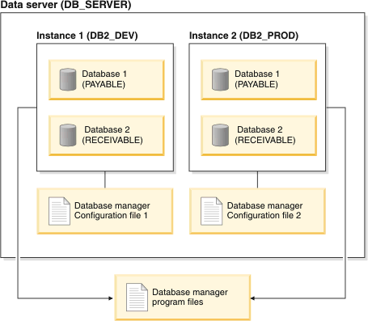
DB2 实例
独立的DB2环境
每个数据服务器可以有多个实例
所有实例共享同样的可执行二进制文件
每个实例有自己的配置参数文件
每个实例可以有不同的软件级别
Notes:
When we install DB2 on a server, we must create one or more DB2 instances that will manage databases, accepting incoming requests, and return data to connected applications. When a database is created, it is created within an instance. The creation of multiple instances on the same physical server provides a unique database server environment for each instance. All instances share the same executable program files, but each has a separate configuration file so that each instance can be fine-tuned to its own specific purpose.
For example, you can maintain a test environment and a production environment on the same machine, or you can create an instance for each application and then fine-tune each instance specifically for the application it will service, or, to protect sensitive data, you can have your payroll database stored in its own instance so that owners of other instances (on the same server) cannot see payroll data.
There is also another special type of instance called the DB2 Administration Server (DAS). The DAS is a special DB2 administration control point used to assist with the administration tasks only on other DB2 servers. A DAS must be running if you want to use the Client Configuration Assistant to discover the remote databases or the graphical tools that come with the DB2 product, for example, the Control Center or the Task Center. There is only one DAS in a DB2 database server, even when there are multiple instances.

Slide 11
DB2 实例
一些有关实例的命令
下面多数命令需要在控制中心中执行
命令 | 描述 | 例子
db2start | 启动默认实例 | db2start
db2stop | 停止当前实例 | db2stop -f
db2icrt | 创建实例 | db2icrt –u db2fenc1 db2inst1
db2idrop | 删除实例 | db2idrop –f db2inst1
db2ilist | 列出所有实例 | db2ilist
db2imigr | 升级DB2后迁移一个实例 | db2imigr –u db2fenc1 db2inst1
db2iupdt | 安装补丁后升级实例 | db2iupdt –u db2fenc1 db2inst1

Slide 12
DB2 实例 : 实例和数据库配置文件
查看和更改实例配置文件:
查看和更改数据库配置文件:
描述 | 例子
查看数据库管理器配置 | db2 get dbm cfg show detail
更改数据库管理器配置 | db2 update dbm cfg using health_mon off
描述 | 例子
查看数据库配置 | db2 get db cfg for testdb db2 connect to testdb db2 get db cfg show detail
更改一个数据库配置 | db2 update db cfg using logprimary 10

Slide 13
DB2 日志
通过DIAGLEVEL参数来控制日志的数量
db2diag.log日志
  存放于$DB2INSTANCE_HOME/sqllib/db2dump/
  该日志包含DB2所有错误和警告日志信息
stmm.log日志
  存放于$DB2INSTANCE_HOME/sqllib/db2dump/stmm
  日志存放于多个文件中(最多5个)
  该日志包含性能统计数据和DB2的优化结果
Notes:
Other logging also available:
- instancename.nfy (notify log is missing)
- Transaction log files - suggestion "db2 error and diagnosis files"

Slide 14
IBM Data Server Client客户端
允许客户端计算机连接远程服务器并且访问该服务器上的数据库. 通过三种方式:
IBM Data Server Runtime Client
  支持在JDBC, ADOODBC, DB2 CLI, .NET, ADO.NET, OLE DB, PHP和Ruby中运行和配置应用程序.
  包含DB2 CLP命令行程序,但是没有图形化界面工具
  目录保存连接信息(结点, 数据库)
IBM Data Server Client
  包括以上所有功能，另外对应用程序开发，数据库管理和配置服务器/客户观提供支持
  包括图形化工具
IBM Data Server Drivers
  IBM ODBC和CLI数据服务器驱动程序
  IBM JDBC和SQLJ数据服务器驱动程序
  IBM数据服务器驱动程序包
    ODBC, CLI, .NET, OLE DB, PHP, Ruby, JDBC和SQLJ
    CLPPlus
为独立软件开发商
设计的小型解决方案
Notes:
The IBM Data Server Client is actually a package that installs all drivers/tools necessary to provide access to a DB2 server for ALL supported interfaces and programming Sometimes it is not necessary to install the whole package of drivers. For example, an ISV that uses JDBC to access a DB2 server might ship DB2’s JDBC driver together with their application… which is the only requirement for a JDBC application to access a DB2 server.
Other interfaces (CLI, ODBC, etc) have other requirements, thus might require that the IBM Data Server Client installed.

Slide 15
配置远程连接
有些程序接口在使用数据库之前要求将其添加进目录中.
执行添加功能的工具:
  配置助手 (图形化界面)
  控制中心 (图形化界面)
  命令行处理器 (CLP)
当连接远程服务器上数据库时，需要:
  将远程系统 (结点) 添加到目录中
  将远程结点上的数据库添加到目录中
注意：当您创建一个数据库时，DB2会自动将其添加进本地目录中

Slide 16
手动添加一个远程目录
作为实例用户来向目录中添加远程结点.
你也可以将DAS添加进远程结点:
将远程数据库添加进目录中：
完成以上操作后，可以开始正常使用远程数据库:
db2 catalog tcpip node db2node remote SERVER1 server 50001
alias
hostname/IP address
port #
db2 catalog admin tcpip node db2das remote SERVER1
db2 catalog db SAMPLE at node db2node authentication SERVER
db2 connect to SAMPLE user db2inst1 using password
Notes:
Sometimes, we may need to access a database stored on a remote DB2 instance. In order to do this, we must first catalog the remote instance (also called a node), and then we must catalog the desired database that exists on the remote node. Once we have completed both of these steps, we can access the database just as if it existed on the local system.
To catalog a node, we first login as the instance user, and execute the db2 catalog tcpip node command. When you catalog a node, you must choose an alias for the node that will be used to refer to the node on the local system. On the screen, we have an example in which we are cataloguing a node with the hostname SERVER1, listening on port 50001, and we will use the alias db2node to refer to the node.
We can also catalog the DAS on a remote node. In this case, we don’t specify port number since we’re not accessing an instance specifically.

Slide 17
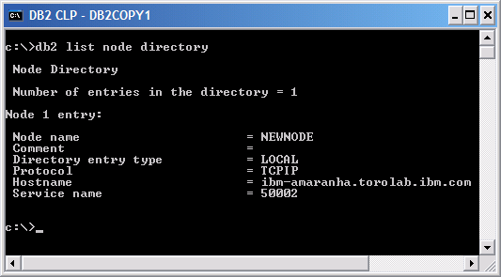
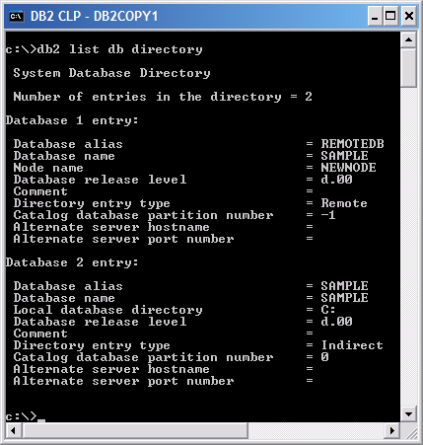
显示本地目录信息
使用以下命令来显示本地目录中的结点，DAS和数据库信息:
db2 list database directory
db2 list admin node directory
db2 list node directory
Notes:
Once we have the node cataloged, we can then catalog the desired database. So, if we wanted to catalog the SAMPLE database on the cataloged node aliased by db2node, we would execute the first command shown on screen. After we have the database cataloged, we can connect to it just as if it existed on the local system.
It is often useful to be able to see what nodes, DAS’, and databases have been cataloged on the local system. To do this, you simply execute the LIST DATABASE DIRECTORY, LIST ADMIN NODE DIRECTORY, and LIST NODE DIRECTORY commands as the instance user.

Slide 18
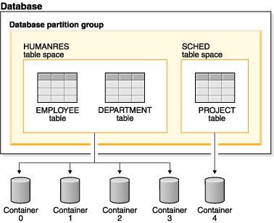
DB2 存储 : 表空间
表空间由一个或多个容器组成的逻辑存储集合
所有的表，索引，和其它数据类型都存在表空间中
给表空间添加磁盘物理地址(容器)来控制表空间的数据存放在磁盘的什么位置.
Notes:
A table space is a storage structure containing tables, indexes, large objects, and long data. It allows you to assign the location of database and table data directory onto containers. A container can be a directory name, a device name, or a file name. By customizing how our data is stored, we can achieve improved performance and more flexible configuration.

Slide 19
DB2 存储 : 表空间
目录表空间 (一个)
  包含数据库中所有的系统目录表
  该表空间称为SYSCATSPACE并且不能被删除
用户表空间 (一个或多个)
  包含所有用户定义的表
  用户表空间USERSPACE1会被默认创建
系统临时表空间(一个)
  存储数据库管理器执行排序和联接操作时所需要的数据
用户临时表空间 (一个或多个):
  存储创建表时所需要的临时数据，使用以下命令来创建
  CREATE/DECLARE GLOBAL TEMPORARY TABLE
Notes:
A database must contain at least three table spaces:
* One catalog table space, which contains all of the system catalog tables for the database. This table space is called SYSCATSPACE, and it cannot be dropped. IBMCATGROUP is the default database partition group for this table space.
* One or more user table spaces, which contain all user defined tables. By default, one table space, USERSPACE1, is created. IBMDEFAULTGROUP is the default database partition group for this table space.
* One or more temporary table spaces, which contain temporary tables. Temporary table spaces can be system temporary table spaces or user temporary table spaces.
System temporary table spaces hold temporary data required by the database manager while performing operations such as sorts or joins. These types of operations require extra space to process the results set. A database must have at least one system temporary table space; by default, one system temporary table space called TEMPSPACE1 is created at database creation. IBMTEMPGROUP is the default database partition group for this table space.
User temporary table spaces hold temporary data from tables created with a DECLARE GLOBAL TEMPORARY TABLE statement. To allow the definition of declared temporary tables, at least one user temporary table space should be created with the appropriate USE privileges. USE privileges are granted using the GRANT statement. A user temporary table spaces is not created by default at database creation.

Slide 20
DB2 存储 : 表空间
表空间可以由操作系统管理(SMS)，或者由数据库管理(DMS)，或者由DB2的自动存储功能管理
系统管理空间 (SMS)
    数据存放在文件系统的文件中
    使用操作系统的标准I/O函数来访问数据
    除非需要，否则空间不会被额外分配
    适用于小型，个人数据库以及存储空间变化频繁的数据库
    对维护和监控要求较低
CREATE TABLESPACE tbsp1
MANAGED BY SYSTEM
USING ('d:\acc_tbsp', 'e:\acc_tbsp', 'f:\acc_tbsp')
Notes:
There are three way that we can have our table spaces managed. These methods determine how storage will be allocated to and managed by a table space, and can affect performance.
First, we have System Managed Space (SMS) table spaces. An SMS table space is managed by the operating system, which stores the database data into a space that is assigned when a table space is created.
Some advantages of an SMS table space include:
* Space is not allocated by the system until it is required
* Creating a table space requires less initial work, because you do not have to predefine the containers
* Indexes created on range partitioned data can be stored in a different table space than the table data
However, one down side to an SMS table space is that the file system of the operating system decides where each logical file page is physically placed. This means that pages might not allocated contiguously on disk depending on the level of other activity on the file system and the file system algorithm used to determine placement. Because of this, performance of an SMS table space can be negatively impacted.
In general, small, personal databases where high performance is not a strong concern are easiest to manage with SMS table spaces.
In the example above, we’ve created an SMS table space called tbsp1, and specified that the table space should store its data in any of the 3 directories d:\acc_tbsp, e:\acc_tbsp, or f:\acc_tbsp.

Slide 21
DB2 存储 : 表空间
  数据库管理空间 (DMS)
    数据存储在文件或者Raw设备中
    能够绕过操作系统的I/O函数从而增加性能
    适用于对数据库性能要求比较高的应用程序
    需要较频繁的维护和监控
    当容器空间不足时，可以通过设置参数来自动增加容器空间
CREATE TABLESPACE tbsp1
PAGESIZE 8K
MANAGED BY DATABASE
USING (FILE 'd:\db2data\acc_tbsp' 5000,
FILE 'e:\db2data\acc_tbsp' 5000)
CREATE TABLESPACE tbsp2
PAGESIZE 8K
MANAGED BY DATABASE
USING (FILE ' /storage/dms1' 10 M) AUTORESIZE YES
Notes:
A Database-Managed (DMS) table space is managed by the database manager, and is designed and tuned to meet its requirements. We can specify either a list of files to be used by the table space or raw devices to be used.
Pre-allocated files and devices can also be added to an existing DMS table space in order to increase its storage capacity. The database manager will then automatically rebalance existing data into all the containers belonging to the table space.
With DMS, the database manager can ensure that page are physically contiguous because it bypasses operating system I/O functions and interfaces with the disk directly. This can improve performance significantly. The down side to DMS, however, is that it requires more tuning and administration since you will need to add more storage containers as the table space fills.
In general, a well-tuned set of DMS table spaces will outperform SMS table spaces. If you are creating a table space for a performance-sensitive application – particularly one involving a large number of INSERT operations – it is recommended that you use DMS table spaces.
In the example above, we have created a DMS table space named tbsp1 and assigned to it 2 storage files. Each file will be pre-allocated with 5000 pages, so the total size of each file is 5000 x page size. For example, since we have specified an 8 KB page size, the total size of each file will be 5000 x 8 KB = 40,000 KB or 40 MB.

Slide 22
DB2 存储 : 表空间
  自动存储表空间
    数据库允许使用自动存储时
    数据库管理器能够自动分配容器 (物理存储地址)
    自动调整表空间的大小
    对普通/大型表空间来使用数据库管理
    对用户或系统临时表空间使用系统管理
CREATE DATABASE mydb AUTOMATIC STORAGE YES
CONNECT TO mydb
CREATE TABLESPACE tbsp1 MANAGED BY AUTOMATIC STORAGE
Notes:
An automatic storage database is one in which table spaces can be created and whose container and space management characteristics are completely determined by the DB2(R) database manager. At the most basic level, databases that are enabled for automatic storage have a set of one or more storage paths associated with them. A table space can be defined as "managed by automatic storage" and its containers assigned and allocated by DB2 based on those storage paths.
Although the automatic storage table space type appears to be a different table space type, it is really just an extension of the existing SMS and DMS types. If you create a table space as a regular or large table space, it is created as a DMS table space with file containers. If you create a table space as a user or system temporary table space, it is created as an SMS table space with directory containers.
Before we can create a table space to be managed by automatic storage, the database itself must be enabled for automatic storage. This is done at database creation time using the AUTOMATIC STORAGE YES option of the CREATE DATABASE command. You cannot disable or enable automatic storage for a database after it has been created.
In the example above, we have created the database mydb and enabled it for automatic storage. We then connect to the database and create an automatic storage table space called tbsp1 within it.
Note that the MANAGED BY AUTOMATIC STORAGE clause might be specified, or the MANAGED BY clause might be left out completely (which implies automatic storage). No container definitions are provided in this case because the DB2(R) database manager assigns the containers automatically.

Slide 23
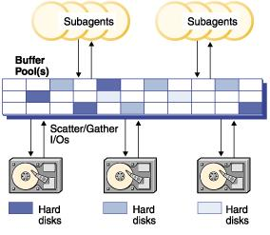
DB2 存储 : 缓冲池
  用来放置表和索引的缓存数据的内存区
  能够有效的减少访问数据的时间
  每个数据库至少需要一个缓冲池
  通过内存自调优功能(STMM)来自动调价缓冲池达到优化目的
Notes:
When a row of data in a table is first accessed, the database manager places the page that contains that data into a buffer pool. Pages stay in the buffer pool until the database is shut down or until the space occupied by the page is required by another page.
Pages in the buffer pool can be either in-use or not, and they can be dirty or clean:
* In-use pages are currently being read or updated. To maintain data consistency, the database manager only allows one agent to be updating a given page in a buffer pool at one time. If a page is being updated, it is being accessed exclusively by one agent. If it is being read, it may be read by multiple agents simultaneously.
* "Dirty" pages contain data that has been changed but has not yet been written to disk.
* After a changed page is written to disk, it is clean and might remain in the buffer pool.
A large part of tuning a database involves setting the configuration parameters that control the movement of data into the buffer pool and the writing of data from the buffer out to disk. If not needed by a recent agent, the page space can be used for new page requests from new applications. Database manager performance is degraded by extra disk I/O.
You can use the snapshot monitor to calculate the buffer pool hit ratio, which can help you tune your buffer pools.

Slide 24
DB2 存储 : 缓冲池
每个表空间都有一个同样页面大小的缓冲池
根据表的用途设置多个缓冲池，能够通过缓冲不同数量的数据来达到增加数据库性能的目的，比如说：
  给一个大型的随机访问表空间较小的缓冲池
  给OLTP应用程序设置的表空间一个较大的缓冲池
如果创建表空间时，没有特别指定缓冲池，那么数据库会使用默认的 IBMDEFAULTBP缓冲池
CREATE BUFFERPOOL bp4k PAGESIZE 4K
CREATE TABLESPACE tbsp1 PAGESIZE 4K BUFFERPOOL bp4k
Notes:
When designing buffer pools, you need to understand the relationship between table spaces and buffer pools. Each table space is associated with a specific buffer pool. IBMDEFAULTBP is the default buffer pool. The database manager also allocates these system buffer pools: IBMSYSTEMBP4K, IBMSYSTEMBP8K, IBMSYSTEMBP16K, and IBMSYSTEMBP32K (formerly known as the "hidden buffer pools"). To associate another buffer pool with a table space, the buffer pool must exist and the two must have the same page size. The association is defined when the table space is created (using the CREATE TABLESPACE statement), but it can be changed at a later time (using the ALTER TABLESPACE statement).
Having more than one buffer pool allows you to configure the memory used by the database to improve overall performance. For example, if you have a table space with one or more large (larger than available memory) tables that are accessed randomly by users, the size of the buffer pool can be limited, because caching the data pages might not be beneficial. The table space for an online transaction application might be associated with a larger buffer pool, so that the data pages used by the application can be cached longer, resulting in faster response times. Care must be taken in configuring new buffer pools.
Note: If you have determined that a page size of 8 KB, 16 KB, or 32 KB is required by your database, you must have at least one bufferpool of the matching page size defined and associated with table space in your database.

Slide 25
DB2 安全性
DB2中有三种授权方式:
  权限
  特权
  LBAC基于标签访问
显式权限/特权:
  通过GRANT语句来显式赋予权限或特权给用户
隐式权限/特权:
  赋予用户所在的用户组，或用户所属的角色或其所继承的角色权限或特权来隐式的将该权限或特权赋予此用户
Notes:
Users (identified by an authorization ID) can successfully execute SQL or XQuery statements only if they have the authority to perform the specified function. To create a table, a user must be authorized to create tables; to alter a table, a user must be authorized to alter the table; and so forth.
There are three forms of authorization, authorities, privileges, and LBAC credentials. We’ll talk briefly about authorities and privileges, but leave LBAC to another presentation.
The database manager requires that each user be specifically authorized, either implicitly or explicitly, to use each database function needed to perform a specific task. Explicit authorities or privileges are granted to the user (GRANTEETYPE of U in the database catalogs). Implicit authorities or privileges are granted to a group to which the user belongs (GRANTEETYPE of G in the database catalogs) or to a role in which the user, the group or another role is a member (GRANTEETYPE of R in the database catalogs).

Slide 26
DB2 SAMPLE数据库
DB2自带的很多样本程序都是用SAMPLE数据库
如何创建支持XML和关系型数据的SAMPLE数据库:
SAMPLE 数据库能够在任何时候被删除或者重建:
通过连接和查询SAMPLE数据库来验证数据库程序是否正确安装
db2sampl –sql –xml
db2 drop database SAMPLE
Notes:
The SAMPLE database can be used for testing applications, trying features of DB2, etc.

Slide 27
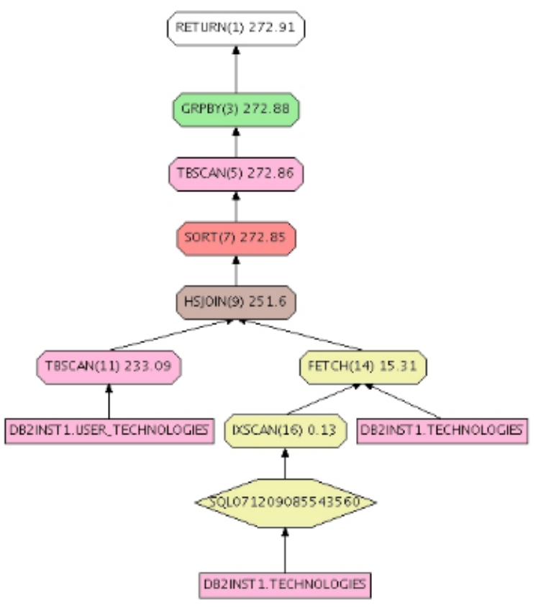
DB2 访问方案
指定SQL或XQuery中访问数据的操作语句的顺序
同时显示被选择的表，索引或者列的统计信息，操作属性，以及如表空间，函数统计数据等全局信息和与优化相关的配置参数
可以用来优化查询
Visual Explain 工具可以图形化的查看语句的访问方案

Slide 28




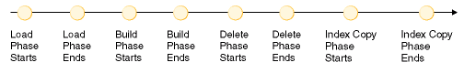
Import/Export/Load 功能
Oracle 工具
  输出数据: Oracle exp; SQL*Plus
  输入数据: Oracle imp; SQL*Loader
DB2 EXPORT
  用来将表或者视图中数据输出到文件
DB2 IMPORT
  使用SQL INSERT语句来向表中输入数据
DB2 LOAD
  高速，低级的数据装载功能
  装载处理的步骤
    装载
    创建
    删除
    拷贝索引
ID
…
DOC (XML)
PR27
…
PR28
…
ACC
…
Notes:
The export utility extracts data using an SQL select or an XQuery statement, and places that information into a file. You can use the output file to move data for a future import or load operation or to make the data accessible for analysis.
The import utility populates a table, typed table, or view with data using an SQL INSERT statement. If the table or view receiving the imported data already contains data, the input data can either replace or be appended to the existing data.
The DB2 load utility is a high-speed, low-level data loading utility that loads data into a DB2 database in four phases.
The load process consists of four distinct phases (see Figure):
Load
During the load phase, data is loaded into the table, and index keys and table statistics are collected, if necessary. Save points, or points of consistency, are established at intervals specified through the SAVECOUNT parameter in the LOAD command. Messages are generated, indicating how many input rows were successfully loaded at the time of the save point.
Build
During the build phase, indexes are produced based on the index keys collected during the load phase. The index keys are sorted during the load phase, and index statistics are collected (if the STATISTICS USE PROFILE option was specified, and profile indicates collecting index statistics). The statistics are similar to those collected through the RUNSTATS command.
Delete
During the delete phase, the rows that caused a unique or primary key violation are removed from the table. These deleted rows are stored in the load exception table, if one was specified.
Index copy
During the index copy phase, the index data is copied from a system temporary table space to the original table space. This will only occur if a system temporary table space was specified for index creation during a load operation with the READ ACCESS option specified.
Note: After you invoke the load utility, you can use the LIST UTILITIES command to monitor the progress of the load operation.
Some differences between the import and load utility :
Import | Load
Slow when moving large amounts of data. | Faster than the import utility when moving large amounts of data,
| because the load utility writes formatted pages directly into the database
|
No support for importing into | Support for loading into materialized query tables
materialized query tables |
|
Supports import into tables, views | Supports import into tables only
and nicknames |
|
If an import operation is interrupted, | If a load operation is interrupted, and a savecount was specified, the table remains in
and a commitcount was specified, the | Load Pending state and cannot be used until the load operation is restarted, a load terminate
table is usable and will contain the rows | operation is invoked, or until the table space is restored from a backup image created
that were loaded up to the last COMMIT. | some time before the attempted load operation.
The user can restart the import |
operation, or accept the table as is. |
|
All constraints are validated during an | The load utility checks for uniqueness and computes generated column values,
import operation. | but all other constraints must be checked using SET INTEGRITY.

Slide 29
DB2 工具
DB2 包括了丰富的工具集来帮助设计，管理，监控和维护数据库及实例。
  IBM Data Studio 2.2 将会用来代替以下不再使用的工具
工具 | 命令 | 作用
控制中心 | db2cc | 管理实例和数据库
复制中心 | Db2rc | 管理不同服务期间的复制
卫星管理中心 | db2cc | 管理不同DB2服务器
命令行处理器 | db2 db2cmd | 执行DB2命令行指令
健康中心 | db2hc | 查看解决健康警报等
任务中心 | db2cc –tc | 执行定制任务及向相关人员发送提醒信息
日志 | db2cc -j | 监控工作，恢复记录等
配置助手 | db2ca | 配置实例及数据库
不再使用
不再使用
不再使用
不再使用
不再使用
不再使用
不再使用
Notes:
When you install DB2, not only do you get the core DB2 Data Server, but you also get a rich set of tools for designing, administering, monitoring, and maintaining your databases and instances.
The Control Center is the main tool that you will likely use, and can be used to administer instances and databases, as well as launch other tools such as the Health Center, Task Center, and so on. You can use Control Center to perform tasks such as creating databases, modifying tables, etc.
The Replication Center allows you to configure and administer SQL and/or Q replication between DB2 servers and databases.
The Satellite Administration Center allows the administration of federated collections of DB2 servers.
The Command Line Processor (CLP) is another tool that you will use quite frequently, allowing you to execute any DB2 command at the command prompt.
The Health Center allows you to view alerts about the health of your databases and instances, and provides assistance on how to resolve them.
The Task Center allows you to schedule jobs to execute at a certain time, and can optionally send notices to email addresses, pagers, etc. when jobs complete or if problems occur.
The Journal provides a historical view, allowing you to view the status of jobs, past job output, recovery history, etc.
Finally, the Configuration Assistant allows you to configure your instances and databases, allowing you to change database manager and database parameters, as well as set registry variables.

Slide 30
DB2 数据库常用监控命令
DB2 Snapshot
DB2 Event Monitor
db2expln, Visual Explain - DB2 Explain Tool
db2top - IBM Single System View Monitor for DB2
db2pd
db2advis - DB2 Design Advisor

Slide 31
IBM Data Studio
总览
项目和工作区
数据源浏览视图
  创建数据库连接
  添加、修改、删除数据和数据库对象
创建、执行和分析查询
项目浏览视图
  创建数据项目
  创建和部署内置程序

Slide 32
IBM Data Studio 2.2总览
用来开发和管理数据解决方案的免费开发环境(IDE)
  专门针对开发和管理人员
  支持DB2 for LUW, i5/OS and z/OS, Apache Derby, Informix IDS, 及其它软件
  免费下载 http://www.ibm.com/software/data/studio
权益
  整合之前由不同工具提供的功能 – 减少工具间的切换
  基于Eclipse平台开发, 较容易学习
  简化开发和管理
    通过SQL builder来创建查询
    XML文档和schema编辑器
    通过图形化的点击操作方式来创建和修改数据对象
Notes:
Previously, there was no single IDE to do everything: DBAs had to use the Control Center for schema work, Health Center to manage the health of their data servers. Different tools are needed if developers want to build websites using JSP and applications using framework such as J2EE, etc.
Data Studio provides application developers with a single integrated development environment that can be used to create, deploy, and debug data centric applications.
This can improve the productivity of programmers and DBAs.

Slide 33
Data Studio 家族其它产品
收费版本:
  Optim Development Studio 2.2 (前身 IBM Data Studio Developer)
    创建以及测试数据库和pureQuery应用程序
    支持Oracle数据库
  Optim Database Administrator 2.2 (前身 IBM Data Studio Administrator)
    对复杂的数据库构架改变提供自动化及简化功能
内核共享
  不同版本开发的函数允许在同程序下运行
  IDE将函数当做插件来装载并使用

Slide 34
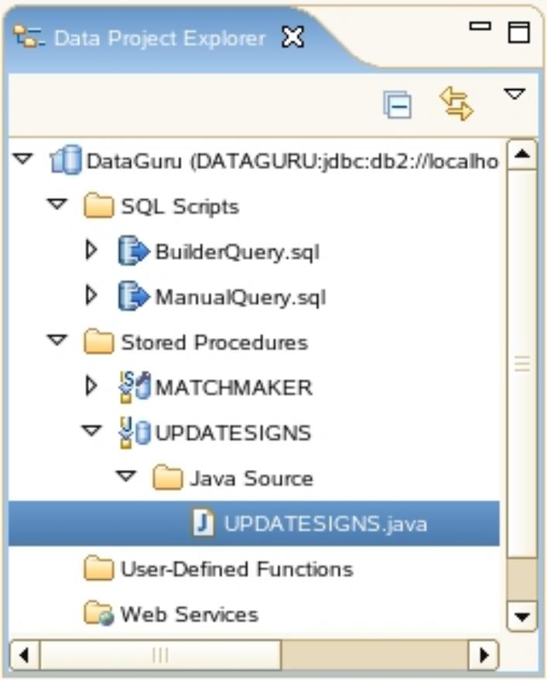
Data Studio – 项目和工作区
所有相关对象都在项目中
  允许不同类型的程序项目存在, 包括 Java, C/C++等.
  Data Studio使用数据开发项目
用工作区来组织和管理项目
  工作区是系统中包含一个或多个项目的目录

Slide 35
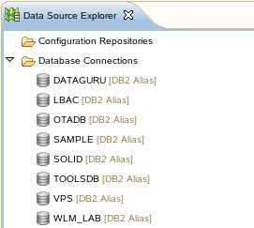
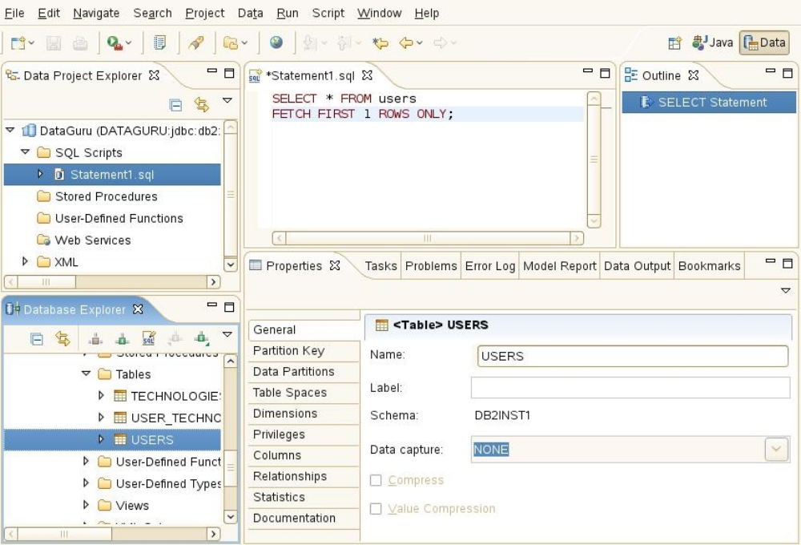
Data Studio – 视图和透视
视图可以完成所有工作
  视图是用来显示和管理对象的任务窗口
  每个视图显示一个指定的对象类型
透视用来组织管理视图
  通过打开一个透视，所有相关联的视图都将自动打开
  Data Studio提供Java和数据透视

Slide 36
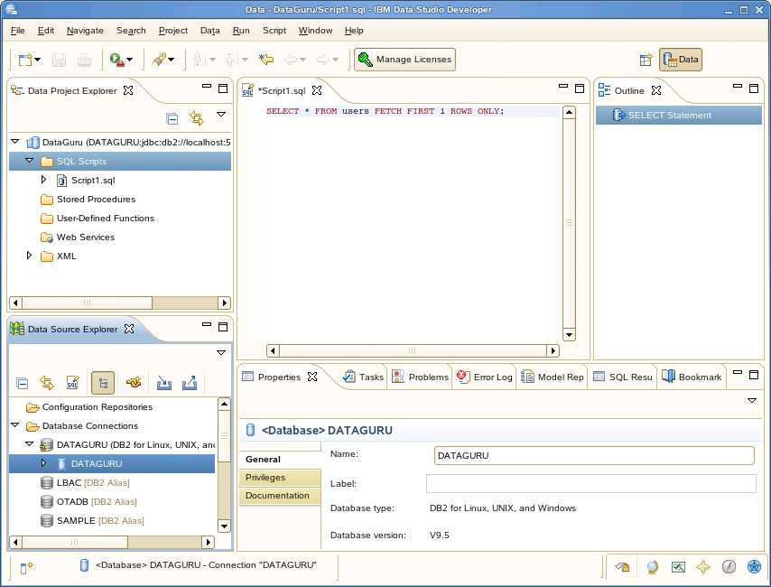
Data Studio总览
透视选择器
项目浏览器
视图
主视图
大纲视图
数据源浏览器视图
混合视图

