Slide 1
Impact of Food Deserts on Chronic Disease in Nashville
Data Analysis performed by Kenneth Simmons, RN
Nashville Software School – DDA6

Slide 2
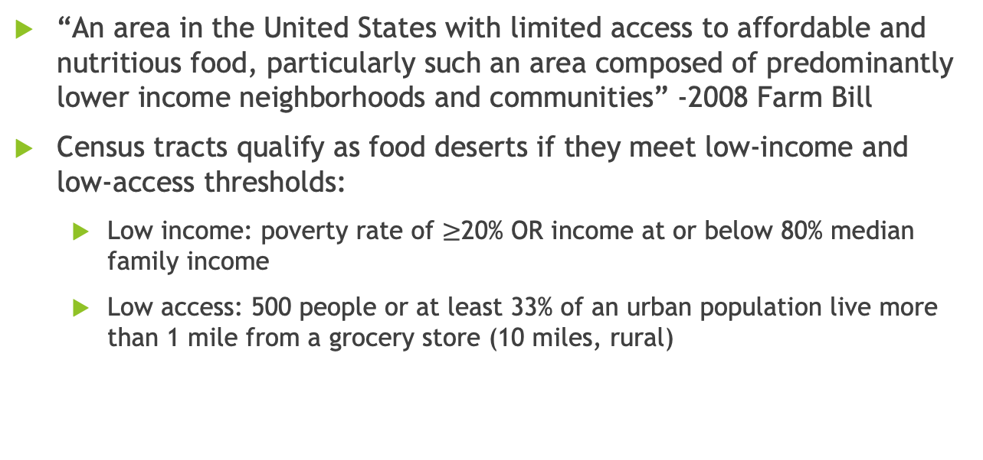
What is a Food Desert?
“An area in the United States with limited access to affordable and nutritious food, particularly such an area composed of predominantly lower income neighborhoods and communities” -2008 Farm Bill
Census tracts qualify as food deserts if they meet low-income and low-access thresholds:
Low income: poverty rate of $≥$20% OR income at or below 80% median family income
Low access: 500 people or at least 33% of an urban population live more than 1 mile from a grocery store (10 miles, rural)
Access to Affordable and Nutritious Food, 2009.
Economic Research Service U.S. Department of Agriculture, 2011.
University of Nevada, Reno. “What is a Food Desert?.”
Notes:
-Low-income: a poverty rate of 20 percent or greater, or a median family income at or below 80 percent of the statewide or metropolitan area median family income;
-Low-access: at least 500 persons and/or at least 33 percent of the population lives more than 1 mile from a supermarket or large grocery store (10 miles, in the case of rural census tracts).
-The 2010 Census food desert analysis deviated from the established USDA definition, defining a low-income community requires 40 percent of the population to have an income at or below 200 percent of federal poverty thresholds for family size
-Of interest, using the alternate low-income classification, 29.7 million people live in low income census tracts more than 1 mile from a supermarket.

Slide 3
Health Impacts on Individuals/Communities
Wealthier neighborhoods: over three times as many supermarkets, compared to lower income neighborhoods
Availability of personal transportation can contribute to malnutrition
Minority communities have fewer food choices and more premature death
Morland, Wing, 2002
Gallagher, 2006
Notes:
-According to a study in the American Journal of Preventive Medicine, wealthier neighborhoods have over three times as many supermarkets as lower income neighborhoods. Keep in mind that this is nation-wide, not Nashville specifically.
-Findings from this study led researchers to speculate that the migration of supermarkets to suburbs and the lack of transportation available to low-income communities are contributing to malnutrition amongst poorer communities
-”Premature death due to cancer and cardiovascular disease is also greater for African-American, White, and Latino communities where there is greater imbalance of food choices.” (Gallagher, 2006)
A study in Chicago demonstrated that African-Americans are the most disadvantaged in regards to access to healthy food choices, and travel the furthest on average to grocery stores [in Chicago]. (Gallagher, 2006)

Slide 4
Reasoning Behind my Analysis
Initial lightbulb moment: the Piggly Wiggly on West End closed down
Rising food costs
Nashville has less than ideal public transportation (subjective opinion)
I am an RN, but public health is everyone’s business
Everyone loves food
Notes:
Piggly Wiggly was closest grocery store. After closer, no choice but to drive ~15-20 minutes to Publix or Kroger, dependent on traffic.
I am a registered nurse, and public health in all its forms is a big interest of mine. Public health is an important subject matter to everyone in a community.

Slide 5
Analysis technique flow chart?
Steps and arrows to make it look good

Slide 6
Limitations of my Analysis
Does not take into account convenience stores, restaurants, gas stations, etc
Categorization of individual markets etc far too subjective
Availability of produce at grocers kept as ‘control’ for healthy food access, and impact on public health
Supermarket/Grocery queries limited by API nuances
Queries kept to large-chain groceries/supermarkets with established presence
60 results per query
‘honorable mentions’ kept in some cases
Only looking at geospatial relationships and average disease prevalence
Does not look at household income or other census data
Notes:
I quickly discovered that my analysis will have a few limitations.
Most of these limitations surround API nuances
* Google Places API limits queries to 60 results
* Results differ depending on size of search area
* ‘zoom in’ on google maps while doing a search
* Duplicates are a given when searching amongst adjacent zip codes
Too much subjectivity when categorizing stores
* one API parameter is establishment type
* parameter set for query, but results still not perfect
* required manual filtering
* many results in grocery query too ambiguous, potentially fitting other categories more closely
This analysis did not look at data other than number of grocery stores and the relationship to chronic disease.

Slide 7
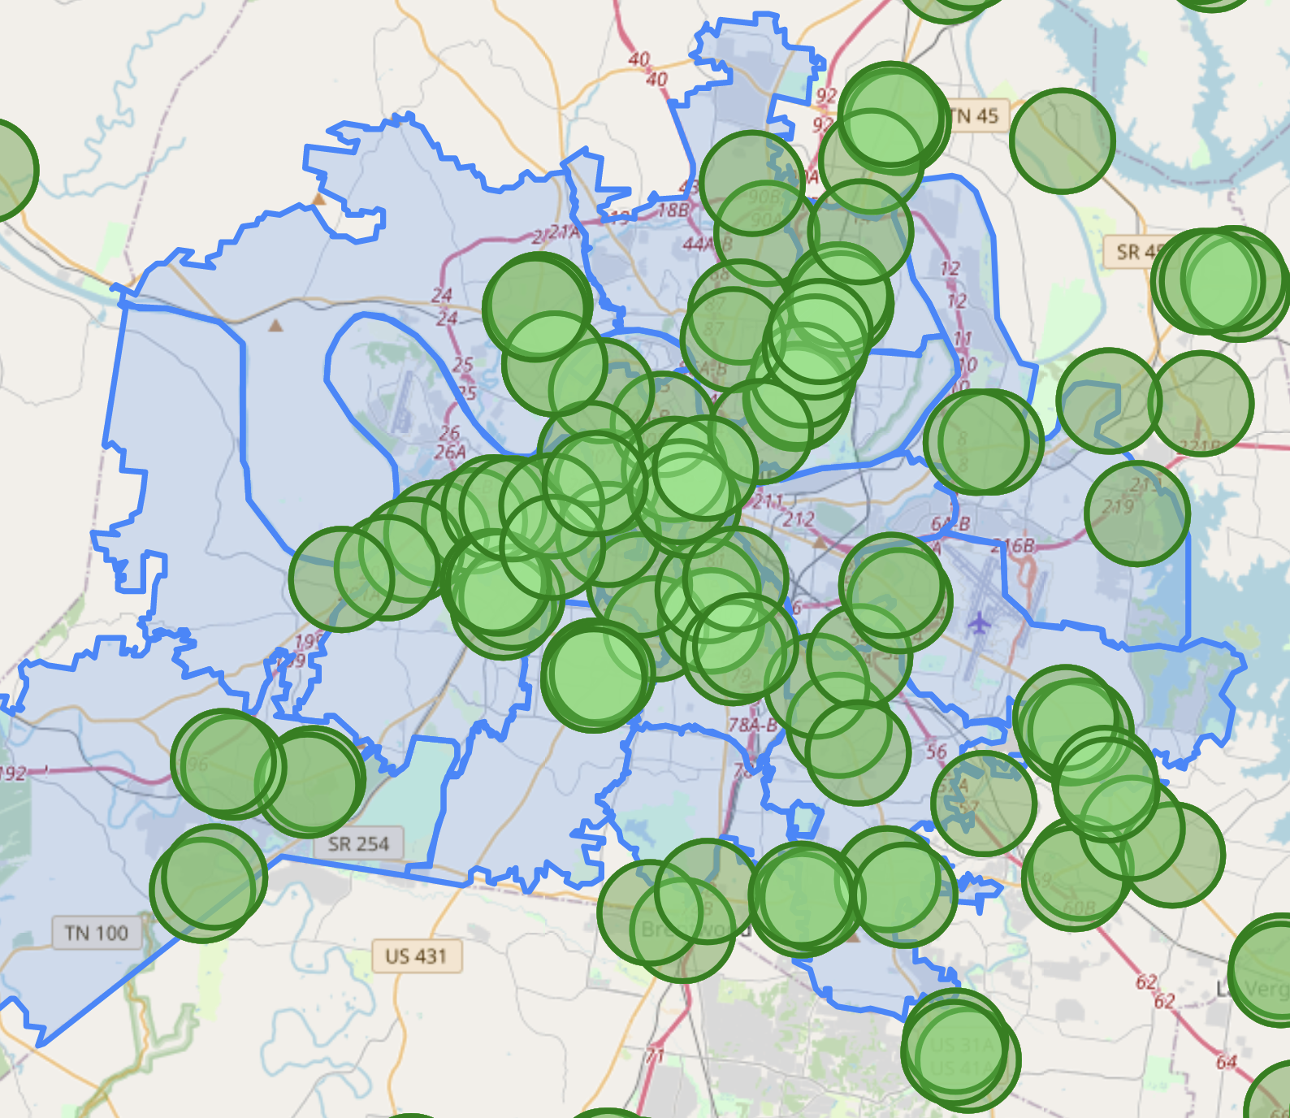
Impact on Nashville

Slide 8
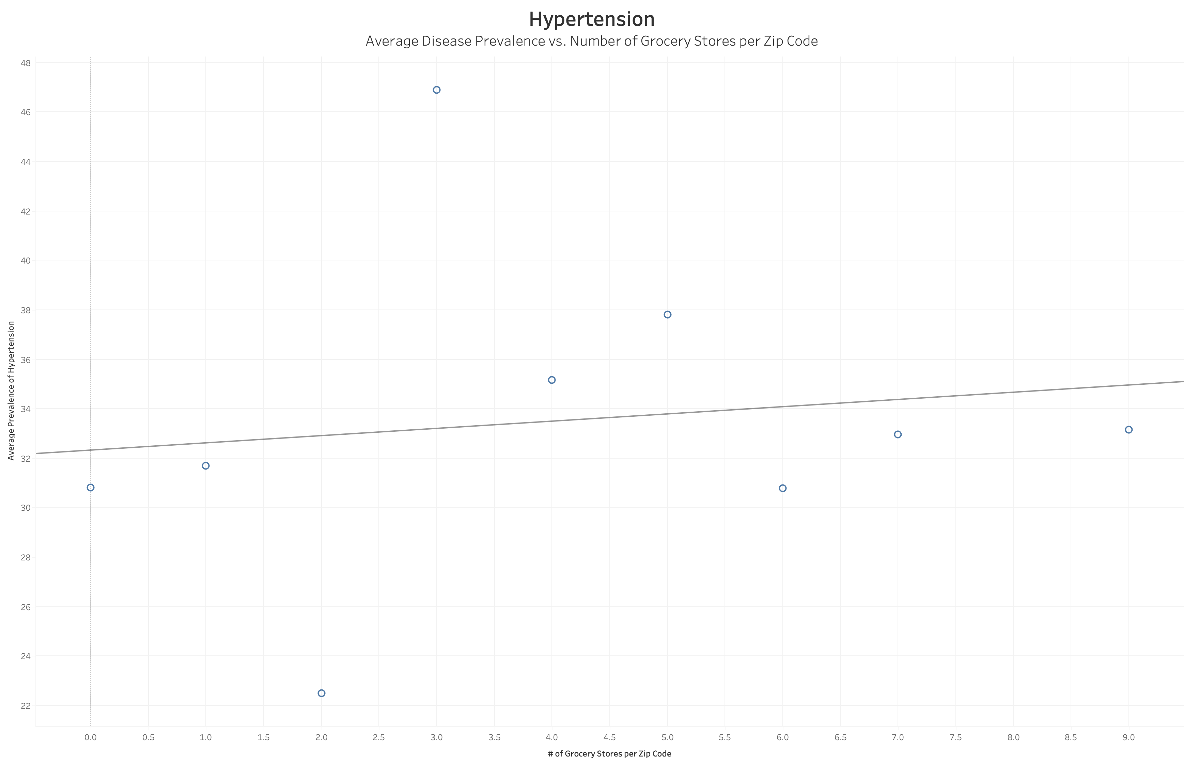
Notes:
Most of the following scatter plots demonstrate a weak relationship. There are some interesting findings however.

Slide 9
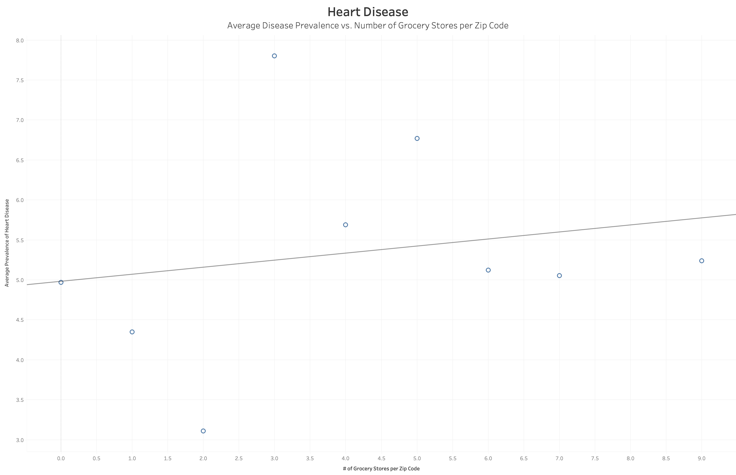

Slide 10
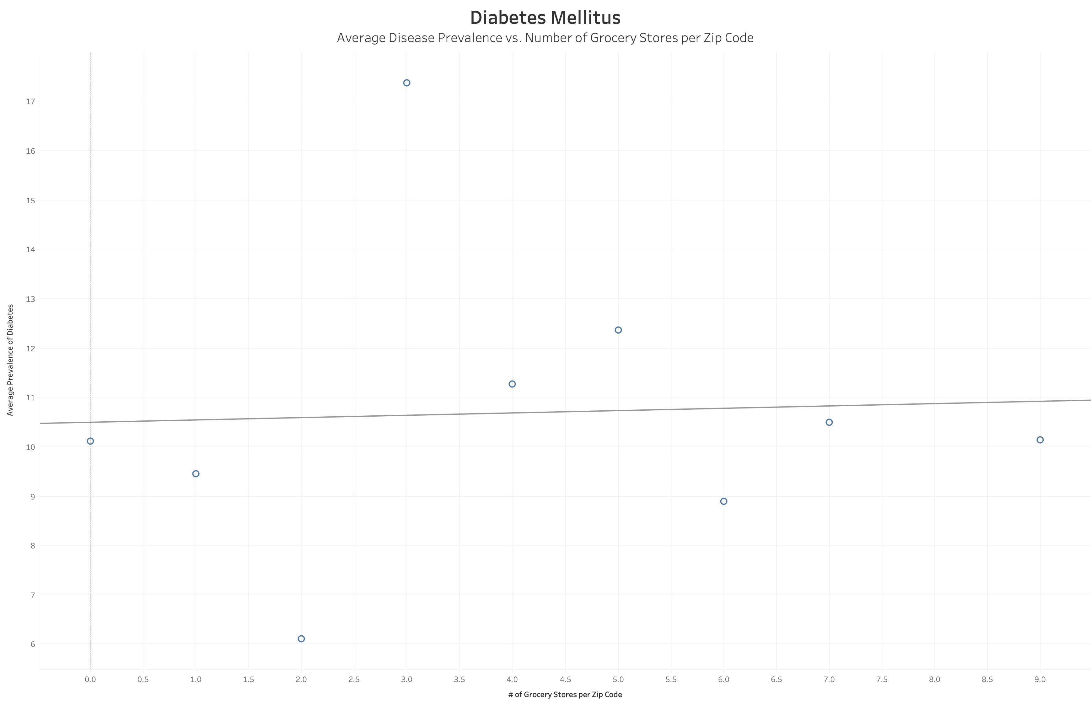

Slide 11
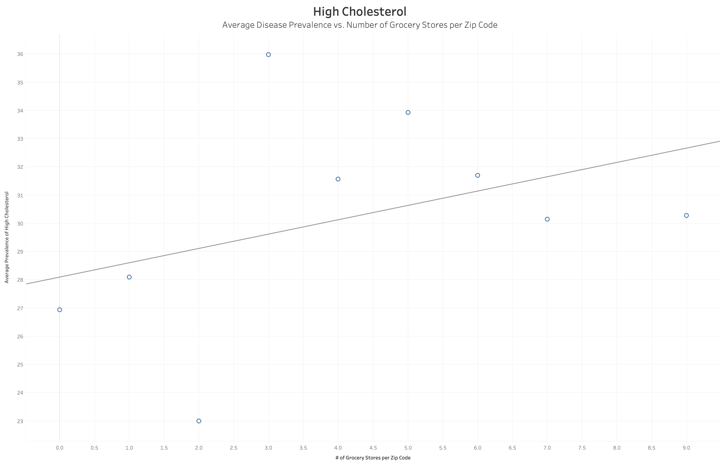
Notes:
High cholesterol seems to have the highest prevalence out of all diseases examined. The positive trend line works against my hypothesis however, so further analysis would benefit from looking at other metrics.

Slide 12
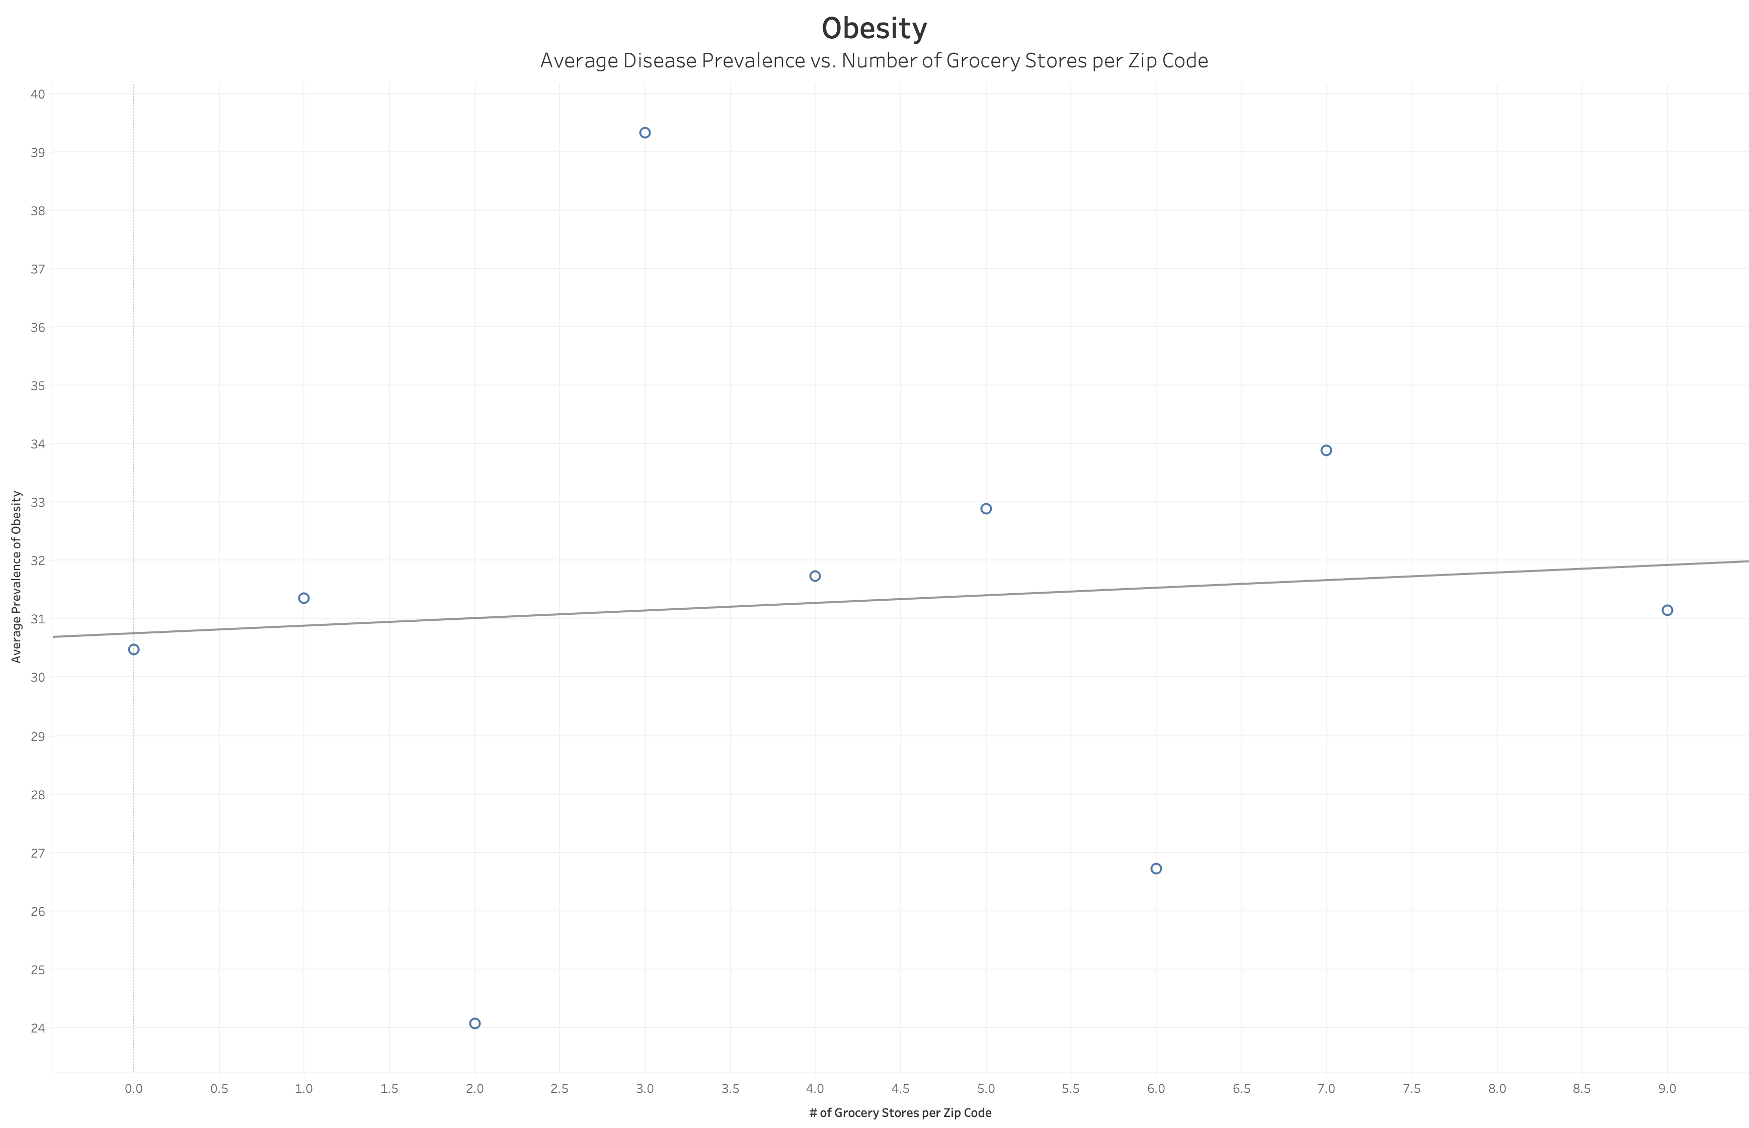

Slide 13
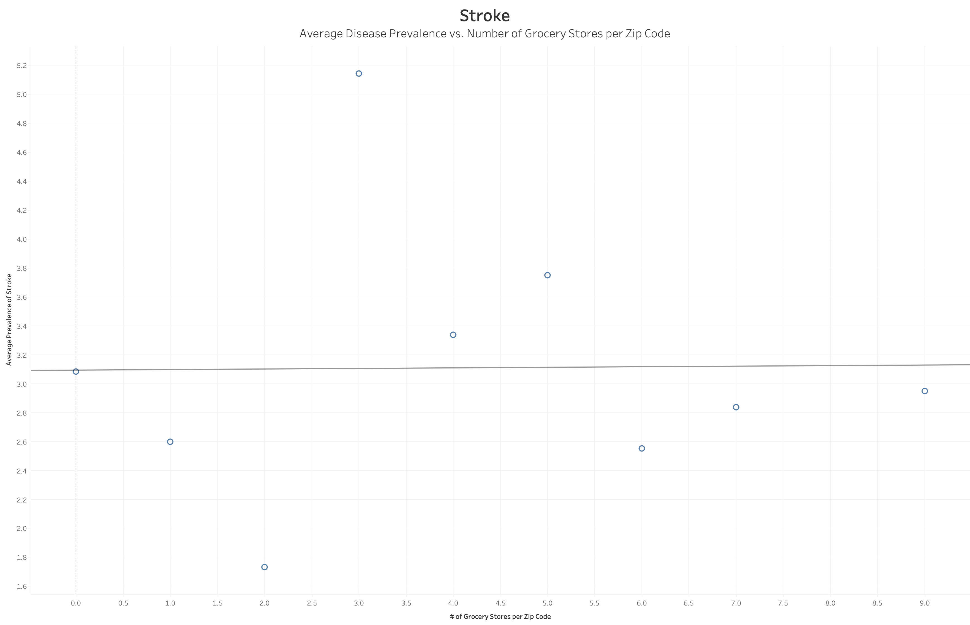

Slide 14
Why does one zip code have a total of 9 grocery stores while other zip codes only have one? What percentage of grocery stores that one zip code accounts for

Slide 15
Works Cited
Gallagher, M. (2006). Examining the Impact of Food Deserts on Public Health in Chicago. Study commissioned by LaSalle Bank. 2006. Retrieved 4/25/22 from http://www.marigallagher.com/2006/07/18/examining-the-impact-of-food-deserts-on-public-health-in-chicago-july-18-2006/
Morland, K., Wing, S., et al. (2002). Neighborhood characteristics associated with the location of food stores and food service places. American Journal of Preventive Medicine. 22(1),23-29. Retrieved 4/25/22 from http://www.ncbi.nlm.nih.gov/pubmed/11777675
United States Department of Agriculture Economic Research Service. (2009). Access to Affordable and Nutritious Food: Measuring and Understanding Food Deserts and Their Consequences. Retrieved 4/25/22 from https://www.ers.usda.gov/webdocs/publications/42711/12716_ap036_1_.pdf?v=41055
University of Nevada, Reno. (n.d.).What is a Food Desert?. https://extension.unr.edu/publication.aspx?PubID=2484
Ver Ploeg, M., Nulph, D., & Williams, R. (2011). Mapping Food Deserts in the United States. Economic Research Service U.S. Department of Agriculture. Retrieved 4/25/22 from https://www.ers.usda.gov/amber-waves/2011/december/data-feature-mapping-food-deserts-in-the-us/

Slide 16
Questions?

Slide 17
Off to the dashboard!

