Slide 1
Impact of Food Deserts on Chronic Disease in Nashville
Data Analysis performed by Kenneth Simmons, RN
Nashville Software School – DDA6

Slide 2
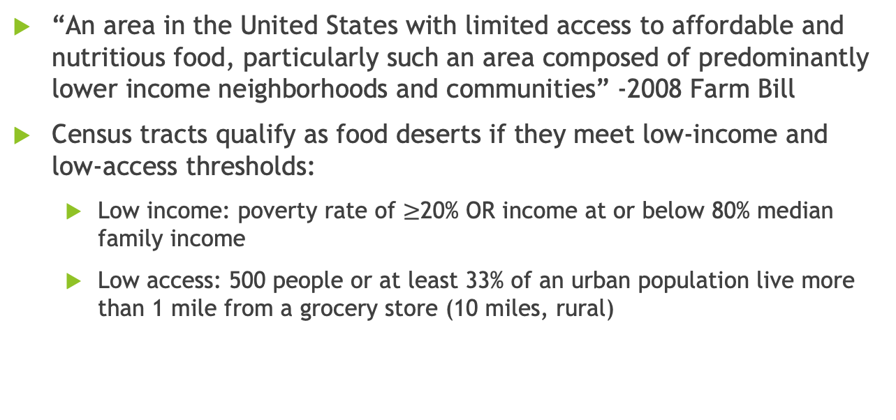
What is a Food Desert?
“An area in the United States with limited access to affordable and nutritious food, particularly such an area composed of predominantly lower income neighborhoods and communities” -2008 Farm Bill
Census tracts qualify as food deserts if they meet low-income and low-access thresholds:
Low income: poverty rate of $≥$20% OR income at or below 80% median family income
Low access: 500 people or at least 33% of an urban population live more than 1 mile from a grocery store (10 miles, rural)
Access to Affordable and Nutritious Food, 2009.
Economic Research Service U.S. Department of Agriculture, 2011.
University of Nevada, Reno. “What is a Food Desert?.”
Notes:
-Low-income: a poverty rate of 20 percent or greater, or a median family income at or below 80 percent of the statewide or metropolitan area median family income;
-Low-access: at least 500 persons and/or at least 33 percent of the population lives more than 1 mile from a supermarket or large grocery store (10 miles, in the case of rural census tracts).
-The 2010 Census food desert analysis deviated from the established USDA definition, defining a low-income community requires 40 percent of the population to have an income at or below 200 percent of federal poverty thresholds for family size
-Of interest, using the alternate low-income classification, 29.7 million people live in low income census tracts more than 1 mile from a supermarket.

Slide 3
Non-health related impacts of food deserts
Socioeconomic discrimination

Slide 4
Health Impacts on Individuals/Communities
Wealthier neighborhoods: over three times as many supermarkets, compared to lower income neighborhoods
Lack of transportation contributes to malnutrition
Minority communities have fewer food choices and more premature death
Morland, Wing, 2002
Gallagher, 2006
Notes:
-According to a study in the American Journal of Preventive Medicine, wealthier neighborhoods have over three times as many supermarkets as lower income neighborhoods
-Findings from this study led researchers to speculate that the migration of supermarkets to suburbs and the lack of transportation available to low-income communities are contributing to malnutrition among the poor.
-”Premature death due to cancer and cardiovascular disease is also greater for African-American, White, and Latino communities where there is greater imbalance of food choices.” (Gallagher, 2006)
A study in Chicago demonstrated that African-Americans are the most disadvantaged in regards to access to healthy food choices, and travel the furthest on average to grocery stores [in Chicago]. (Gallagher, 2006)

Slide 5
Reason why I did this analysis
Piggly wiggly on West End
Rising food costs
Nashville has less than ideal public transportation (subjective opinion)
RN with interest in public health
Everyone loves food
Notes:
Piggly Wiggly was closest grocery store. After closer, no choice but to drive ~15-20 minutes to Publix or Kroger, dependent on traffic.
I am a registered nurse, and public health in all its forms is a big interest of mine

Slide 6
Analysis technique flow chart?
Steps and arrows to make it look good

Slide 7
Limitations of my Analysis
Does not take into account convenience stores, restaurants, gas stations, etc
Categorization of individual markets etc far too subjective
Availability of produce at grocers kept as ‘control’ for healthy food access, and impact on public health
Supermarket/Grocery queries limited by API nuances
Queries kept to large-chain groceries/supermarkets with established presence
60 results per query
‘honorable mentions’ kept in some cases
Only looking at geospatial relationships and average disease prevalence
Not taking into account household income data

Slide 8
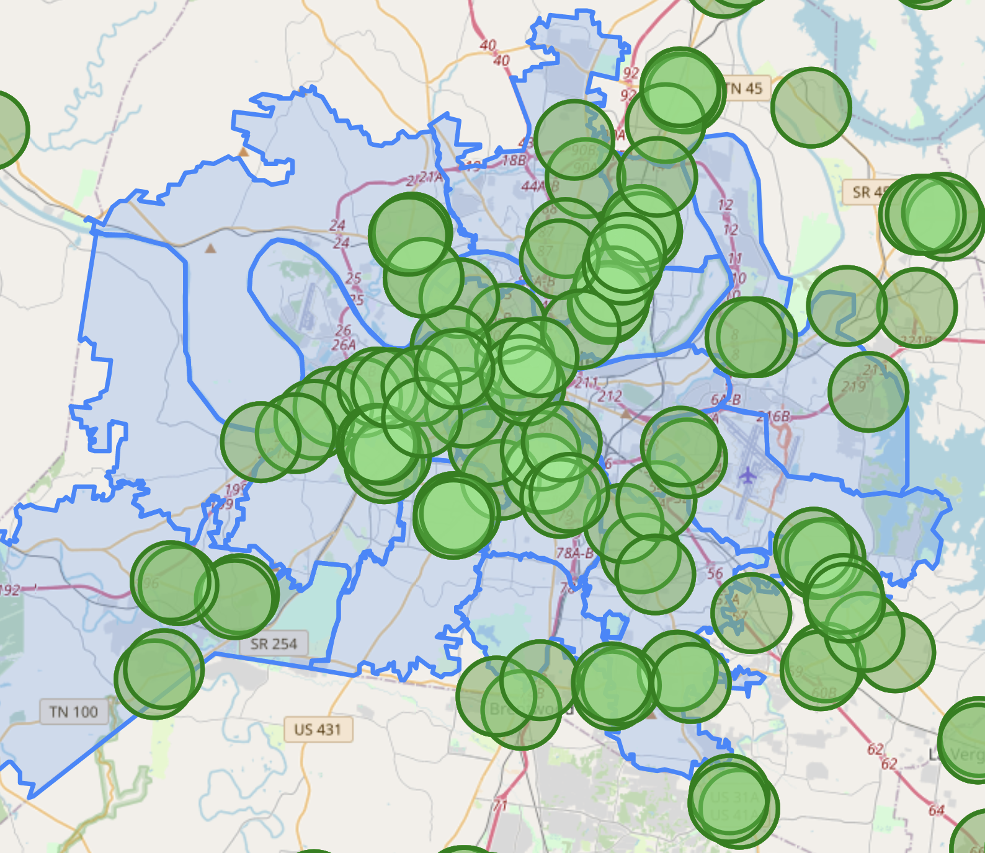
Impact on Nashville

Slide 9
Why does one zip code have a total of 10 grocery stores while other zip codes only have one? What percentage of grocery stores that one zip code accounts for

Slide 10
BP scatterplot
+/- correlation between disease prevalence and # of grocers per zip
Scatter plot and trend line with correlation number on this slide, or next slide

Slide 11
CAD scatterplot
+/- correlation between disease prevalence and # of grocers per zip
Scatter plot and trend line with correlation number on this slide, or next slide

Slide 12
DM scatterplot
+/- correlation between disease prevalence and # of grocers per zip
Scatter plot and trend line with correlation number on this slide, or next slide

Slide 13
High chol scatterplot
+/- correlation between disease prevalence and # of grocers per zip
Scatter plot and trend line with correlation number on this slide, or next slide

Slide 14
obesity scatterplot
+/- correlation between disease prevalence and # of grocers per zip
Scatter plot and trend line with correlation number on this slide, or next slide

Slide 15
stroke scatterplot
+/- correlation between disease prevalence and # of grocers per zip
Scatter plot and trend line with correlation number on this slide, or next slide

Slide 16
Works Cited
United States Department of Agriculture Economic Research Service. (2009). Access to Affordable and Nutritious Food: Measuring and Understanding Food Deserts and Their Consequences. Retrieved 4/25/22 from https://www.ers.usda.gov/webdocs/publications/42711/12716_ap036_1_.pdf?v=41055
Gallagher, M. (2006). Examining the Impact of Food Deserts on Public Health in Chicago. Study commissioned by LaSalle Bank. 2006. Retrieved 4/25/22 from http://www.marigallagher.com/2006/07/18/examining-the-impact-of-food-deserts-on-public-health-in-chicago-july-18-2006/
Morland, K., Wing, S., et al. (2002). Neighborhood characteristics associated with the location of food stores and food service places. American Journal of Preventive Medicine. 22(1),23-29. Retrieved 4/25/22 from http://www.ncbi.nlm.nih.gov/pubmed/11777675
Ver Ploeg, M., Nulph, D., & Williams, R. (2011). Mapping Food Deserts in the United States. Economic Research Service U.S. Department of Agriculture. Retrieved 4/25/22 from https://www.ers.usda.gov/amber-waves/2011/december/data-feature-mapping-food-deserts-in-the-us/
University of Nevada, Reno. (n.d.).What is a Food Desert?. https://extension.unr.edu/publication.aspx?PubID=2484

Slide 17
Questions?

Slide 18
“Off to the dashboard” [hyperlink to Tableau Public dashboard]

