Slide 1
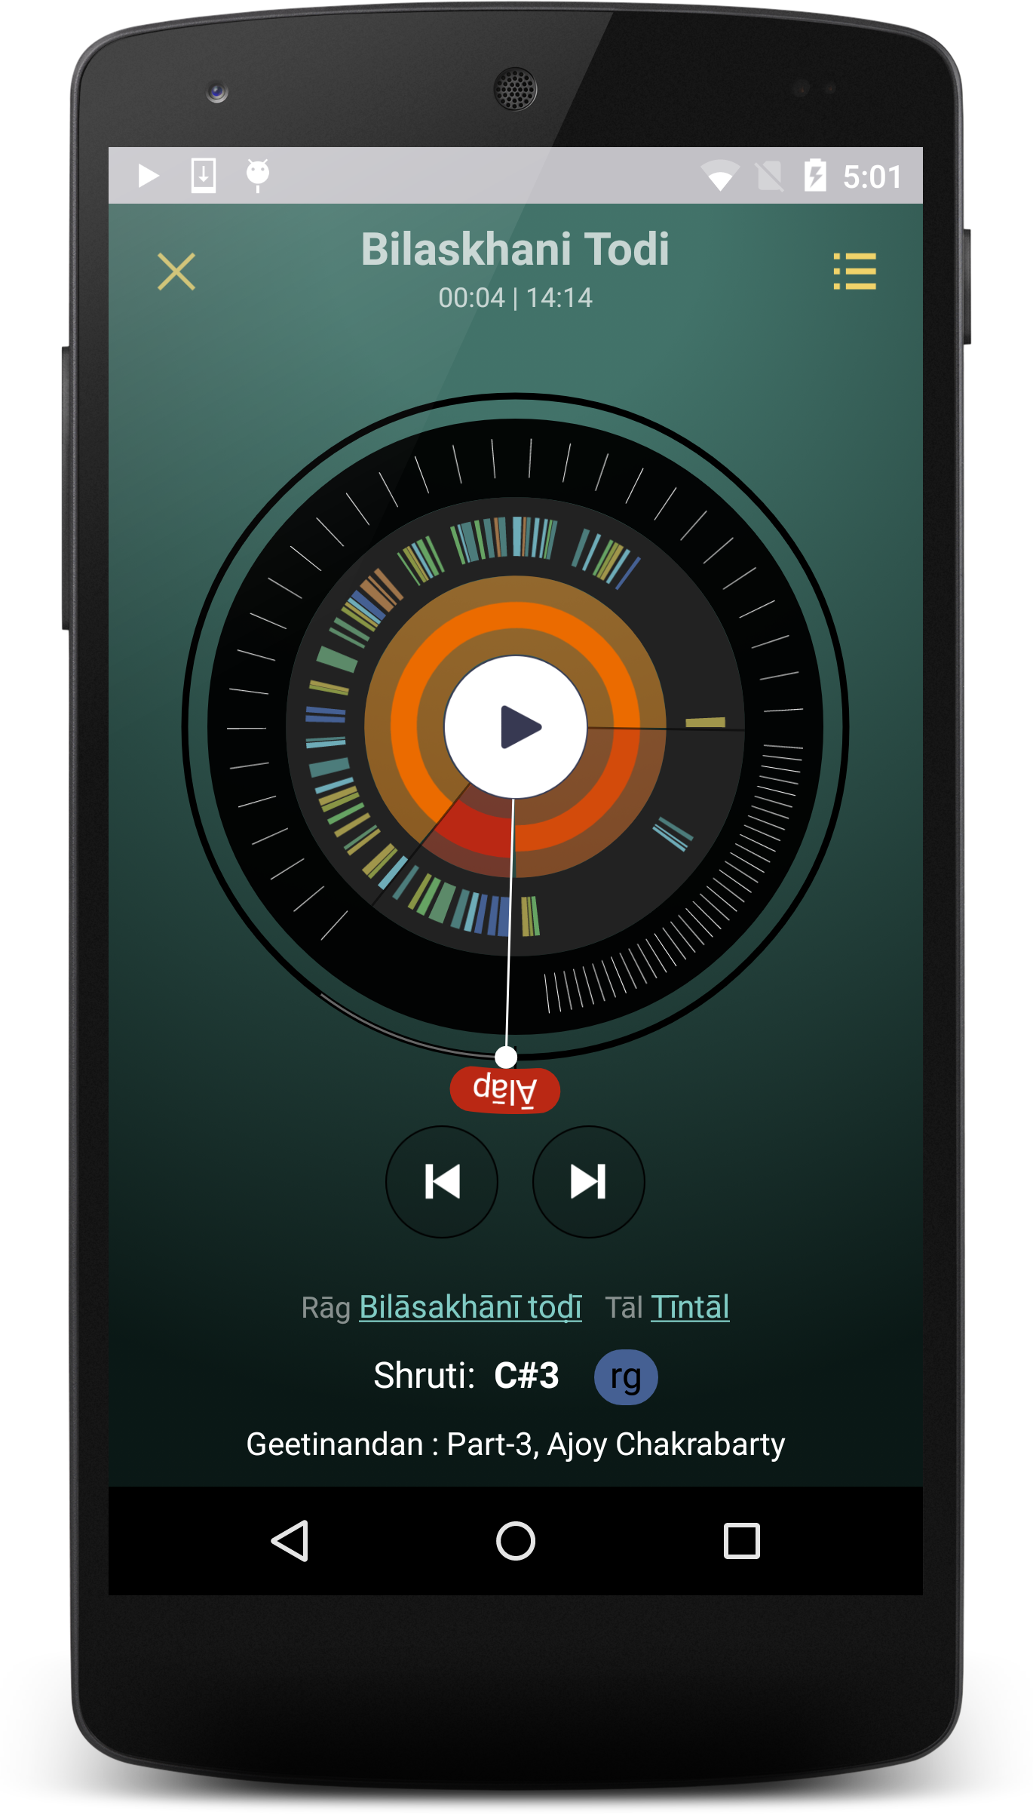
Sections
Phrases
Sama

