Slide 1
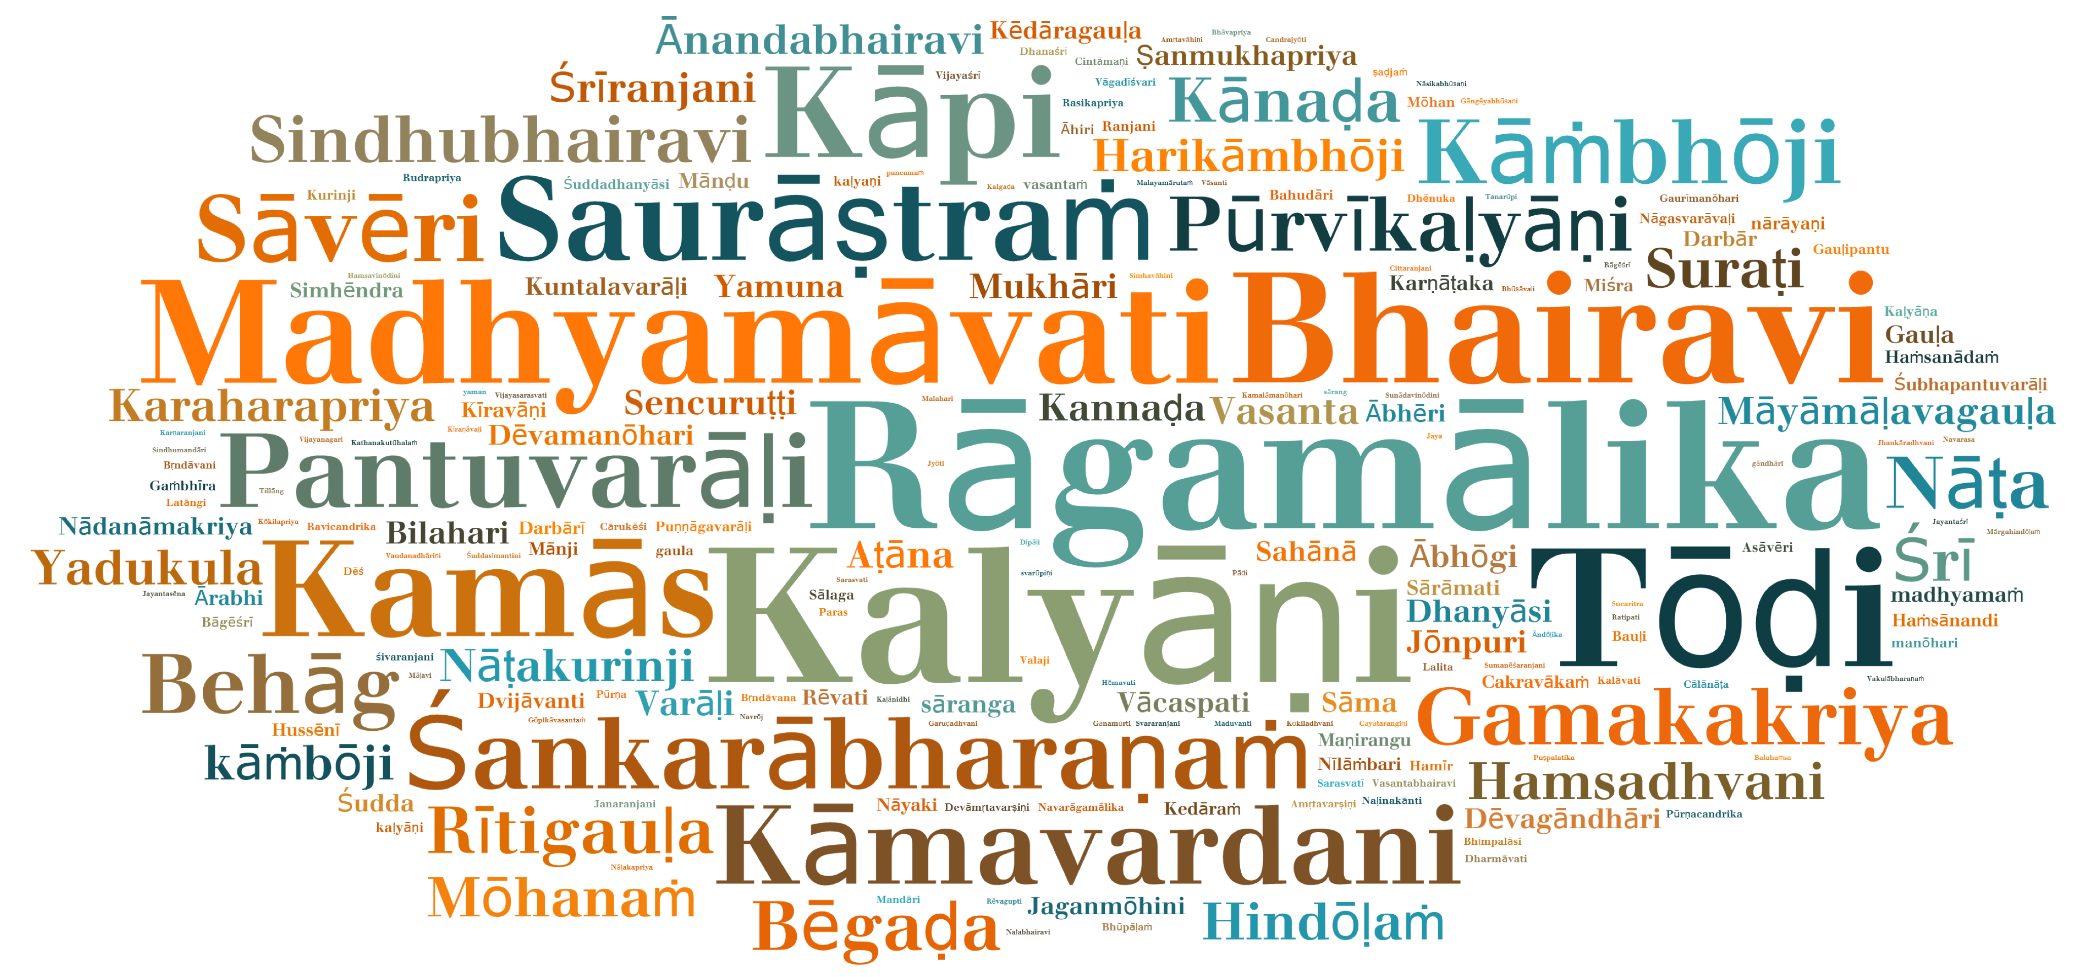
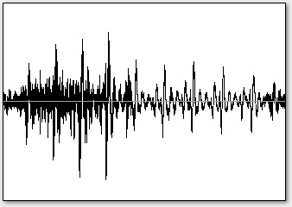
Automatic Rāga Recognition
Pattern Characterization
Melodic Description
Pattern Discovery
Melodic Similarity
Nyās Segmentation
Tonic Identification (Evaluation)

