Slide 1
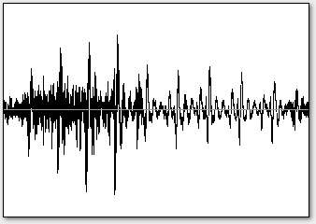
Audio
Tonic Pitch
Tonal Feature Extraction
Feature Distribution Estimation
Tonic Selection

