Slide 1
Music collection
Melodic Pattern Discovery
Data Processing
Intra-recording Pattern Discovery
Inter-recording Pattern Detection
Melodic Pattern Clustering
Pattern Network Generation
Similarity Thresholding
Community Detection
TFIDF Feature Extraction
Vocabulary Extraction
Term-frequency
Feature Extraction
Feature Normalization
Feature Matrix

Slide 2
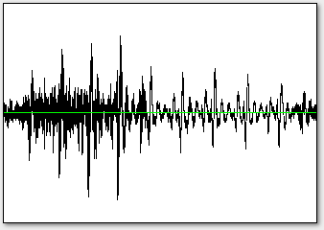
Features &
Rāga labels
Predicted rāga labels
Audio recordings
r₁
f₁
l₁
Classification
Phrase-based Feature
Extraction
r₂
f₂
l₂
r₃
f₃
l₃
Training set
r_{n-k}
f_{n-k}
l_{n-k}
r_{n-k+1}
f_{n-k+1}
l_{n-k+1}
Testing set
r_{n}
f_{n}
l_{n}

Slide 3
Features &
Rāga labels
Predicted rāga labels
Audio recordings
Phrase-based Feature
Extraction
Classification
R_{tr}
(F, L)_{tr}
Training set
Testing set
R_{ts}
F_{ts}
L_{ts}

Slide 4
T_{s}*

Slide 5
T_{s}*

Slide 6
