Slide 1
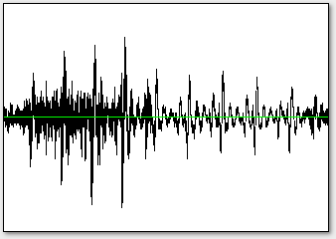
Audio signal
Predominant Melody Estimation
Pre-processing
Tonic Normalization
Surface Generation
Power Compression
Post-processing
Gaussian smoothening
Feature

Slide 2
Audio signal
Predominant Melody Estimation
Tonic Normalization
Pre-processing
Surface Generation
Power Compression
Gaussian smoothening
Post-processing
TDMS

