Slide 1
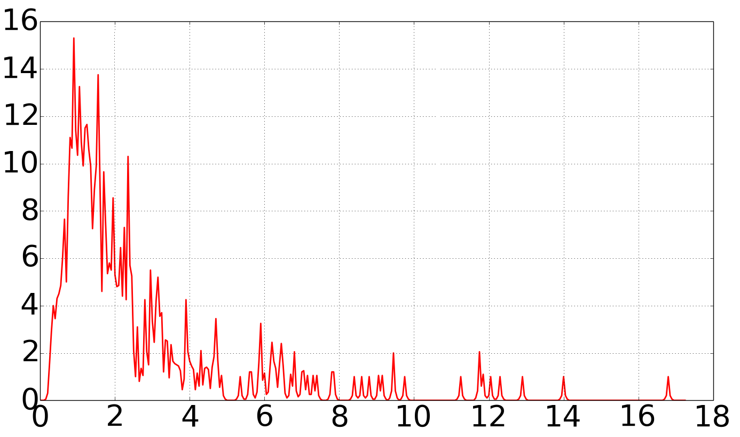
0.8
1.6
2.4
Count
Ratio

