Slide 1
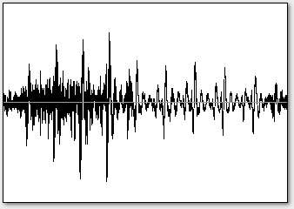
Audio1
Audio2
Predominant Pitch Estimation and Post-processing
Pitch Normalization
Partial Transcription
Svara Duration Truncation
Distance Computation with Complexity Weighting
Melodic Similarity

