Slide 1
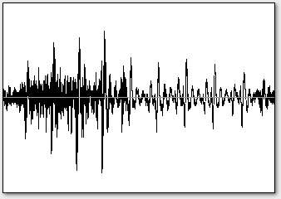
Audio1
Audio2
Predominant Pitch Estimation
Pitch Normalization
Uniform Time-scaling
Distance Computation
Melodic Similarity

