Slide 1
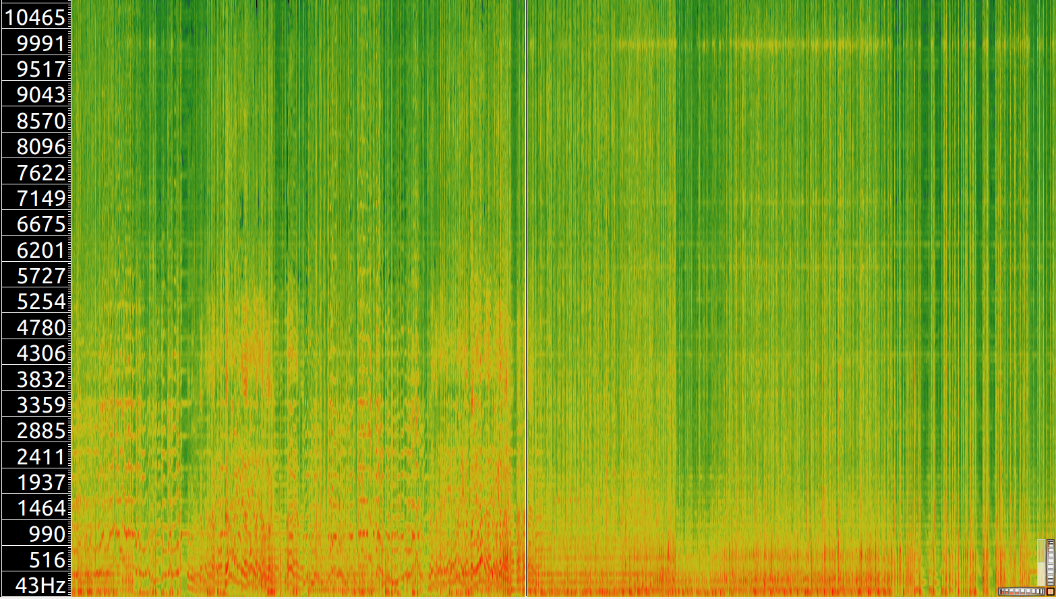
Vocal section
Tani section
Frequency (Hz)

