Slide 1
TOPIC MODELLING
DISCOVERING TOPICS IN A TEXT CORPUS USING LDA
By,
DHANUSH KOTRIKE BODA RAMYASRI LATHA
PRAJJWAL JORIA
UNDER THE GUIDANCE OF,
VAIBHAV SHAH

Slide 2
TOPIC MODELLING
Topic modeling works by analyzing a body of text to identify clusters of similar words and patterns, such as word frequencies. It can then group words under topics and produce a summary set of terms that represent the collection's overall primary topics. For example, topic modeling can automatically tag each document with the topic it most closely resembles
Topic modeling can be used for a variety of purposes, including:
Group support tickets: group together similar support tickets
News Categorization: Automatically categorizing news articles into topics like politics, sports, and technology.
Academic Research: Summarizing research papers to discover prevalent research topics.
Email Filtering: Categorizing emails into topics like work, personal, and spam for better organization.

Slide 3
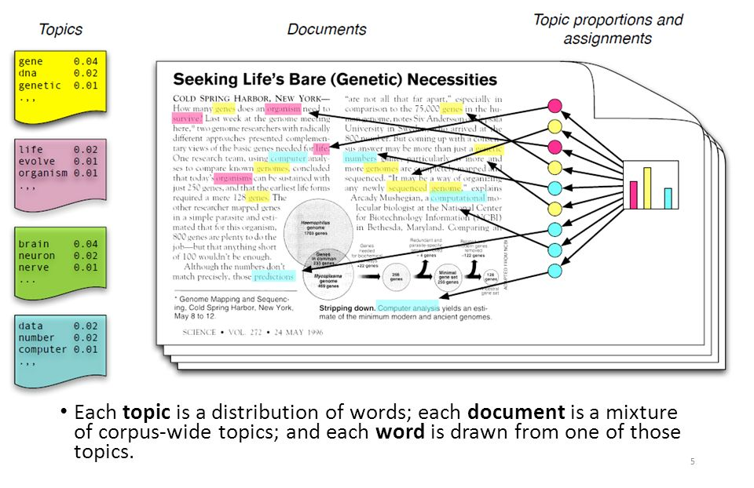
TOPIC MODELLING

Slide 4
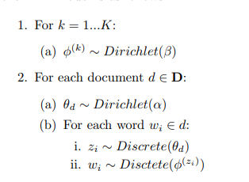
LDA (LATENT DIRICHLET ALLOCATION)
LDA is a generative probabilistic model for collections of grouped discrete data
β
φ K
α
z
w N
M
θ
The generative process described above results in the following joint distribution: p(w, z, θ, φ|α, β) = p(φ|β)p(θ|α)p(z|θ)p(w|φz)

Slide 5
POSTERIOR INFERENCE
p(θ, φ, z|w, α, β) = p(θ, φ, z, w|α, β) / p(w|α, β)
p(z|w, α, β) = p(z, w|α, β) / p(w|α, β)
GIBBS SAMPLING
p(zi |z−i , α, β, w)
∝

Slide 6
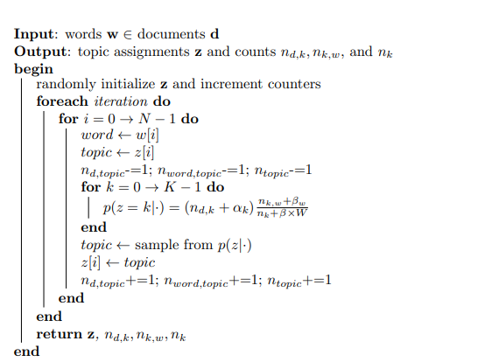
ALGORITHM
Here in the above algorithm K, α, β are hyper-parameters

Slide 7
IMPLEMENTATION
Importing documents
Preprocessing documents
Vocabulary building & Building a corpus
LDA implementation
Finding Topic-Document distribution
Calculating coherence score

Slide 8
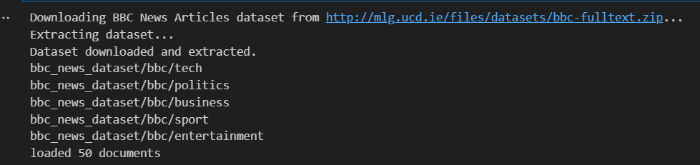
IMPORTING DOCUMENTS
In this process 50 Documents are downloaded from BBC news articles dataset
Download the documents using a Url as Zip file
Extract the file and loaded as Documents

Slide 9
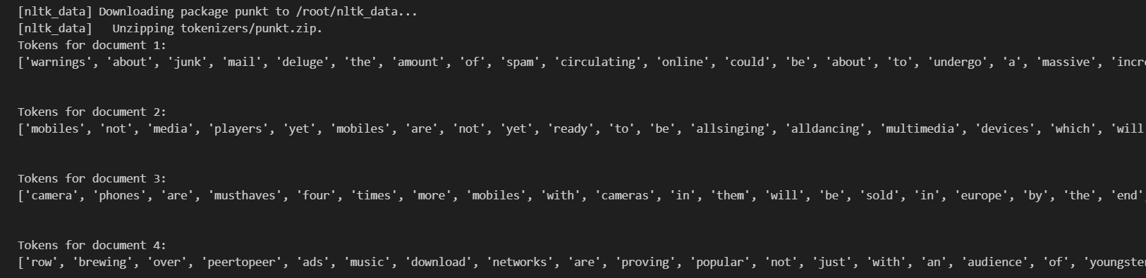
PREPROCESSING DOCUMENTS
This process involves cleaning of each dataset such as,
Removing punctuation
Removing stopwords They all stored as tokens in Documents variable

Slide 10
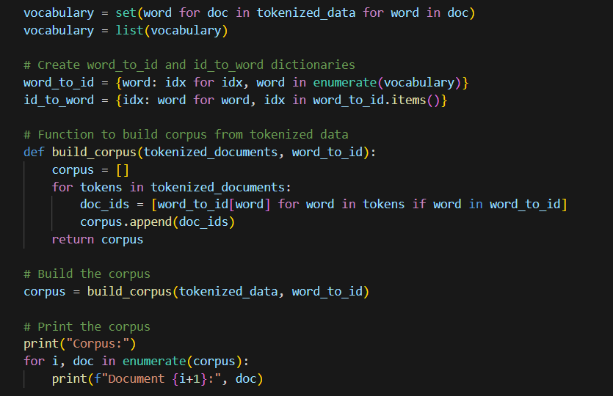
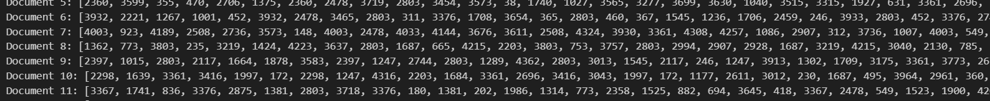
VOCABULARY BUILDING & A CORPUS
In this process unique words from tokens are stored as vocabulary
Each word given with an ID and dictionary is created to build a corpus
At last, each document is given with id to words and corpus created with all documents

Slide 11

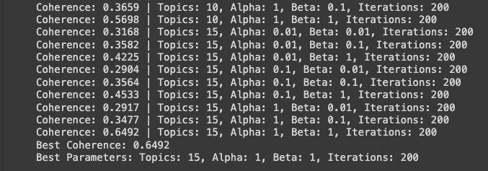
COHERENCE SCORE
Coherence is a measure of how well the topics in a topic model are separated and coherent.

Slide 12
RESULTS
Topic 0: ['ericsson', 'services', 'ads', 's', 'low', 'jobs', 'stadium', 'george', 'film', 'late’]
Topic 1: ['unilever', 'increased', 'upgrade', 'parrys', 'arjen', 'nanotechnology', 'found', 'germanys', 'concerns', 'rightback’]
Topic 2: ['relief', 'time', 'geldof', 'businesses', 'sent', 'sure', 'worker', 'nearly', 'state', 'added’]
Topic 3: ['v', 'ireland', 'switzerland', 'france', 'republic', 'cyprus', 'islands', 'israel', 'faroe', 'simon’]
Topic 4: ['osbournes', 'his', 'level', 'said', 'compared', 'in', 'metal', 'here', 'insurer', 'happiness’]
Topic 5: ['spammers', 'makers', 'blacklists', 'got', 'record', 'demands', 'quality', '32', 'amount', 'giant’]
Topic 6: ['gallery', 'past', 'compared', 'years', 'there', 'sees', 'signals', 'wants', 'fiscal', 'defeat’]
Topic 7: ['pc', 'im', 'karachi', 'sonys', 'lakhani', 'domain', 'bonuses', 'department', 'largest', 'memory’]
Topic 8: ['funeral', 'property', 'if', 'legitimate', 'before', 'davis', 'brown', 'her', 'visitors', 'mainly’]
Topic 9: ['ons', 'it', 'gill', 'honda', 'publish', 'picked', 'test', 'code', 'thing', 'can’]
Topic 10: ['the', 'to', 'and', 'of', 'in', 'a', 'for', 'is', 'on', 'that’]
Topic 11: ['wilkinson', 'warnings', 'potential', 'replace', 'stanley', 'administrators', 'pc', 'stage', 'donation', 'won’]
Topic 12: ['paris', 'worst', 'impossible', 'leader', 'musicology', 'domains', 'available', '10', 'become', 'wait’]
Topic 13: ['not', 'this', 'bandstand', 'profits', 'recall', 'englands', 'reasons', 'peertopeer', 'clinton', '2001’]
Topic 14: ['released', 'sonys', 'volume', 'leeds', 'storage', 'helped', 'throughout', 'card', 'sony', 'sales']

Slide 13
THANK YOU!

