Slide 1
Data Science Salaries – Managing expectations
By: leah Latham, Jonah foeday, manroop gill, & murtatha alwan

Slide 2
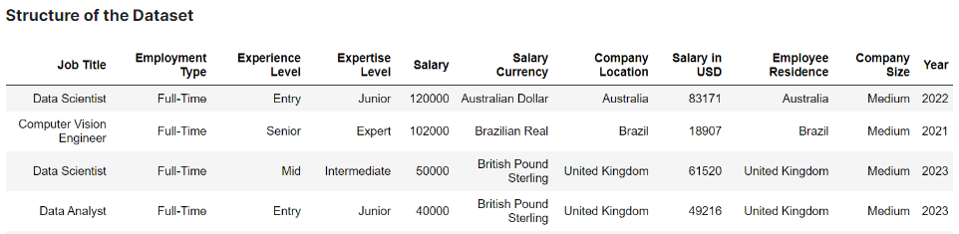
Project overview
Analyzed Data Science salaries from 2020 to 2023
Source: https://www.kaggle.com/datasets/iamsouravbanerjee/data-science-salaries-2023
File format: CSV file
File description: 3,300 rows of data with 11 columns
Notes:
ai-jobs.net (source used from Kaggle)

Slide 3
RESEARCH QUESTIONS
How have data science salaries changed over time? (by country and company size)
What is the breakdown of experience level required for data science jobs, and how do they vary?
What is the breakdown of job titles for data science jobs, and how do they vary?
Do US companies hire US residents, and do US residents work for US companies?

Slide 4
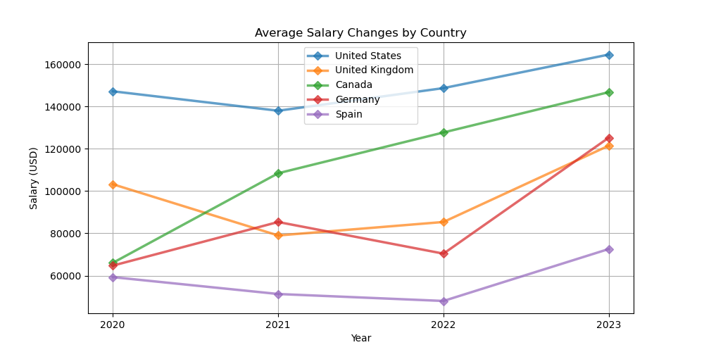
How have data science salaries changed over time? – By country (company location)
There are 71 total countries included in the dataset
89.8% of data science jobs are represented by the top 5 countries
The US alone claims 75.6% of the data science jobs in the dataset
Notes:
ai-jobs.net (source used from Kaggle)

Slide 5
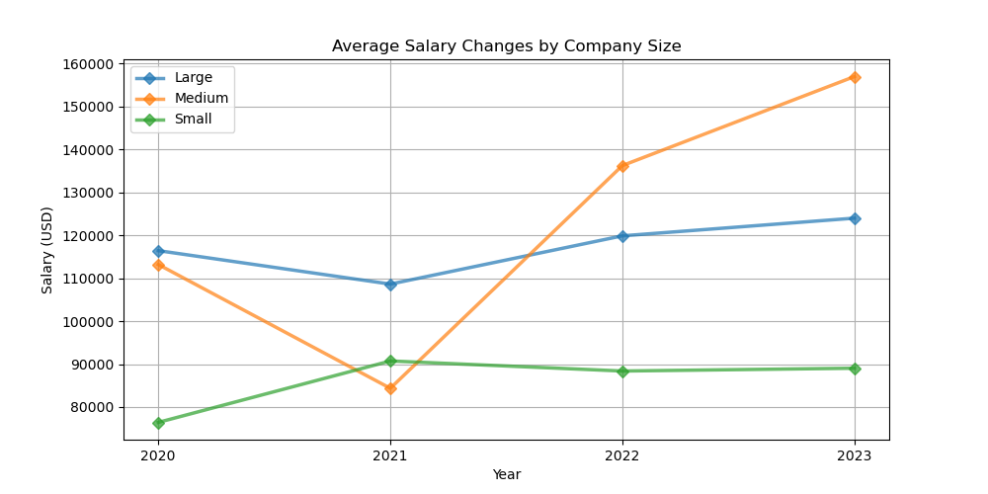
How have data science salaries changed over time? – By company size
The data is categorized into 3 different company sizes:
Small: 151 companies
Medium: 2707 companies
Large: 442 companies
Medium-sized companies showed the greatest increase, moving from lowest average salary in 2021 to highest in 2022 and 2023
Notes:
ai-jobs.net (source used from Kaggle)

Slide 6
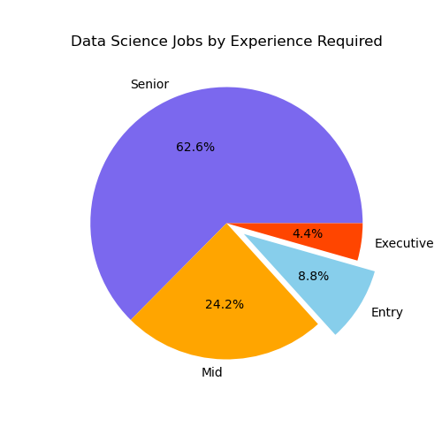
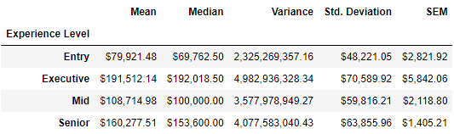
What is the breakdown of experience level required for data science jobs?
Senior-level positions comprised the majority of jobs with 62.6% and an average salary of $160,000 USD
Entry-level positions (this is us) only comprised 8.8% of jobs, with an average salary of $80,000 USD
As experience level increases, the variation (standard deviation) in salary also increases

Slide 7
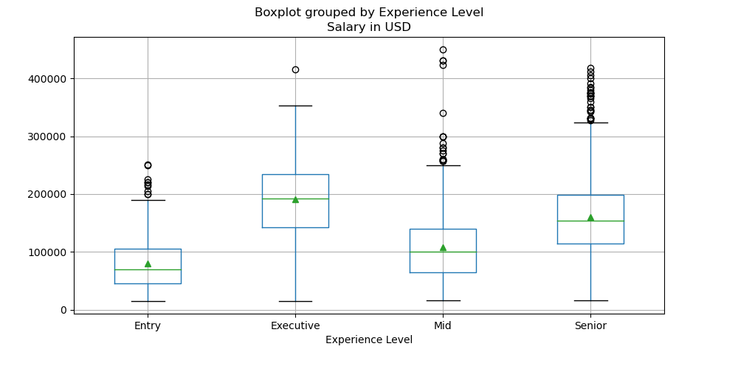
How do data science salaries vary by experience level?
The ANOVA test showed a statistically significant difference in salary based on experience level
P-value = 3.974 e-116
Notes:
ai-jobs.net (source used from Kaggle)

Slide 8
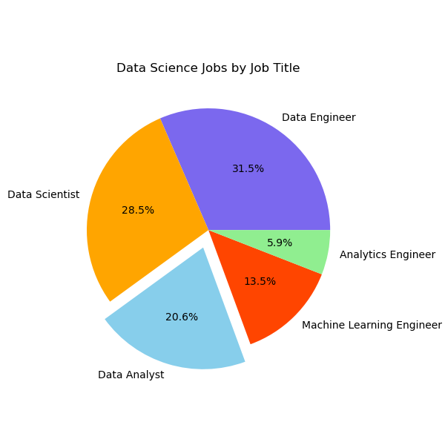
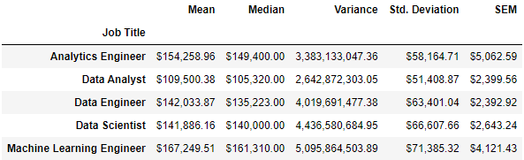
What is the breakdown of job titles for data science jobs?
Data Engineer jobs comprised the majority of jobs with 31.5% and an average salary of $142,000 USD
Data Analyst jobs comprised 20.6% of jobs, with an average salary of $109,500 USD

Slide 9
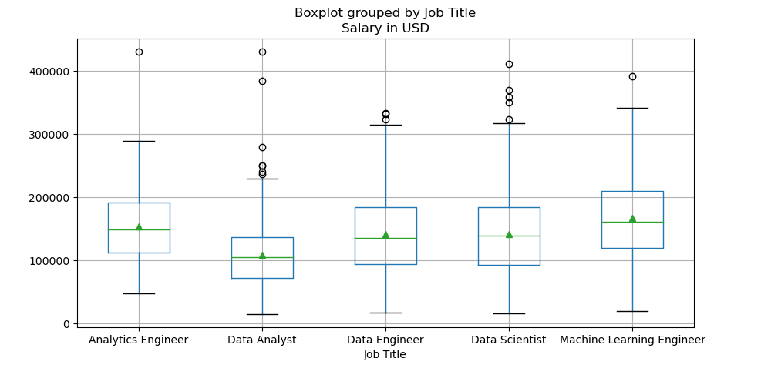
How do data science salaries vary by job title?
The top 5 most common data science jobs made up 67.5% of all jobs in the dataset
The ANOVA test showed a statistically significant difference in salary based on job title
P-value = 9.11 e-35
Notes:
ai-jobs.net (source used from Kaggle)

Slide 10
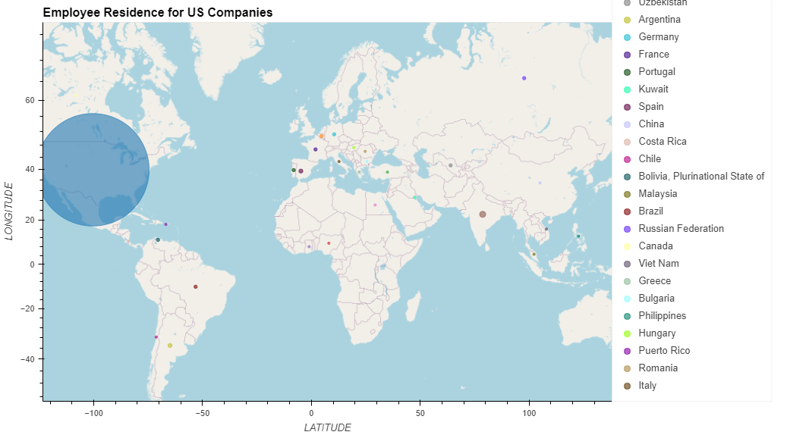
Do us companies hire us residents?
US companies hired employees from 30 countries
98.1 % were US residents
Of note, though the UK was 2nd in volume, no US companies hired UK residents
Notes:
ai-jobs.net (source used from Kaggle)

Slide 11
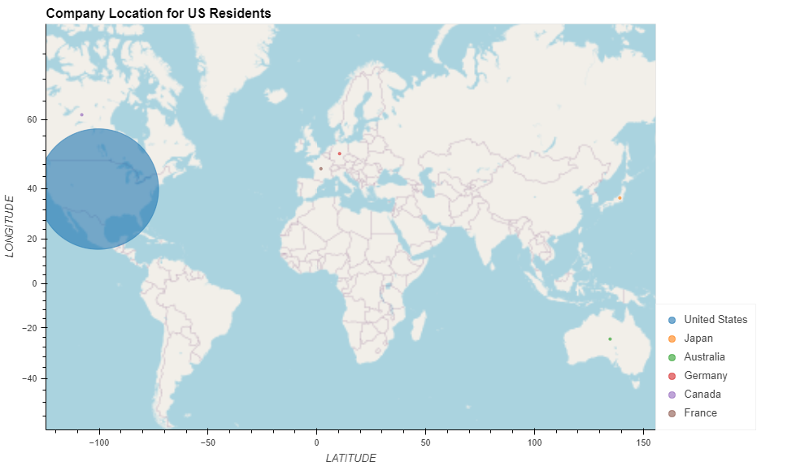
Do us residents work for us companies?
US residents worked for 6 countries
99.8 % were US companies
Of note, though the UK was 2nd in volume, no US residents worked for UK companies
Notes:
ai-jobs.net (source used from Kaggle)

Slide 12
CONCLUSIONS / implications
Data science salaries have increased over time with medium size companies showing the highest growth and US companies consistently offering the most money
8.8% of data science jobs required entry-level experience, with a mean salary of $ 80,000 USD and a median salary of $ 70,000 USD
Data Analyst positions made up 20.6% of the 5 most common jobs, with the lowest mean salary among that group ( $ 110,000 USD)
Machine Learning Engineer positions made up 13.5% of the 5 most common jobs, with the highest mean salary among that group ($ 167,000 USD)
98.1% of the employees hired by US companies were also US residents, and 99.8% of the companies US residents worked for were US companies

Slide 13
Questions?

