Slide 1
Data Science Salaries – Managing expectations
By: leah Latham, Jonah foeday, manroop gill,
murtatha alwan, & Alicia hill

Slide 2
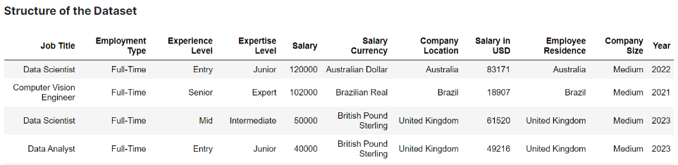
Project overview
Analyzed Data Science salaries from 2020 to 2023
Source: https://www.kaggle.com/datasets/iamsouravbanerjee/data-science-salaries-2023
File format: CSV file
File description: 3,300 rows of data with 11 columns
Notes:
ai-jobs.net (source used from Kaggle)

Slide 3
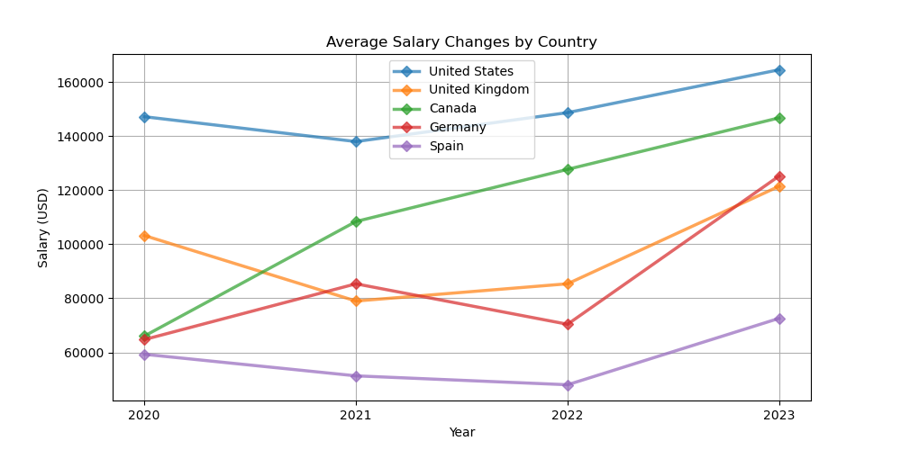
How have data science salaries changed over time? – By country (company location)
There are 21 total countries included in the dataset
89.8% of data science jobs are represented by the top 5 countries
The US alone claims 75.6% of the data science jobs in the dataset
Notes:
ai-jobs.net (source used from Kaggle)

Slide 4
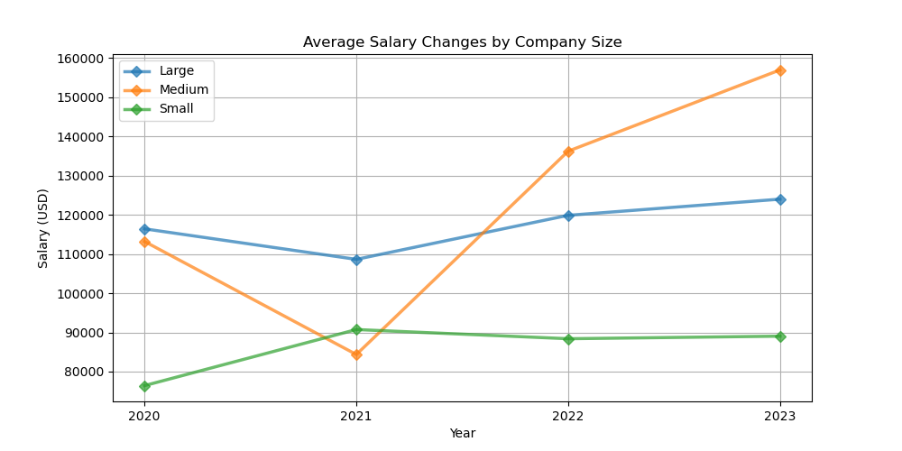
How have data science salaries changed over time? – By company size
The data is categorized into 3 different company sizes:
Small: 151 companies
Medium: 2707 companies
Large: 442 companies
COME BACK – t-test??
Notes:
ai-jobs.net (source used from Kaggle)

Slide 5
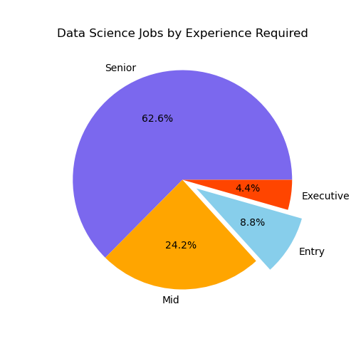
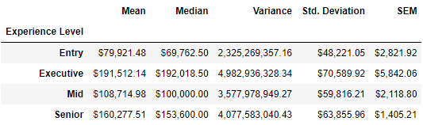
What is the breakdown of experience level required for data science jobs?
Senior-level positions comprised the majority of jobs with 62.6% and an average salary of $160,000 USD
Entry-level positions (this is us) only comprised 8.8% of jobs, with an average salary of $80,000 USD
As experience level increases, the variation (standard deviation) in salary also increases

Slide 6
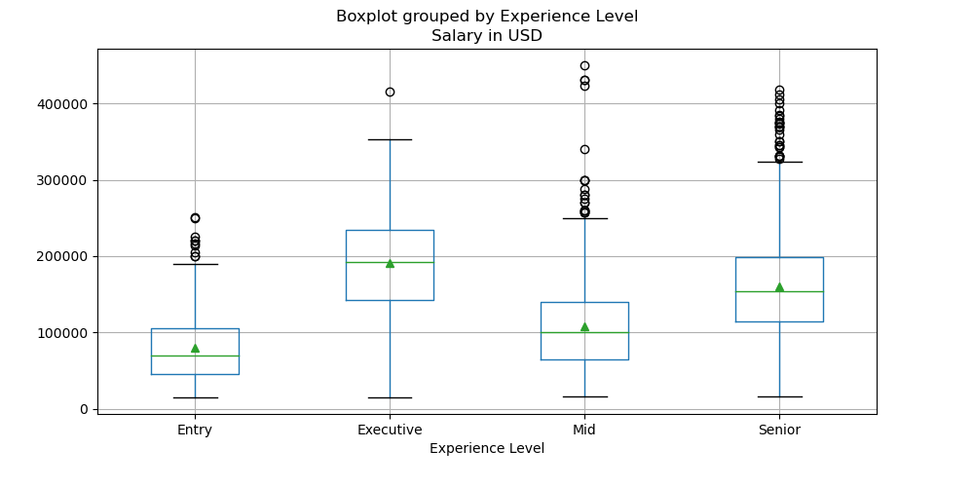
How do data science salaries vary by experience level?
The ANOVA test showed a statistically significant difference in salary based on experience level
P-value = 3.974 e-116
Notes:
ai-jobs.net (source used from Kaggle)

Slide 7
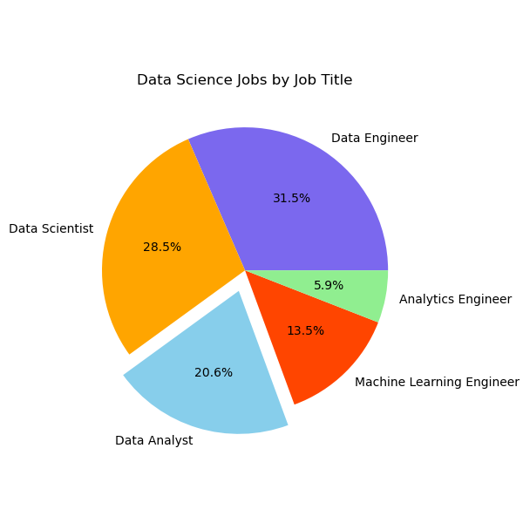
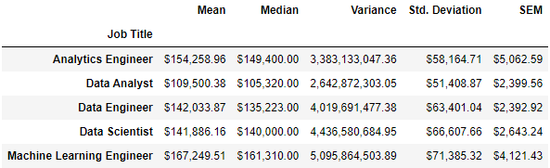
What is the breakdown of Job Title required for data science jobs?
Data Engineer jobs comprised the majority of jobs with 31.5% and an average salary of $142,000 USD
Data Analyst jobs comprised 20.6% of jobs, with an average salary of $109,500 USD

Slide 8
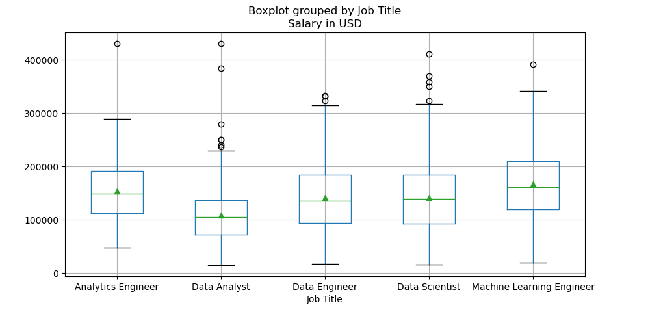
How do data science salaries vary by job title?
The ANOVA test showed a statistically significant difference in salary based on job title
P-value = 9.11 e-35
Notes:
ai-jobs.net (source used from Kaggle)

Slide 9
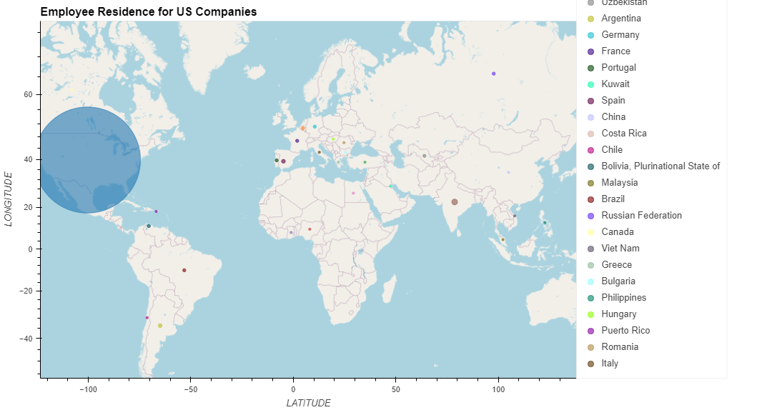
Do us companies hire us residents?
US companies hired employees from ___# countries
____% were US residents
Of note, though the UK was 2nd in volume, no US companies hired UK residents
Notes:
ai-jobs.net (source used from Kaggle)

Slide 10
Do us residents work for us companies?
Notes:
ai-jobs.net (source used from Kaggle)

Slide 11
conclusions

