Slide 1

Airline Passenger Satisfaction
Analysis,
Insights,
Predictions &
Evaluation
Latha Reddy

Slide 2

Dataset Overview
Data set is having 129880 and 24 columns
Sample features: Gender, Age, Customer Type, Type of Travel, Class, Flight Distance, Departure Delay, Arrival Delay, Departure and Arrival Time Convenience. (9 features)
Survey Features: Ease of Online Booking, Check-in Service, Online Boarding, Gate Location, On-board Service, Seat Comfort, Leg Room Service, Cleanliness, Food and Drink, In-flight Service, In-flight Wifi Service, In-flight Entertainment, Baggage Handling (13 features)
Target Feature: Satisfaction

Slide 3
Data Preprocessing
Handling Missing Values
- Used min value to fill the missing values
Encoding the categorical features
- Used Label Encoding Technique to encoding the categorical columns
Feature Scaling
- Used StandardScaler to standardizes features by removing the mean and scaling to unit variance

Slide 4
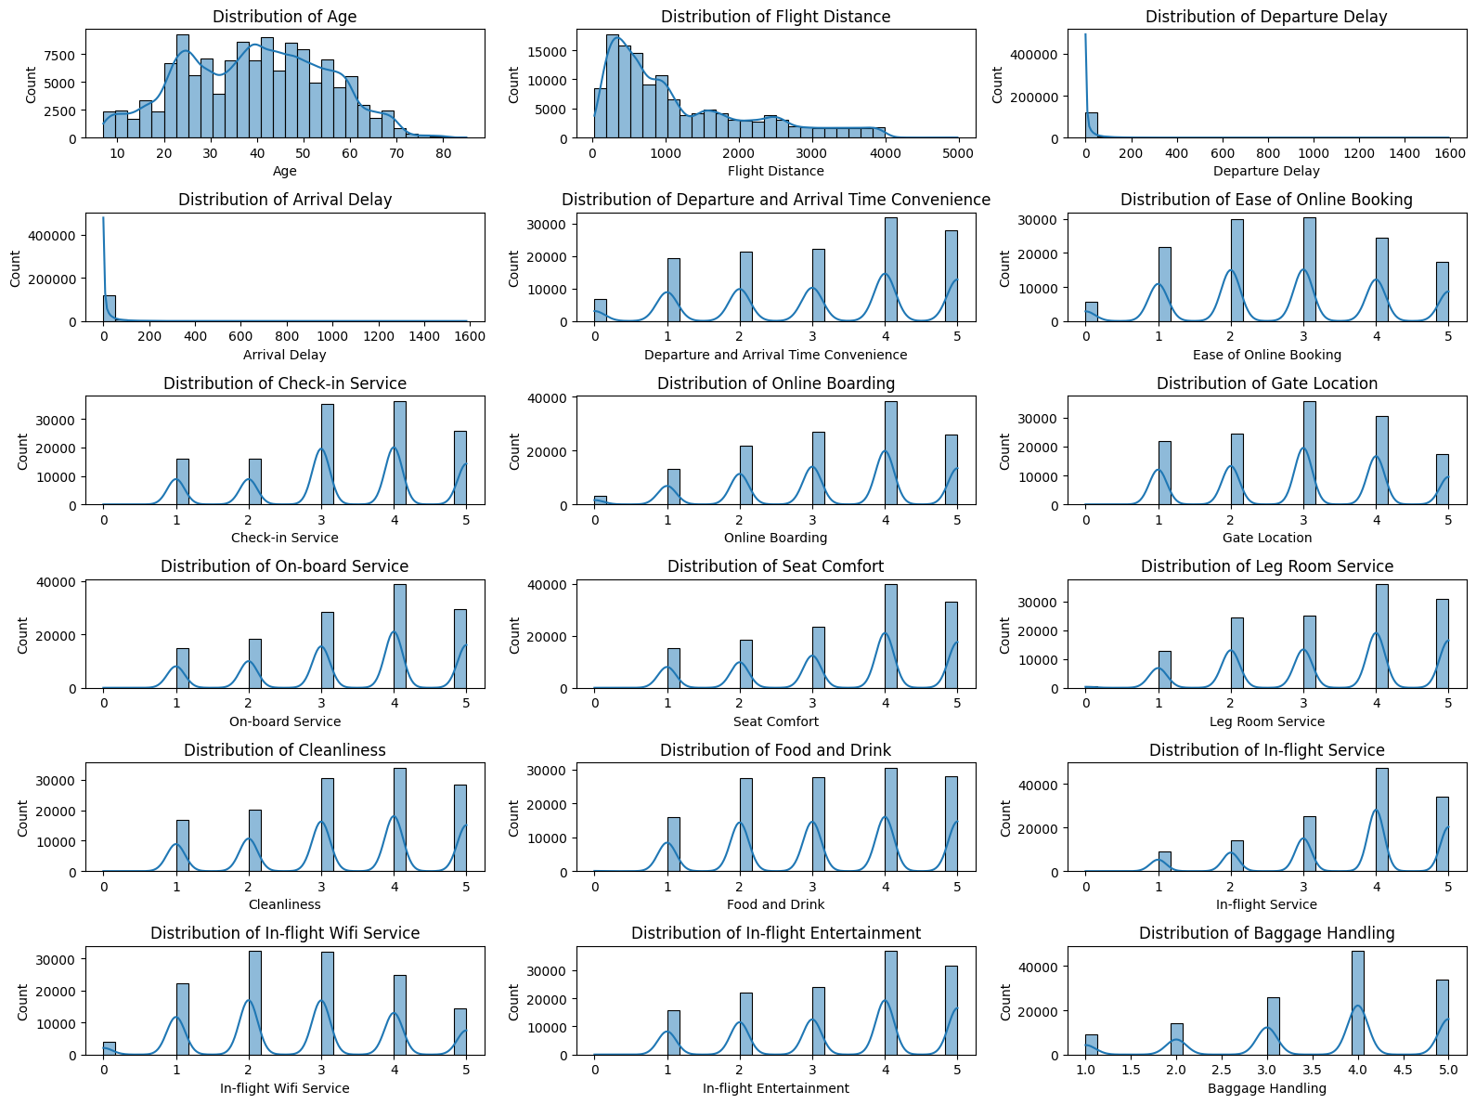
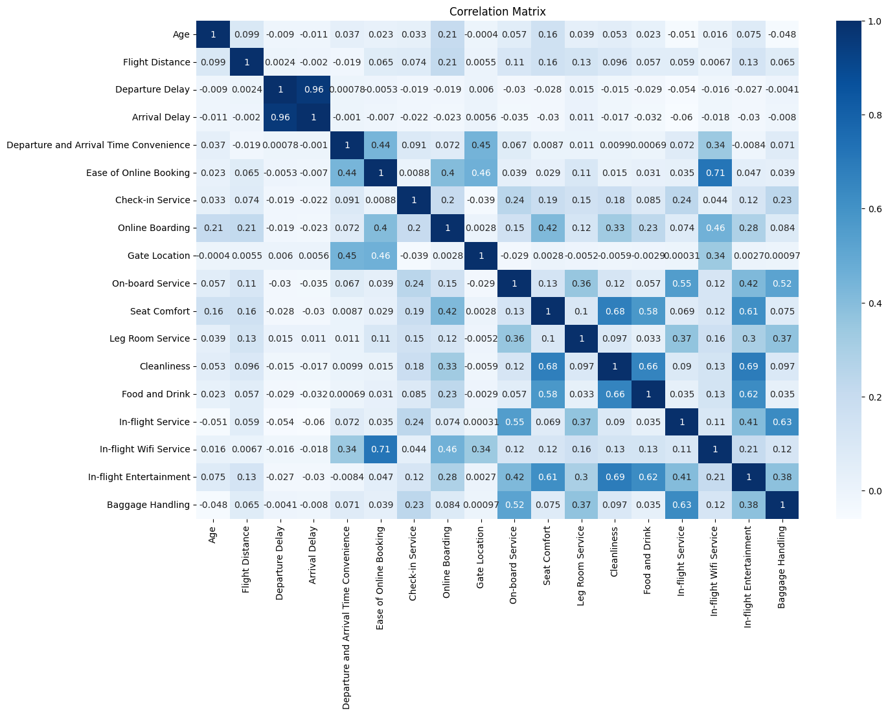
Exploratory Data Analysis
Distribution Plots
Correlation (Heatmap) Analysis

Slide 5
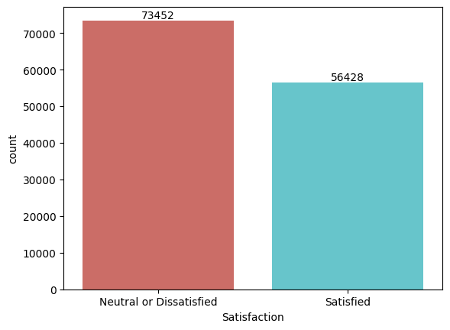
Exploratory Data Analysis
Balance between Target Feature
Neutral or Dissatisfied – 56.6%
Satisfied – 43.4%

Slide 6
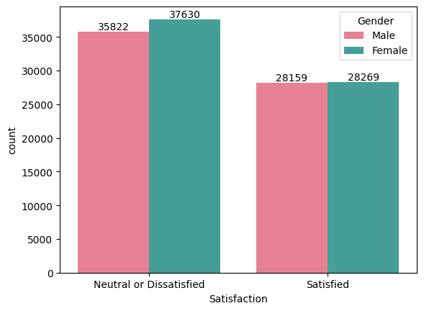
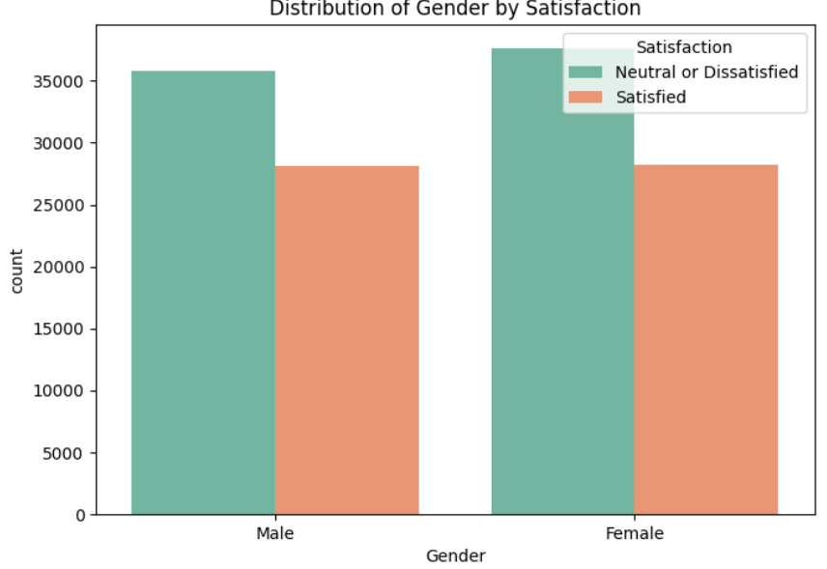
Exploratory Data Analysis
** Gender does not affect the satisfaction

Slide 7
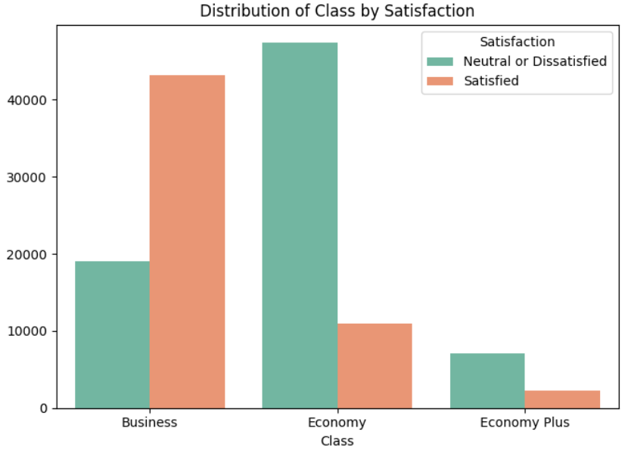
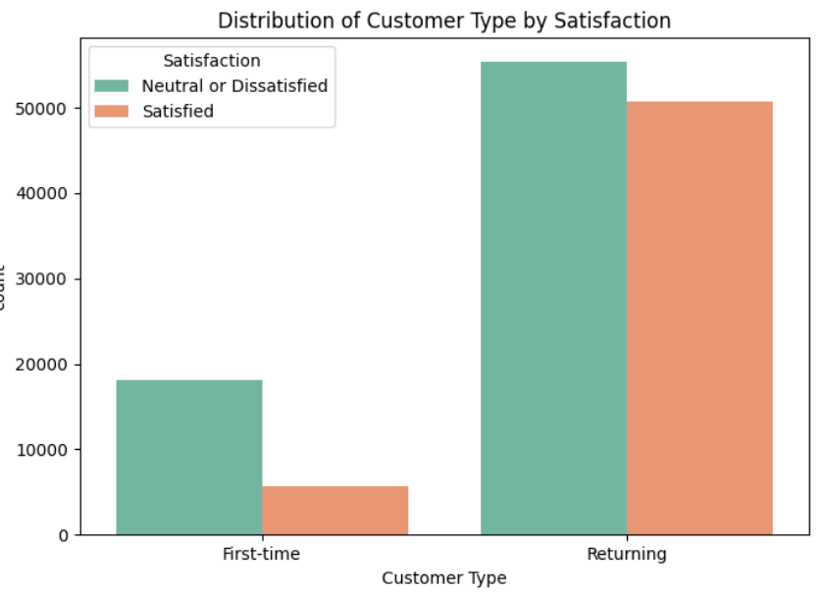
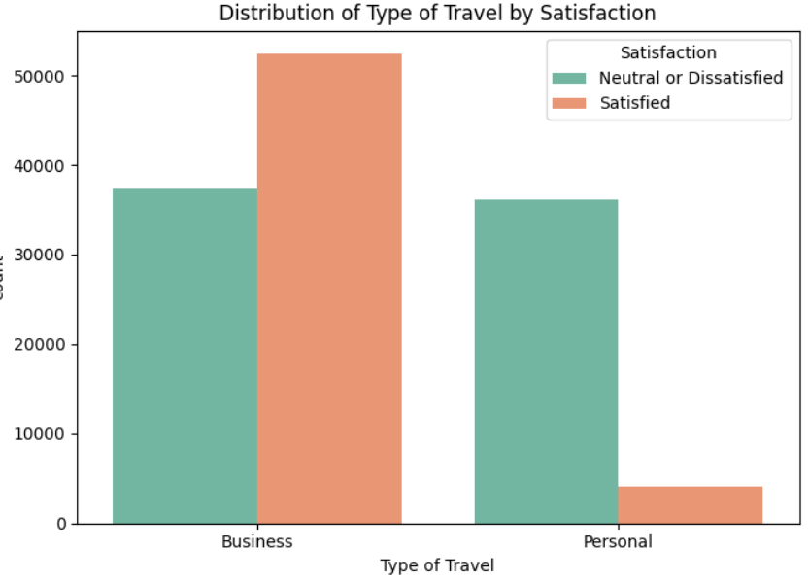
Exploratory Data Analysis
Count plot between Categorical features by Satisfaction feature
Most of the passengers are Returning Customers
Business purpose travel passengers are more satisfied than personal travel passengers
Business class passengers are more satisfied than Economy and Economy Plus passengers

Slide 8
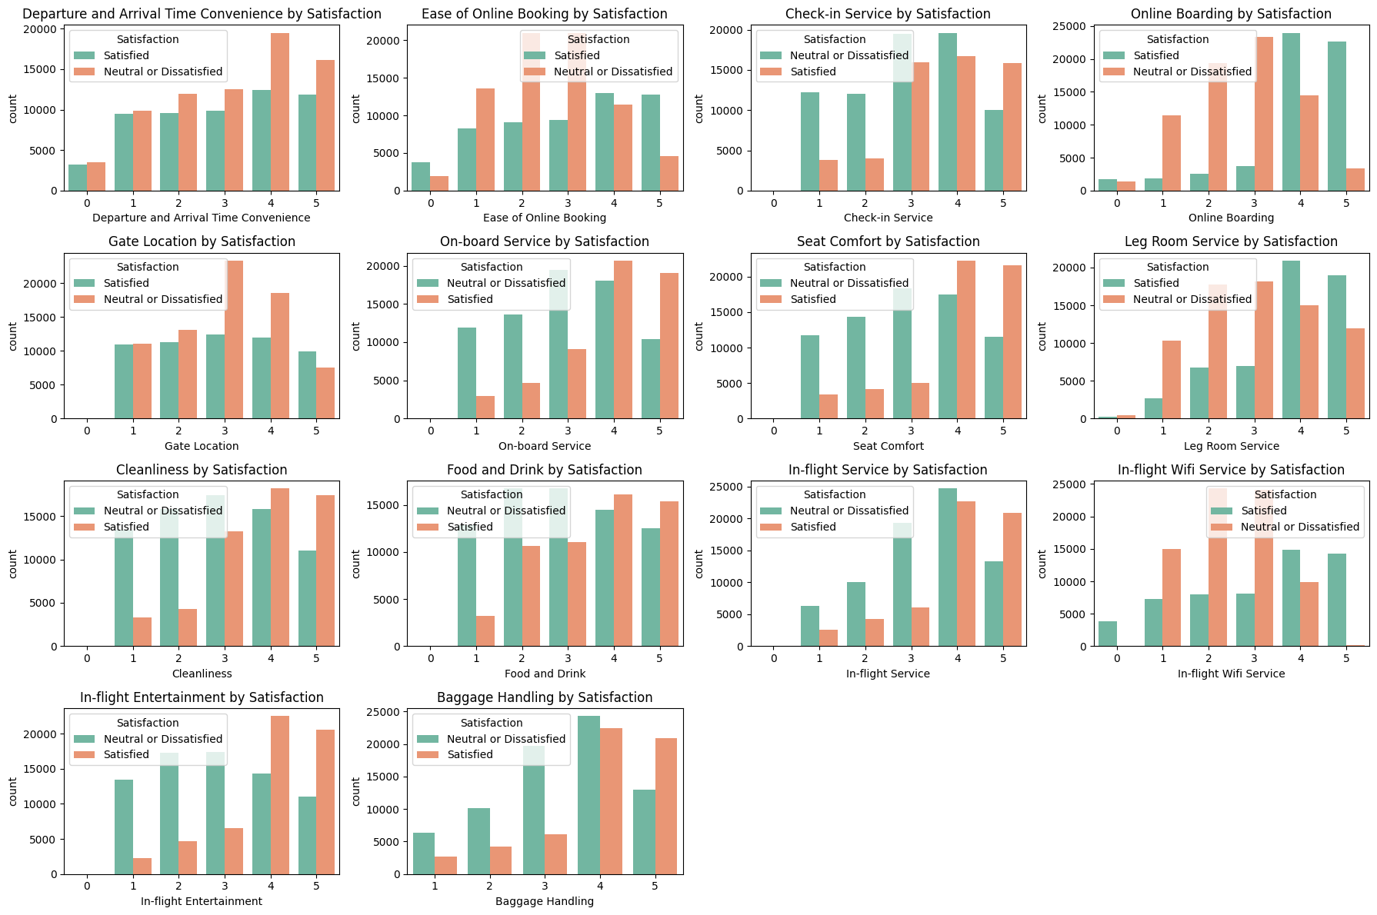
Exploratory Data Analysis
Count plot between Survey features by Satisfaction column

Slide 9
Model Selection
Logistic Regression: A linear model used for binary classification (predicting one of two classes).
Decision Trees: A non-linear model that uses a tree-like structure to make decisions based on data features.
Random Forests: An ensemble method that combines multiple decision trees to improve accuracy and robustness.
SVM: A powerful algorithm that finds the optimal hyperplane to separate data into classes.
K-Nearest Neighbors: A non-parametric algorithm that classifies data based on the majority class of its nearest neighbors.
Gradient Boosting: It is an ensemble learning method used for classification and regression tasks. It is a boosting algorithm which combine multiple weak learner to create a strong predictive model. It works by sequentially training models where each new model tries to correct the errors made by its predecessor.
XGBoost (Extreme Gradient Boosting) : Advanced version of Gradient Boosting that includes regularization to prevent overfitting. Faster than traditional Gradient Boosting, for large datasets.

Slide 10
Model Training and Evaluation
Train and Test Split
- Split the data 80% Train data and 20% Test data
Metrics used for evaluation (Performance Matrix):
- Accuracy: Overall correctness.
- Precision: Correct positive predictions.
- Recall: Ability to detect all Dissatisfied cases.
- F1 Score: Balancing precision and recall.
- ROC Curve: Visualizing trade-offs between true positive and false positive rates.

Slide 11
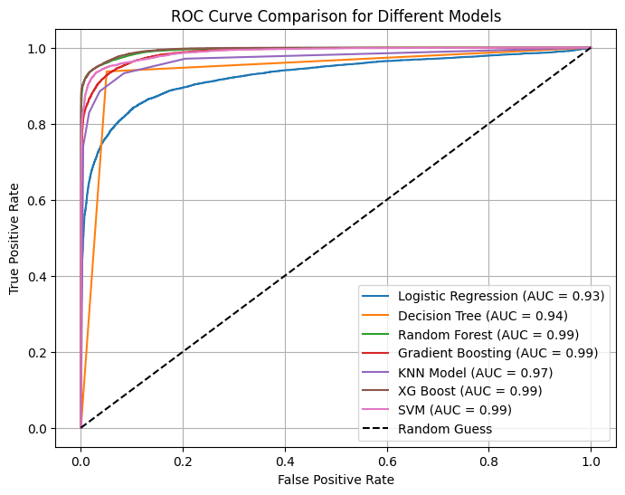
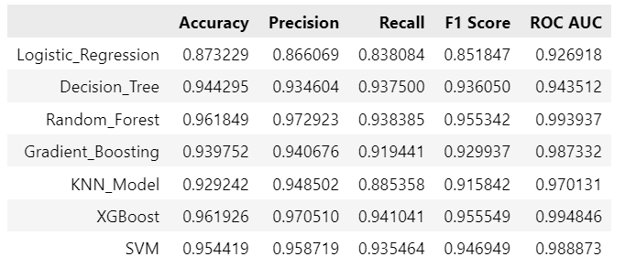
Model Training and Evaluation
XGBoost is the best choice for this classification task due to its consistently high performance across all metrics, particularly in balancing precision and recall, and achieving the highest ROC AUC, indicating excellent classification capability.

