Slide 1

ML-Driven Bank Customer Churn Analysis
Insights, Predictions and Evaluations

Slide 2

Goal
Build a predictive model to classify customers as likely to churn (Exited = 1) or stay (Exited = 0).
Identify key factors influencing customer attrition.
Provide actionable insights for customer retention strategies.

Slide 3

Introduction
Customer Churn: Customers leaving a service or a bank
Importance of churn prediction in the banking industry:
o Retaining valuable customers.
o Enhancing customer satisfaction.
o Driving business strategy.

Slide 4

DataSet
10,000 | 13 | 9 | 2+3 | 1
rows | features | Numerical Features | Categorical Features | Target Column(Exited)
Features/Columns | Description
CustomerId | Customer’s Unique Id
Surname | Customer’s Last Name
CreditScore | It is numeric value representing customer’s credit score (Ranges from 350 from 850)
Geography | Where Customer’s resides having 3 values (France, Spain and Germany)
Gender | Customer’s Gender (Male or Female)
Age | The customer's age
Tenure | The number of years the customer has been with the bank
Balance | The customer's account balance
NumOfProducts | The number of bank products the customer uses (e.g., savings account, credit card)
HasCrCard | Whether the customer has a credit card (1 = yes, 0 = no)
IsActiveMember | Whether the customer is an active member (1 = yes, 0 = no)
Estimated Salary | The estimated salary of the customer
Exited | Whether the customer has churned (1 = yes, 0 = no)

Slide 5
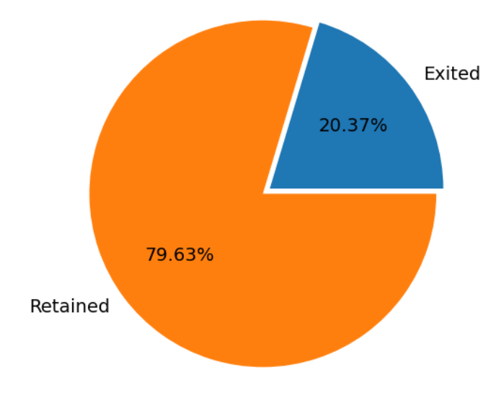
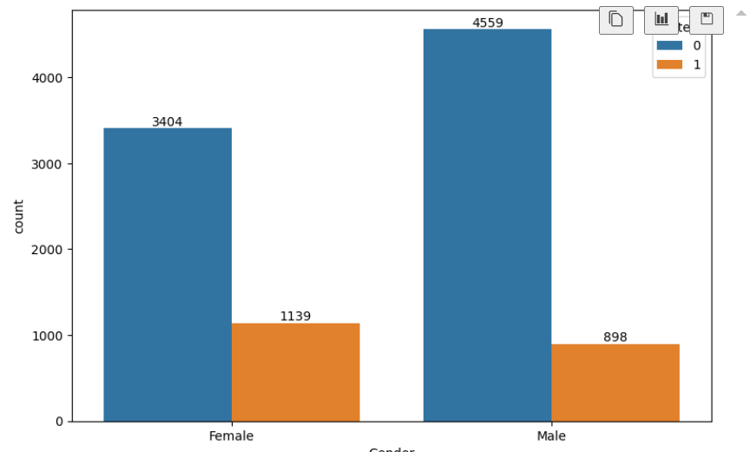
Visualizations
A bank churn rate of 20.37% indicates that approximately 1 in 5 customers are leaving or closing their accounts
Even though men make up a larger portion of the overall customer base, women are leaving the bank at a higher rate

Slide 6
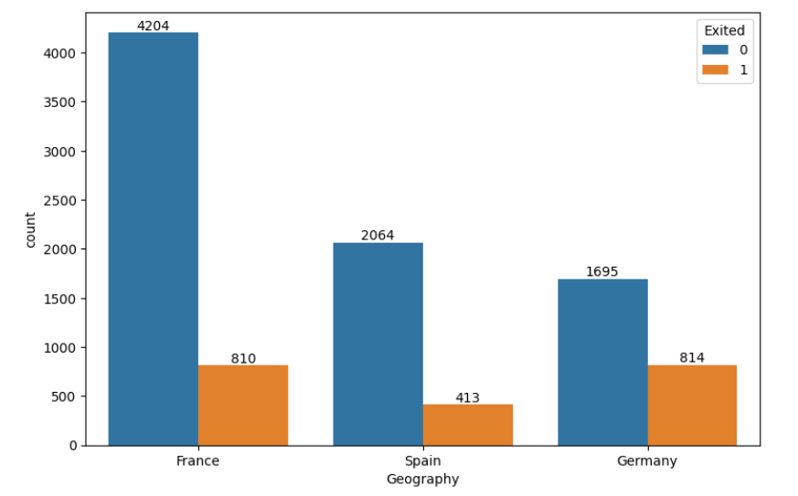
Visualizations
Typically, France is having more customers, But Germany shows a higher churn rate compared to other two countries.

Slide 7
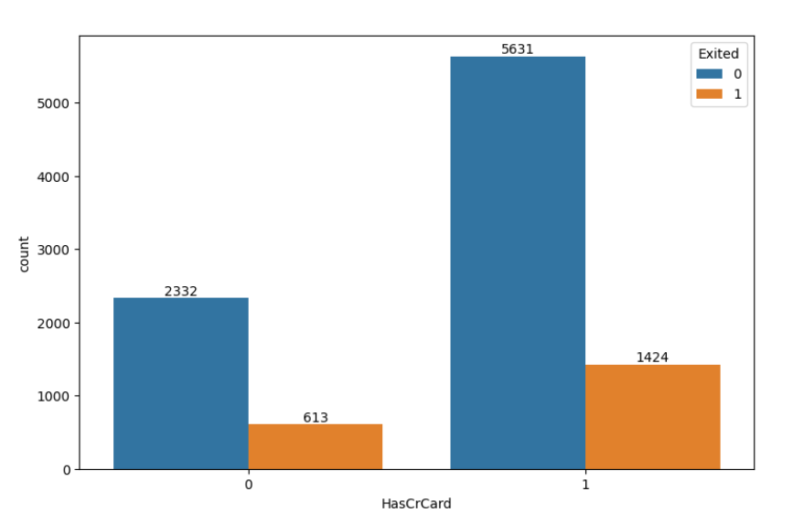
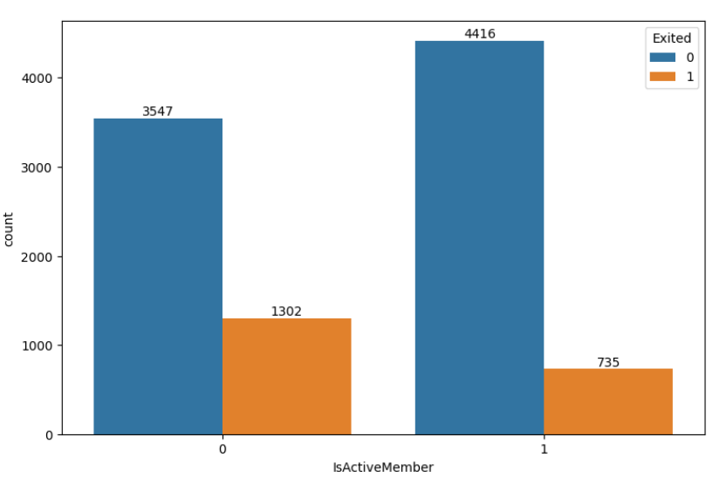
Visualizations
The number of credit card owners are higher than those who do not own a credit card.
Inactive member have a higher churn rate than active members

Slide 8
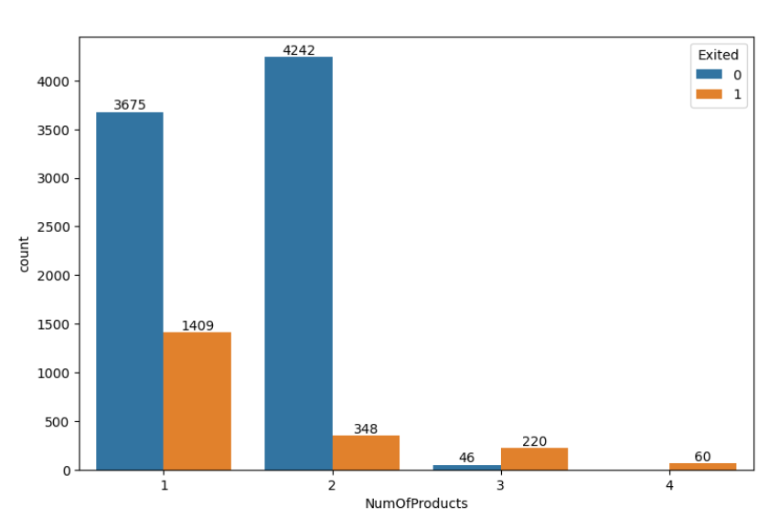
Visualizations
Increased Complexity:
Customers with multiple products (3 or 4) might find it difficult to manage or understand the benefits of all the services they have subscribed to.
Customer Expectations:
Higher product usage could mean customers expect superior service, better rewards, or personalized experiences. If these expectations are unmet, they might decide to leave.

Slide 9
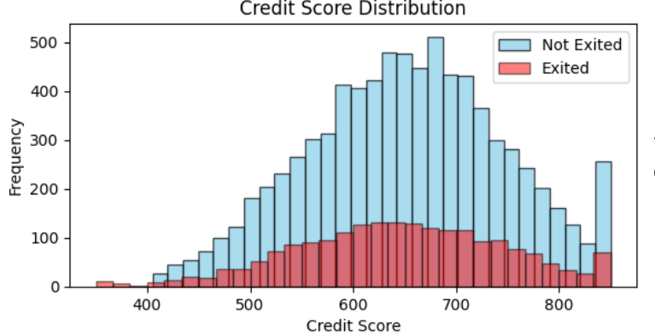
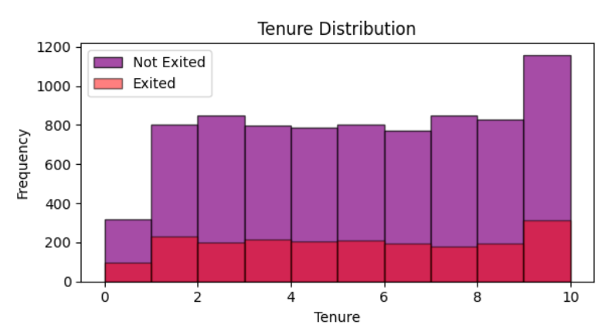
Visualizations
There is no significant impact of CreditScore and Tenure on churn prediction, it suggests that this variable does not strongly correlate with whether a customer decides to leave the bank or stay

Slide 10
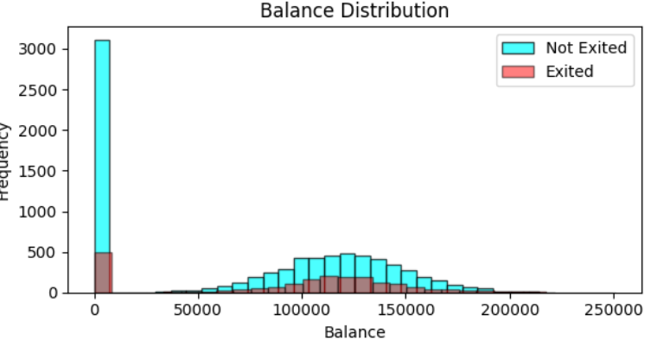
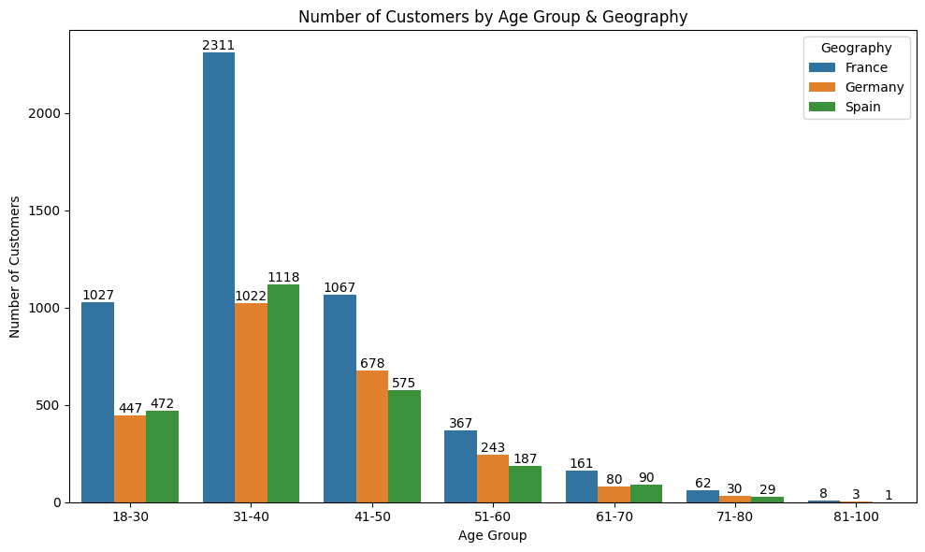
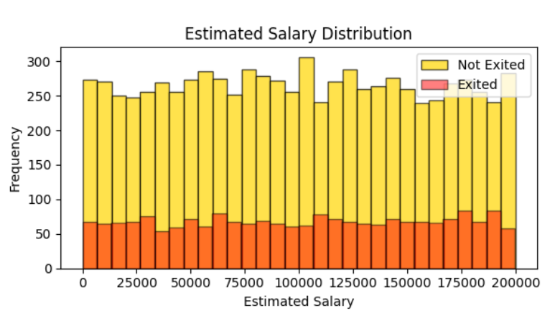
Visualizations
This Histogram plots shows the distribution of Balance and Estimated Salary
The bar plot shows the No of the customers based on Age and Geography.

Slide 11
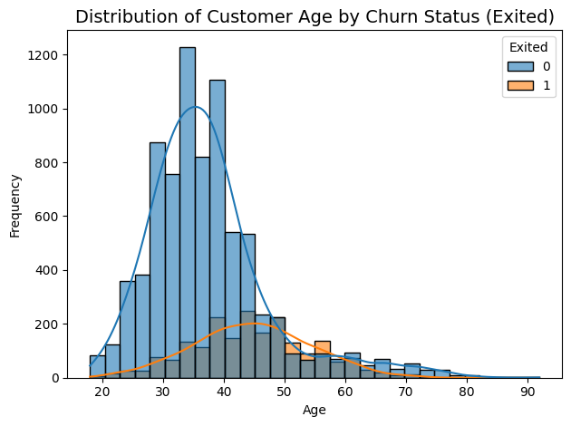
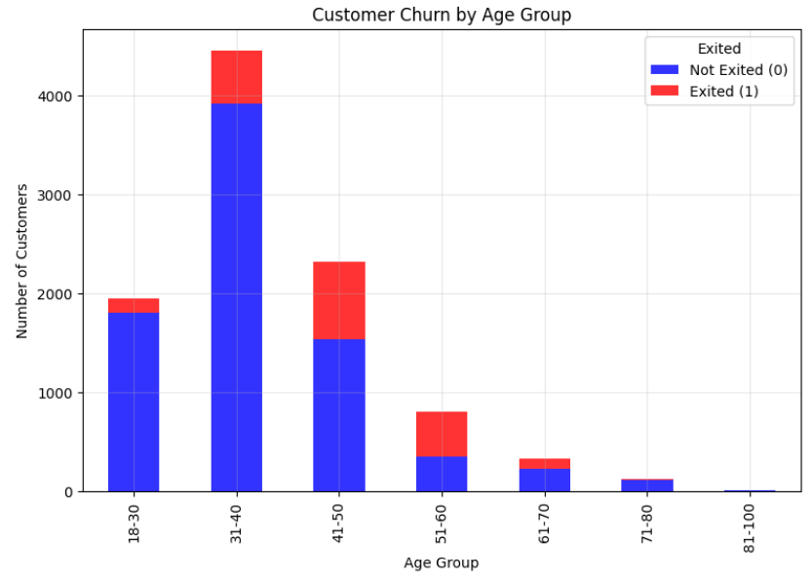
Visualizations
This Histogram and Bar plots shows the distribution of Age.
The distribution of people with Age ranging from 31 to 40 is higher than other groups.

Slide 12
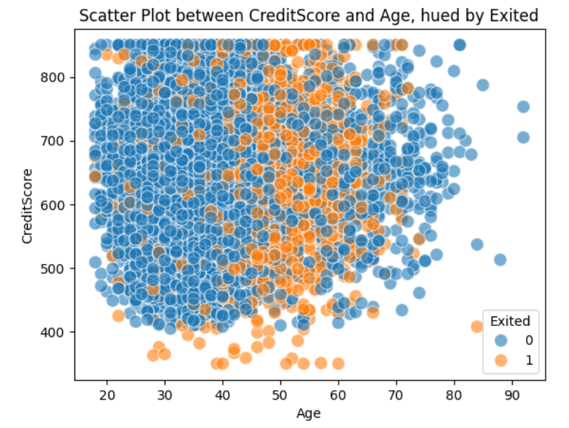
Exploratory Data Analysis (EDA)
This Scatter plot shows the customer churn rate is more on the Age group between 40-65.
There is no specific pattern on CreditScore.

Slide 13
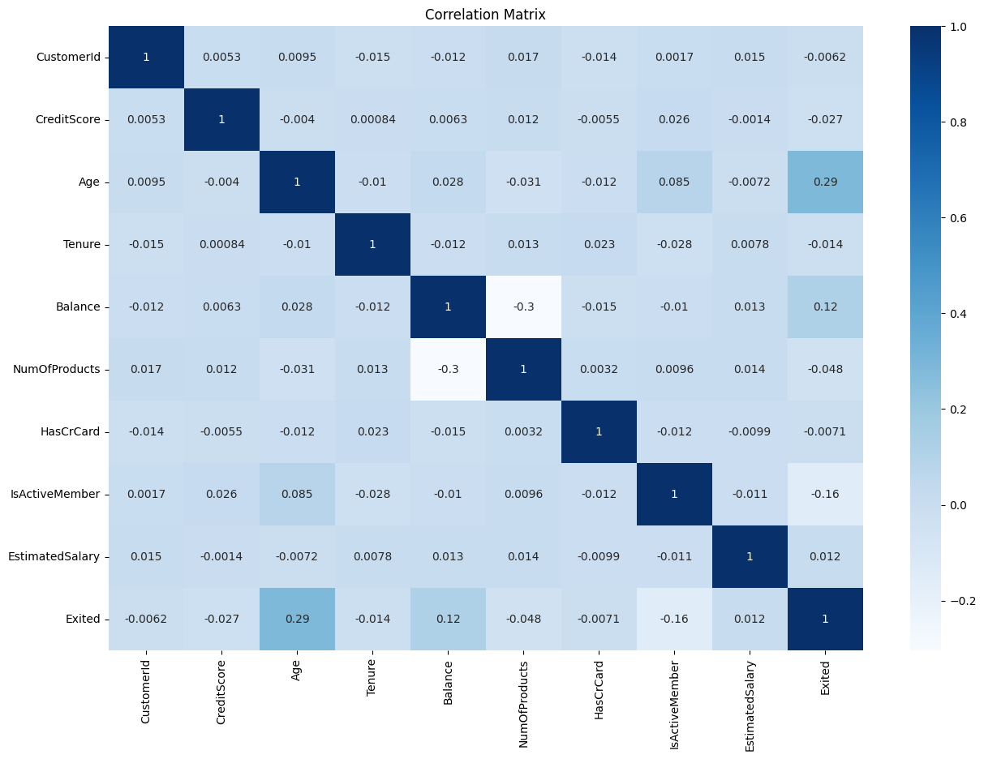
Exploratory Data Analysis (EDA)
Heatmap between variables
By Heatmap, we can see that there is no significant correlation between the columns.

Slide 14
Exploratory Data Analysis (EDA) & PreProcessing
The data is clean, having no null values
The columns “CustomerId” and “Surname” is not useful features for the prediction. Dropped the two columns
The categorical features “Geography” and “Gender” encoded to numerical format.
The data is unbalanced with target column, used SMOTE technique on X (All features except the target column) and Y(Target Column) for over sampling method. After SMOTE, the data is balanced on target column.
Then splitting the data into train(80%) and test(20%) using train_test_split
Converting all numerical features to single normalize scale used Standard Scaler

Slide 15
Model Selection
Models Used:
Logistic Regression: is a supervised machine learning algorithm widely used for binary classification tasks
Decision Tree: is a flowchart-like diagram that shows the possible outcomes of a series of decisions
Random Forest: is a machine learning algorithm that uses an ensemble of decision trees to make predictions, combining the outputs of multiple trees to achieve a more accurate and robust result, particularly for classification and regression tasks
Gradient Boosting Classifier: is a machine learning technique that combines multiple weak learners (like decision trees) to create a strong predictive model, iteratively improving upon previous errors by focusing on misclassified instances
KNN Classifier: is a simple, supervised machine learning algorithm that classifies data points based on the majority class of their nearest neighbors in the feature space
XGBoost Classifier: is a powerful, open-source machine learning algorithm that uses gradient boosted decision trees, known for its speed, efficiency, and ability to handle large datasets
SVM: is a supervised learning algorithm used for both classification and regression tasks

Slide 16
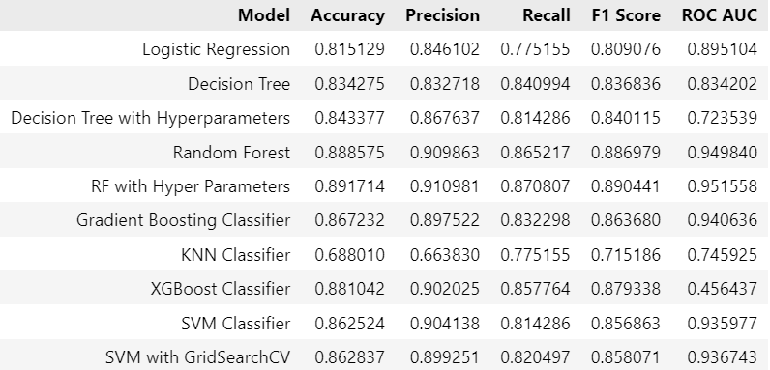
Model Evaluation

Slide 17
Model Evaluation
Metrics used for evaluation:
Accuracy: Overall correctness.
Precision: Correct positive predictions.
Recall: Ability to detect all churn cases.
F1 Score: Balancing precision and recall.
ROC Curve: Visualizing trade-offs between true positive and false positive rates.
Comparison of model performance:
Based on Metrics used for Evaluation Random Forest with Tuned Parameters gives best performing for Accuracy, Precision, Recall, F1-Score and ROC-AUC
Hence, we use Random Forest Model as our final model.

Slide 18


THANK YOU!
Latha Reddy Palle
latha.palle@gmail.com

