Slide 1
Detecting Fraudulent Transactions with Advanced Machine Learning Techniques and Predictive Analytics
Latha Palle

Slide 2
Problem Statement
Develop a machine learning model to detect potentially fraudulent transactions based on the provided features. The dataset contains information about various transactions, including account age, payment method, time of transaction, and category. The goal is to build a classification model that can accurately classify transactions as either legitimate or potentially fraudulent.

Slide 3
Data Dictionary
The dataset is having 39221 rows and 8 columns
accountAgeDays: The number of days the account has been active.
numItems: The number of items associated with the account.
localTime: Some measure of time, possibly in hours or a similar unit.
paymentMethod: The method used for payment (e.g., PayPal, store credit, credit card).
paymentMethodAgeDays: The number of days since the payment method was associated with the account.(It indicates how long ago the current payment method (e.g., PayPal, credit card) was linked to the account.)
isWeekend: A binary indicator of whether the transaction occurred on a weekend (1 for yes, 0 for no).
Category: The category of the transaction (e.g., electronics, shopping, food).
Label(Target column) A binary label (0 for legitimate, 1 for potentially fraudulent).

Slide 4
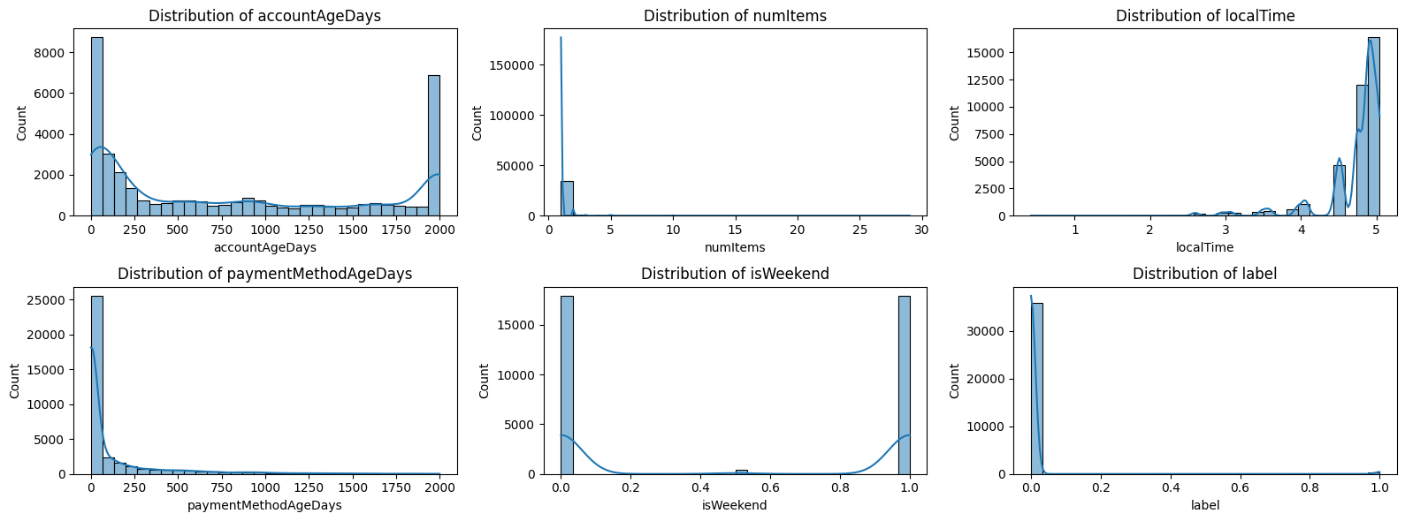
Data Distribution of numerical features

Slide 5
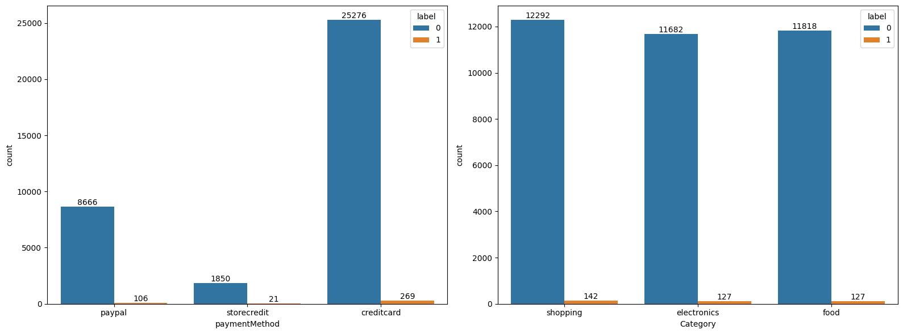
Data Distribution of Categorical features

Slide 6
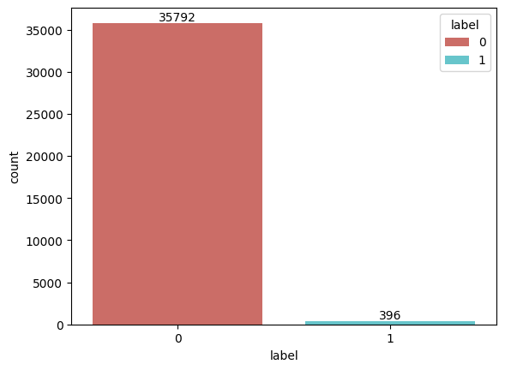
Analysing the target column: Imbalance data
----------- Count -----------
label
0 --- 35792
1 --- 396
label (%)
0 98.905715
1 1.094285

Slide 7
Data Cleaning and Data Preprocessing
Duplicate Rows (3033 rows duplicated)
  All duplicate rows are deleted.
Handling Missing Values
  Variables ‘isWeekend’ & ‘Category’ has missing values, the missing values of ‘isWeekend’ is aligned with ‘label’s category of ‘fraud’ i.e 1. So we can not impute this variable with 0 or 1. So dropped this column.
Encoding the Categorical Columns
Feature Scaling
Imbalance treatment – using SMOTE

Slide 8
Model Selection
Logistic Regression: A linear model used for binary classification (predicting one of two classes).
Decision Trees: A non-linear model that uses a tree-like structure to make decisions based on data features.
Random Forests: An ensemble method that combines multiple decision trees to improve accuracy and robustness.
SVM: A powerful algorithm that finds the optimal hyperplane to separate data into classes.
K-Nearest Neighbors: A non-parametric algorithm that classifies data based on the majority class of its nearest neighbors.
Gradient Boosting: It is an ensemble learning method used for classification and regression tasks. It is a boosting algorithm which combine multiple weak learner to create a strong predictive model. It works by sequentially training models where each new model tries to correct the errors made by its predecessor.
XGBoost (Extreme Gradient Boosting) : Advanced version of Gradient Boosting that includes regularization to prevent overfitting. Faster than traditional Gradient Boosting, for large datasets.

Slide 9
Model Training & Evaluation
Train and Test Split
- Split the data 80% Train data and 20% Test data
Metrics used for evaluation (Performance Matrix):
- Accuracy: Overall correctness.
- Precision: Correct positive predictions.
- Recall: Ability to detect all Dissatisfied cases.
- F1 Score: Balancing precision and recall.
- ROC Curve: Visualizing trade-offs between true positive and false positive rates.

Slide 10
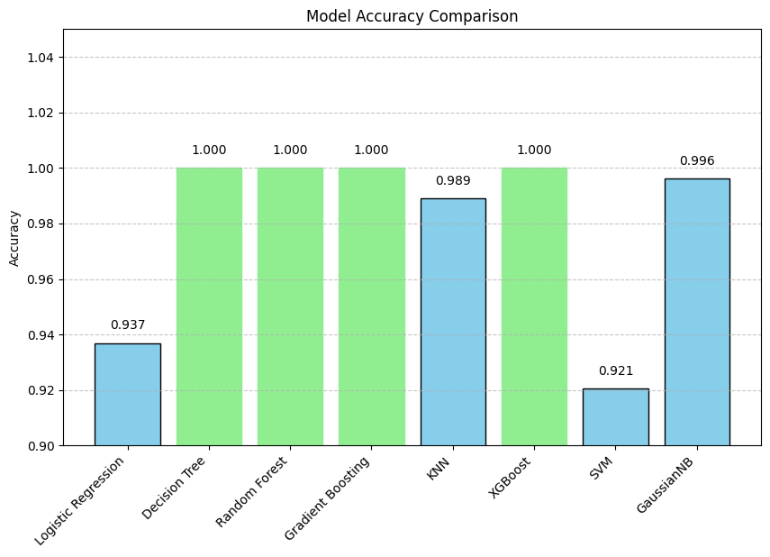
Models Evaluation

Slide 11
Conclusion
All models achieved high accuracy, with tree-based methods (Decision Tree, Random Forest, Gradient Boosting, XGBoost) delivering perfect scores. GaussianNB and KNN also performed exceptionally well. While perfect accuracy may indicate strong learning, it could also suggest overfitting — therefore, cross-validation is recommended to validate generalization performance. For a balance of accuracy, simplicity, and interpretability, GaussianNB or KNN may be preferred, whereas tree-based ensembles offer maximum predictive power.

