Slide 1

Gold Price Dynamics Dashboard
Power BI
NAME:SINGAM LATHA
STD ID:AF05100687

Slide 2
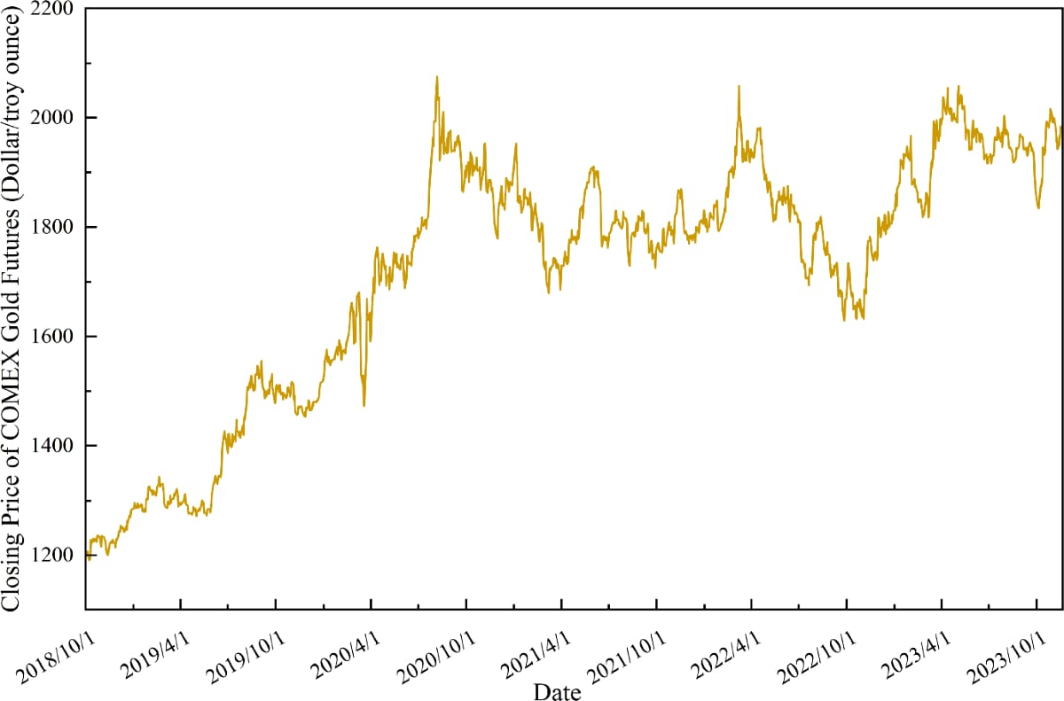
Objective
• Analyze gold price trends over time
• Compare monthly and yearly data
• Visualize trading volume
• Provide insights using dashboards

Slide 3

Data Sources
Kaggle Dataset (Gold Price Data)
Fields Include:
Date
Open
High
Low
Close
Volume

Slide 4
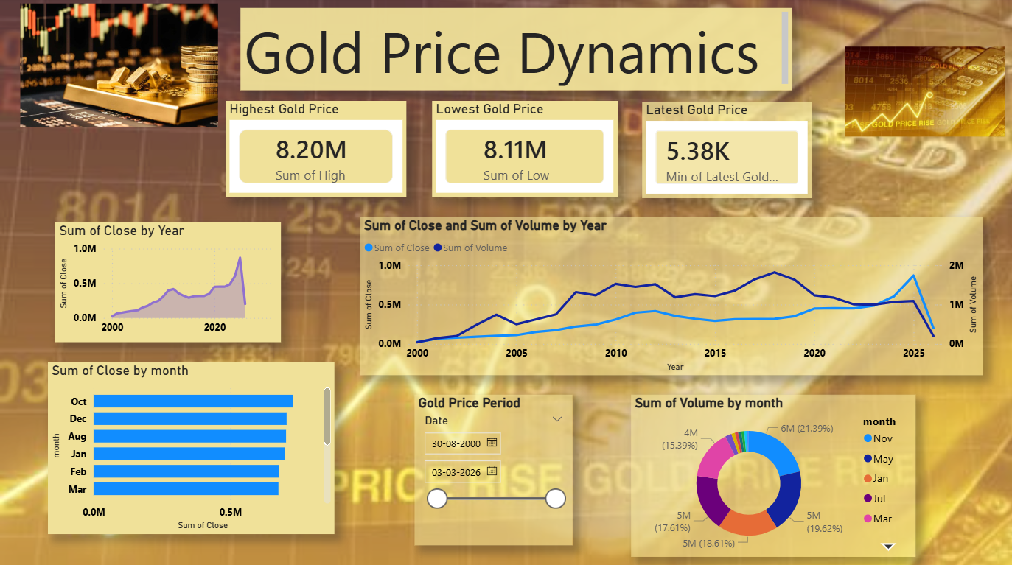
Dashboard Overview
Top - KPI Cards (High ,Low ,Latest Price)
Middle - Price Trend Chart
Bottom -Monthly Analysis
Filters – Data Slicer

Slide 5

Price Summary
KPI cards include:
Highest Gold Price
Lowest Gold Price
Latest Gold Price

Slide 6
Features
Displays price trends over time
Shows price fluctuation(High & Low)
Monthly comparison of gold prices
Interactive filtering using slicer
Easy-to-understand visualization

Slide 7
Price Trend Analysis
Line/Combo Chart
close price over years
Displays volume alongside price
Helps identify:
Growth trends
Sudden increases/decreases

Slide 8

Monthly Analysis
Bar Chart :
Shows average close price by month
Helps identify:
High-performance months
Seasonal trends

Slide 9
Tools & Technologies
• Power BI
• DAX (Data Analysis Expressions)
• Excel Dataset

Slide 10

Conclusion
• Dashboard provides clear insights
• Helps in decision making
• Easy and interactive visualization

Slide 11

THANK YOU

