Slide 1
Exploratory Analysis of International Tourism Trends and Visitor Behavior
COURSE: DATA SCIENCE | CODE: 21CSC303T
By:
Student Name: Sumathi M & Lathikeswari Ramanathan
Register Number: RA2311026050015, RA2311026050239

Slide 2
Introduction
Tourism is one of the fastest-growing sectors, contributing significantly to global economy and employment.
Over the years, international travel has increased due to globalization and improved transportation.
Analyzing tourism data helps in understanding trends, patterns, and future planning.

Slide 3
Objectives
To preprocess and clean tourism dataset for analysis.
To perform exploratory data analysis (EDA) to identify trends and patterns.
To compare tourist arrivals across countries and analyze growth rates.
To study the impact of COVID-19 and present insights using visualizations.

Slide 4
Methodology
Dataset collected from Kaggle containing country-wise tourist arrivals (2014–2020).
Data transformed from wide format to long format using Pandas.
Data cleaning and preprocessing performed to ensure consistency.
Exploratory Data Analysis conducted to study trends, growth, and comparisons.
Visualizations created using Matplotlib to represent insights clearly.

Slide 5
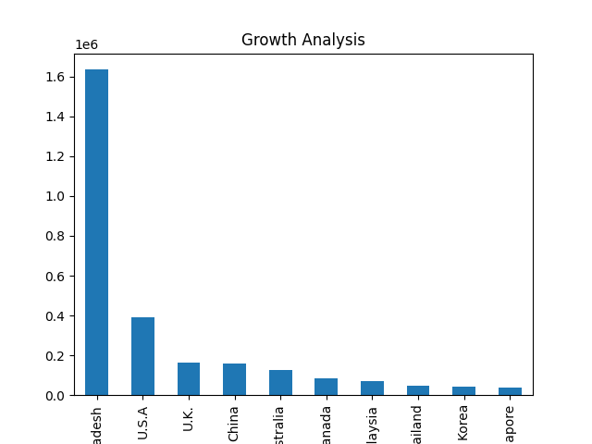
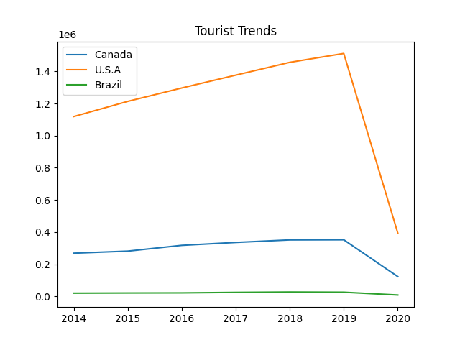
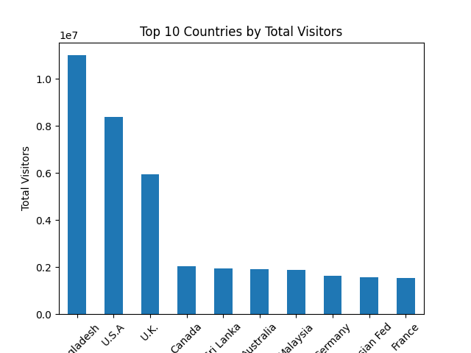
Data Analysis & Visualizations

Slide 6
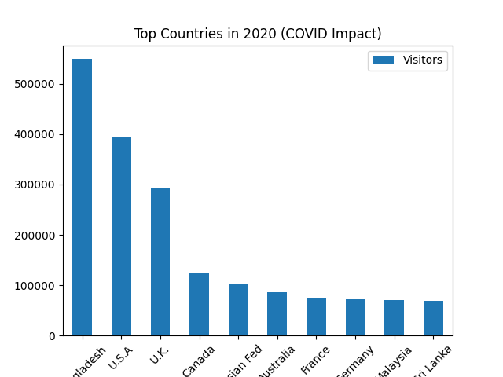
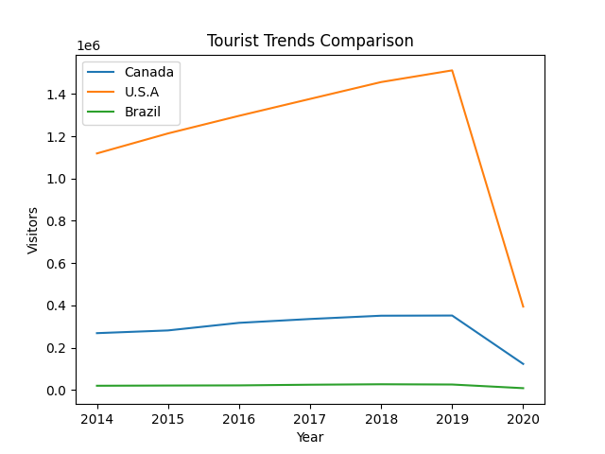
COVID-19 Impact & Key Findings

Slide 7
Conclusion & Future Scope
Conclusion:
Tourism showed steady growth from 2014 to 2019.
A few countries dominate global tourism trends.
COVID-19 caused a major decline in 2020.
Future Scope:
Include more recent data
Add external factors (economy, policies)
Develop interactive dashboards

