Slide 1
DIGITAL PORTFOLIO
STUDENT NAME: M. LATHIKA
REGISTER NO:21024u18043
NMID: astvu21021024u18043
DEPARTMENT: BSC. COMPUTER SCIENCE
COLLEGE: SRI AKILANDESWARI WOMEN’S COLLEGE
UNIVERSITY : THIRUVALLUVAR

Slide 2
PROJECT TITLE
LATHIKA
DIGITAL PORTFOLIO

Slide 3


AGENDA
Problem Statement
Project Overview
End Users
Tools and Technologies
Portfolio design and Layout
Features and Functionality
Results and Screenshots
Conclusion
Github Link
3/21/2024 Annual Review

Slide 4
PROBLEM STATEMENT
Title: Problem Statement
Text: Design and develop a portfolio website that effectively showcases Lathika’s skills, experience, and education, while providing a good user experience and being easy to navigate.
Bullet points:
Showcase technical skills and experience
Highlight education and certifications
Provide a way for users to contact Lathika

Slide 5

PROJECT OVERVIEW
Title: Problem Overview
Text :Creating a portfolio website that showcases one's skills, experience, and education in a visually appealing and user-friendly manner.
Bullet points:
Difficulty in showcasing complex skills and experience in a simple way
Need for a website that is easy to navigate and visually appealing
Importance of having an online presence in today's digital age

Slide 6

WHO ARE THE END USERS?
Title: End User
Text: Potential employers, clients, or collaborators who want to learn more about Lathika’s skills and experience.
Bullet points:
Technical professionals
Hiring managers
Potential clients

Slide 7
TOOLS AND TECHNIQUES
Title:Tools and Technology
Text :HTML, CSS, JavaScript, and responsive design techniques.
Bullet points:
HTML for structure and semantics
CSS for styling and layout
JavaScript for interactivity and dynamic effects
Responsive design for mobile-friendliness

Slide 8
POTFOLIO DESIGN AND LAYOUT
Title : Portfolio Design and Layout
Text : A clean and minimalistic design with a navigation bar, sections for different types of content, and a responsive layout.
Bullet points:
Use of gradients and colors to enhance visual appeal
Clear and concise headings and labels
Responsive design for different screen sizes
8

Slide 9
FEATURES AND FUNCTIONALITY
Title : Features and Functionality
Text: A variety of features, including a contact form, skills section, certifications section, and more.
Bullet points:
Contact form with validation and alert message
Skills section with list of technical skills
Certifications section with list of relevant certifications
Responsive design for mobile-friendliness

Slide 10
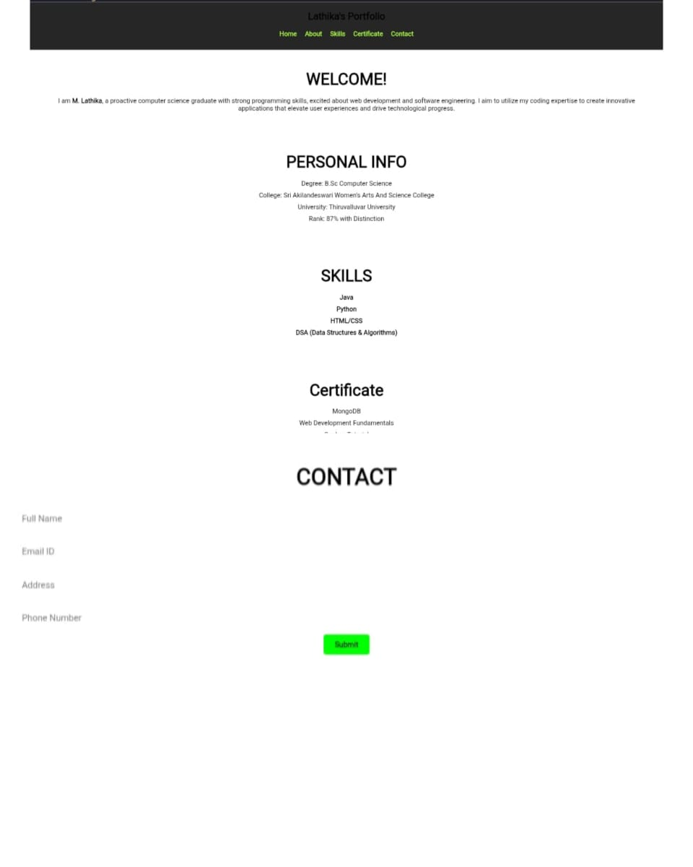

RESULTS AND SCREENSHOTS
3/21/2024 Annual Review
10

Slide 11
CONCLUSION
Title: Conclusion
Text: The portfolio website effectively showcases Lathika’s skills, experience, and education, while providing a good user experience and being easy to navigate.
Bullet points:
Meets the needs of potential employers, clients, or collaborators
Provides a platform for Lathika a to showcase her skills and experience
Demonstrates proficiency in HTML, CSS, JavaScript, and responsive design techniques
11

