Slide 1
Ansible Automation Platform
Optimise Domain -> Automation Team
9th Apr 2024
Vignesh Balasubramanian

Slide 2


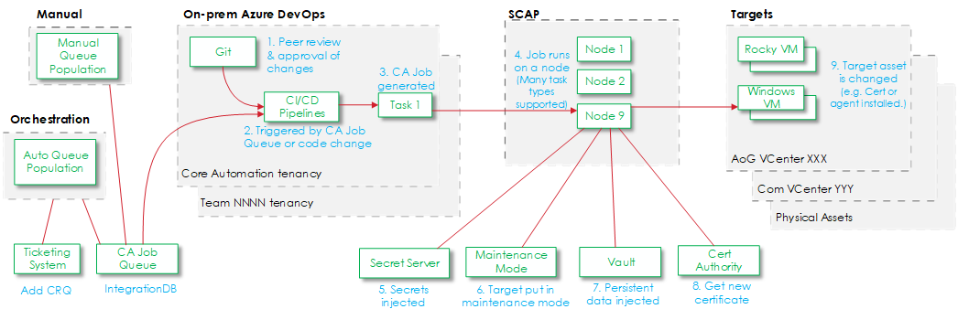
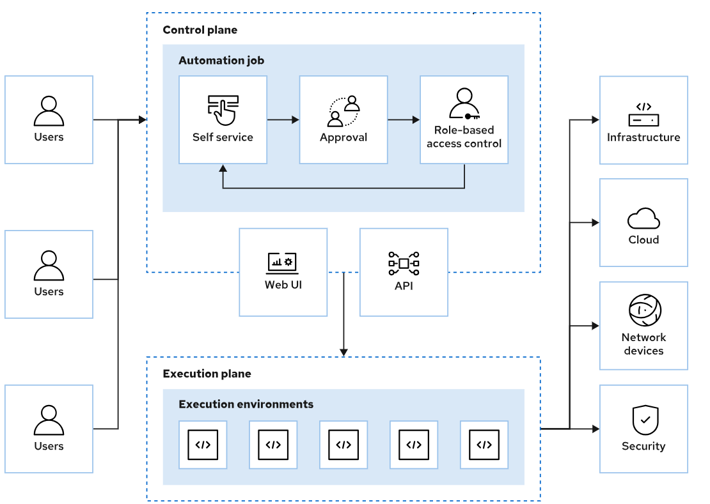
SCAP vs Ansible Automation Platform
SCAP replaced by Red Hat Ansible Automation Platform & OpenShift Containers in Stage environment, automation jobs can be run for any infrastructure resources (Compute, Storage, Networks, Fortinet, etc)
SCAP previously using OpenSource dockers & Azure DevOps to trigger automation jobs can be run only for Virtual Machines
More automation usecases and integrations possible by going this path
This is free of cost given Internal Azure DevOps is also available.
This involves license cost which needs to be estimated
& CCL is a Red Hat Partner to deploy to Production
SCAP – Scalable Containerised Automation Platform

Slide 3
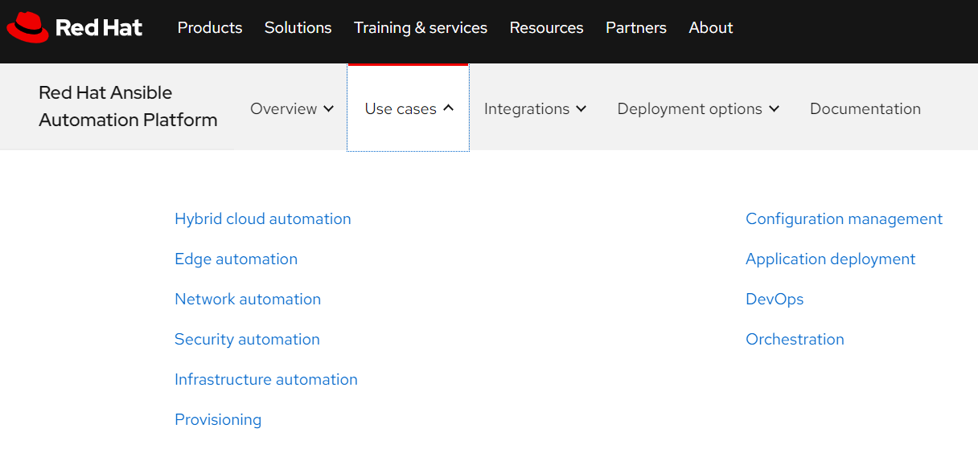
Ansible Automation Platform - Usecases
Red Hat Ansible Automation Platform - Use Cases

Slide 4
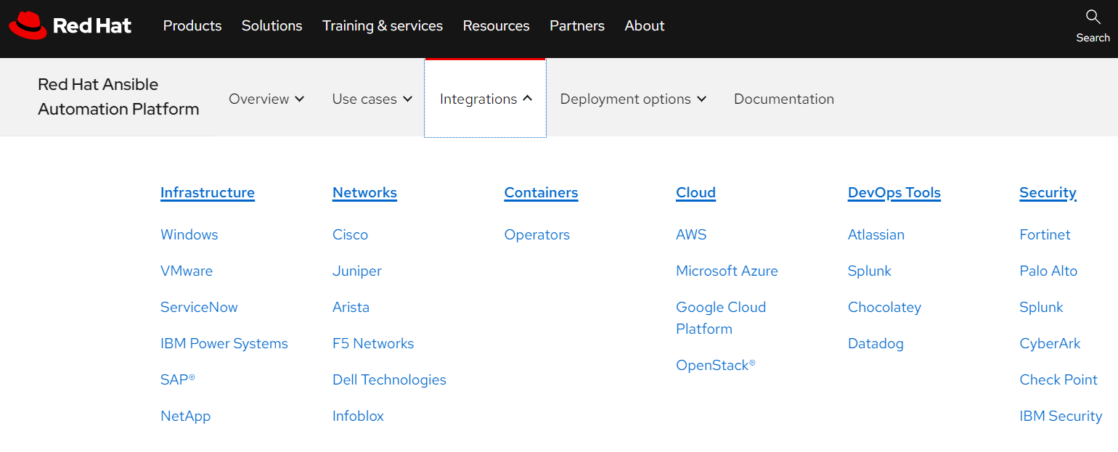
Ansible Automation Platform - Integrations
Integrations Overview | Ansible

Slide 5
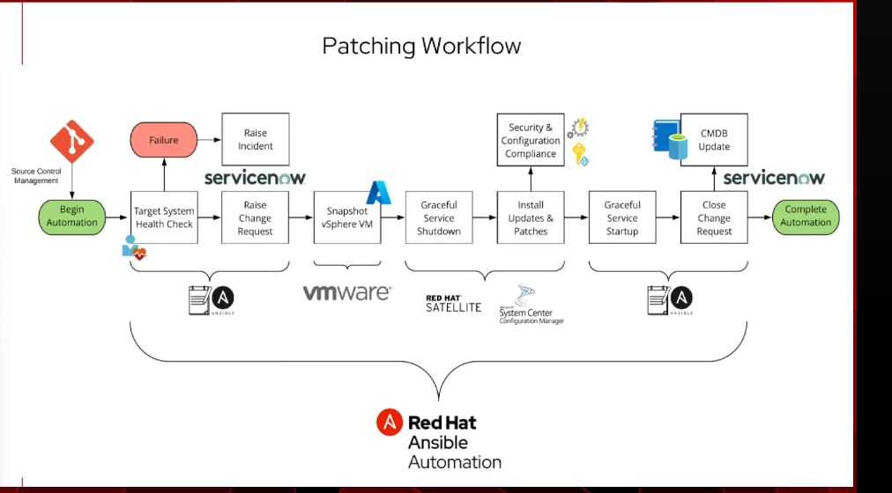
Ansible Automates 2024 – Sydney event
Patching usecase explained – aligns exactly with our thinking / usecase !

Slide 6
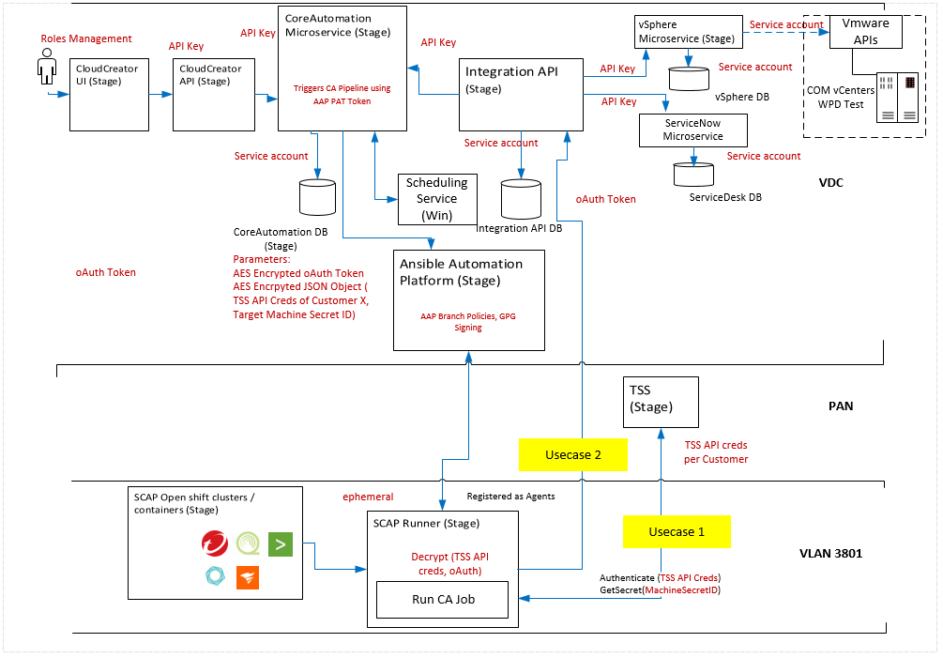
Ansible Automation Platform – Stage Environment

