Slide 1
Fusion Tables: Beyond the Map
NICAR 2013, Louisville, Ky. 3/2/2013
Daniel Lathrop
The Dallas Morning News

Slide 2


Slide 3
The maps rock, but can I do something else with it?
Notes:
http://www.reuters.com/article/2011/06/08/us-bigdata-idUSTRE75762Y20110608
Analysis: Crunching Big Data more than a byte-sized bet
By Sayantani Ghosh
BANGALORE | Wed Jun 8, 2011 3:37pm EDT

Slide 4
Data import tricks…
First convert to CSV or Excel
First make it a Google Documents Spreadsheet (super cool intermediate step)
Is there a KML file (Google Maps/Google Earth file)?
Is there an ESRI Shapefile? Use shpescape.com

Slide 5
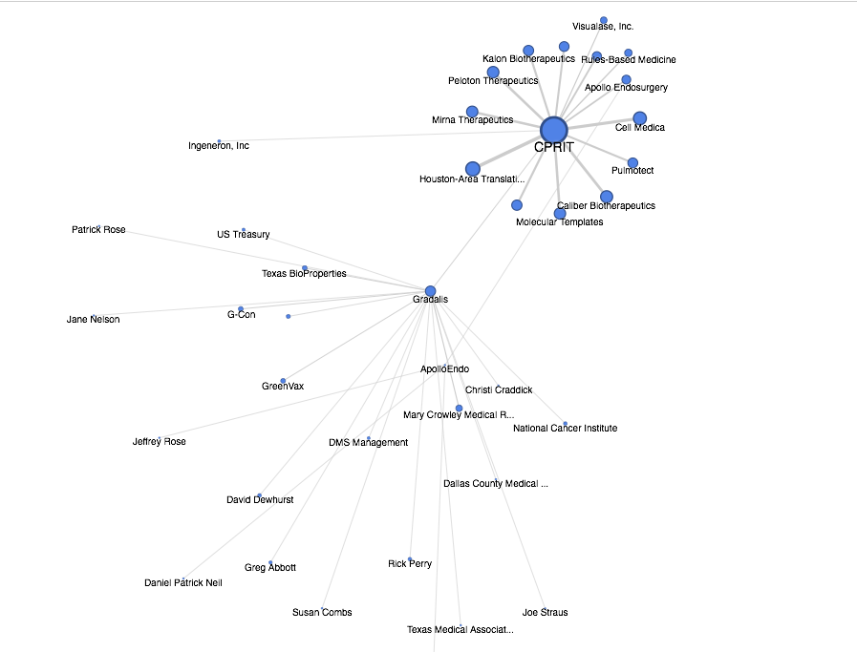
Your friend the network graph
(always a crowd pleaser)

Slide 6
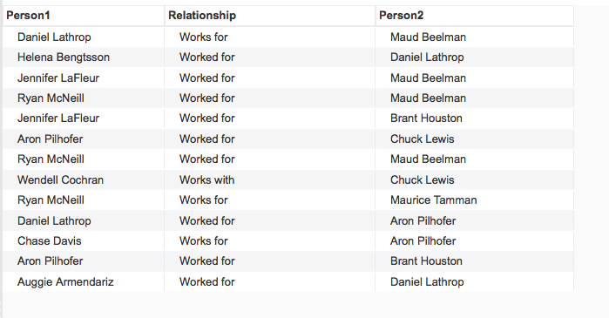
Also for DIY Networks …

Slide 7
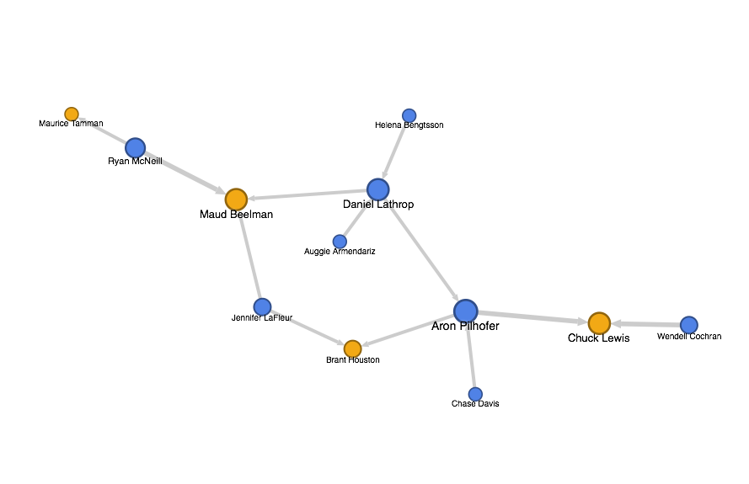
Also for DIY Networks …

Slide 8
Join replacement surgery
Remember FEC data?
Individuals and Committee names are separate. *
* This is known as normalization, and it’s actually a good thing.

Slide 9
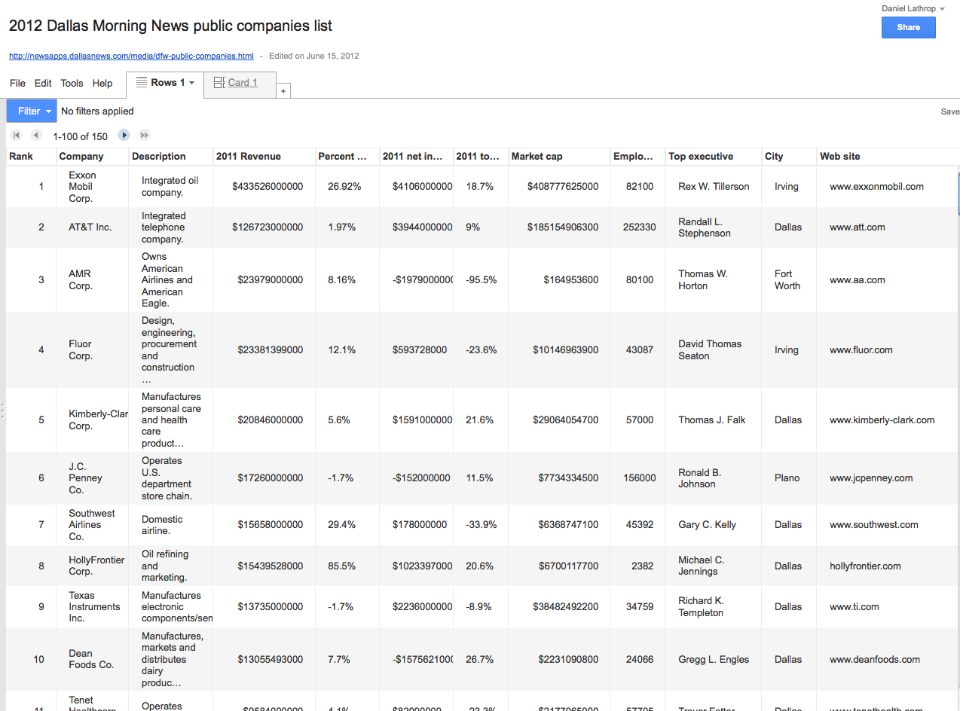
Join replacement surgery

Slide 10
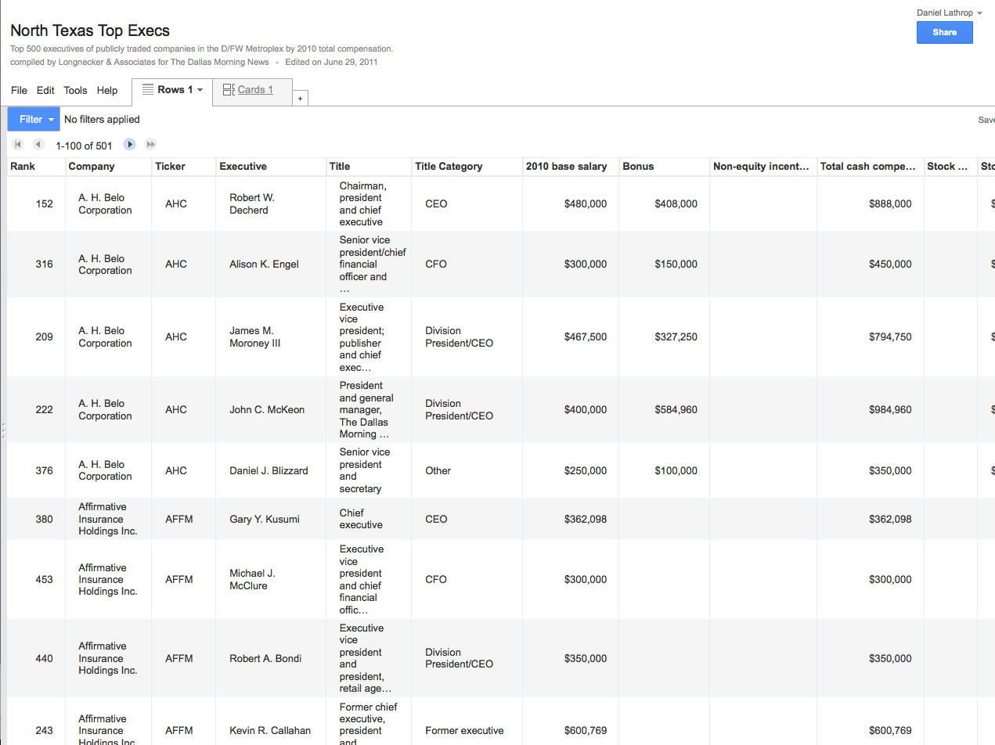
Join replacement surgery

Slide 11
Join replacement surgery

Slide 12
Join replacement surgery
Is there a shared key in one field? If not, you must create it before you import the file.
But be careful or Daniel Lathrop == Daniella Throp
So use | (pipes) or / or . or : or etc. (but never commas)

Slide 13
Suddenly you can find out who got money from whom, in your Web browser. More importantly, so can your colleagues.
SELECT * FROM INDV INNER JOIN CMTES ON CMTEID = CMTEID;

Slide 14
Use it with other Google tools
Google Visualization API
Open Refine
(Psst, the Google Maps API)

Slide 15
SQL API Magic…
CSV
JSON
JSONP
developers.google.com/fusiontables/docs/v1/sql-reference

Slide 16
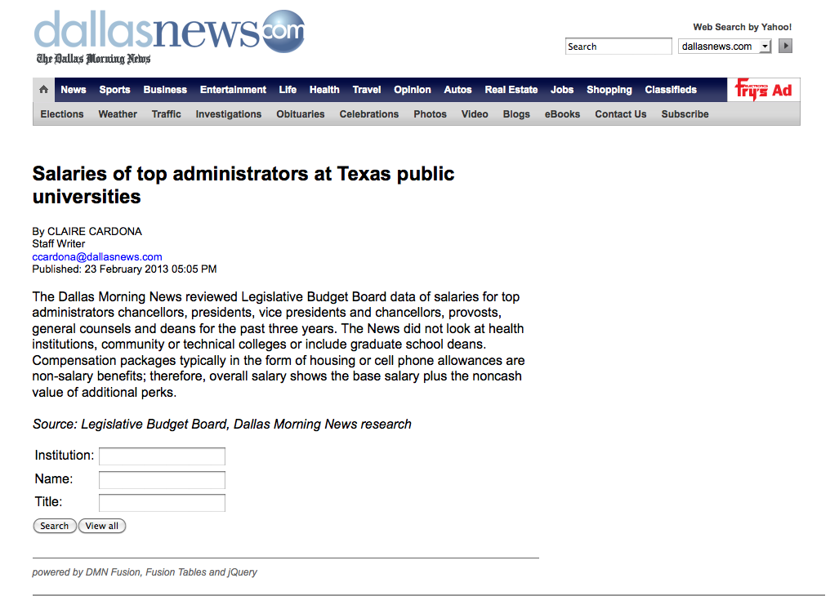
Speaking of APIs, can I get me a searchable database?
github.com/DallasMorningNews/dmn-fusion

Slide 17
fini

