Slide 1
LATİF FURKAN DEMİR
BAHÇEŞEHİR ÜNİVERSİTESİ
YAZILIM MÜHENDİSLİĞİ
github.com/latiffurkandemir

Slide 2
ToDo RESTful API
SPRING BOOT
STARTER-WEB
STARTER-DATA-JPA
STARTER-DATA-JDBC
STARTER-SECURITY
STARTER-VALIDATION
STARTER-ACTUATOR
DEVTOOLS
PostgreSQL
ORM Framework
Hibernate
PostgreSQLDialect
Docker
Authentication, Authorization
Spring Security
JSON Web Token (JWT)
DESIGN PATTERNS
Factory (ResponseFactory)
Singleton
Builder
...

Slide 3
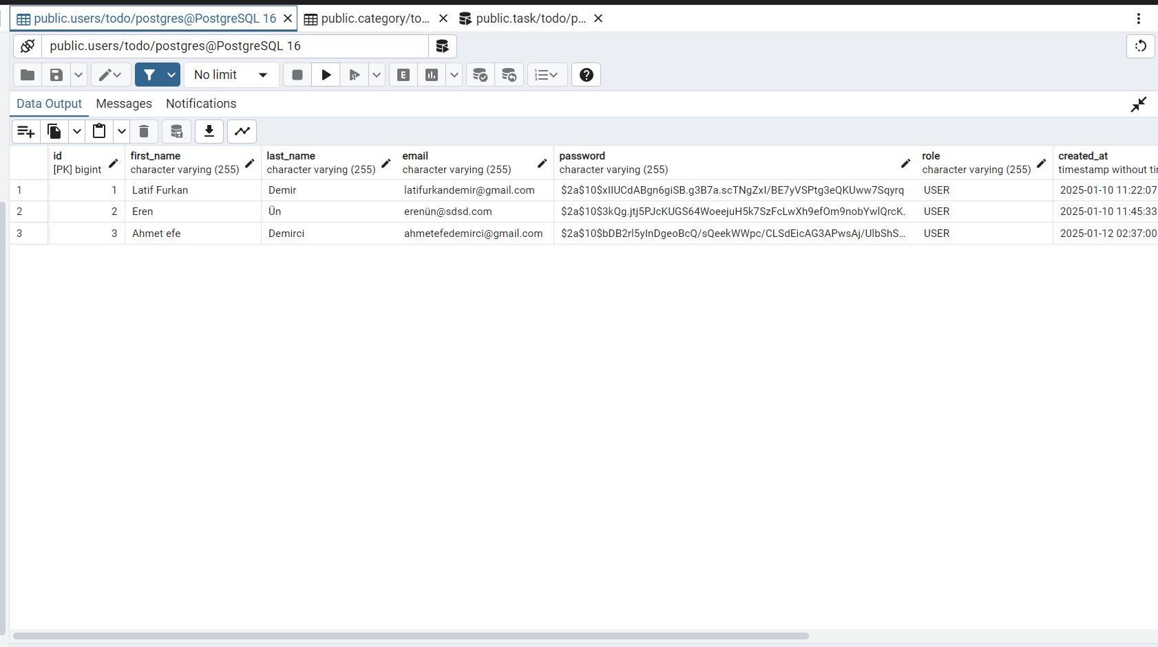

Slide 4
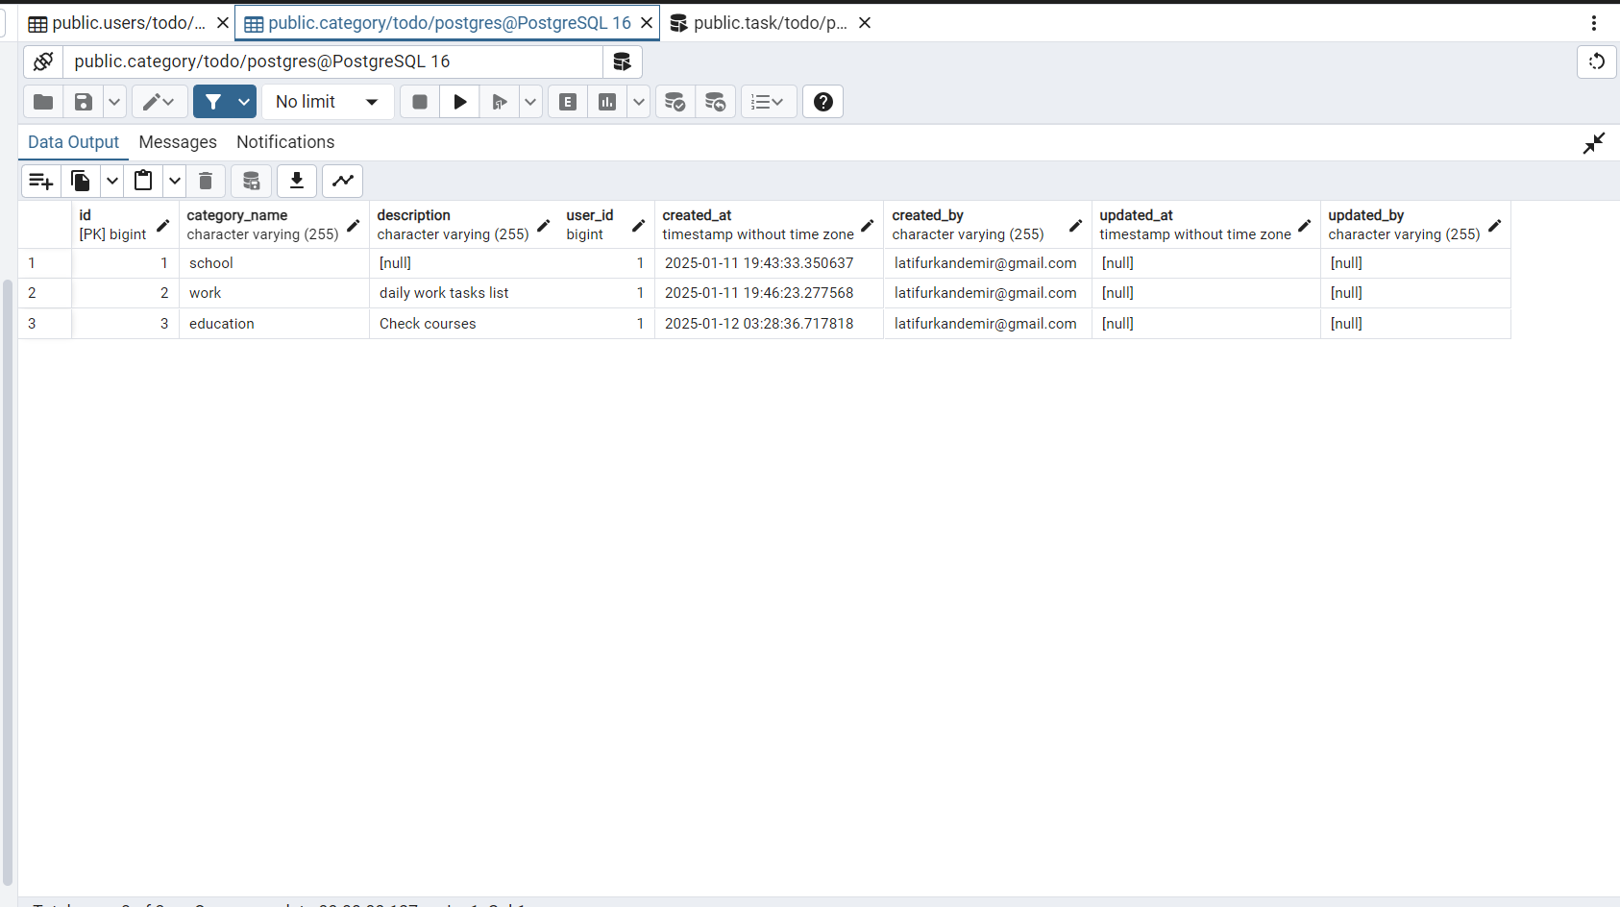

Slide 5
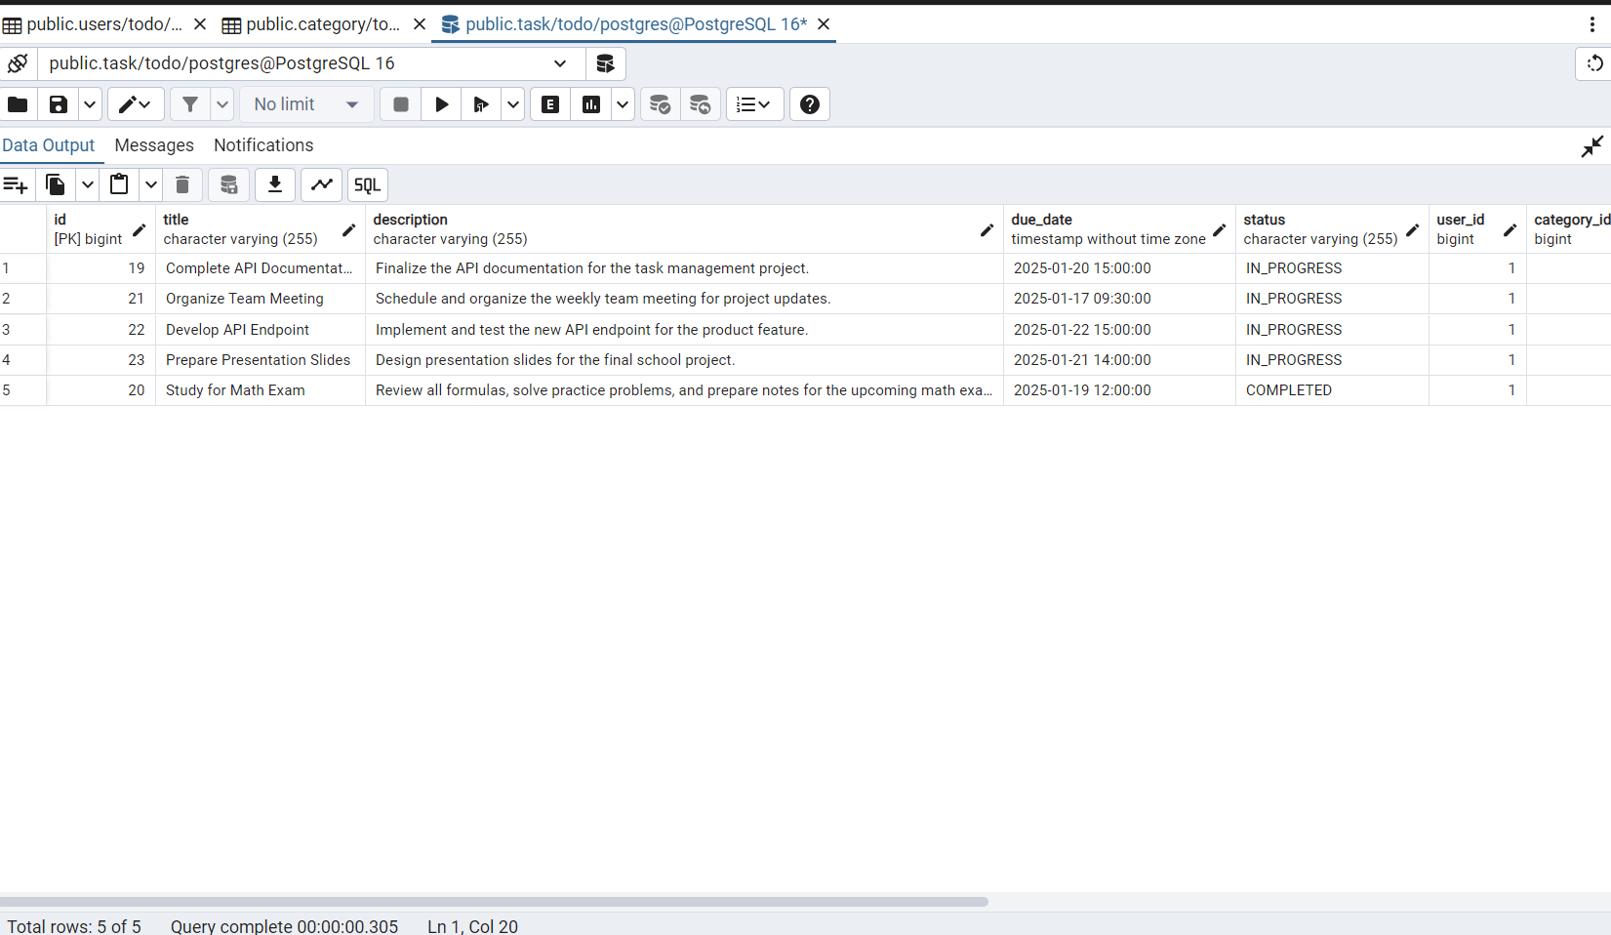

Slide 6
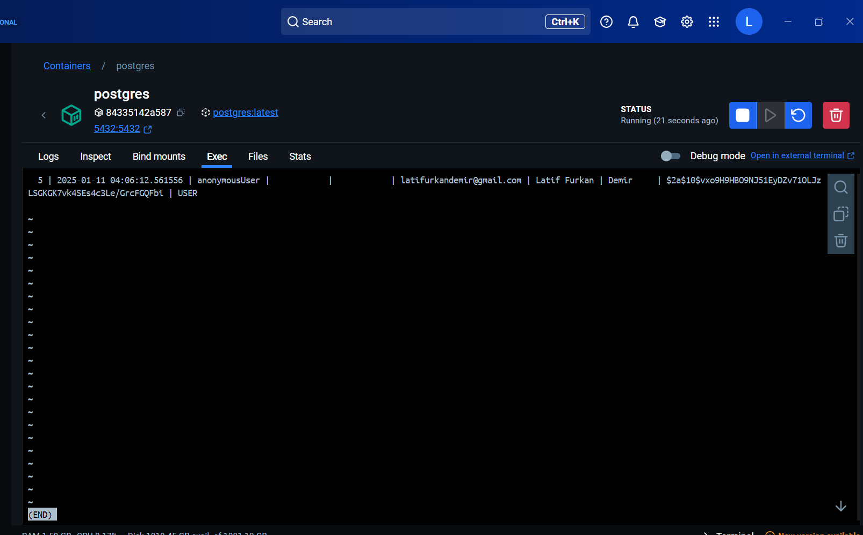

Slide 7
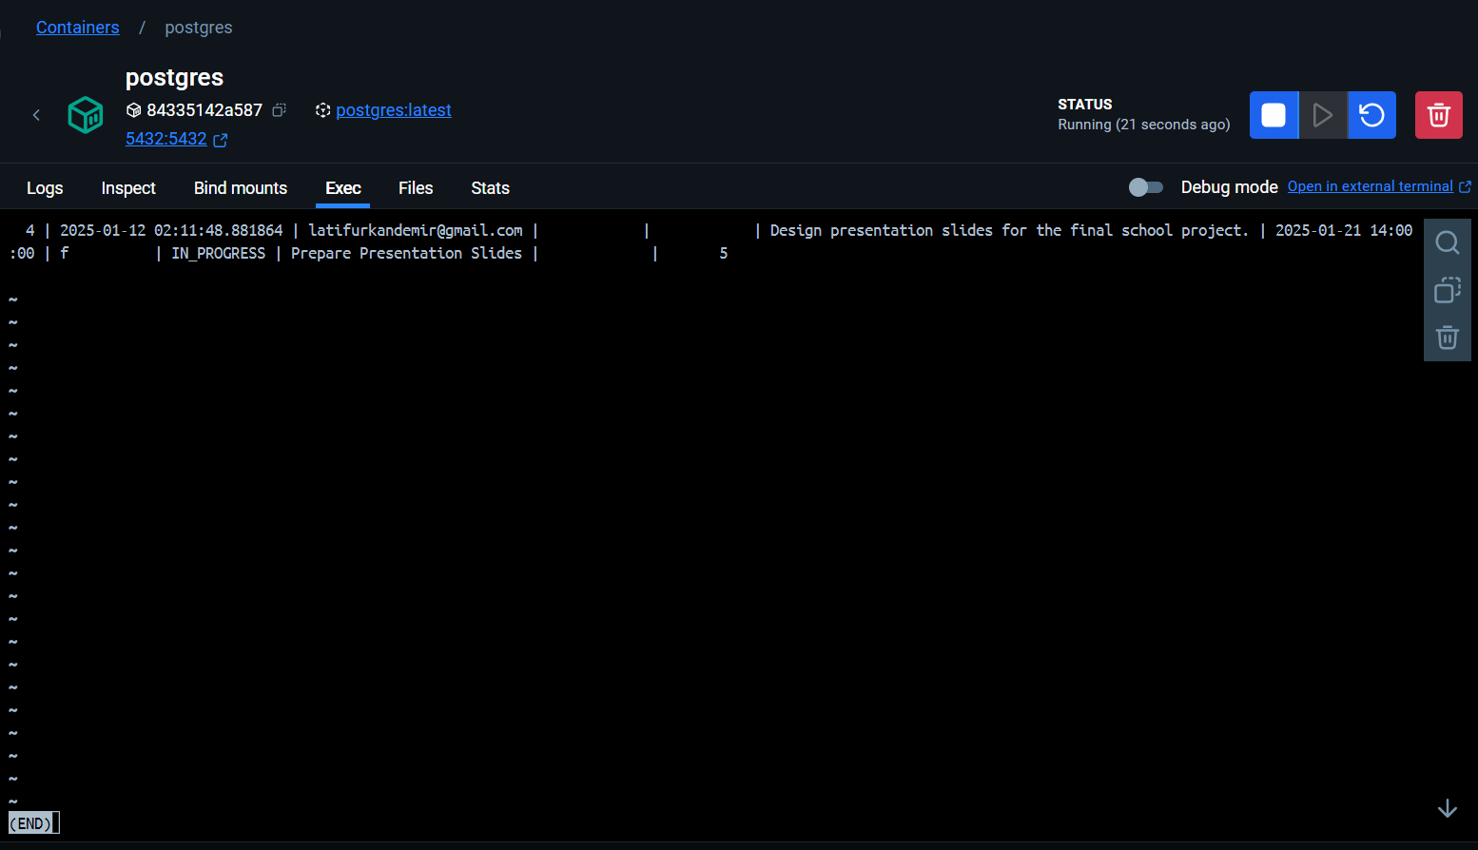

Slide 8
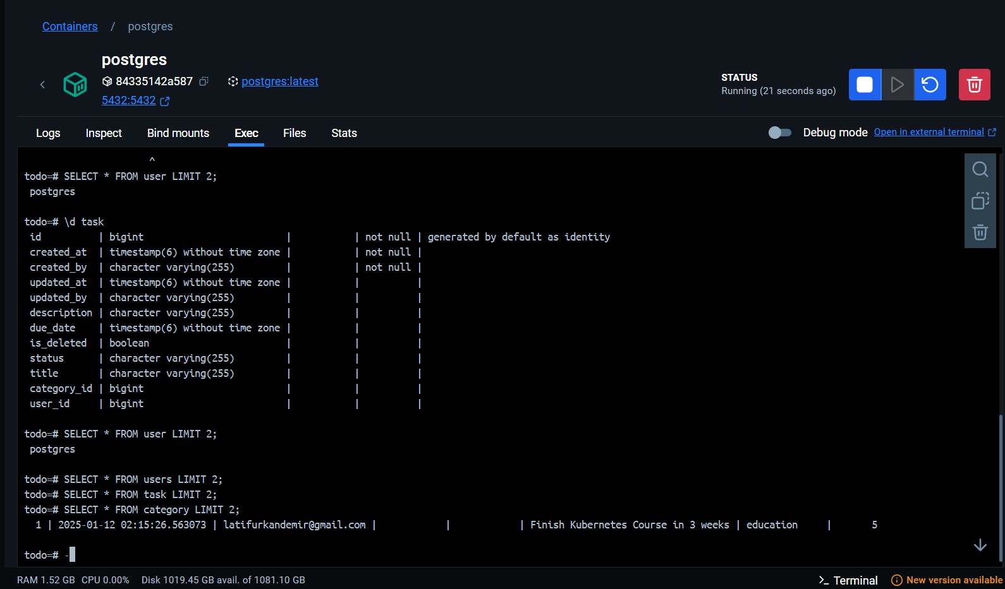

Slide 9
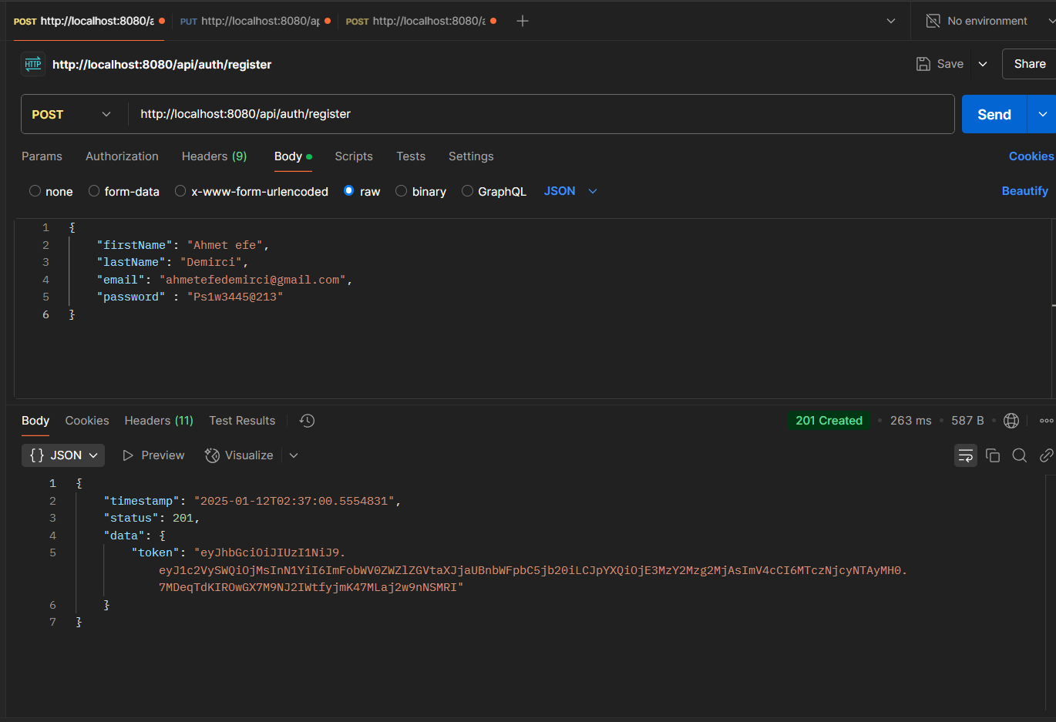

Slide 10
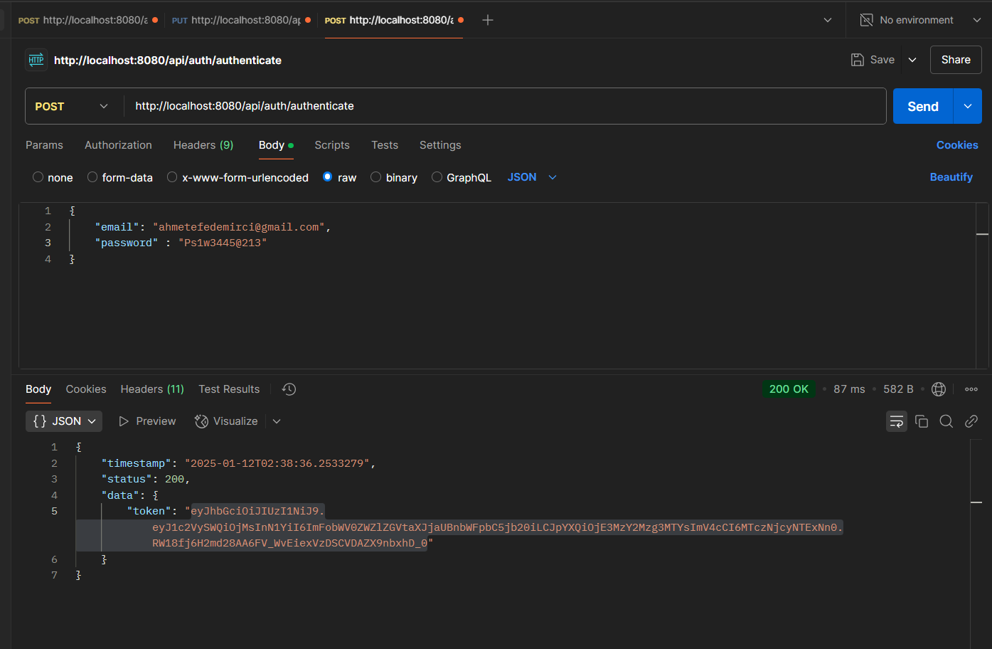

Slide 11
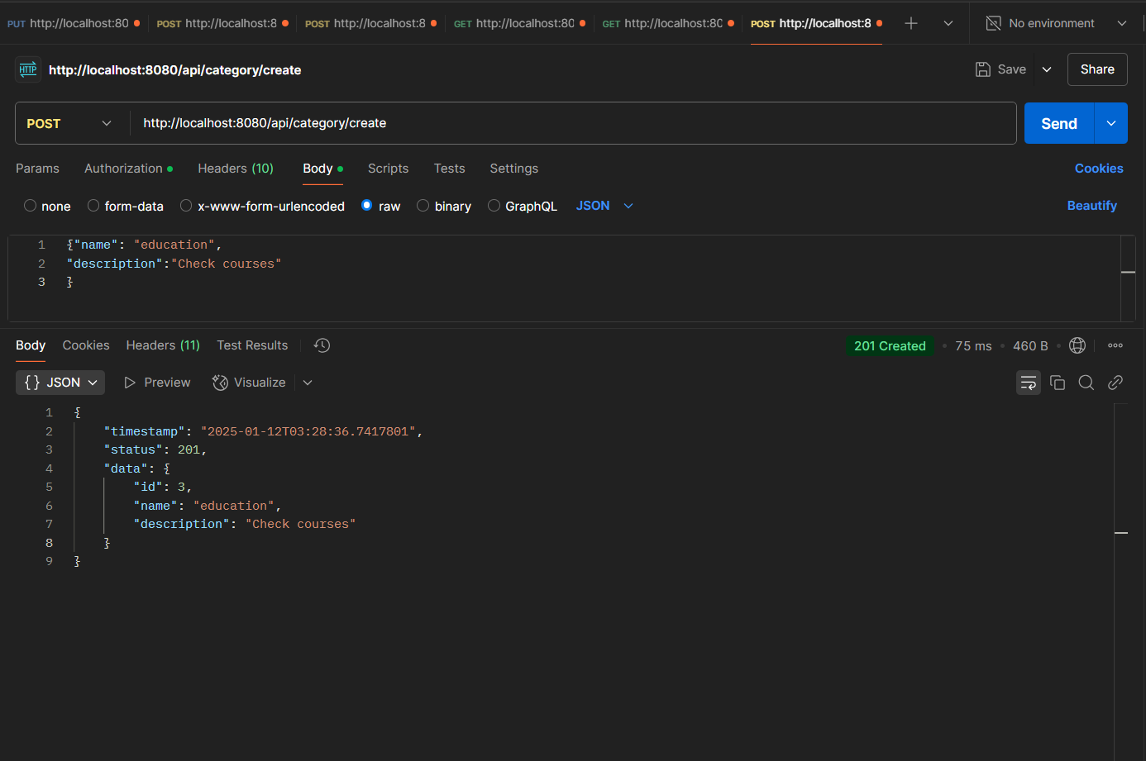

Slide 12
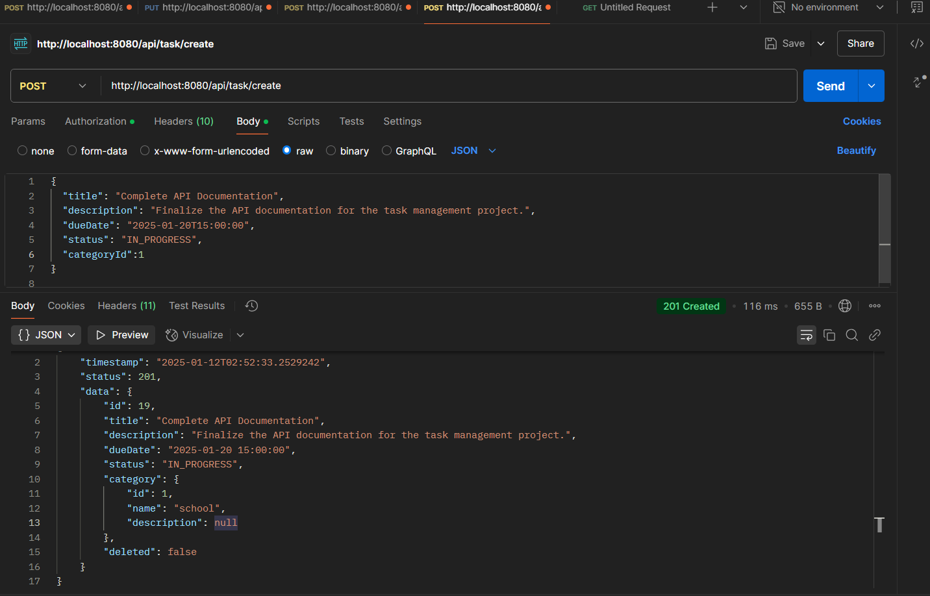

Slide 13
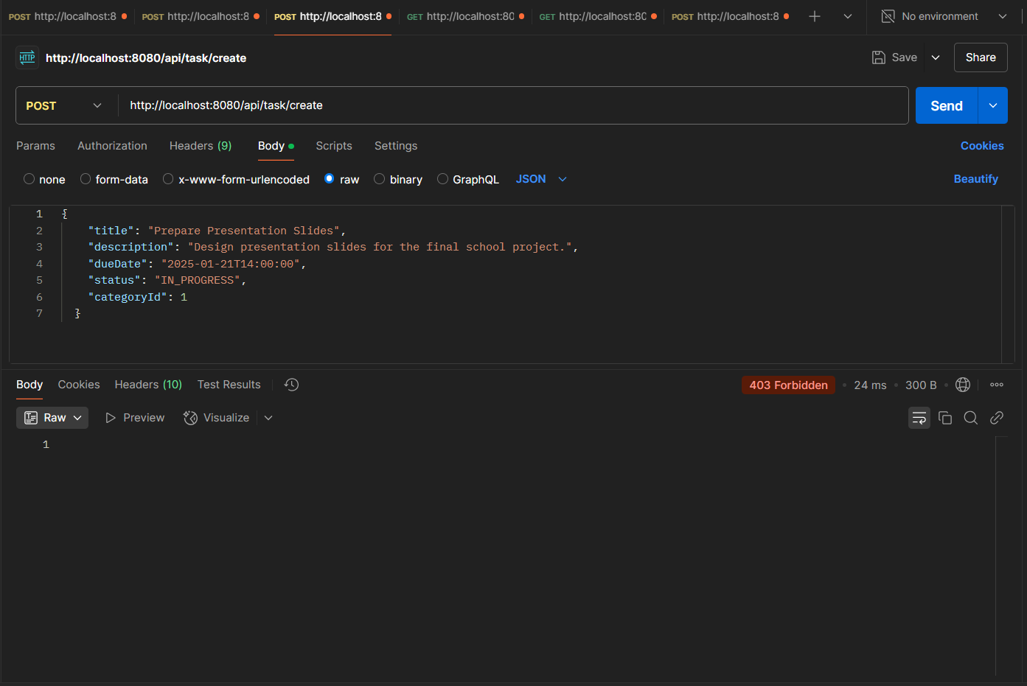

Slide 14
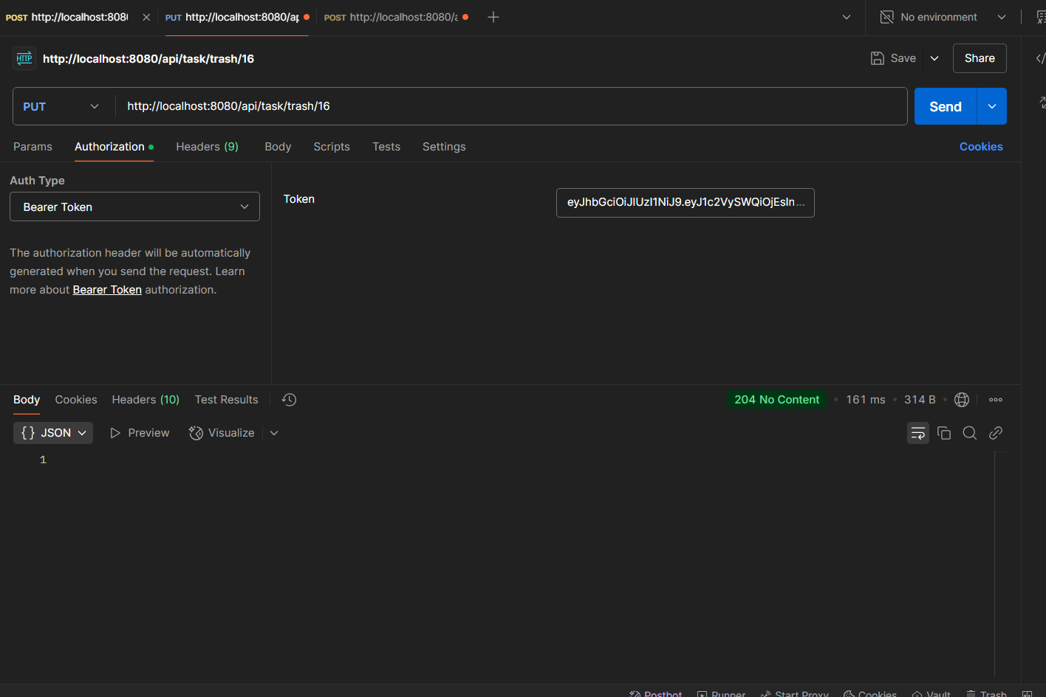

Slide 15
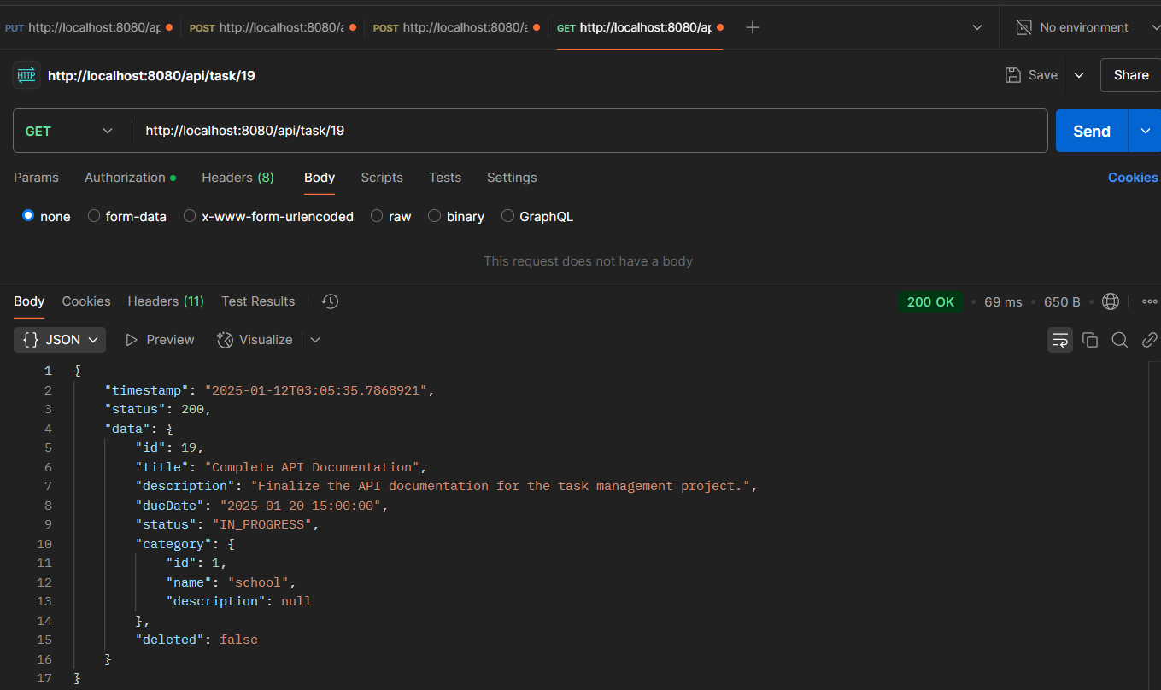

Slide 16
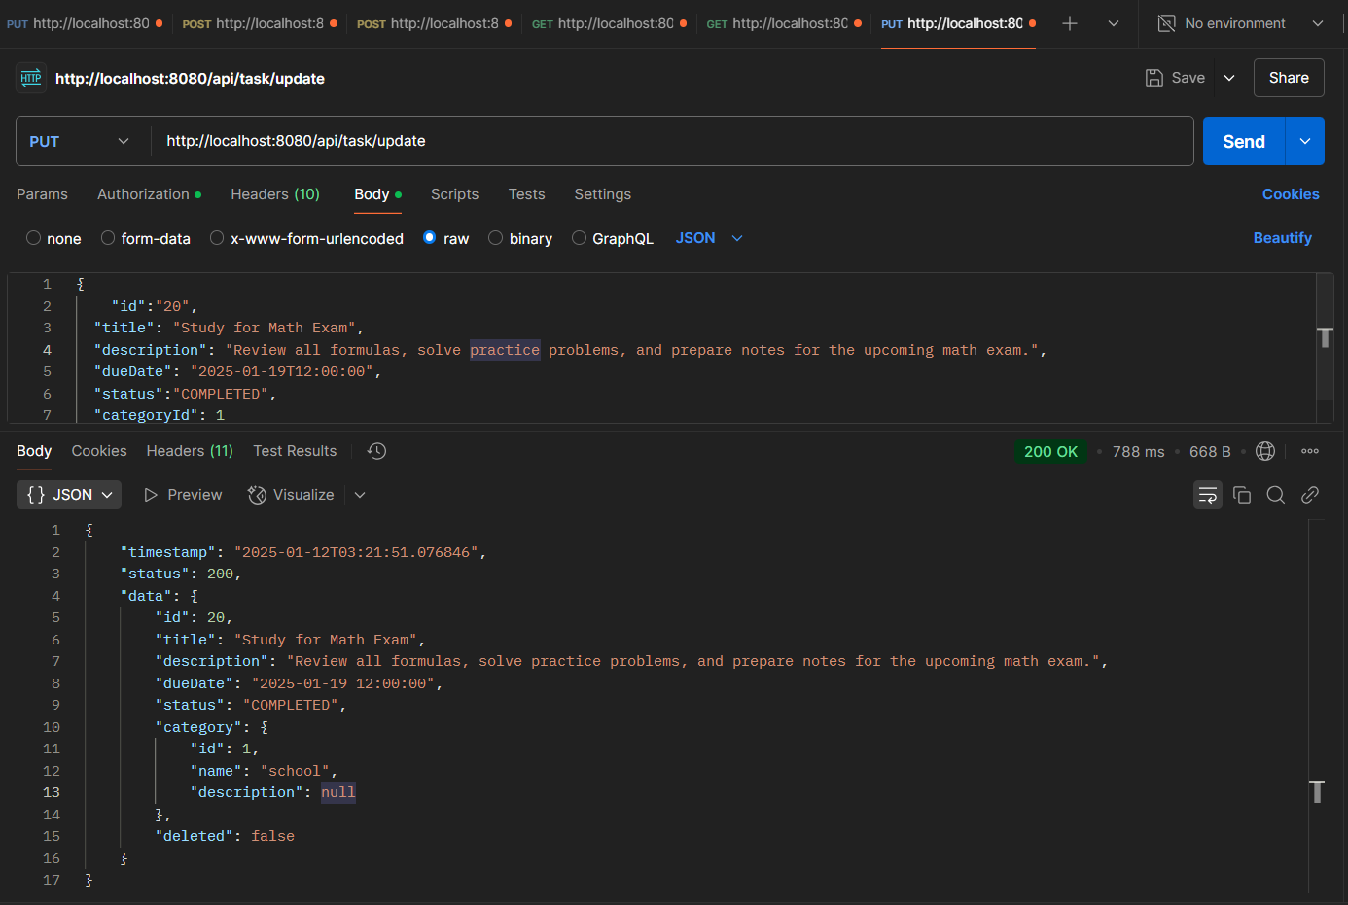

Slide 17
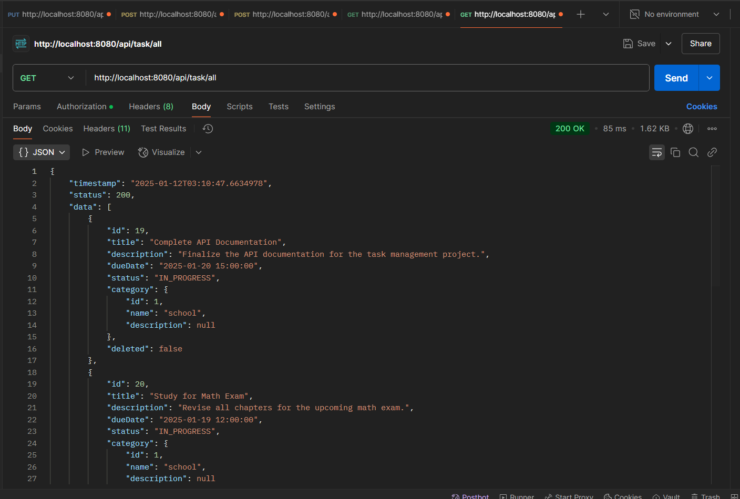

Slide 18
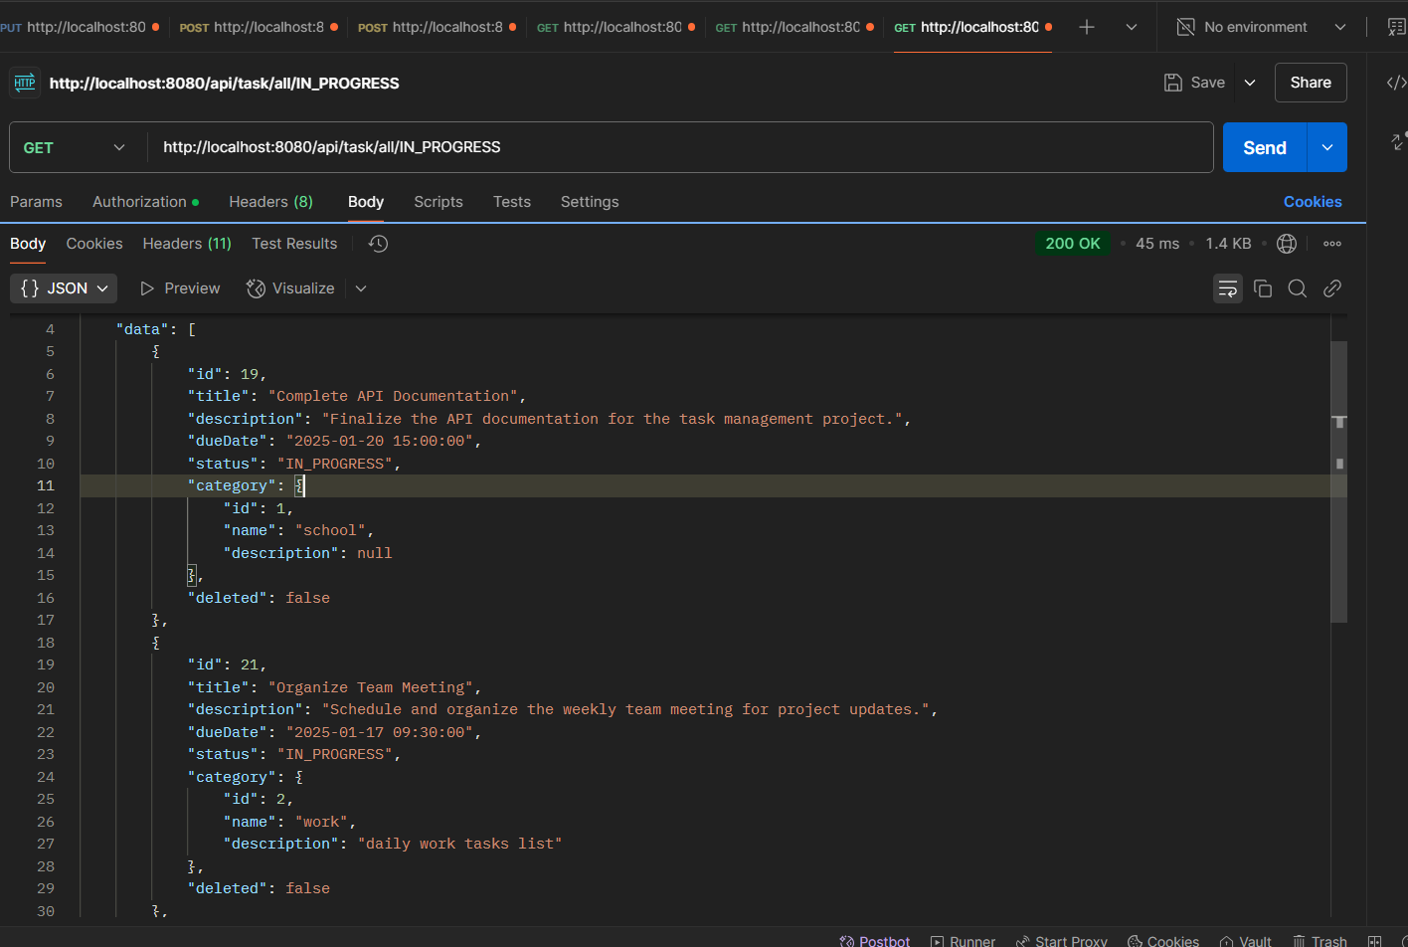

Slide 19
İZLEDİĞİNİZ İÇİN TEŞEKKÜRLER

