Slide 1
Possible Sources of Anomaly

Slide 2
Random noise
Systematic noise
Data quality ( Checksum)

Slide 3
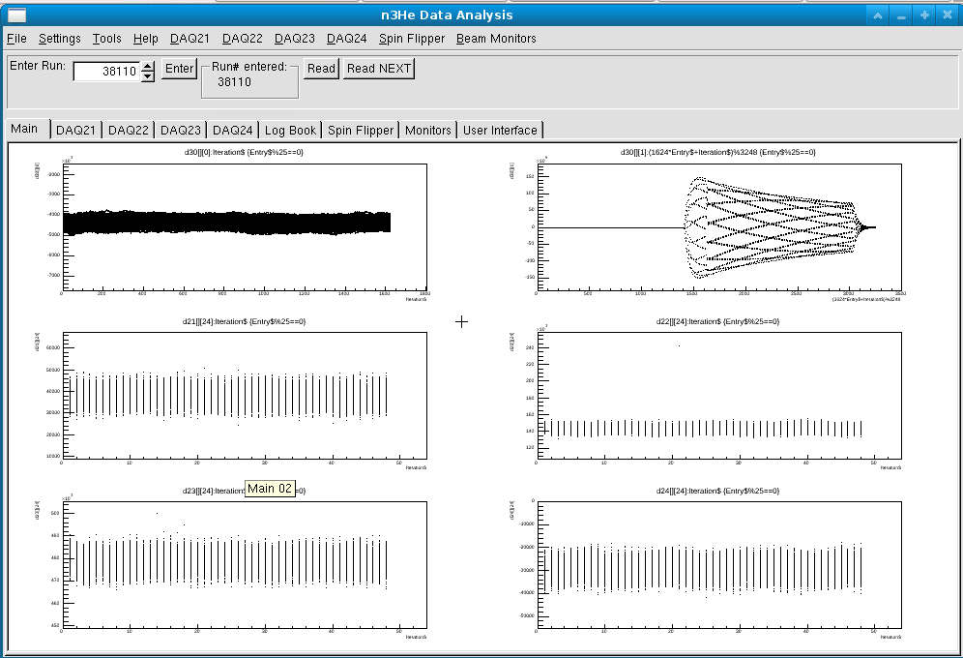
Random noise

Slide 4
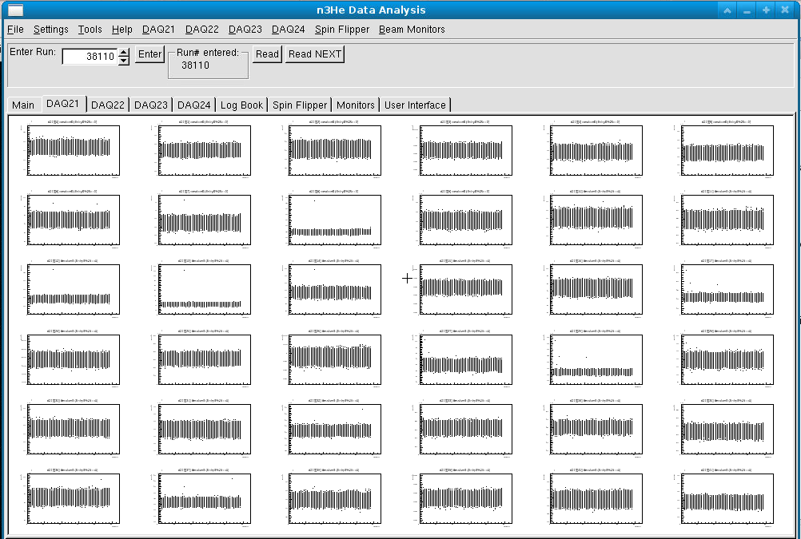

Slide 5
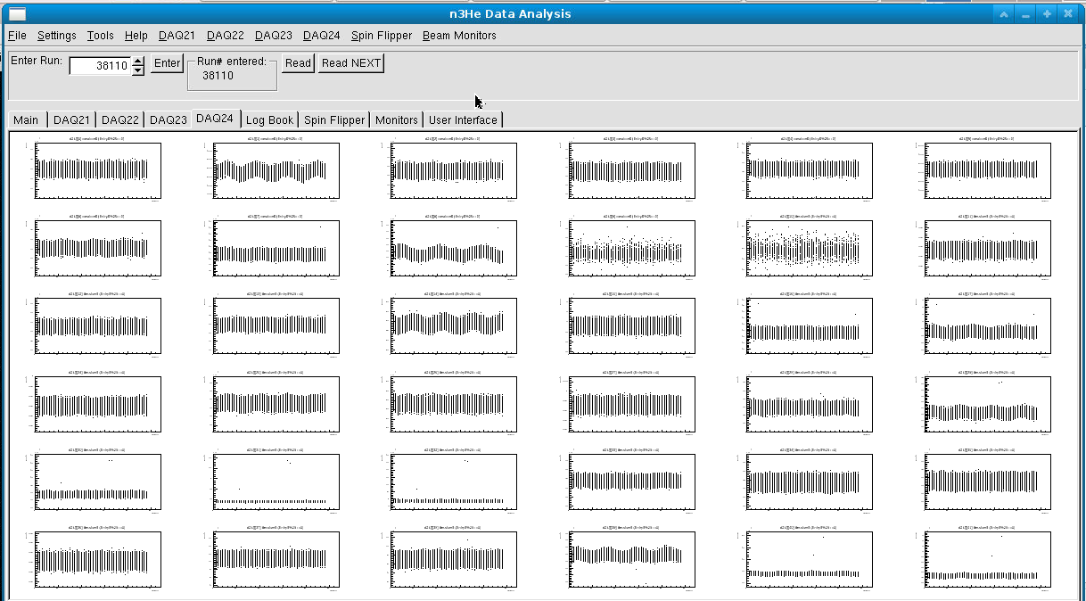

Slide 6
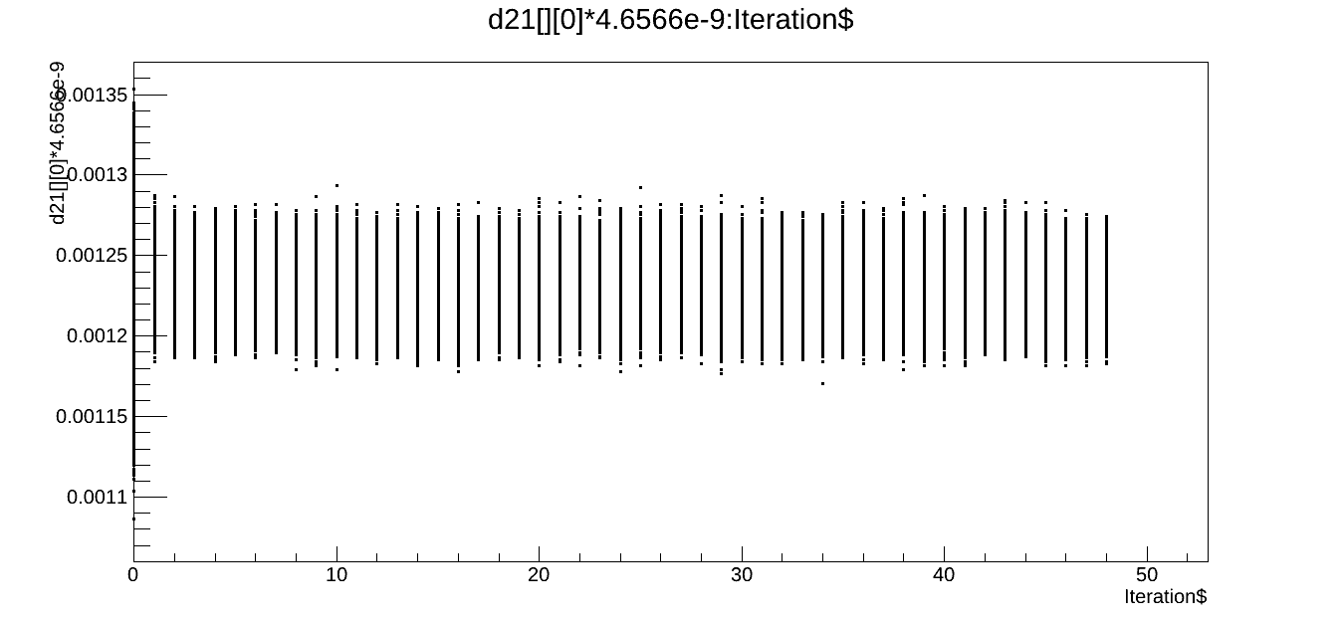
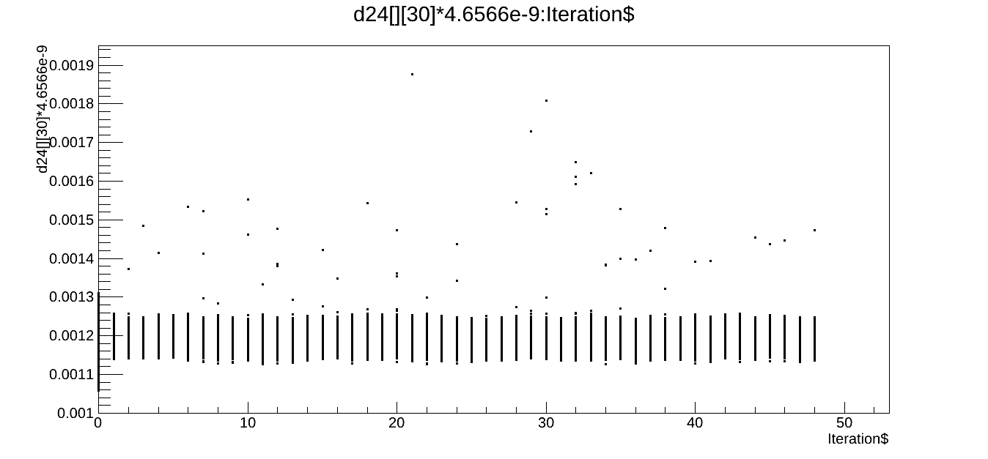

Slide 7
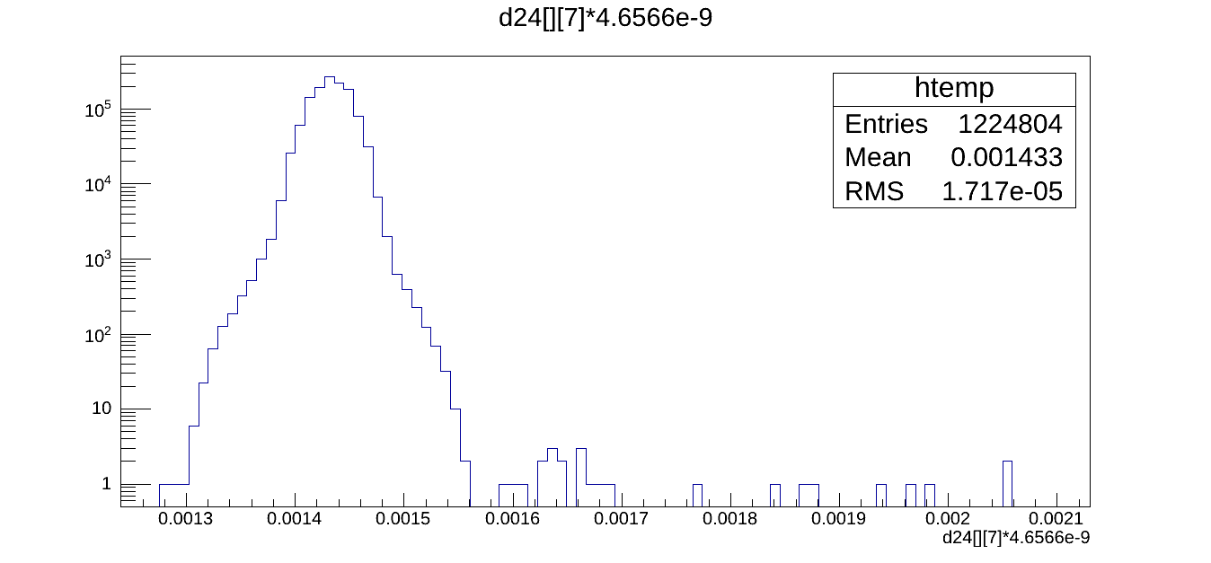
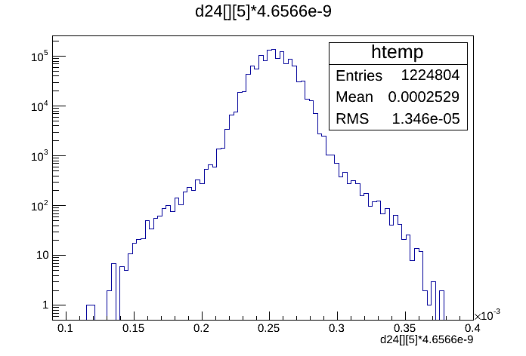

Slide 8
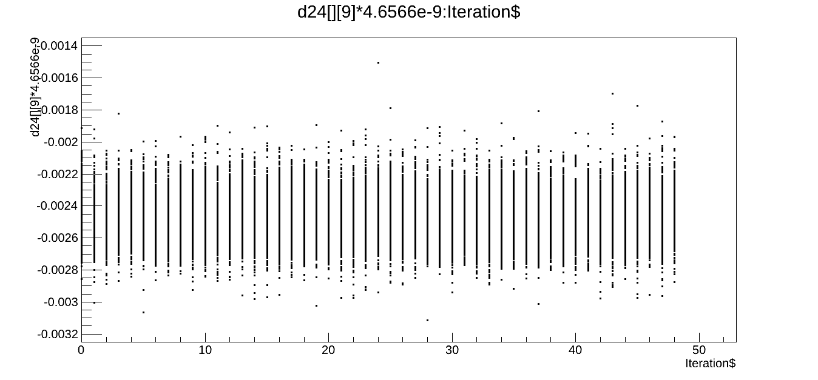
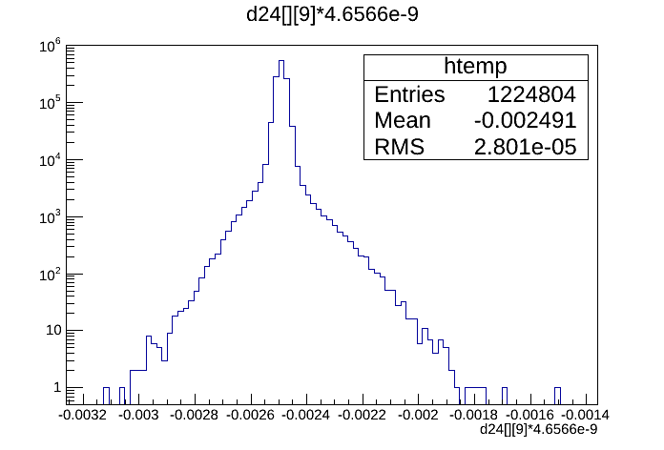

Slide 9
Systematic noise

Slide 10
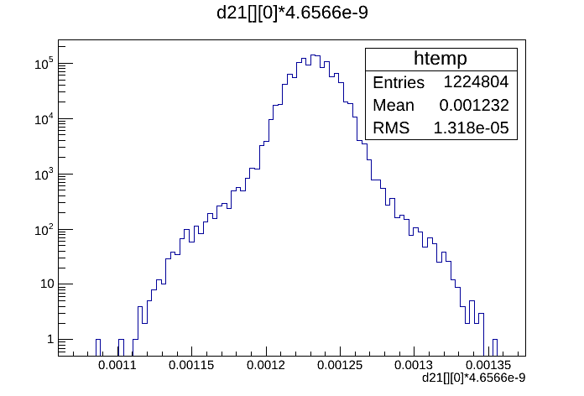
Full time bin window

Slide 11
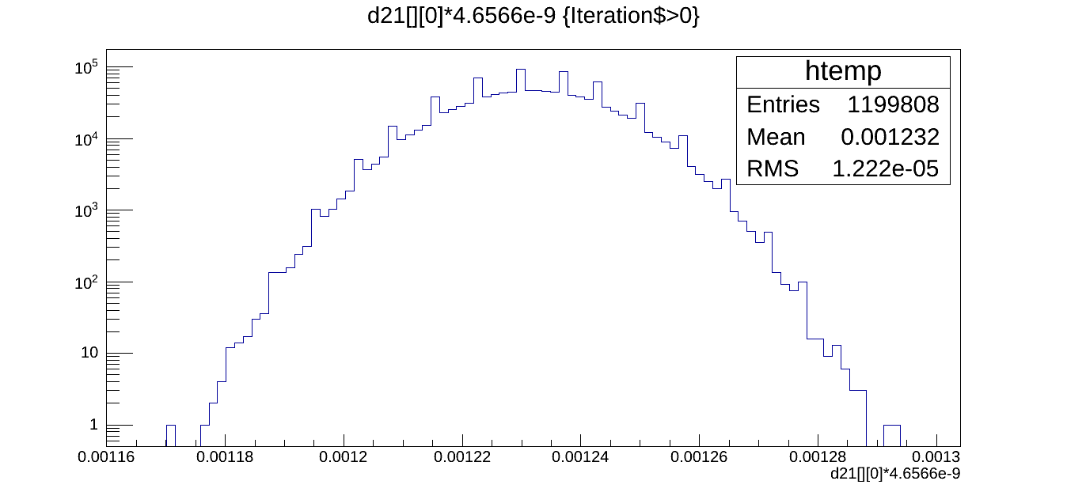
Selected time bin window

Slide 12
Data Quality (Checksum)
No bad checksum found so far.

Slide 13
LR vs UD Data set
Choppers settings were different.
Target has been rotated.
Beam power was low for LR.
In LR data has much less noise compared to UD data set(3 ch vs 16 ch).

