Slide 1

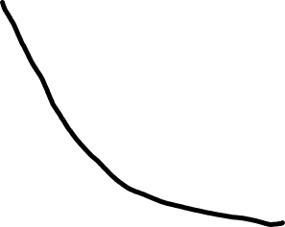




Word-wise error
ADAM
SGD
LBFGS
Number of effective pass

