Slide 1

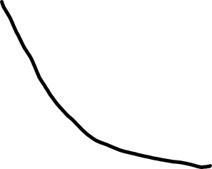




Training objective value
ADAM
SGD
LBFGS
Number of effective passes

