Slide 1
Sunset Summit Gated Community – Software Application
A capstone project by:
Marlon Ramos, Jose Lara and Charles Henderson

Slide 2
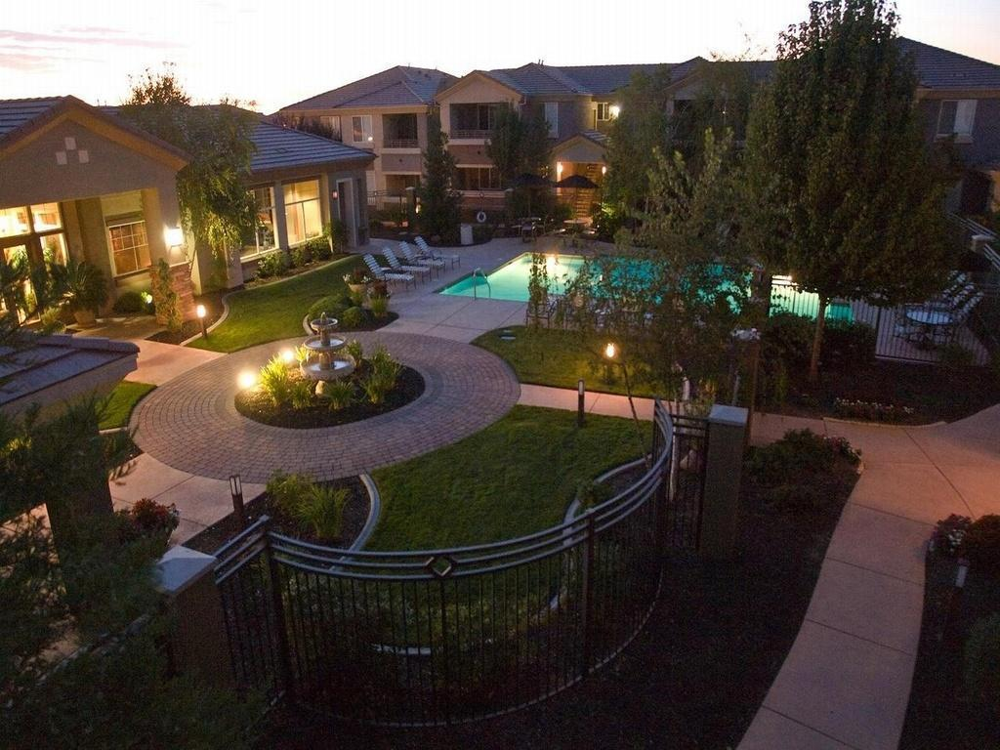
Table of Contents
Sunset Summit Gated Community Overview
Software Requirements Specifications
Use-Case Diagram
Entity Relationship Diagram (ERD)
User Interface Prototypes
Application Live Presentation

Slide 3

Sunset Summit Gated Community Overview
Sunset Summit Gated Community is a residential community
Current software application is archaic and obsolete
Advantages to upgrading software application:
  Cost-effectiveness
  Data organization
  Data integrity
  User-friendliness

Slide 4
Software Requirement Specifications (SRS)
Utilize Agile Software development lifecycle
SRS Overview
Sunset Summit Gated Community Use-Case Diagram
User Interface Prototypes
Concept
Iteration (-1)
Identify Concepts
Develop Initial Vision
Inception
Iteration (0)
Initial Requirements
Active Stakeholder participation
Construction
Iteration (N)
Deliver the working system
Initial Architecture
Transition
Iteration (N)
Production
Release Iteration (N)
Evolution with stakeholder input
Pilot test the application
Deployment of the system into production
Operate and Support the deployed system
Identify the bugs of the system and possible solutions
Agile Software Development Lifecycle
Iteration (N + 1)

Slide 5
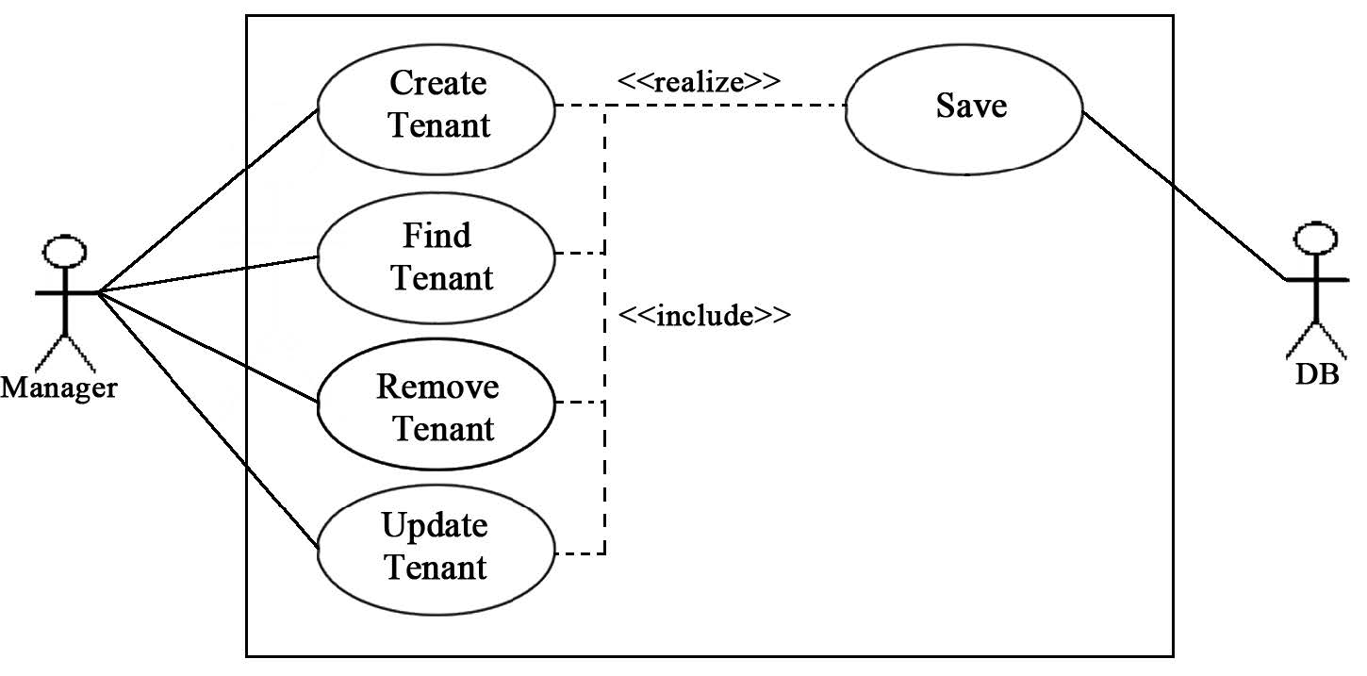
Use-Case Diagram
A Use Case Diagram visualizes the
functional requirements
Actors (An entity that interacts with
the system):
  Manager
  Resident
  SSGC Database
Use Cases (The action the is produced as a
result of the interaction with an Actor):
  Create
  Find
  Remove
  Update
  Save

Slide 6
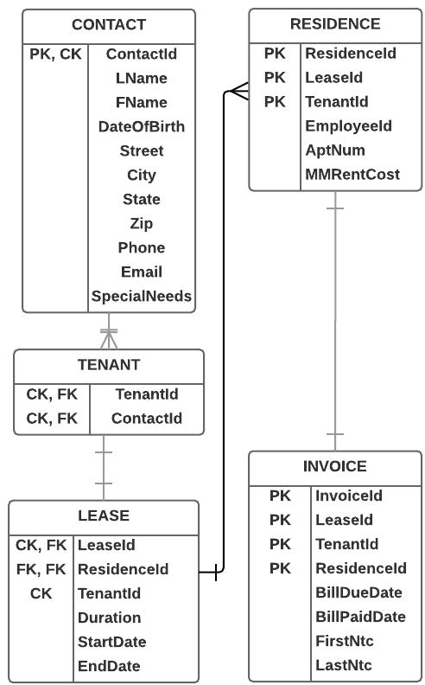
Entity Relationship Diagram (ERD)
Visualizes the relationships between the entities within the Database
Shows the flow of the application from contact to invoice
The entities established in the database are:
  Contact
  Tenant
  Lease
  Residence
  Invoice

Slide 7
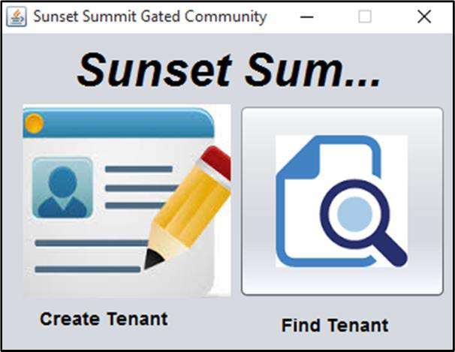
User Interface Prototypes - Home
Main Graphical User Interfaces
Home
  Allows user to choose to create
  or find tenant
Create Tenant
  Allows employee to input all
  necessary data for that tenant
Find Tenant
  Allows employee to find, update,
  or show more information on the
  tenant.
  All wanted information will be displayed
  on the table below the input fields

Slide 8
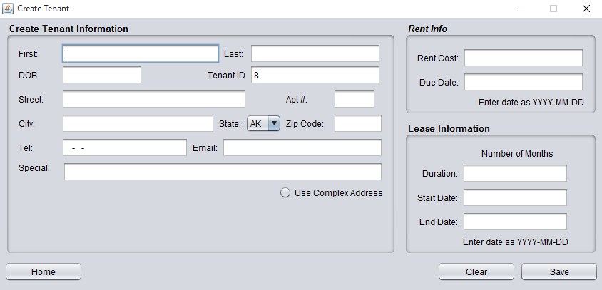
User Interface Prototypes – Create Tenant
Main Graphical User Interfaces
Home
  Allows user to choose to create
  or find tenant
Create Tenant
  Allows employee to input all
  necessary data for that tenant
Find Tenant
  Allows employee to find, update,
  or show more information on the
  tenant.
  All wanted information will be displayed
  on the table below the input fields

Slide 9
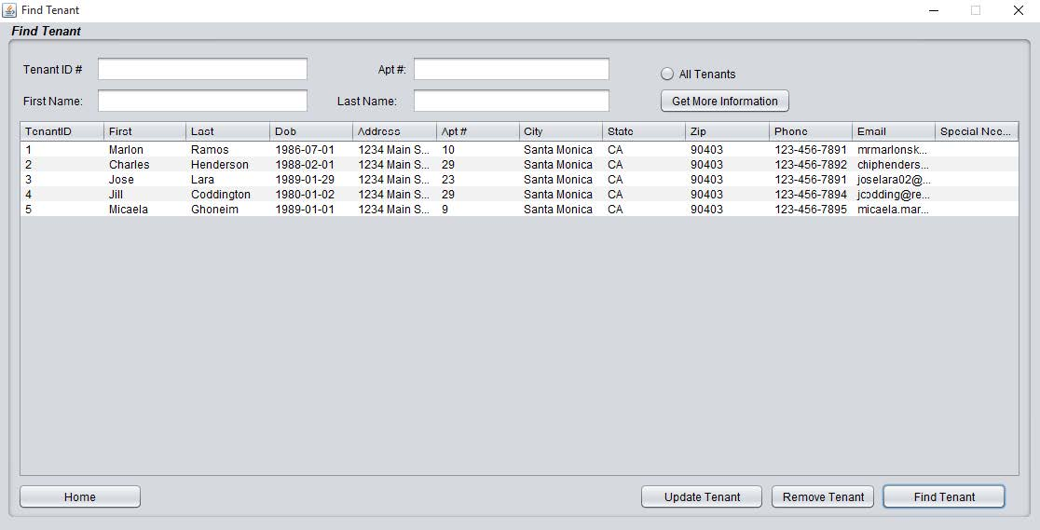
User Interface Prototypes – Find Tenant
Main Graphical User Interfaces
Home
  Allows user to choose to create
  or find tenant
Create Tenant
  Allows employee to input all
  necessary data for that tenant
Find Tenant
  Allows employee to find, update,
  or show more information on the
  tenant.
  All wanted information will be displayed
  on the table below the input fields

Slide 10
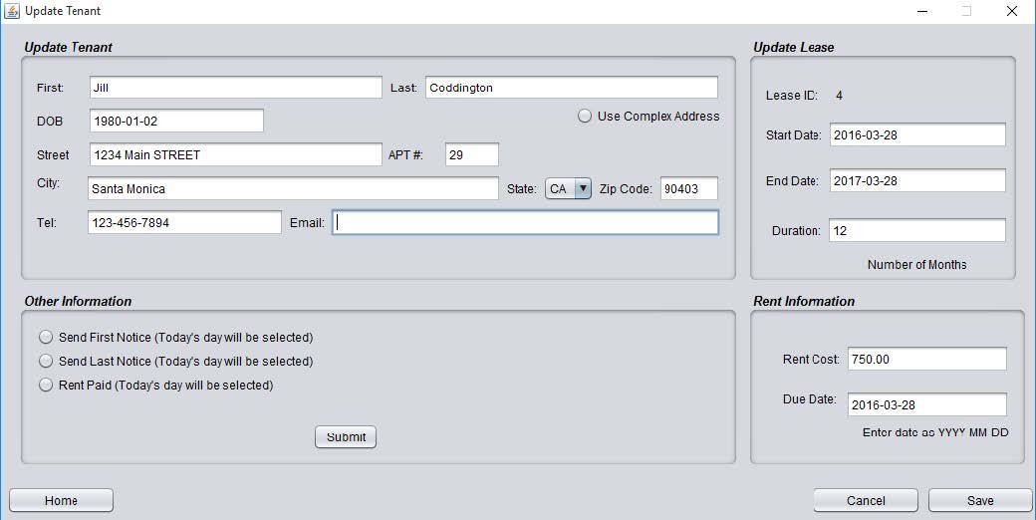
User Interface Prototypes – Update Tenant
Main Graphical User Interfaces
Update Tenant
  Will allow for change of a tenants
  information
Get More Information
  Will bring up leasing information
  of the tenant.

Slide 11
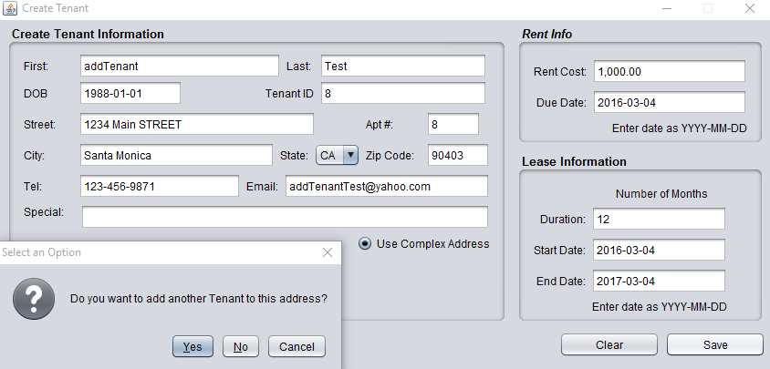
User Interface Prototypes – Add Tenant
Main Graphical User Interfaces
Update Tenant
  Will allow for change of a tenants
  information
Get More Information
  Will bring up leasing information
  of the tenant.

Slide 12
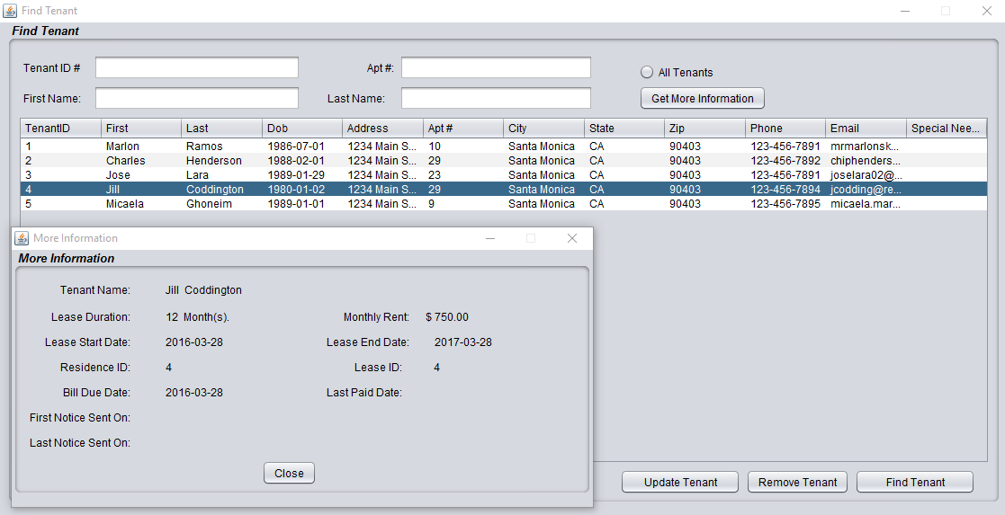
User Interface Prototypes – More Tenant Information
Main Graphical User Interfaces
Update Tenant
  Will allow for change of a tenants
  information
Get More Information
  Will bring up leasing information
  of the tenant.

Slide 13
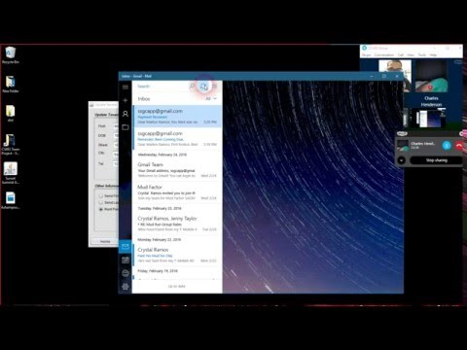
Application Live Presentation

Slide 14
Thank You For Your Time

