Slide 1
Demand Forecasting and Inventory Optimization
Strategy
Lighthouse Labs - Final Project
My name is Lat Leger, and prior to Lighthouse Labs, I worked in business development, project management, and logistics within the B2B Wholesale realm. My key focal point? Demand forecasting and inventory optimization for various projects. I grasp the significance of managing costs and the diminishing worth of stagnant inventory.
Notes:
My name is Lat Leger. Prior to Lighthouse Lab I worked in the B2B Wholesale industry.
My key focal point? Demand forecasting and inventory optimization for various projects.
I wanted to marry my years of experience and what I have learned in this boot camp to be able to provide a strategic solution for businesses,
so they can help their customers more efficiently.

Slide 2

Demand Forecasting and Inventory Optimization
Strategy
Notes:
- I have been working together with City Cyclery in Windsor, ON.
- They offer services for bicycles, including sales, service, and repair.
- With a wide selection of over 5,000 parts and accessories,
- City Cyclery has kindly provided their live data for this project.

Slide 3
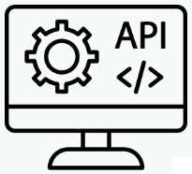



Next steps:
Our journey doesn't end here – it's only the beginning. We're stepping it up and adding APIs and automation to make our inventory seamless.
Notes:
- I will be helping them optimize their Demand Forecasting and Inventory Optimization Strategy.
- Our journey starts here – it's only the beginning. We're stepping up our Inventory Management game, optimizing safety stock, reorder points, and order quantities.
Our plan is to:
Implement APIs, like RESTful API to access required data.
Integrate email notifications, using Python libraries like “smptlib” to send emails.
Schedule automation by using CRON scheduler.
Continuously test and monitor our demand forecasting and inventory optimization model.

Slide 4

motivation:
Our Motivation:
Demand Forecasting and precise Inventory Optimization for cost reduction and customer satisfaction.
Notes:
We're tackling two challenges:
precise Demand Forecasting and
efficient Inventory Optimization.
Our goal is to minimize costs, ensure customer satisfaction, and reveal valuable insights from data analysis.
We are also attempting to forecast quantities one week in advance.
Reducing the purchasing from daily to once a week.

Slide 5
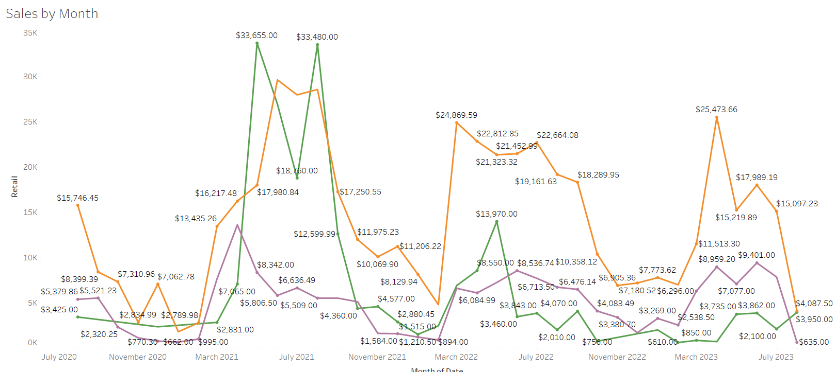
Our data:
First Glance:
3 years of data
Significant seasonality
Product is the most sold category
Data was in multiple .csv files
Needed significant feature engineering
Notes:
- We used Tableau to make some preliminary exploratory discoveries on the raw data.
- We are using Prophet and SARIMA models for this time series data since both are good for analyzing and predicting data with strong seasonality.
- Python, along with visualization libraries like Matplotlib and Plotly, for data processing and visualizations.
- With peaks representing each prime season.

Slide 6
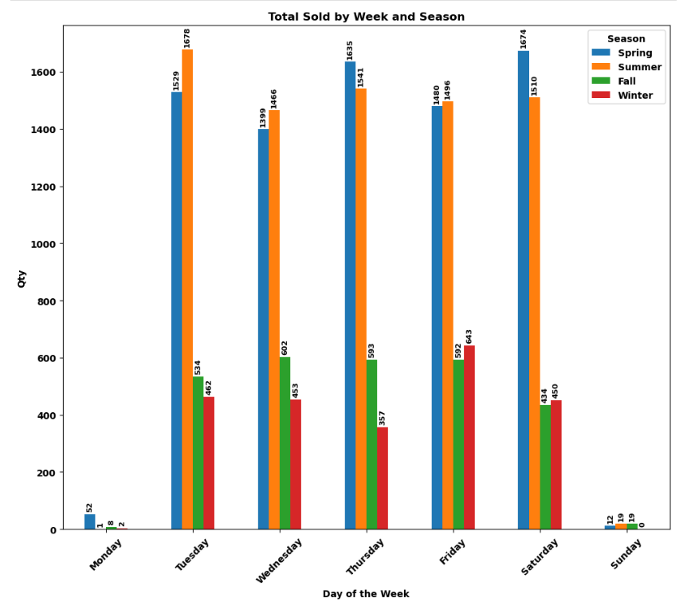
In this chart, we can see how seasonality impacts sales. As expected, the Spring and Summer seasons have the most impact on the quantity sold.
Notes:
- The chart shows seasonality's impact on daily sales, with Blue and Orange columns affecting quantity more than Green and Red columns.
- Spring and Summer have the busiest days, with Tuesdays and Thursdays being the busiest.
- Fall has consistent sales, with Saturday being the slowest.
- Winter experiences a drop in sales, with Friday being the busiest day.

Slide 7
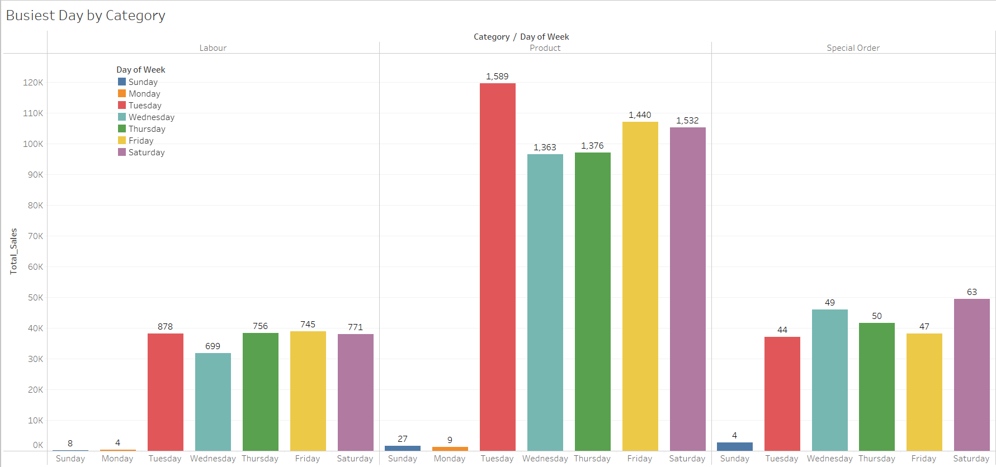
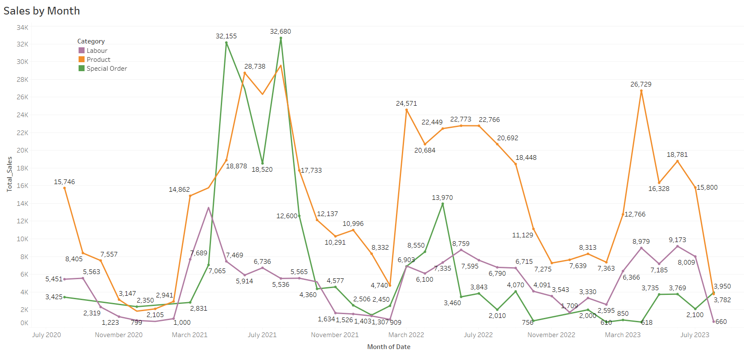
Schematics:
In this chart, we have broken down sales based on Labour, Product and Special Order categories.
Notes:
- In this chart, we have broken down sales based on Labour, Product and Special Order categories.
- However, since we are working on optimizing the in stock inventory, we will only be focusing on the Product category.

Slide 8
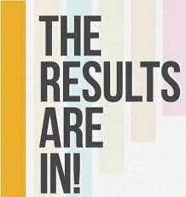
results:
Results:
Our hard work is paying off, and we've got the visuals to prove it. We have also used MAE, and RMSE to evaluate our models – we've got the acronyms and the numbers to back them up.
Notes:
- Our hard work has paid off, and we've got the visuals to prove it.
- Metrics don't lie, and we're showcasing our model's performance through a series of charts.

Slide 9
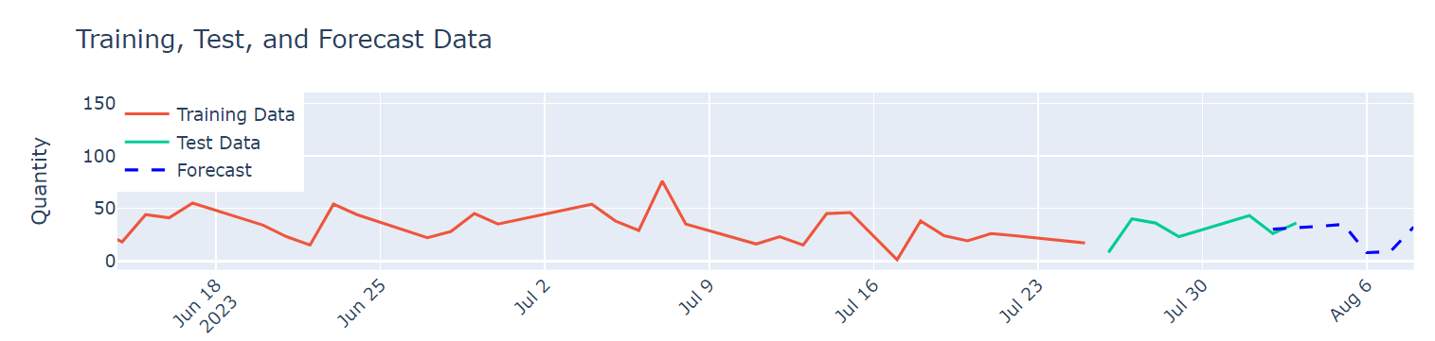
results:
Prophet Model
Notes:
- The Prophet model uses historical data to predict the units sold.
- If we look back, we know our two busiest days of the week are Tuesday and Thursday in the Summer months, which is reflected in the two spikes in Test data, shown in green.
- In the Forecast data, shown in blue, we can see a dip in quantities sold, because those are the two days we are closed.

Slide 10
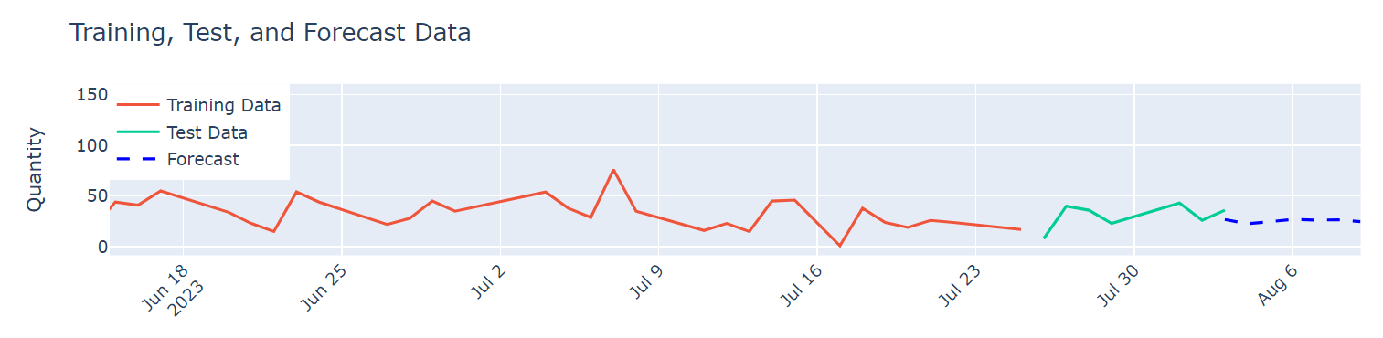
results:
SARIMA Model
Notes:
The SARIMA model uses historical data, as well.
We can see in the Forecast data, also shown in blue, the units sold do not reflect the business being closed.
The model did not account for this trend.

Slide 11
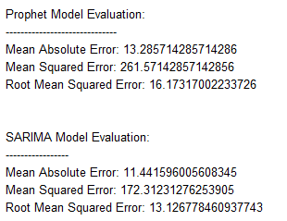
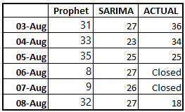
results:
Notes:
After performing model evaluations, we assumed the SARIMA model would provide a more realistic prediction, based on the results of our evaluations.
However, when we compared the results with the actual quantities sold the following week, we see the Prophet model yielded more accurate results and accounted for the shop being closed on Sunday and Monday.
We will have to do more predictions to confirm our results.

Slide 12

Navigating Challenges:
Challenges:
Predicting the future involves a complex dataset influenced by weather, seasonality, and external variables, but our approach ensures accuracy and adaptability.
Notes:
However, let's be real – predicting the future isn't all sunshine and rainbows.
Our dataset dances to its own rhythm, influenced by various factors but we're up for the challenge!
We're exploring every avenue, including external variables like weather patterns and neighbourhood events, to elevate the accuracy of our forecasts.

Slide 13

Conclusions :
Our Conclusions:
So, what's the verdict? The journey thus far has been illuminating, but not perfect predictions yet. Embracing challenges, learning from twists, and using knowledge to steer the ship towards success, our model is getting closer.
Notes:
So, what's the verdict?
Our journey so far has been illuminating.
But we'll admit we haven't cracked the code of perfect predictions just yet.
We're embracing the challenges, learning from every twist and turn, and using that knowledge to steer our ship toward success.
And while our model may not be a crystal ball, it's getting pretty close!

Slide 14
Thank you
Thank you!
Notes:
- Our voyage is ongoing, steering toward success, one prediction at a time. Thank you.

