Slide 1

SQL PROJECT WEEK 2

Slide 2
E-Commerce Databases
1. Review and understand data:
- I started comparing column information from the various tables
- I reviewed data types, to see if they make sense.
- I reviewed project questions to ensure I focused on cleaning important information first.

Slide 3
E-Commerce Databases
2. Clean and transform Data
- I looked for NULL values and decided if they should be removed or converted.
- I found duplicate values and decided if they should be removed.
- I checked if columns were formatted with correct data types.
- I formatted data within columns, ie. prices had two decimal points, cities and countries has proper capitalization, etc.

Slide 4
E-Commerce Databases
3. Develop insights
- Because there was so much information, I focused on the questions required.
- From there I grouped relevant information together into a smaller table and cleaned the data.
- Once I cleaned the data, I started to see more relevant information when I continued to clean additional data

Slide 5
Which cities and countries have the highest level of transaction revenues on the site?
The cities and country who have the highest level of transaction revenue on the site are varying States, Mountain View, Salem, New York and Sunnyvale. All of the top cities are in the United States

Slide 6
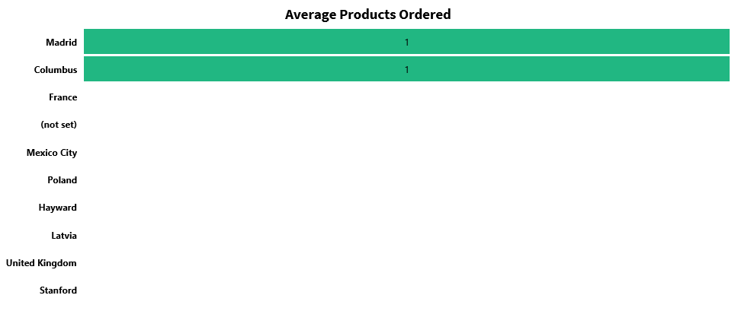
What is the average number of products ordered from visitors in each city and country?
Visitors in Columbus, USA and Madrid, Spain buy an average of one item.

Slide 7
Is there any pattern in the types (product categories) of products ordered from visitors in each city and country?
City | Country | Productcategory | Count
United States | United States | Home/Nest/Nest-USA/ | 3
Mountain View | United States | Home/Nest/Nest-USA/ | 3
United States | United States | Electronics | 2
United States | United States | ${escCatTitle} | 2
Canada | Canada | ${escCatTitle} | 1
Canada | Canada | Home/Apparel/Kid's/Kids-Youth/ | 1
Canada | Canada | Home/Shop by Brand/YouTube/ | 1
Chicago | United States | Lifestyle | 1
Colombia | Colombia | Home/Apparel/Men's/Men's-T-Shirts/ | 1
Columbus | United States | (not set) | 1
Dallas | United States | Home/Shop by Brand/YouTube/ | 1
Detroit | United States | Drinkware | 1
Dublin | Ireland | Home/Bags/ | 1
Finland | Finland | ${escCatTitle} | 1
France | France | Headgear | 1
Houston | United States | ${escCatTitle} | 1
Los Angeles | United States | Home/Apparel/Men's/Men's-Outerwear/ | 1
Madrid | Spain | ${escCatTitle} | 1
Mexico | Mexico | (not set) | 1
Mountain View | United States | ${escCatTitle} | 1
Mountain View | United States | Apparel | 1
Mountain View | United States | Home/Apparel/Women's/Women's-Outerwear/ | 1
Mountain View | United States | Nest-USA | 1
New York | United States | ${escCatTitle} | 1
New York | United States | (not set) | 1
Customers from the United States purchased more electronics, than those outside of the United States

Slide 8
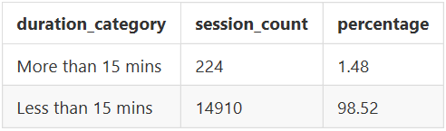
What is the relationship between time on site and revenue?
All sales happened within 15 mins of being on the site. Based on our queries, we can see most visitors log off after 15 mins as well. Only about 1.5% of visitors stay over 15 mins, but it does not result in sales.

Slide 9
Is there a relationship between stock levels and order quantity? How about lead times?
No, both order quantity and lead times do not affect stock levels.

Slide 10
E-Commerce Databases
QA Process:
As mentioned earlier, my main QA process was keeping track of all the changes I made in each table. I was continuously going back to check on my progress.
BEFORE – Analytics Table
AFTER – Analytics Table

