Slide 1

SQL PROJECT WEEK 2

Slide 2
E-Commerce Databases
Project Flow:
I reviewed the original data to see if there were any relationships that were evident at first glance. I noticed there was a lot of NULL data, that needed to be managed.
I reviewed the required questions to see how I could start understanding the data provided.
I started to clean my data of NULL values by creating queries in each table to filter NULL values in each column. When I completed a column, I would continue to run the query to ensure the number of NULL values were going down and the data still made sense.
I then looked possible duplicate information or column which were entirely NULL. I would review and possibly delete the columns.
I would start comparing columns with like titles to find relationships and possible KEYs.

Slide 3
E-Commerce Databases
..continued
Project Flow:
As I was removing NULL values, I would check if columns had the correct data types.
For the unit price and revenues columns, I had to change data types, remove NULLs and they /1000000. This provided the correct dollar amounts.
There was also several steps to ensure timeonsite, time, and vistiorstarttime were formatted correctly.
Once I cleaned all the data, I believed help me get the results I needed. I continued to clean the remaining data. So, I could find data queries.
I would like to thank my fellow students who have helped me understand and complete this project.

Slide 4
E-Commerce Databases
Project Discoveries:
Which cities and countries have the highest level of transaction revenues on the site?
What is the average number of products ordered from visitors in each city and country?
Is there any pattern in the types (product categories) of products ordered from visitors in each city and country?
What is the relationship between time on site and revenue?
Is there a relationship between stock levels and order quantity? How about lead times?

Slide 5
Which cities and countries have the highest level of transaction revenues on the site?
The cities and country who have the highest level of transaction revenue on the site are varying States, Mountain View, Salem, New York and Sunnyvale. All of the top cities are in the United States

Slide 6
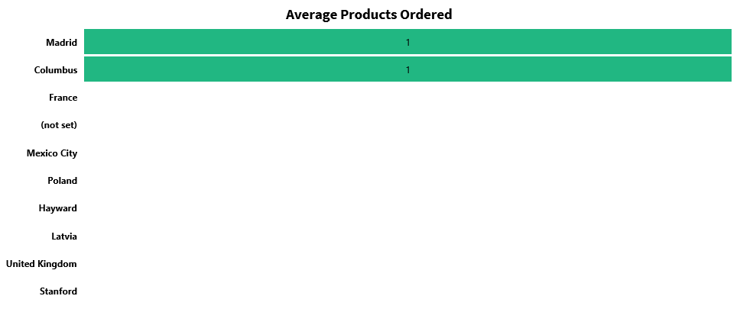
What is the average number of products ordered from visitors in each city and country?
Visitors in Columbus, USA and Madrid, Spain buy an average of one item.

Slide 7
Is there any pattern in the types (product categories) of products ordered from visitors in each city and country?
City | Country | Productcategory | Count
United States | United States | Home/Nest/Nest-USA/ | 3
Mountain View | United States | Home/Nest/Nest-USA/ | 3
United States | United States | Electronics | 2
United States | United States | ${escCatTitle} | 2
Canada | Canada | ${escCatTitle} | 1
Canada | Canada | Home/Apparel/Kid's/Kids-Youth/ | 1
Canada | Canada | Home/Shop by Brand/YouTube/ | 1
Chicago | United States | Lifestyle | 1
Colombia | Colombia | Home/Apparel/Men's/Men's-T-Shirts/ | 1
Columbus | United States | (not set) | 1
Dallas | United States | Home/Shop by Brand/YouTube/ | 1
Detroit | United States | Drinkware | 1
Dublin | Ireland | Home/Bags/ | 1
Finland | Finland | ${escCatTitle} | 1
France | France | Headgear | 1
Houston | United States | ${escCatTitle} | 1
Los Angeles | United States | Home/Apparel/Men's/Men's-Outerwear/ | 1
Madrid | Spain | ${escCatTitle} | 1
Mexico | Mexico | (not set) | 1
Mountain View | United States | ${escCatTitle} | 1
Mountain View | United States | Apparel | 1
Mountain View | United States | Home/Apparel/Women's/Women's-Outerwear/ | 1
Mountain View | United States | Nest-USA | 1
New York | United States | ${escCatTitle} | 1
New York | United States | (not set) | 1
Customers from the United States purchased more electronics, than those outside of the United States

Slide 8
What is the relationship between time on site and revenue?
All sales happened within 15 mins of being on the site. Based on our queries, we can see most visitors log off after 15 mins as well. Only about 1.5% of visitors stay over 15 mins, but it does not result in sales.

Slide 9
Is there a relationship between stock levels and order quantity? How about lead times?
No, both order quantity and lead times do not affect stock levels.

Slide 10
E-Commerce Databases
QA Process:
As mentioned earlier, my main QA process was keeping track of all the changes I made in each table. I was continuously going back to check on my progress.
BEFORE – Analytics Table
AFTER – Analytics Table

