Slide 1

SQL PROJECT WEEK 2

Slide 2
E-Commerce Databases
Project/Goals:
Answer the following questions:
Which cities and countries have the highest level of transaction revenues on the site?
What is the average number of products ordered from visitors in each city and country?
Is there any pattern in the types (product categories) of products ordered from visitors in each city and country?
What is the relationship between time on site and revenue?
Is there a relationship between stock levels and order quantity? How about lead times?

Slide 3
Which cities and countries have the highest level of transaction revenues on the site?
The cities and country who have the highest level of transaction revenue on the site are varying States, Mountain View, Salem, New York and Sunnyvale. All of the top cities are in the United States

Slide 4
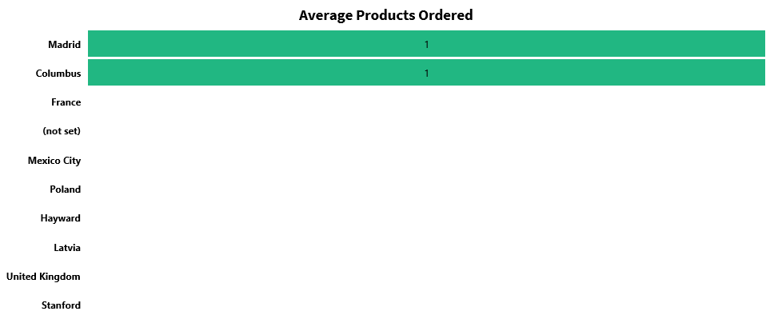
What is the average number of products ordered from visitors in each city and country?
Visitors in Columbus, USA and Madrid, Spain buy an average of one item.

Slide 5
Is there any pattern in the types (product categories) of products ordered from visitors in each city and country?
City | Country | Productcategory | Count
United States | United States | Home/Nest/Nest-USA/ | 3
Mountain View | United States | Home/Nest/Nest-USA/ | 3
United States | United States | Electronics | 2
United States | United States | ${escCatTitle} | 2
Canada | Canada | ${escCatTitle} | 1
Canada | Canada | Home/Apparel/Kid's/Kids-Youth/ | 1
Canada | Canada | Home/Shop by Brand/YouTube/ | 1
Chicago | United States | Lifestyle | 1
Colombia | Colombia | Home/Apparel/Men's/Men's-T-Shirts/ | 1
Columbus | United States | (not set) | 1
Dallas | United States | Home/Shop by Brand/YouTube/ | 1
Detroit | United States | Drinkware | 1
Dublin | Ireland | Home/Bags/ | 1
Finland | Finland | ${escCatTitle} | 1
France | France | Headgear | 1
Houston | United States | ${escCatTitle} | 1
Los Angeles | United States | Home/Apparel/Men's/Men's-Outerwear/ | 1
Madrid | Spain | ${escCatTitle} | 1
Mexico | Mexico | (not set) | 1
Mountain View | United States | ${escCatTitle} | 1
Mountain View | United States | Apparel | 1
Mountain View | United States | Home/Apparel/Women's/Women's-Outerwear/ | 1
Mountain View | United States | Nest-USA | 1
New York | United States | ${escCatTitle} | 1
New York | United States | (not set) | 1
Customers from the United States purchased more electronics, than those outside of the United States

Slide 6
What is the relationship between time on site and revenue?
All sales happened within 15 mins of being on the site. Based on our queries, we can see most visitors log off after 15 mins as well. Only about 1.5% of visitors stay over 15 mins, but it does not result in sales.

Slide 7
Is there a relationship between stock levels and order quantity? How about lead times?
No, both order quantity and lead times do not affect stock levels.

