Slide 1

Statistical Modelling with Python
Week 5

Slide 2
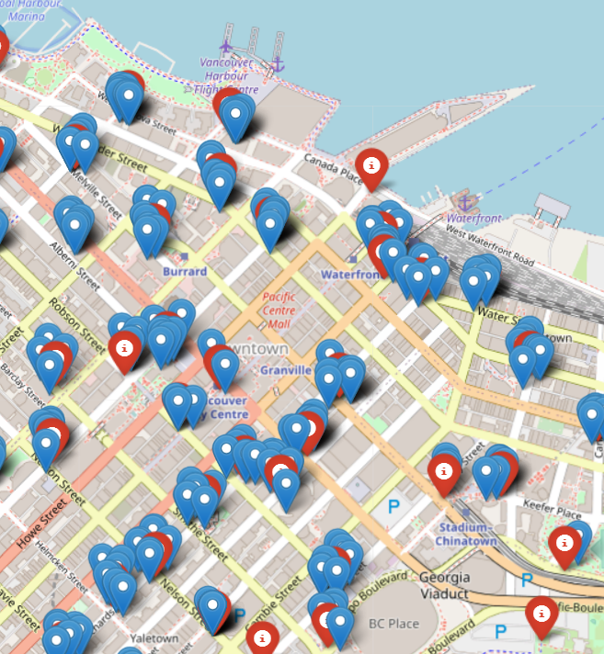
Project Goal
My goal was to find a relationship between the number of Points of Interests in the area and the number of bike stations: Points of Interests or restaurants have a higher rating with nearby bike stations.

Slide 3
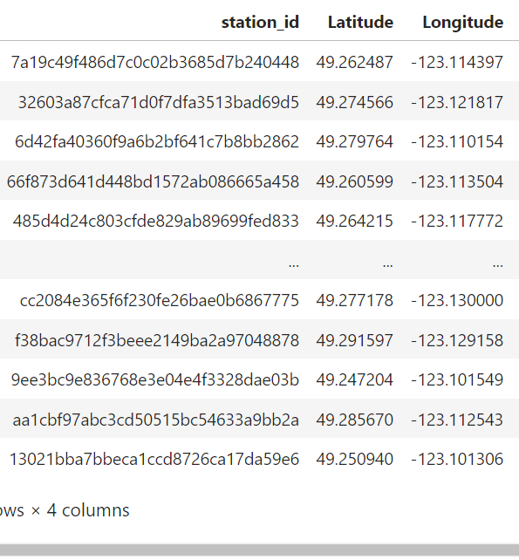
Process:
Choose a city from [CityBikes](https://citybik.es/). Request information from their API.
I choose Vancouver. It has almost 250 stations and a total of 4,563 available bikes

Slide 4
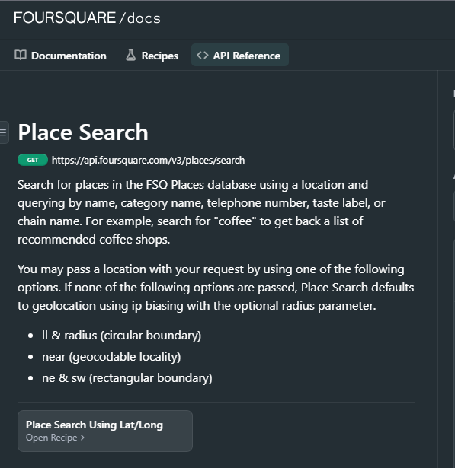
Process:
Connect to Foursquare and Yelps API to get the locations of
Restaurants or bars
Various POIs (points of interest) of your choice
Connecting to the Yelp API was the most tedious. I did not realize very iteration was considered a call, so I kept running out of calls.

Slide 5
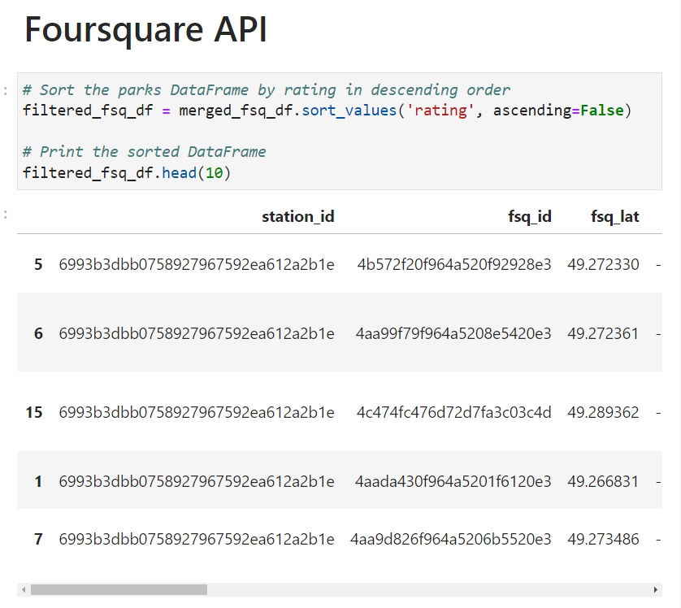
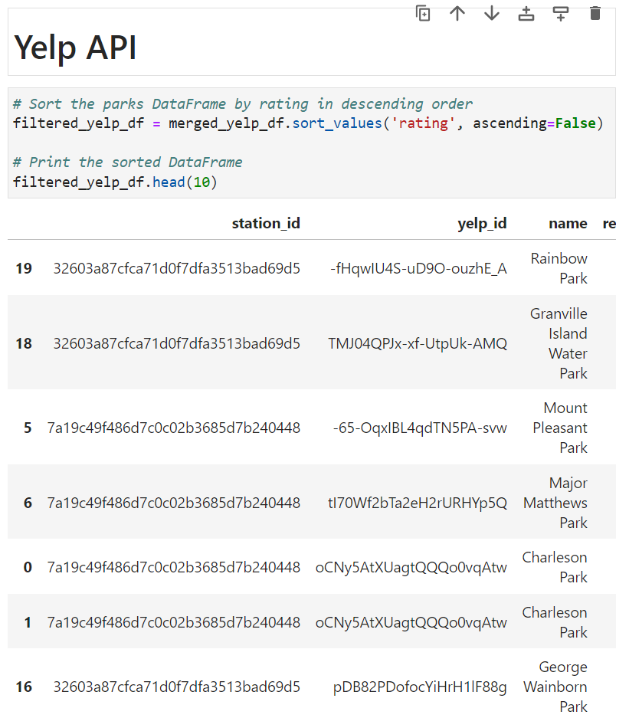
Process:
Create a data frame and compare results. Which gave the most complete information.
Yelp's API provided more information; however, the Foursquare API was easier to work with and I was able to discover more about the data with multiple inquires. On the other hand, I faced was with the limited calls available in Yelp's API.

Slide 6
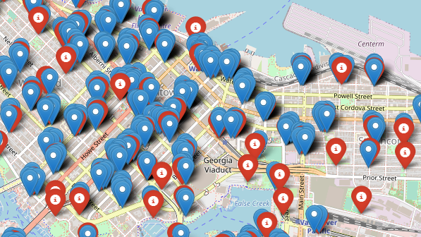
Process:
Use data visualization to explore data.
Since we had coordinates to work with, I choose to create a folium map to show the relationship between the number of Points of Interests in the area and the number of bike stations.

Slide 7
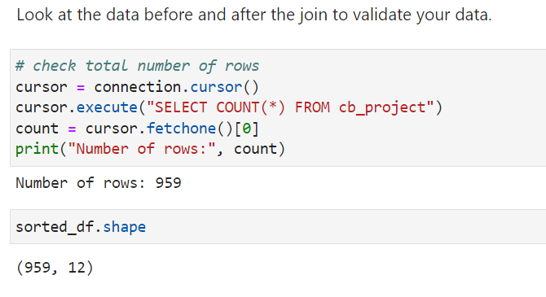
Process:
Create a SQLite database, store collected data and validate your results.
I was able to create a SQLite database and upload the collected data. I validated this by confirming I had the same number of rows.

Slide 8
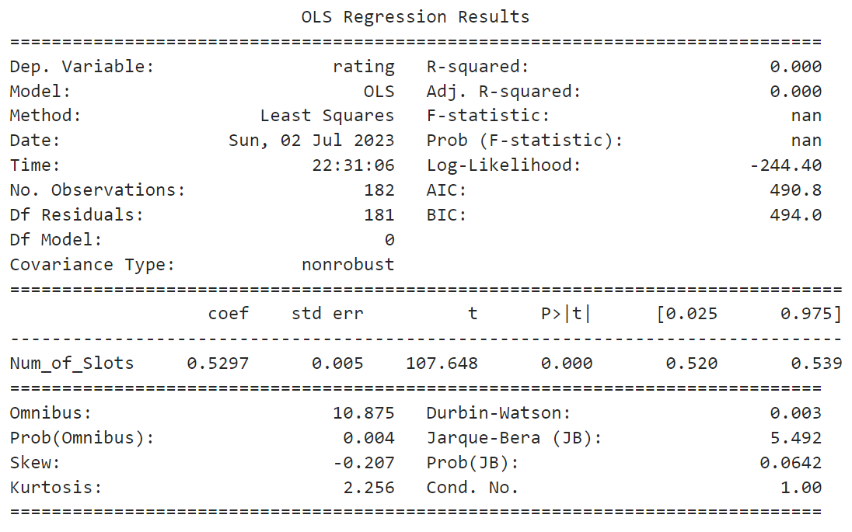
Process:
Build a model and derive insights.
Aside from my challenges with the Yelp API, this was my other biggest challenge. Although, it did not take a lot of time, it did not give a favorable result. The p-values and the R-squared values did not provide an output; therefore, the model could not find a meaningful conclusion from the regression analysis.

Slide 9

Future Goals:
If I had more time, I would have dug deeper and looked for more tangible data which could have helped my regression model to prove hypothesis.
I would also have spent more time customizing the folium map to make it more visually appealing.
I would have also asked for more direction or asked more questions on how APIs worked. ie: each iteration = a call.

