Slide 1

Supervised Learning Project Diabetes Dataset
Lat Leger

Slide 2
Supervised Learning - Project
Use supervised learning techniques to build a machine learning model that can predict whether a patient has diabetes or not, based on certain diagnostic measurements.
The project involves three main parts:
* Exploratory data analysis
* Preprocessing and feature engineering
* Training a machine learning model

Slide 3
Part I : EDA - Exploratory Data Analysis
For this task, you are required to conduct an exploratory data analysis on the diabetes dataset.
You have the freedom to choose the visualizations you want to use.

Slide 4
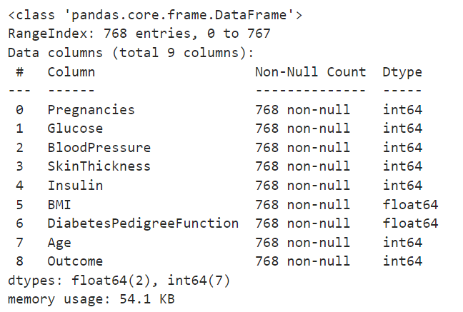
Q: Are there any missing values in the dataset? A: No, there are no missing values. However, Glucose, BloodPressure, SkinThickness, Insulin, BMI have 0 values, which is not physically possible. I replaced the Zeros with the mean of each column.

Slide 5
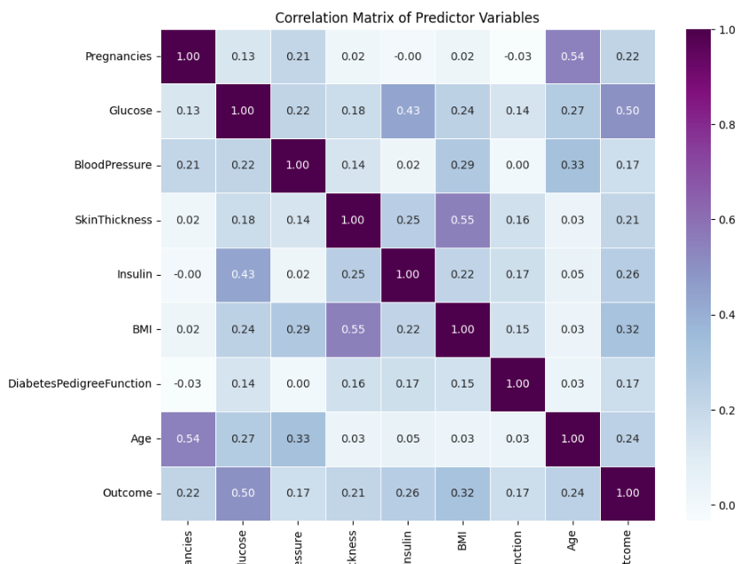
Q: How are the predictor variables related to the outcome variable? A: Each predictor variable has a positive or negative relationship with the outcome variable. Q: What is the correlation between the predictor variables? A: There are several correlations between the predictor variables, like Age, Pregnancy, Insulin, etc. Q: How are the predictor variables related to each other? Using a Correlation Matrix, we can see there are several correlations among predictors. For example: Age + Pregnancies, Outcome + Glucose, BMI + SkinThickness, and Insulin + Glucose.

Slide 6
Q: What is the distribution of each predictor variable? A: Using the describe() method, we can see the distribution of each predictor variable: 1. Pregnancies: Distribution: Appears to be positively skewed, as the mean is slightly greater than the median. 2. Glucose: Distribution: Approximately normally distributed, as the mean is close to the median. 3. BloodPressure: Distribution: Approximately normally distributed, as the mean is close to the median. 4. SkinThickness: Distribution: Appears to be positively skewed, as the mean is slightly greater than the median. 5. Insulin: Distribution: Appears to be positively skewed, as the mean is slightly greater than the median. 6. BMI: Distribution: Approximately normally distributed, as the mean is close to the median. 7. DiabetesPedigreeFunction: Distribution: Appears to be positively skewed, as the mean is slightly greater than the median. 8. Age: Distribution: Appears to be positively skewed, as the mean is slightly greater than the median.

Slide 7
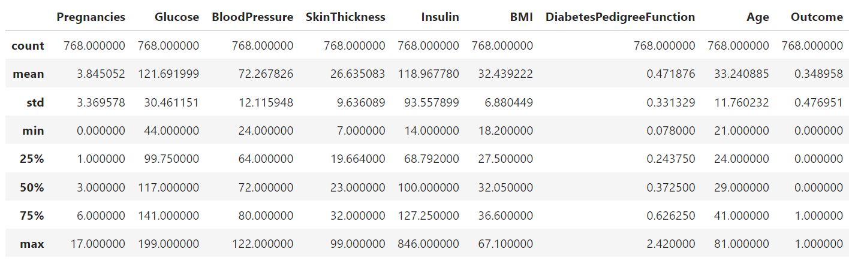
Using the describe() method:

Slide 8
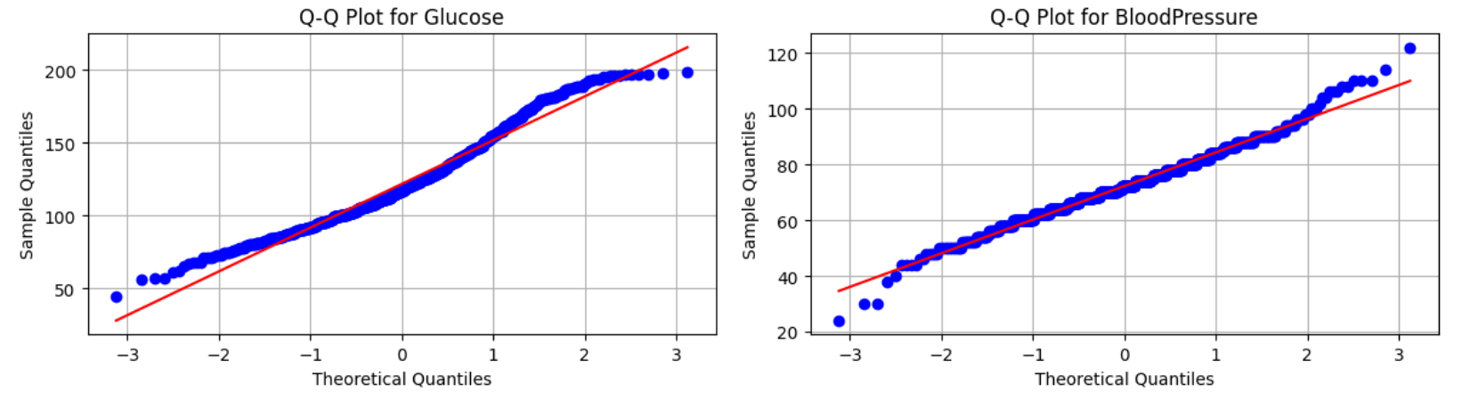
Q: Are there any outliers in the predictor variables? A: Yes, there are outliers. Using Q-Q Plots, we can Insulin has the most outliers.

Slide 9
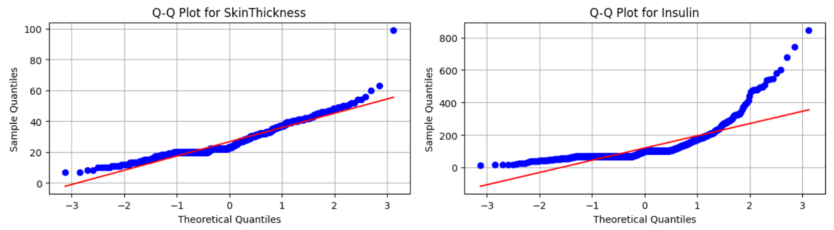

Slide 10
Q: Is there any interaction effect between the predictor variables? A: Using a Multiple Linear Regression model to analyze the relationship between multiple predictor variables and the target variable 'Outcome’. These results indicate that the interaction between these predictor variables and possibly other predictors in the model significantly affects the outcome variable. Therefore, considering these interactions is crucial for interpreting the relationship between the predictors and the target variable accurately.

Slide 11
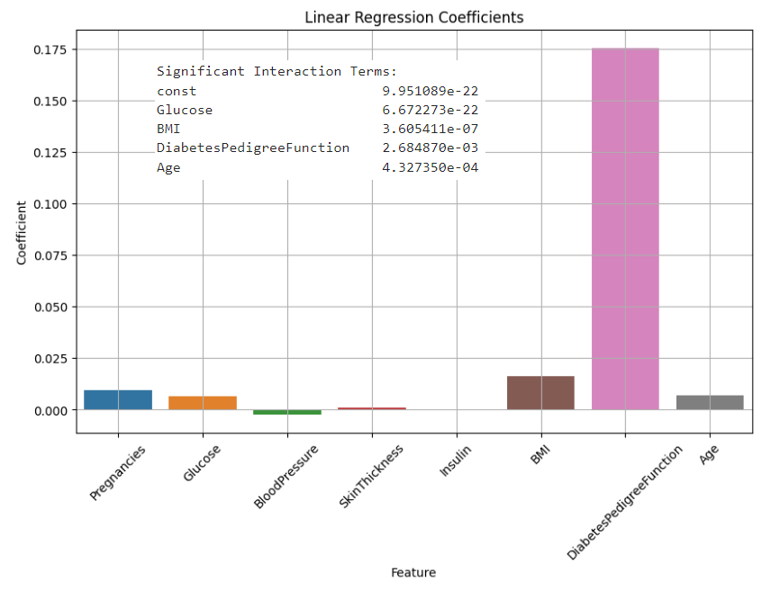

Slide 12
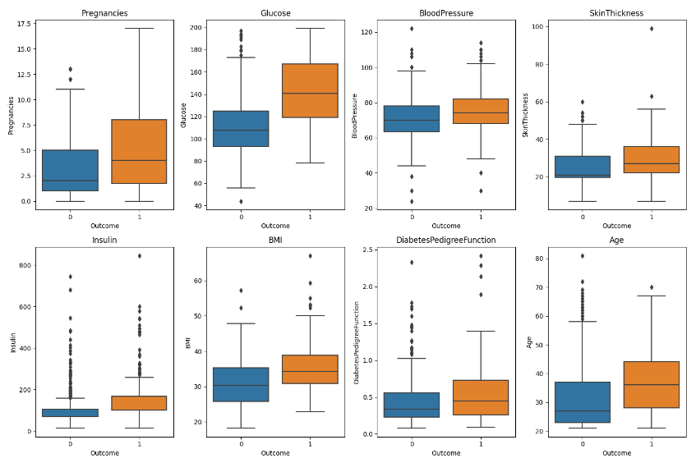
Q: How does the distribution of the predictor variables differ for individuals with diabetes and without diabetes? A: Based on the box plots, we can see that there is more data variability in the data for individuals with diabetes.

Slide 13
Part II : Preprocessing & Feature Engineering
You need to perform preprocessing on the given dataset. Please consider the following tasks and carry out the necessary steps accordingly.
Handling missing values: There are no null values, however, 0 values did not make sense in the results. I converted the 0 values to the mean in each feature split by diabetes vs non-diabetes.
Handling outliers: I used box plots to look for outliers, then used the IQR (Interquartile Range) method to perform outlier imputation.
Scaling and normalization: I did not use scaling and normalization, since I am using a Random Forest Module.
Feature Engineering: Feature Engineering is performed with Random Forest Module.
Handling imbalanced data: I did not find this data set to be imbalanced.

Slide 14
Handling outliers: I used box plots to look for outliers, then used the IQR (Interquartile Range) method to perform outlier imputation.

Slide 15
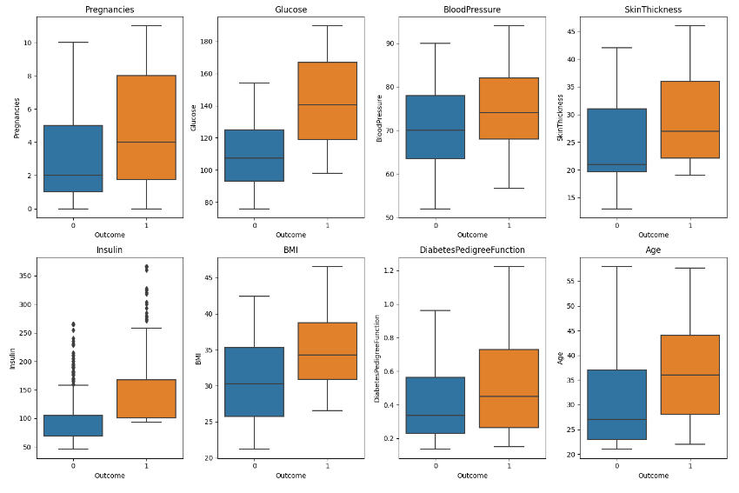

Slide 16
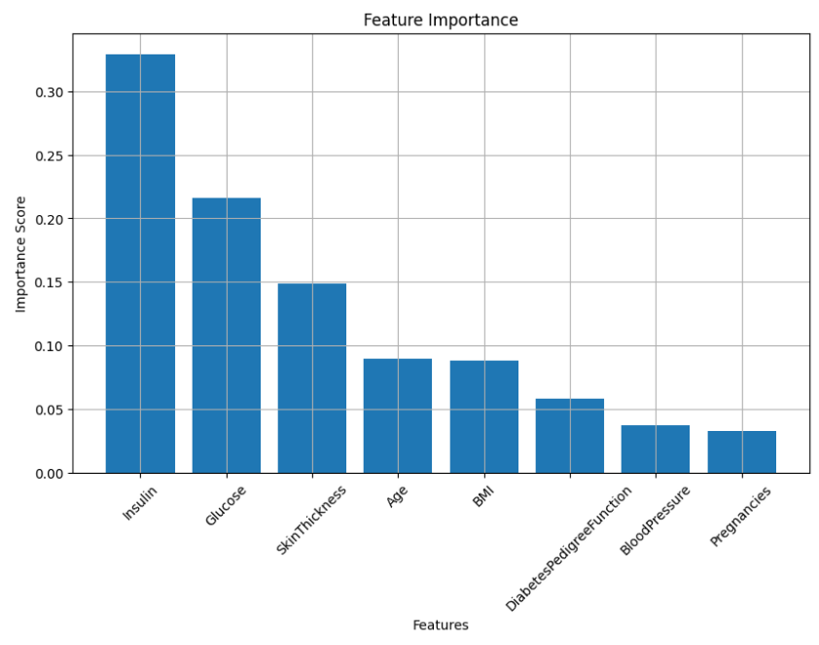
Feature Engineering: Feature Engineering is performed with Random Forest Module.

Slide 17
Part III : Training ML Model
For this task, you are required to build a machine-learning model to predict the outcome variable. This will be a binary classification task, as the target variable is binary. You should select at least two models, one of which should be an ensemble model, and compare their performance.
Train the models: Train the selected models on the training set.
Model evaluation: Evaluate the trained models on the testing set using appropriate evaluation metrics, such as accuracy, precision, recall, F1-score, and ROC-AUC.
Model comparison: Compare the performance of the selected models and choose the best-performing model based on the evaluation metrics. You can also perform additional analysis, such as model tuning and cross-validation, to improve the model's performance.

Slide 18
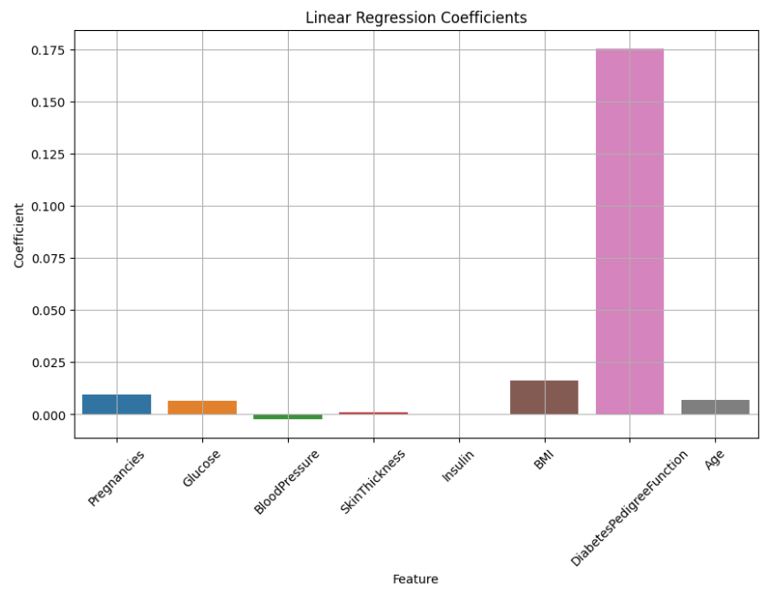
Multiple Linear Regression model with additional functions for data splitting, plotting coefficients, checking for interaction effects, cross-validation, and grid search

Slide 19
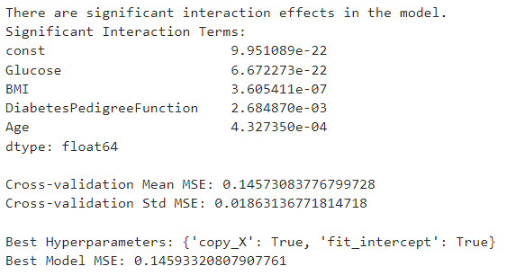
Multiple Linear Regression model with additional functions for data splitting, plotting coefficients, checking for interaction effects, cross-validation, and grid search

Slide 20

Random Forest Classifier with Feature Importance, Probability distribution, Precision, Recall, F1-score, ROC-AUC, Classification Report, Confusion Matrix, and ROC curve

Slide 21
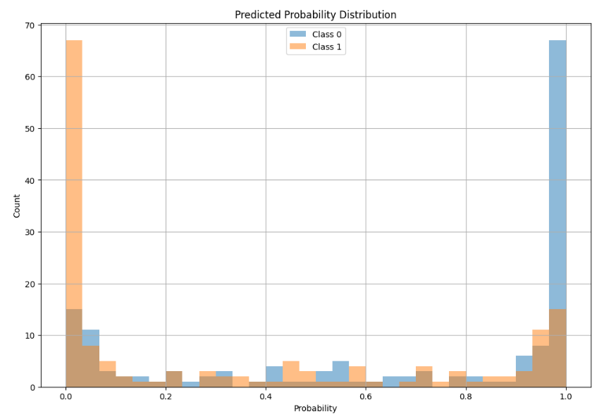
Random Forest Classifier with Feature Importance, Probability distribution, Precision, Recall, F1-score, ROC-AUC, Classification Report, Confusion Matrix, and ROC curve

Slide 22
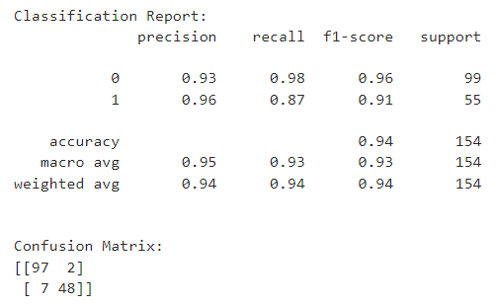
Random Forest Classifier with Feature Importance, Probability distribution, Precision, Recall, F1-score, ROC-AUC, Classification Report, Confusion Matrix, and ROC curve

Slide 23
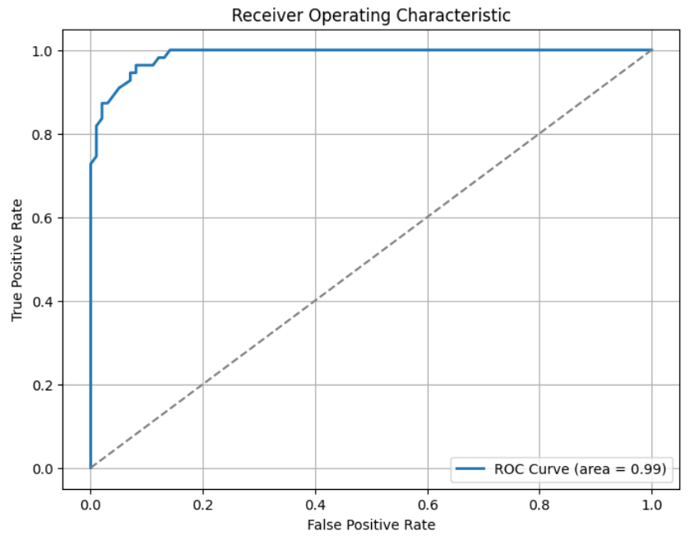
Random Forest Classifier with Feature Importance, Probability distribution, Precision, Recall, F1-score, ROC-AUC, Classification Report, Confusion Matrix, and ROC curve

Slide 24
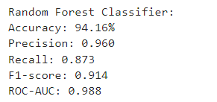
Random Forest Classifier with Feature Importance, Probability distribution, Precision, Recall, F1-score, ROC-AUC, Classification Report, Confusion Matrix, and ROC curve

Slide 25
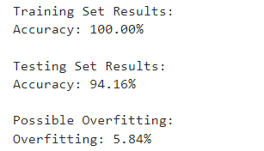
Training and Testing Results

Slide 26
Part IV: Conclusion
Feature Importance: The model identifies the top 5 features that have the most significant impact on predicting the outcome of diabetes. These features, in descending order of importance, are insulin, glucose, skin thickness, age, and BMI. These variables are crucial in predicting whether a person is likely to develop diabetes.
Interaction Effects: The model reveals significant interaction effects between certain predictor variables. Specifically, there are statistically significant interaction terms between the constant term, glucose, BMI, diabetes pedigree function, and age. This indicates that the relationship between these variables is not independent and can influence the outcome differently based on their interactions.
Model Performance: The Random Forest Classifier demonstrates strong performance with an accuracy of 94.16%. It achieves high precision (0.960) and recall (0.873) for the positive class (indicating diabetes). The F1-score, which balances precision and recall, is 0.914. The ROC-AUC score of 0.988 indicates that the model has excellent discrimination ability in distinguishing between the two classes.
Overfitting: There is evidence of potential overfitting, as the model achieves 100% accuracy on the training set but slightly lower accuracy (94.16%) on the testing set. The difference between training and testing set accuracy (5.84%) suggests that the model may perform slightly worse on unseen data. It is essential to consider regularization techniques or further fine-tuning of hyperparameters to reduce overfitting and improve generalization to new data.

