Slide 1
Beyond the Family
How Neighborhood Poverty Shapes Academic Outcomes
Across U.S. School Districts
Latonya Smith | Syracuse University | ITS 686 M001 | April 23, 2026
12,335
U.S. school districts
2009 – 2019

Slide 2
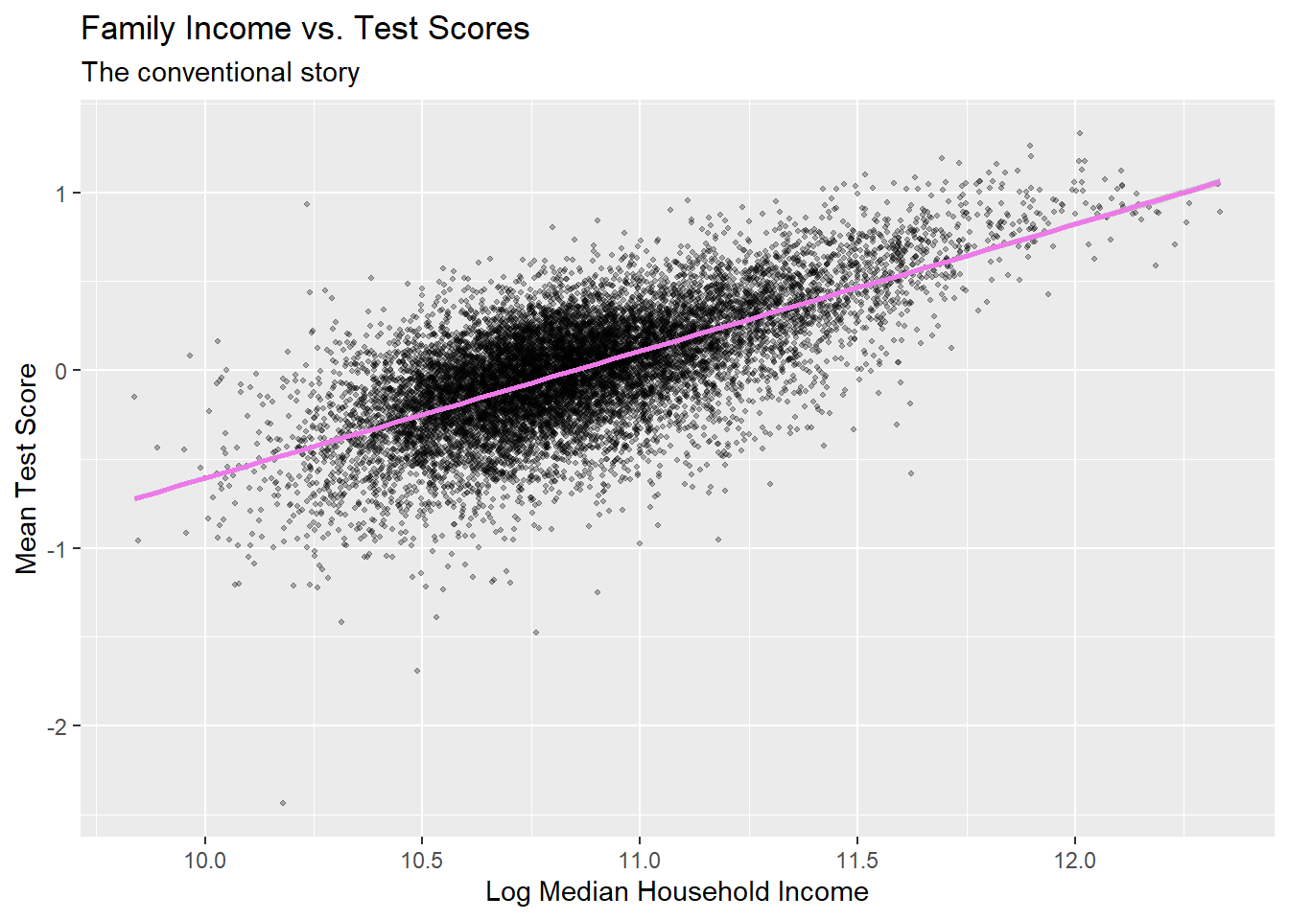
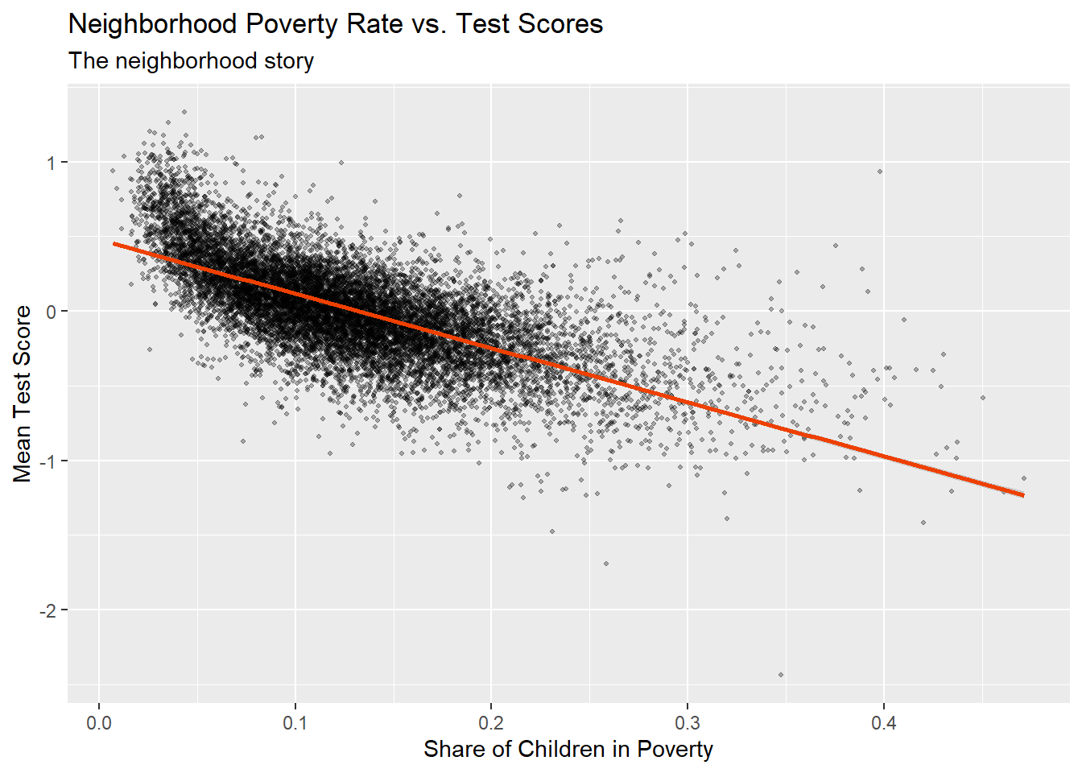
Two Competing Stories
The conventional story — family income
The neighborhood story — poverty rate

Slide 3
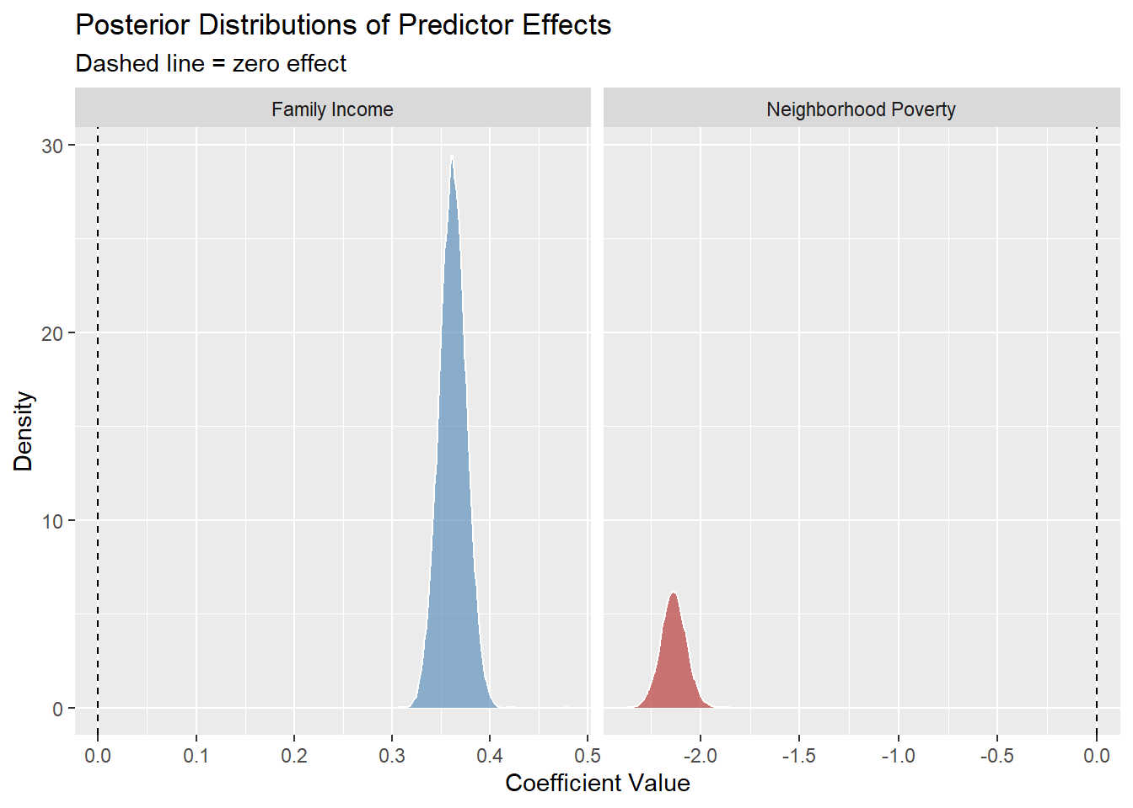
What the Bayesian Analysis Confirms
−2.137
Neighborhood poverty
posterior mean
0.362
Family income
posterior mean
95% credible interval
[−2.261, −2.010]
entirely below zero —
no ambiguity about direction

Slide 4
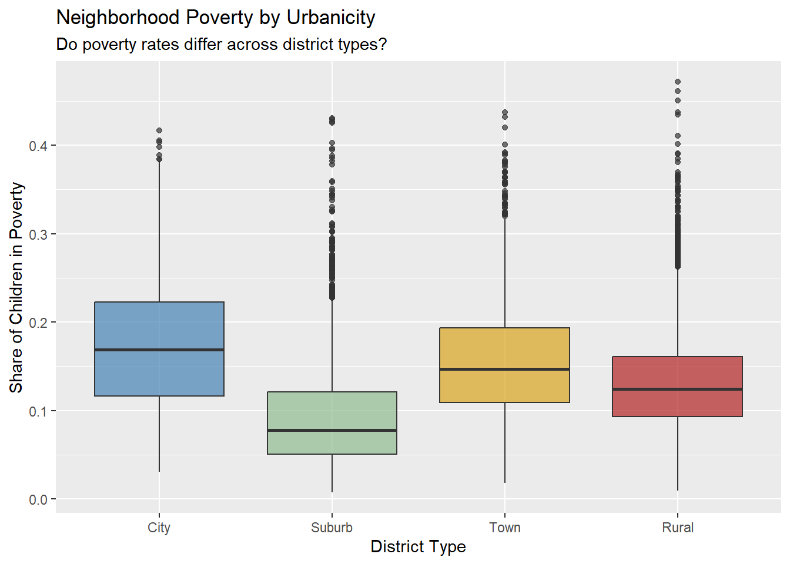
Poverty Rates Are Not Equal Across District Types
Suburb
Lowest poverty rates — and the steepest academic decline when poverty does appear
Rural
Widest spread of poverty — some districts are thriving, others are deeply impoverished
City
Higher median poverty than suburbs but less variability than rural districts

Slide 5
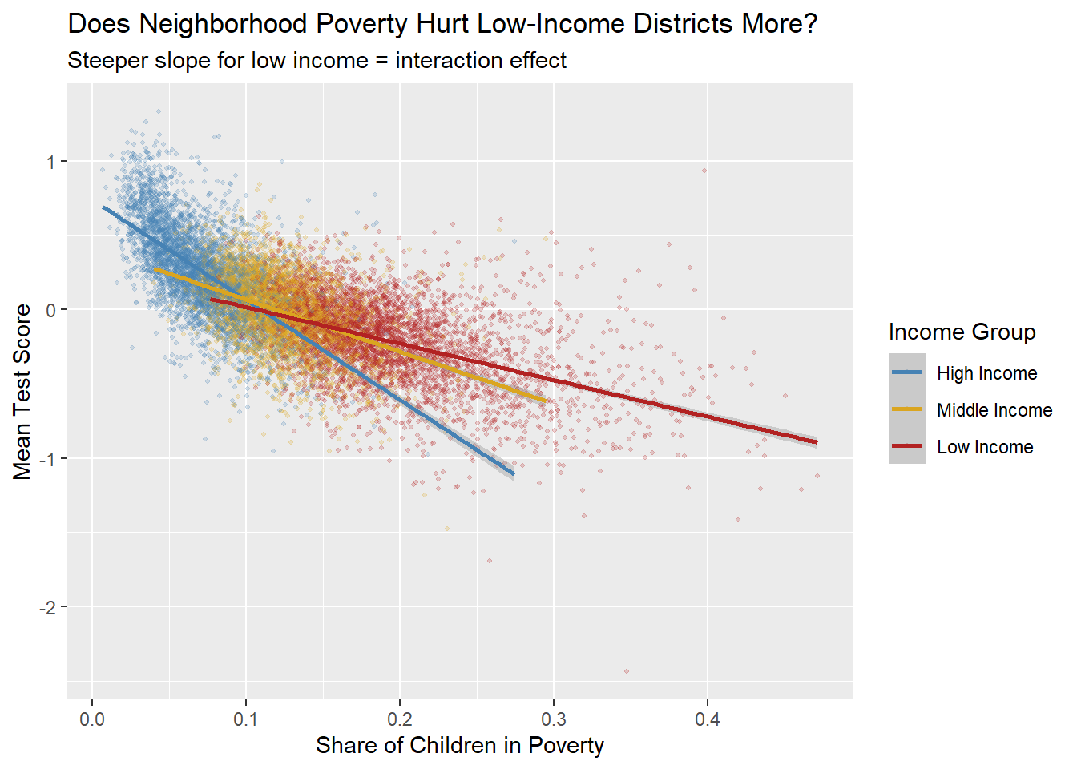
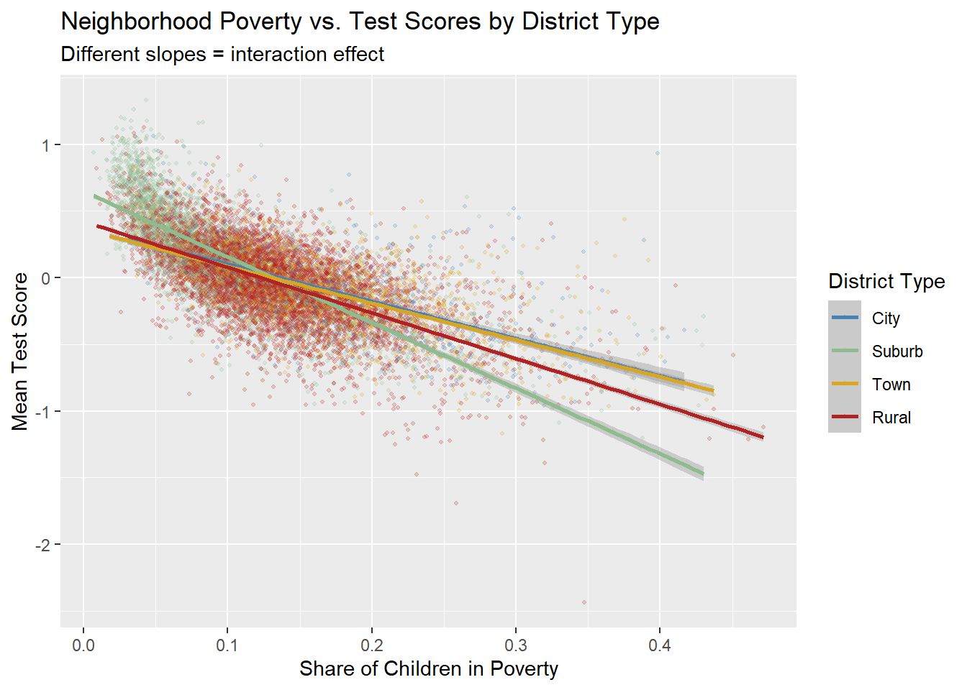
Context Shapes How Damaging Poverty Is
Poverty does not do equal damage everywhere — these non-parallel lines confirm an interaction effect

Slide 6
Recommendations for the Commissioner
1
Adopt a Neighborhood-Level Allocation Framework
Move beyond free/reduced lunch eligibility alone. Weight both individual poverty and neighborhood poverty concentration when distributing funds.
2
Designate & Target Rural High-Poverty Districts
Rural districts are 53% of the dataset with the widest poverty spread. Create a formal Rural High-Poverty designation for districts above 25% child poverty.
3
Reframe the Community Narrative
Help rural communities understand that neighborhood conditions create obstacles no individual effort can fully overcome. Investing in communities enables individual effort.
4
Build Better Data Infrastructure
Current data ends at 2019. Invest in systems linking student outcomes to census tract conditions annually for real-time resource monitoring.

Slide 7
The Bottom Line
Neighborhood poverty is a powerful, independent predictor of academic outcomes. It is one that operates above and beyond family income. The Bayesian posterior mean of −2.137, with a 95% credible interval entirely below zero, leaves no ambiguity: where a child lives shapes their educational trajectory in ways that no amount of individual family effort can fully overcome.
Neighborhood
Context
Investment
matters as much as income
shapes how damaging poverty is
in communities = investment in children
Further research: post-pandemic data · individual-level records · richer neighborhood characteristics

