Slide 1

Automated Donation Recommendations
Ava Latoria · [teammate names]
HackMIT · GiveCampus Challenge
Notes:
[0:00-0:20 — 20 sec]
"Hi, we're DonoRex.
Every university has a small advancement team and a very large alumni database.
DonoRex tells that team exactly who to contact this week, what to say, and why —
and then books it into their real calendar.
Let me show you the problem first."
DELIVERY: Don't read the tagline. Say the team names, then move. This slide is 20 seconds.

Slide 2
Problem
GiveCampus University — real constituent data
20,000
1,002
149
constituents in the database
LYBUNT — gave last year, not this year
personal touches in a 40-hour week
Every CRM can export the list.
Advancement teams still have to choose who gets one of those 149 slots — and whether each touch is stewardship or an ask.
Which 149?
Notes:
[0:20-0:55 — 35 sec]
"This is the real GiveCampus dataset: 20,000 constituents, and 1,002 who gave last
year but not this year — lapsing right now.
A fundraiser has a 40-hour week. That's about 149 meaningful personal touches.
Zero point seven percent of the database.
So the job isn't reporting. The job is choosing — which 149, and what to do with each.
Today that choice is made by gut feel and whoever the fundraiser remembers."
DELIVERY: Land "Which 149?" on the big orange line.

Slide 3
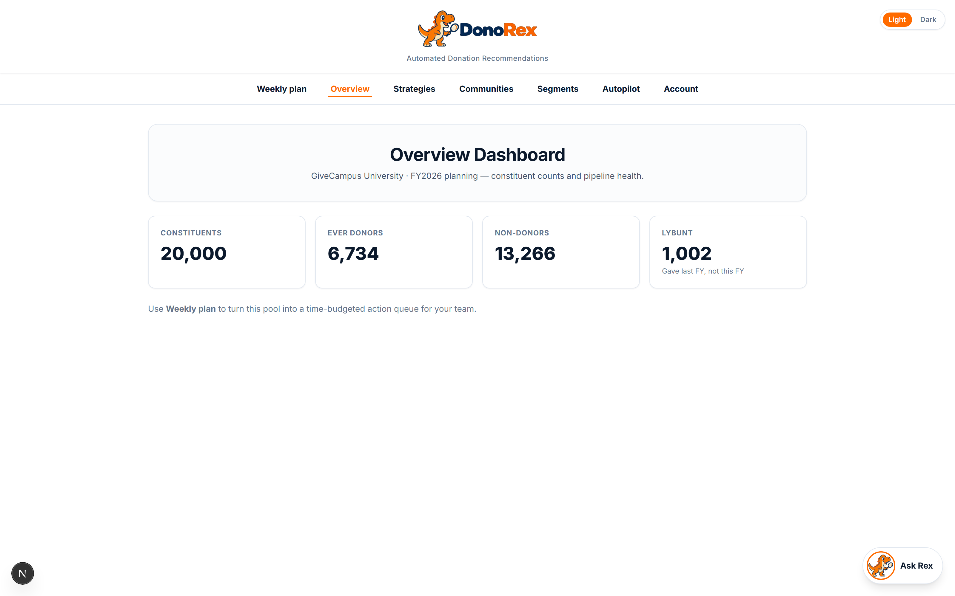
Introducing DonoRex
Automated Donation Recommendations
• Time-budgeted weekly action queue
• Evidence on every recommendation
• Outlook scheduling + approval-gated Autopilot
Notes:
[0:55-1:15 — 20 sec]
"DonoRex answers that question.
It turns a giant alumni database into a weekly plan: who to contact, what action to
take, how many minutes it costs, and why — then optionally books it into Outlook and
drafts the outreach for human approval."
Keep this slide short; the next one is the hero demo frame.

Slide 4
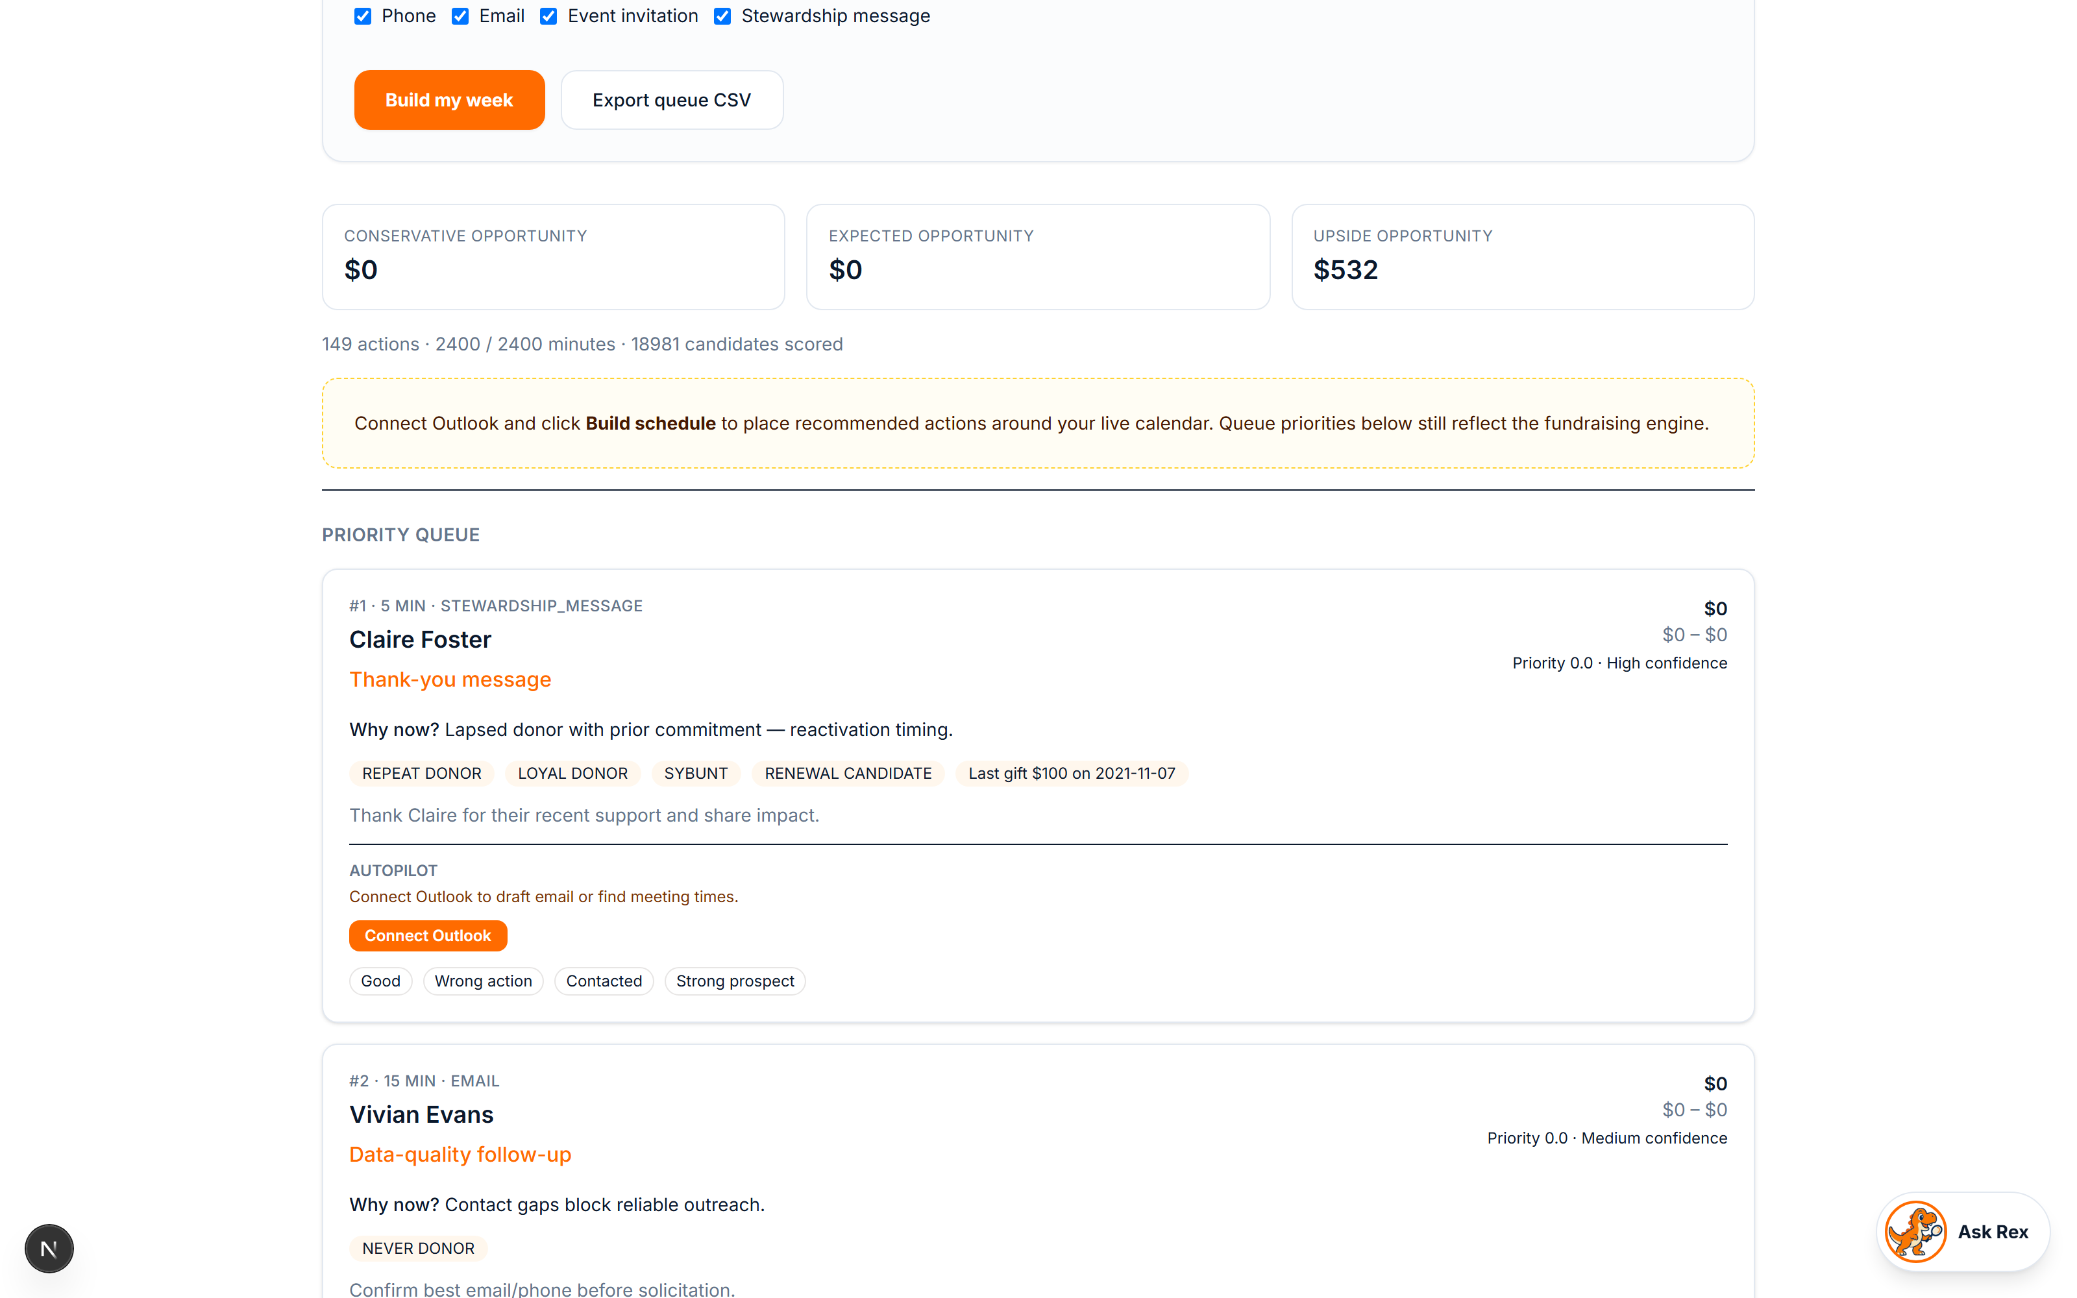
Weekly plan
• Pick objective + hour budget
• Build my week → ranked queue
• Channel, minutes, evidence on every card
• Export CSV or schedule around Outlook
Notes:
[1:15-1:50 — 35 sec]
"This is the hero flow.
Pick a fundraising objective — protect renewals, maximize near-term dollars, reactivate
lapsed donors. Set the hours you actually have — twenty or forty. Hit Build my week.
You get a ranked queue: channel, minutes, evidence, suggested message. Export CSV or
connect Outlook to place tasks around your real calendar.
If the live demo is up, do this on screen instead of the slide."
DELIVERY: Point at objective, hours, and the first queue card.

Slide 5







How it connects
Deterministic engine end-to-end — no LLM choosing who gets asked for money
Data ingestion
Classification
Priority engine
Weekly plan
Scheduling
M365 MCP layer
15 CSVs
20k profiles
paid gifts only
LYBUNT · loyal
lapsed · DNC flags
6 scores
18k actions
hour-budget knapsack
ranked queue
evidence cards
staff export
Outlook busy/
free slots
9–5 placement
7 validated
Graph tools
calendar + mail
Human approval
approve / reject
audit log
no auto-send
Notes:
[1:50-2:40 — 50 sec]
"Here's how the pieces connect — product architecture, not a stack diagram.
Ingestion pulls GiveCampus CSVs into constituent profiles. Classification applies
donor labels — LYBUNT, loyal, lapsed — and contact rules.
The priority engine scores every legal action and packs the best ones into your hour
budget. That becomes the weekly plan you just saw.
Scheduling reads Outlook free/busy and places tasks in open slots.
The M365 MCP layer is a narrow tool registry — seven validated Graph operations for
calendar and mail, nothing arbitrary. Autopilot calls those tools to draft outreach.
Then a human approves before anything sends. The gate is policy, not just UI."
DELIVERY: Trace left to right, then drop down to approval on the last node.

Slide 6
Every recommendation shows its work
Notes:
[2:45-3:45 — 60 sec]
"A fundraiser will not act on a black box. So every card explains itself.
Each one gives you the rank, the channel, how many minutes it costs, and a
'Why now?' — here, lapsed donor, reactivation timing. Then the raw evidence:
repeat donor, loyal, SYBUNT, last gift $100 in 2021. Those are the facts the score
was built from, not a rationalization after the fact.
Open the person and you also get why NOT — why we're not asking them to upgrade, and
what evidence we're missing to be more confident.
And those buttons at the bottom matter: if the fundraiser says 'wrong action,'
that person drops in the next rebuild. The human stays in charge of the queue.
Honest note: the anonymous-gift amounts are redacted on purpose, and the feedback is
session-local right now — it's not a trained model yet."
DELIVERY: Read one real card out loud, name and all. Specificity sells this slide.

Slide 7
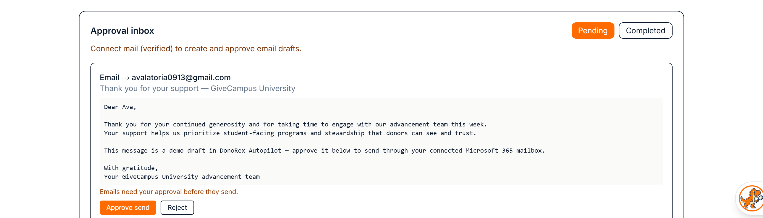
Autopilot drafts it. A human sends it.
• Drafts are grounded in that donor’s real giving history — nothing invented
• Sends and calendar invites are approval-gated in policy, not just in the UI
• Delegated scopes only · AES-256-GCM token cache · full audit log
Notes:
[3:40-4:30 — 50 sec]
"Ranking the work is only half of it. The other half is doing it.
This is Autopilot. When the queue says 'thank Claire Foster,' DonoRex writes the
draft — grounded in her actual giving history, not invented — and pushes it into
Microsoft Graph as a real Outlook draft.
Then it stops. Every send and every calendar invitation lands in this approval
inbox, and a human clicks Approve or Reject. That gate is in the policy layer, not
just the UI — mail.send and calendar.send_invitation are both marked
requires-approval in code, and anything unrecognised defaults to requiring approval.
Everything that happens gets audit-logged: drafted, approved, rejected, executed.
And the permissions are delegated to the signed-in user only — we never asked for
tenant-wide mailbox access. The token cache is AES-256-GCM encrypted on disk."
DELIVERY: The punchline is "it stops." Fundraising automation that sends on its own
is a liability; the approval gate is the feature, not a limitation.

Slide 8
Weaknesses
• Greedy optimizer — near-optimal, not provably optimal
• Opportunity dollars are planning estimates, not causal lift
• Segments match intent templates, not a language model
• Feedback is browser-local — no trained model yet
• Recurring Autopilot tasks need “Run now” — no scheduler
Notes:
[4:25-4:50 — 25 sec]
"What we'd fix.
The optimizer is greedy, not integer programming — near-optimal, and fast enough to
rerun live, but not provably optimal.
The dollar figures are planning estimates from past giving. We are careful not to
call them predicted revenue, because there's no experiment in this dataset that
would let us claim causal lift.
Segments are template matching, not an LLM. Feedback is browser-local. And recurring
automations need a manual Run now — there's no background scheduler yet."
DELIVERY: Say these confidently and quickly. Judges trust teams that name their own
limits before being asked. Do not apologize.

Slide 9
Thank you
• GiveCampus
• HackMIT organizers
• Our mentors
• Rex, our very good dinosaur
donorex — questions?
Notes:
[4:50-5:00 — 10 sec]
"Thanks to GiveCampus for the dataset and the challenge, to the HackMIT organizers,
and to our mentors.
DonoRex: it tells a fundraising team who to call on Tuesday, and why. Happy to take
questions."
BACKUP SLIDES TO HAVE READY (append after this one, do not present):
• Strategy simulator — the same hours run under 7 different strategies
• Communities & connectors — who can introduce you to whom
• Autopilot approval inbox — the human-in-the-loop send gate
• Privacy — anonymous gift redaction, delegated-only Graph scopes,
AES-256-GCM encrypted token cache
LIKELY QUESTIONS:
Q: How do you know the recommendations are good?
A: We can't measure causal lift without an experiment — no A/B data in the set. What
we can show is that the ranking is fully auditable: every score decomposes into
named evidence on the card.
Q: Why not use an LLM to pick?
A: Fundraisers need a reason they can repeat to a boss. The ranking is deterministic
and explainable; the LLM-shaped work is drafting the message, and even that is
gated on human approval.
Q: What's the Microsoft integration actually doing?
A: Delegated permissions for the signed-in user only. It reads free/busy to schedule,
writes drafts, and never sends mail or invitations without an explicit approval
click. Tokens are AES-256-GCM encrypted on disk and every action is audit-logged.

