Slide 1
Catalonian Road Accidents
2010-21
MARINA ALAPONT VIDAL
DANIEL PULIDO GÁLVEZ
SIMÓN HELMUTH OLIVA STARK
JOEL CARDONA SAUS
DAVID LATORRE ROMERO
Presentation: 21/10/2022

Slide 2
Outline
Goals and Database overview
Data Mining process
Descriptive analysis
Preprocessing
5. PCA and Clustering
6. Profiling
7. Conclusions
8. Task Scheduling

Slide 3
Topics and Goals
Topics
Goals
Factors that can affect accidents
Velocity
Weather
State of the road
Consequences of the accident
Number of injuries
Entities involved
What kinds of situations facilitate accidents
Help the society studying accidents
Accidents affects everyone

Slide 4

Database Overview
ORIGINAL DIMENSIONS
21.161 individuals
58 features
AFTER DATA SELECTION
5.000 individuals
23 features:
7 numerical
11 categorical
5 boolean
Data Source: https://analisi.transparenciacatalunya.cat/Transport/Accidents-de-tr-nsit-amb-morts-o-ferits-greus-a-Ca/rmgc-ncpb

Slide 5
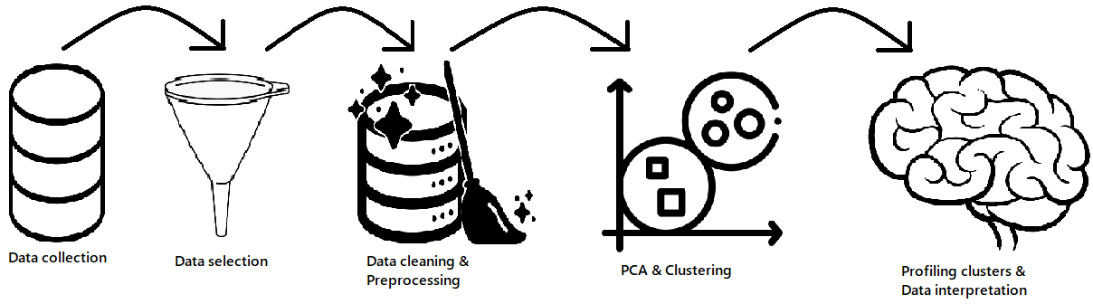
Data Mining Process

Slide 6
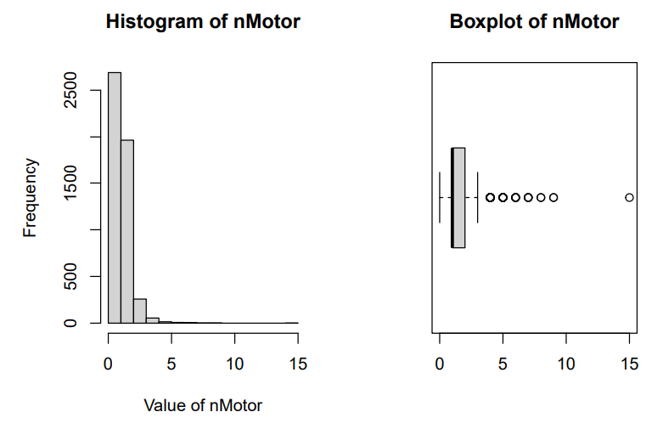
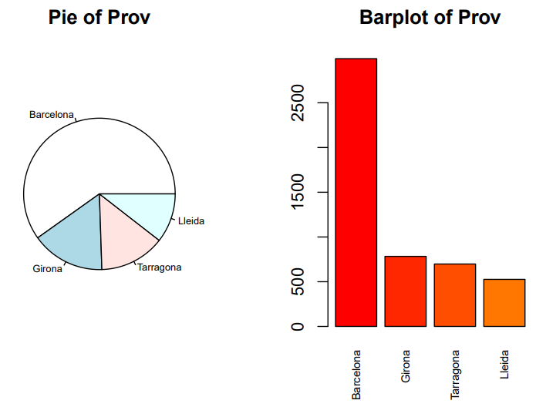

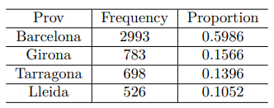
Descriptive Analysis

Slide 7
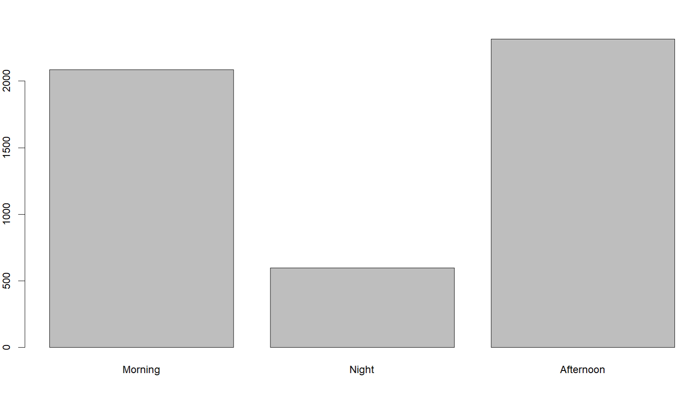
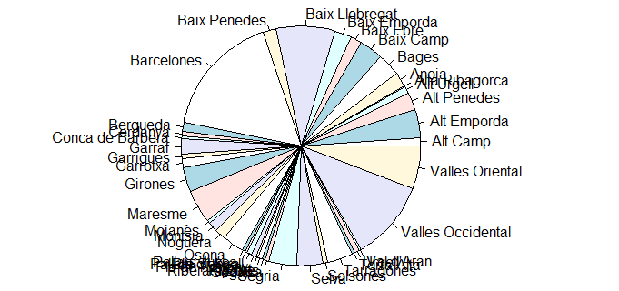
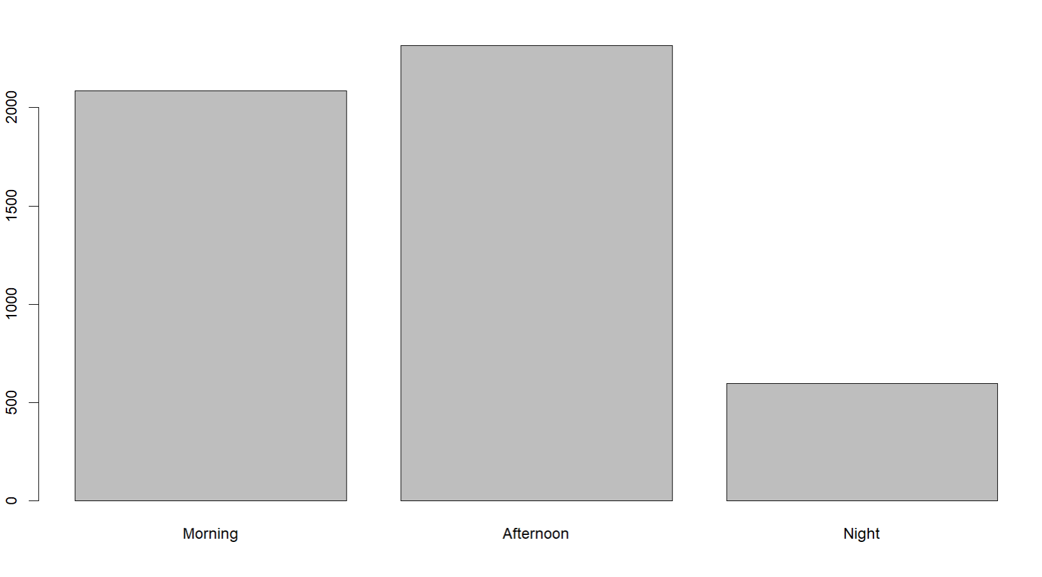

Preprocessing Steps (1)
Factorization, levels, sorting
Renaming: Variables, levels
Character
Factor -> 17
Date -> 1
Integer -> 7
D_INFLUIT_CIRCULACIO -> TrafficInf
D_INFLUIT_ESTAT_CLIMA -> WeatherInf
etc…
Catalan -> English

Slide 8
Preprocessing Steps (2)
MISSINGS
Variable name | Proportion of missing values
Vel | 18,56%
Escaped | 0,82%
Weather | 0,02%
TrafficInf | 0,02%
WeatherInf | 0,02%
LightInf | 0,02%
VisionInf | 6,68%
Surface | 0,02%
Random, no pattern

Slide 9
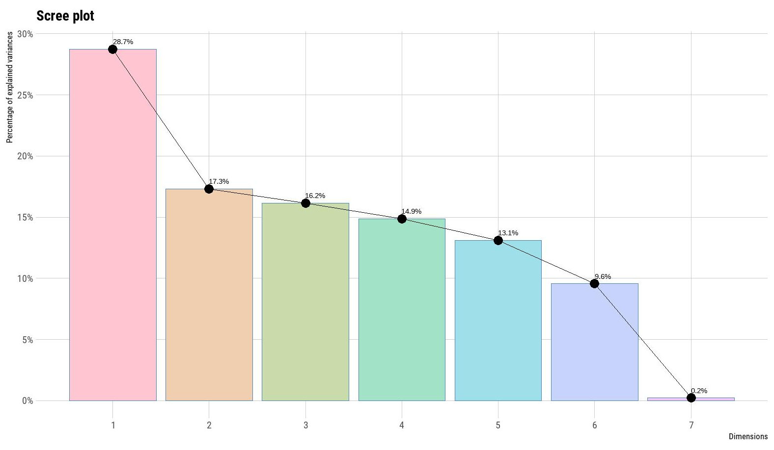
PCA: Specifications

Slide 10
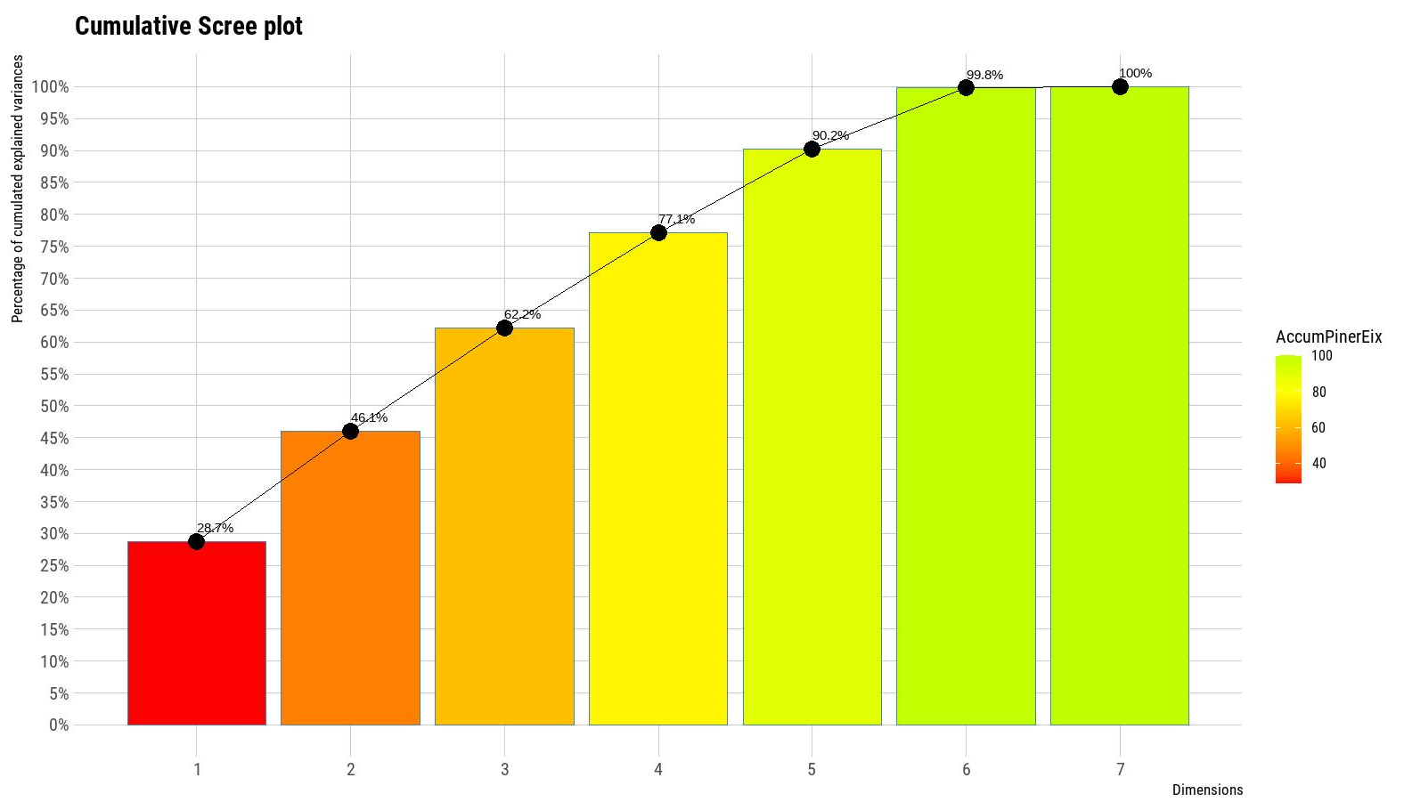
PCA: Specifications
Criteria: keep 80% of the inertia
Selected dimensions: 1 to 4

Slide 11
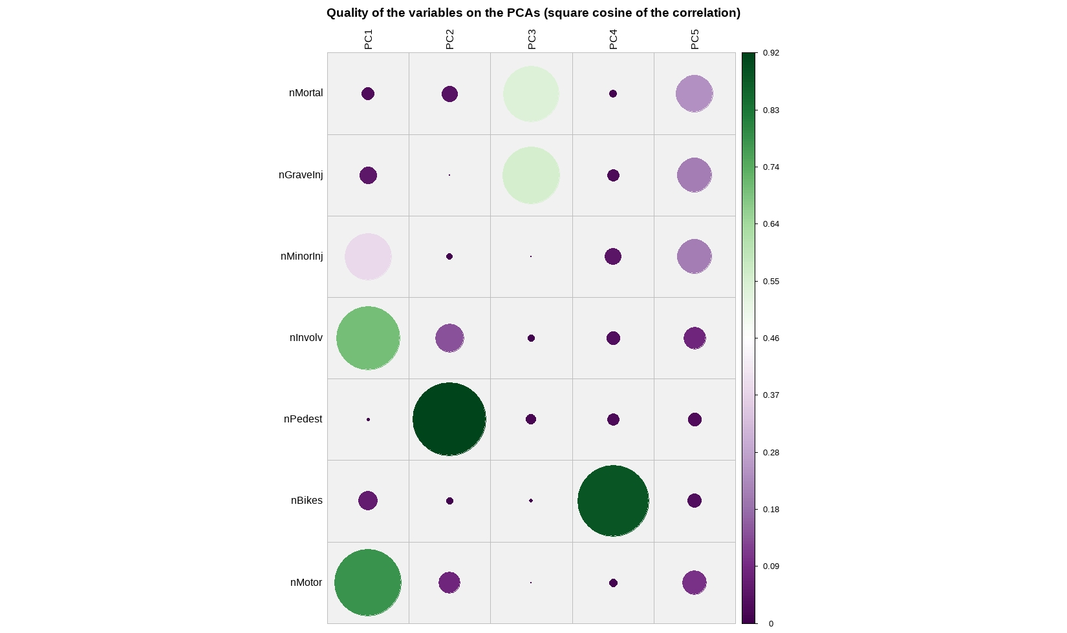
PCA: Specifications (2)
QUALITY -> ^2 cosine of correlation
[0, 1]

Slide 12
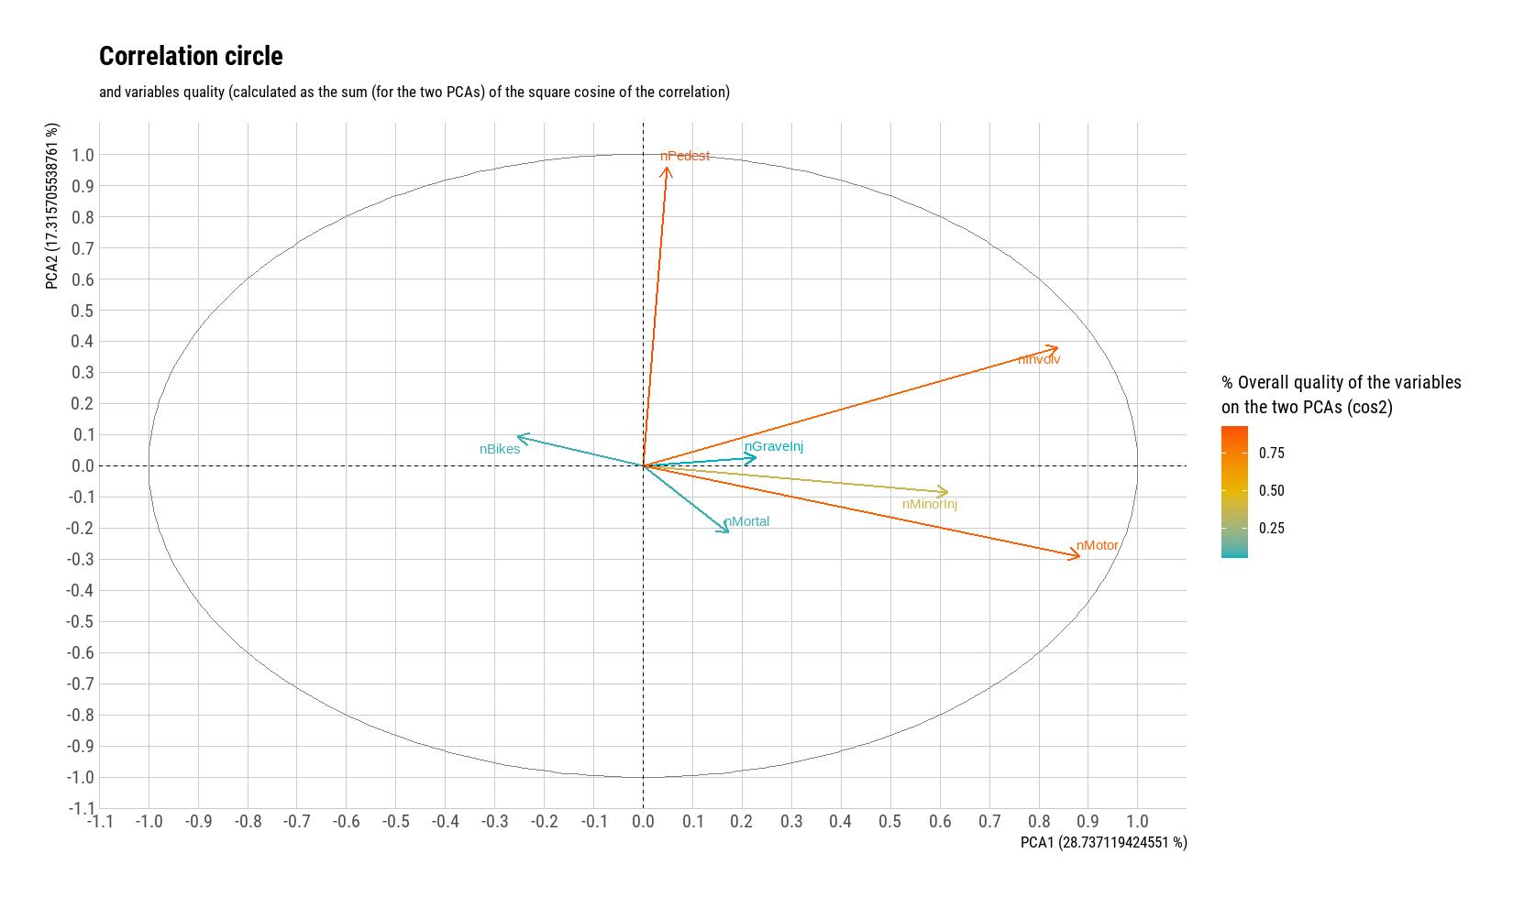
PCA: First Factorial Plane

Slide 13
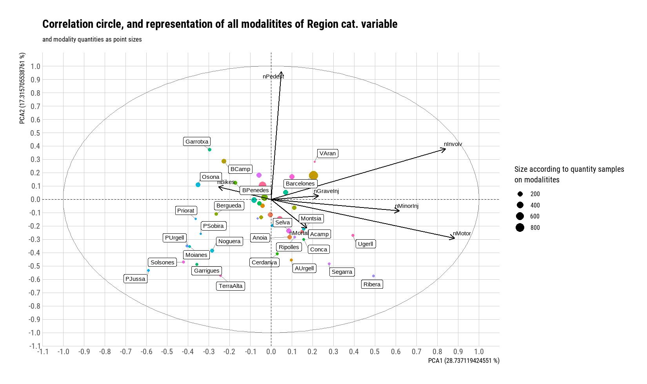
PCA: First Factorial Plane (2)

Slide 14
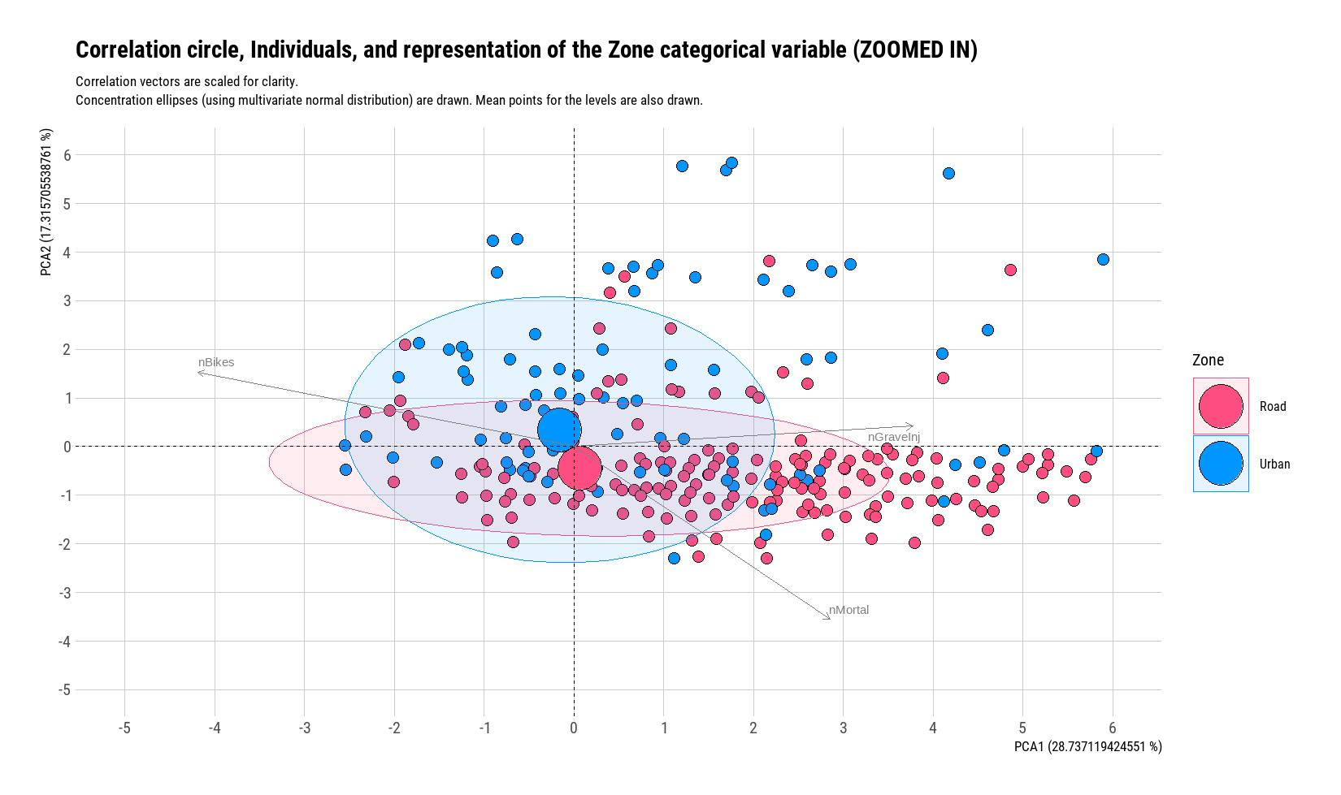
PCA: Conclusions (1)

Slide 15
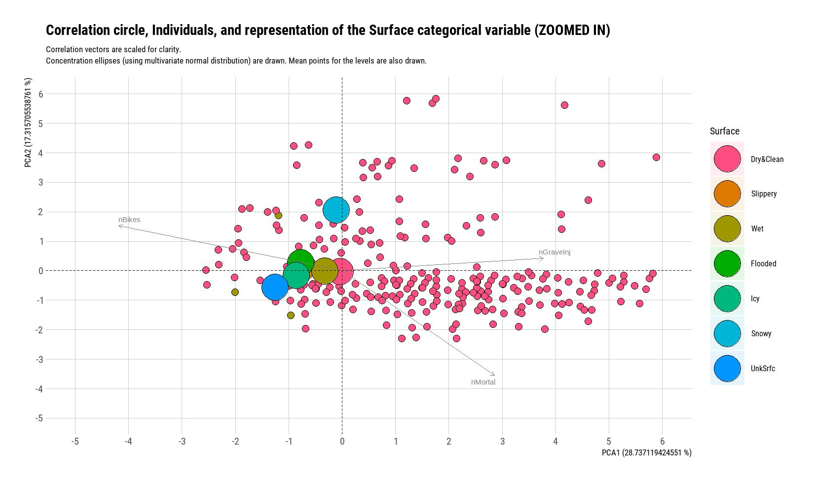
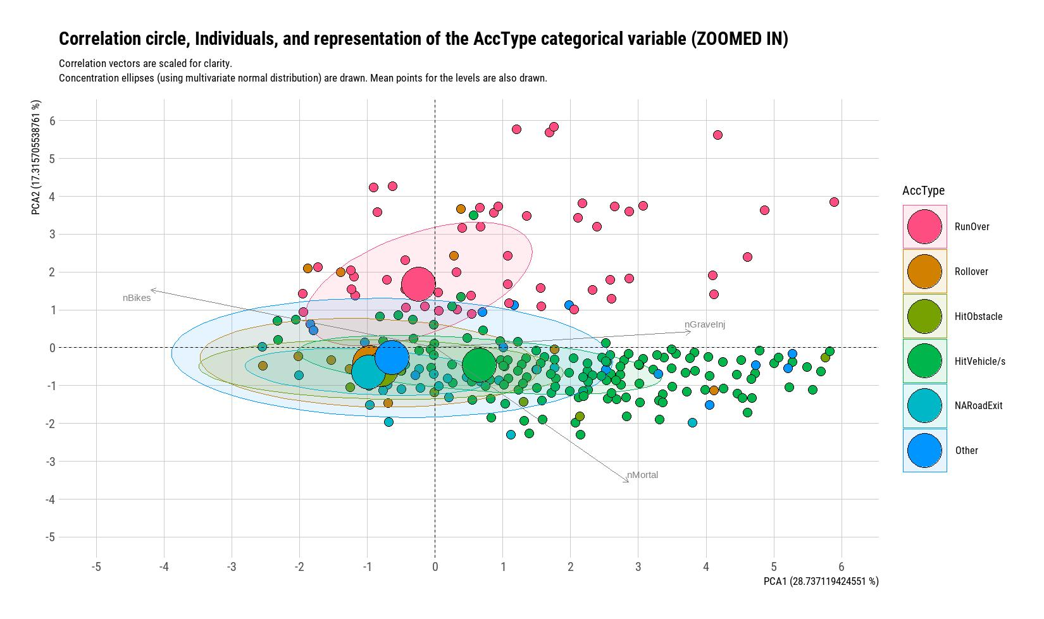
PCA: Conclusions (2)

Slide 16
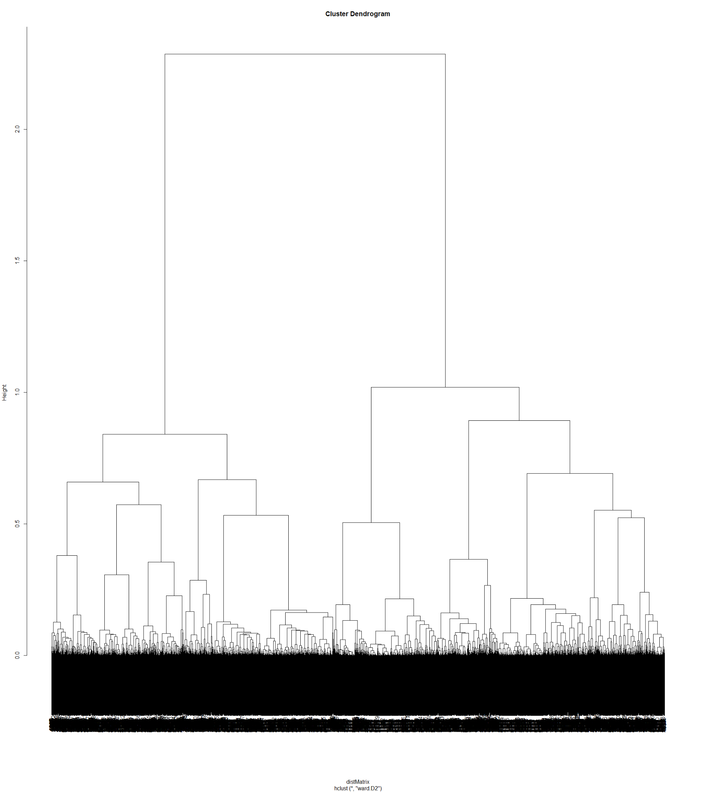
Clustering
process
Date decomposed into Year and Month
Ward’s D2 method
Gower mixed distance
Minimize inter-class inertia loss

Slide 17
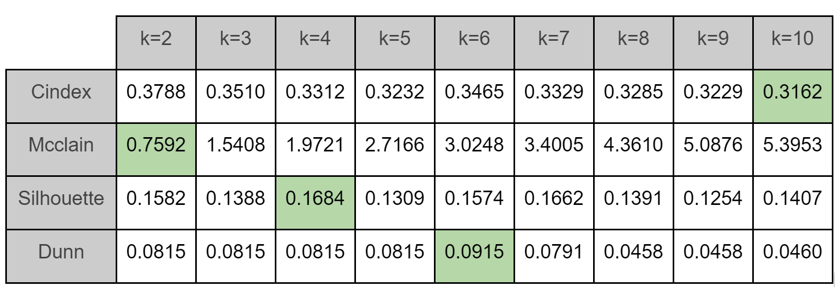
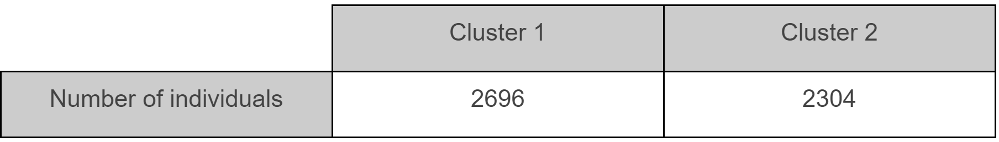
Cluster Number Discussion
KPI’s
PCA results
Expert’s opinion
Number of clusters = 2

Slide 18
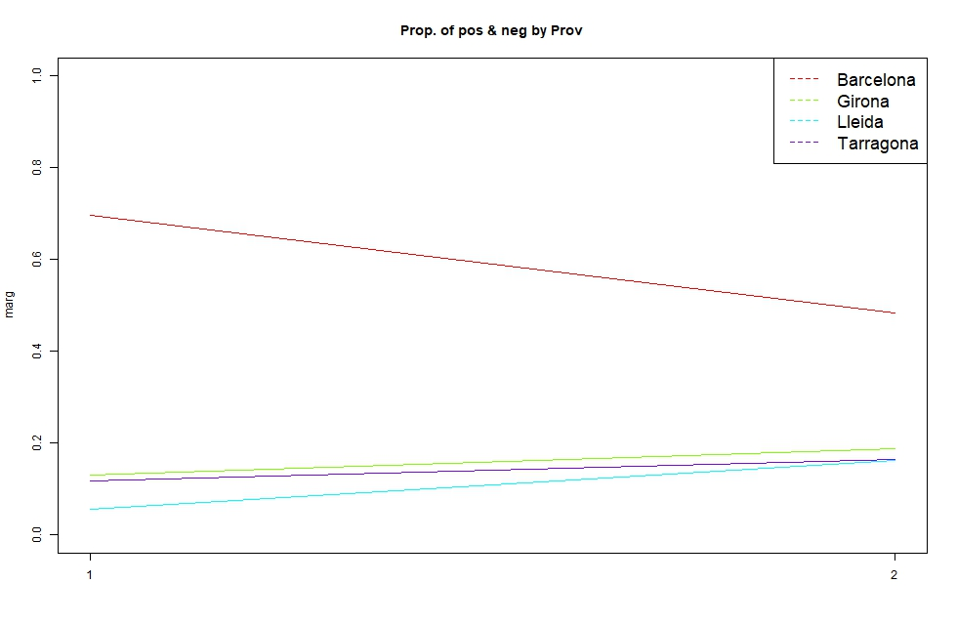
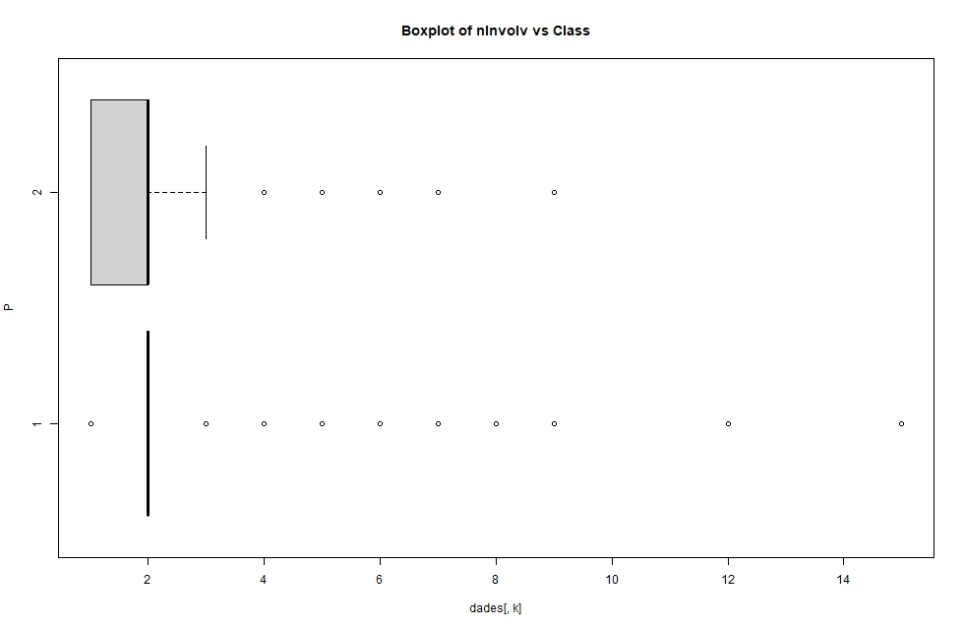
Class Interpretation Tools
Profiling plots + statistics

Slide 19
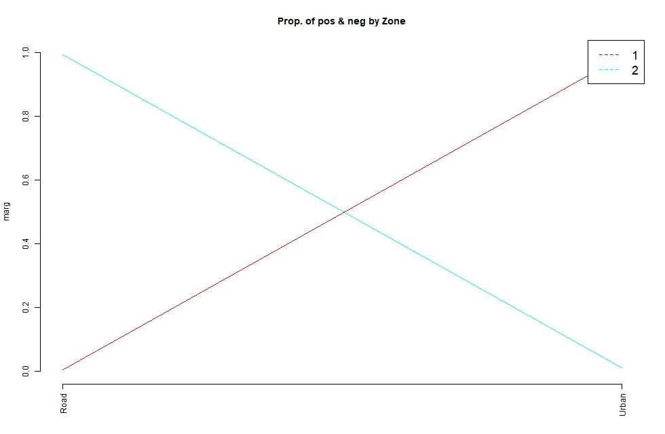
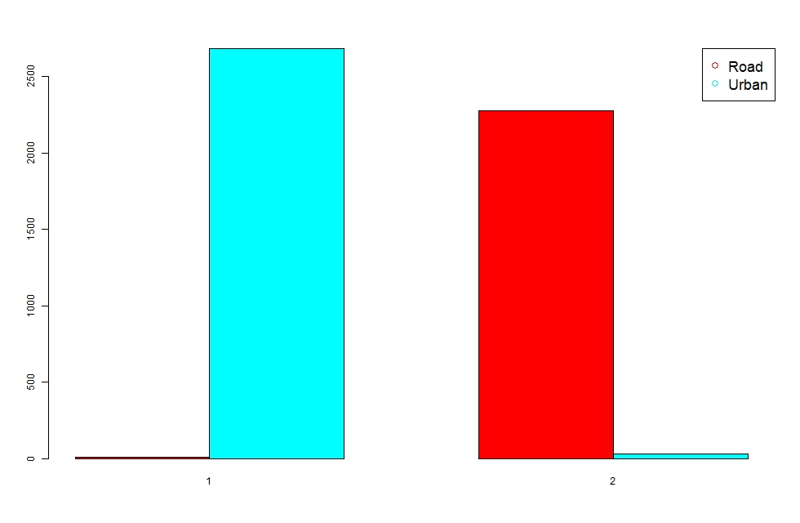

Profiling graphs or numerical information about our clusters to be highlighted

Slide 20
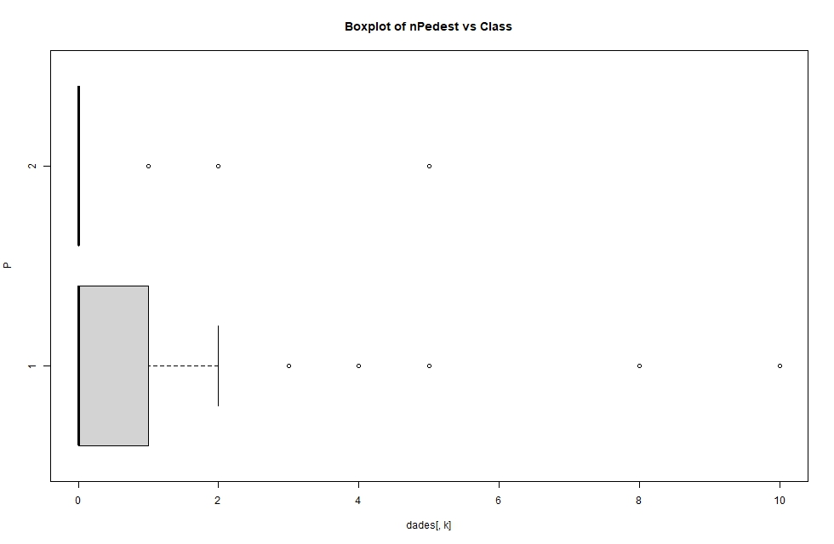
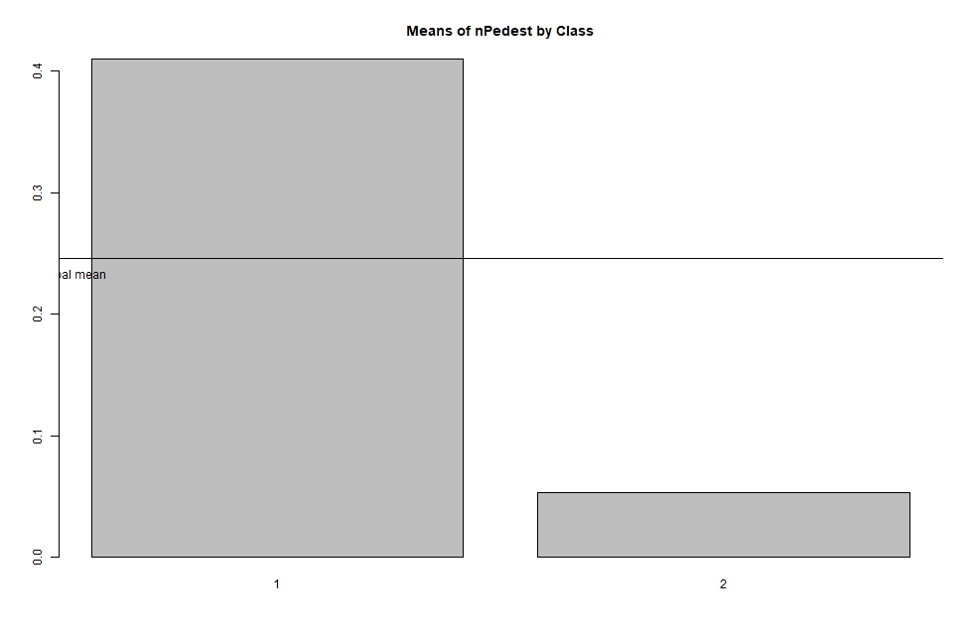

Profiling graphs or numerical information about our clusters to be highlighted

Slide 21
Final Class Profiling
CLUSTER 1:
Urban zones
Run overs
↓ mortality
↓ minor injured victims
↑ number of pedestrians
CLUSTER 2:
Road zones
Unknown exits from the road
↑ mortality
↑ minor injured victims
↓ number of pedestrians

Slide 22
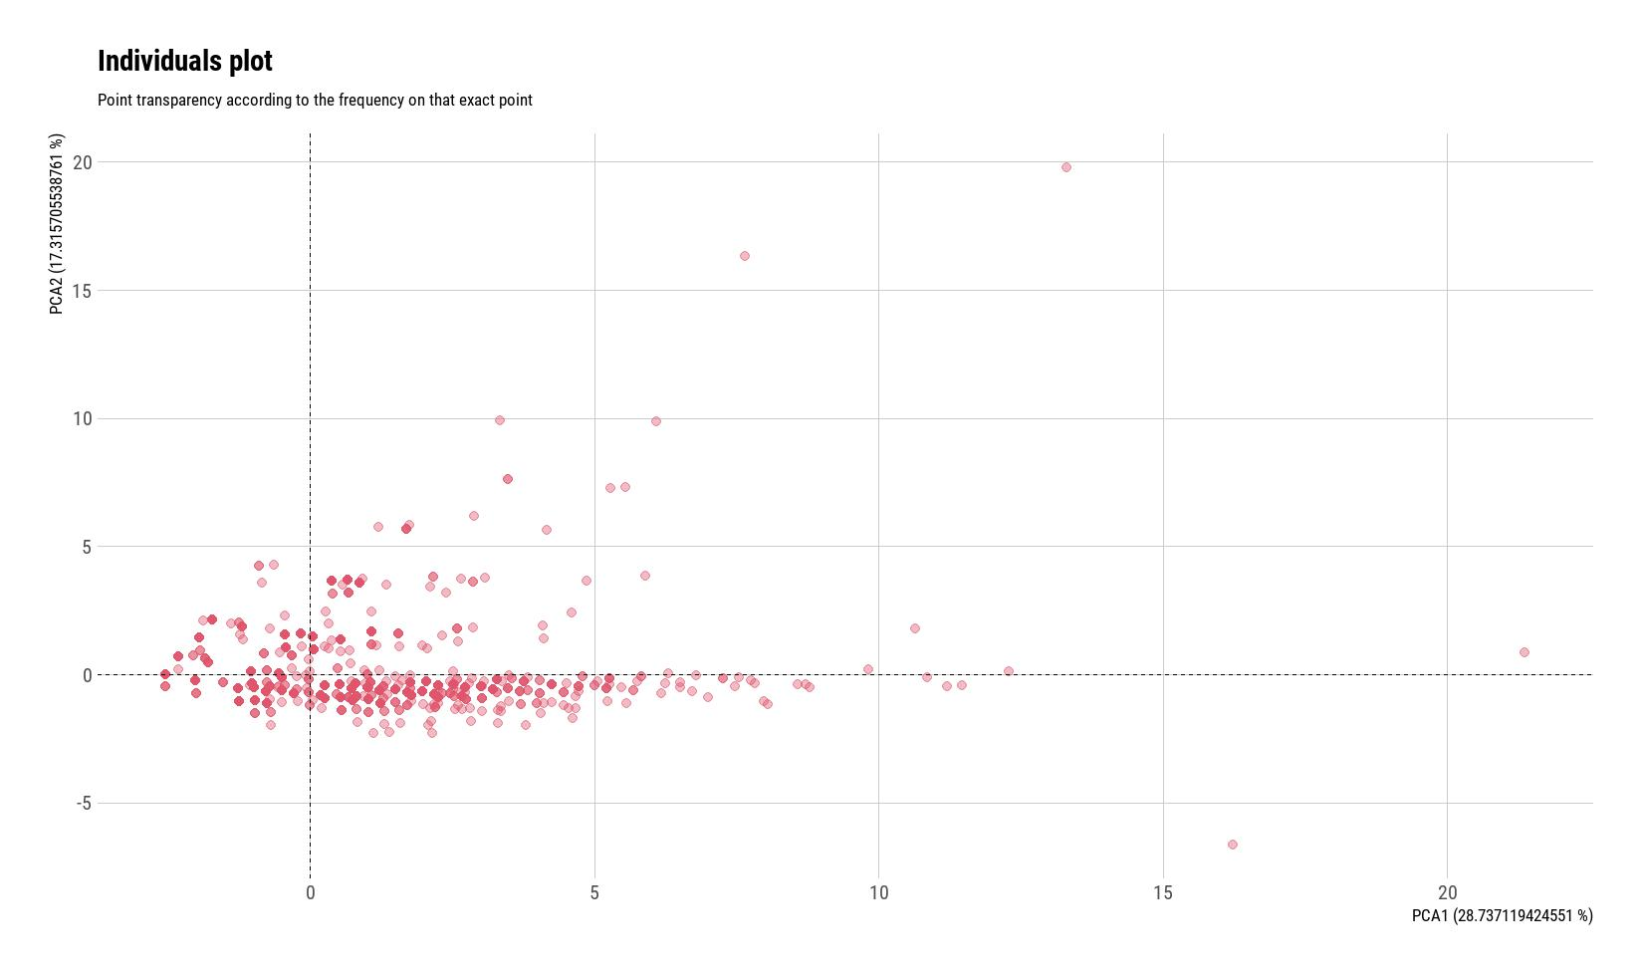
PCA and Clustering Conclusions
CLUSTER 1 | CLUSTER 2
not so s. accidents | serious accidents
low speeds | high speeds
urban roads | rural roads
populated regions | rural regions
not so many un. imp. | many un. implicated
SIMILAR
similar conclusions on PCA!

Slide 23
General Conclusions
Urban, populated, low speeds
focus protect pedestrians
most dangerous, most units implicated.
More sector radars
rural roads, high speed
car, bicycle
Increase distance
icy surface
Very mortal. Extreme safety measures
snowy surface
Related with Runovers
Wet, slippery, flooded
Related with Rollowers, hitting obstacles, road exits.

Slide 24
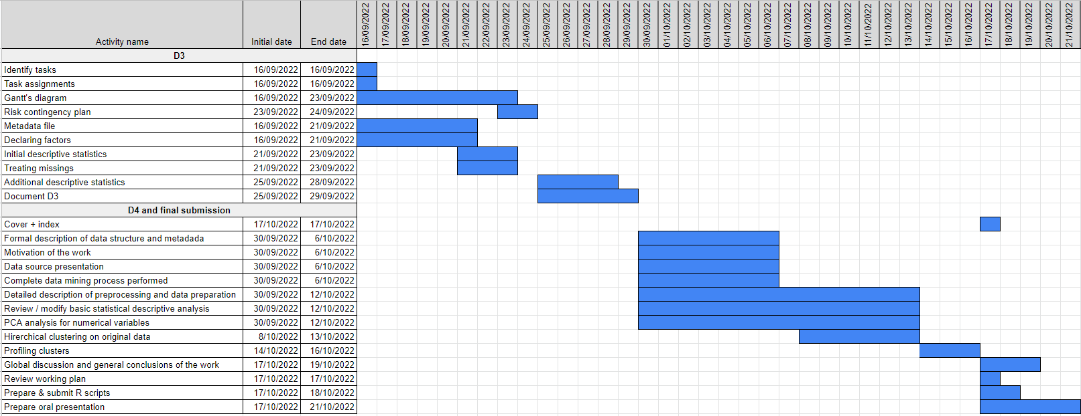
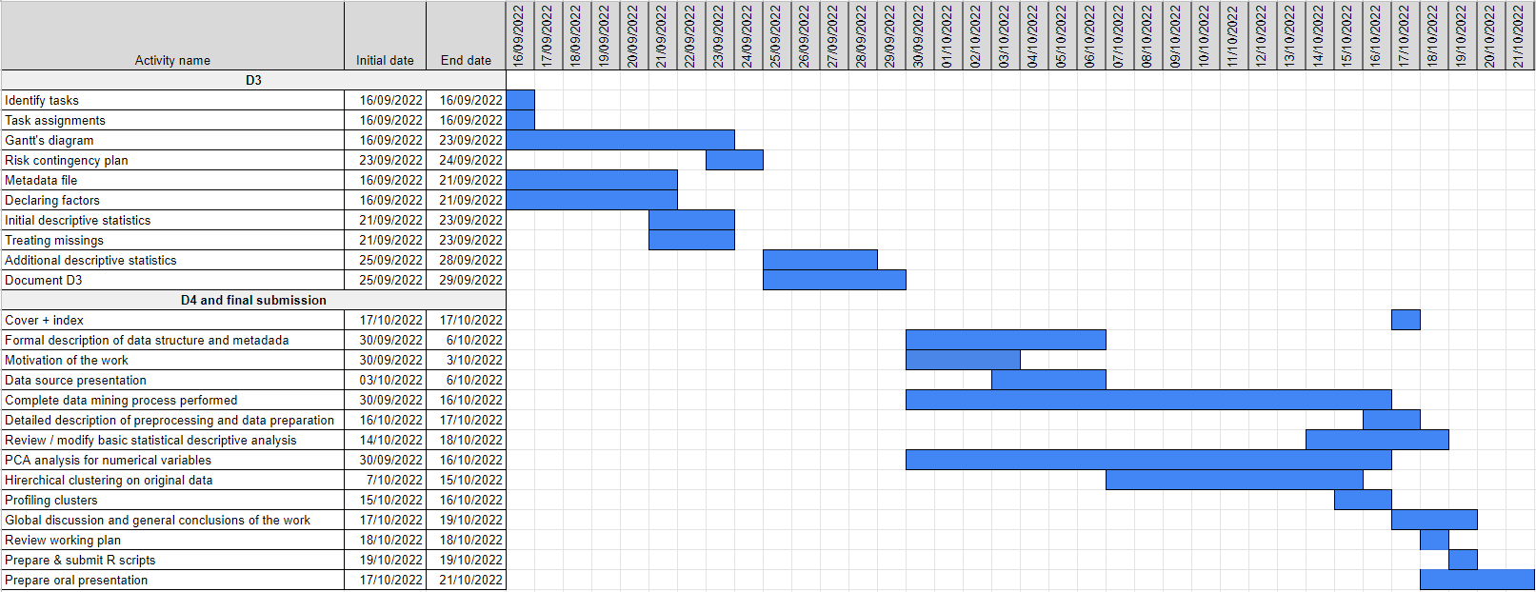
Task Scheduling
Original Gantt Chart
Final Gantt Chart

Slide 25
THANKS
Any questions?

