Slide 1

Programming in Python

Slide 2
Professor: Steve Haga
Office: EC9037
Office Hours: Monday 12:00-2:00
Friday 10:00-12:00
Email: stevewhaga@yahoo.com
(Please write the subject heading in English.)
TA: Pavan Kumar
Office: EC5037
Office hours: Friday 2:00-4:00 pm
Email: pavankumarmp@cereal.cse.nsysu.edu.tw
Sometimes
in EC5012,
not EC9037.

Slide 3
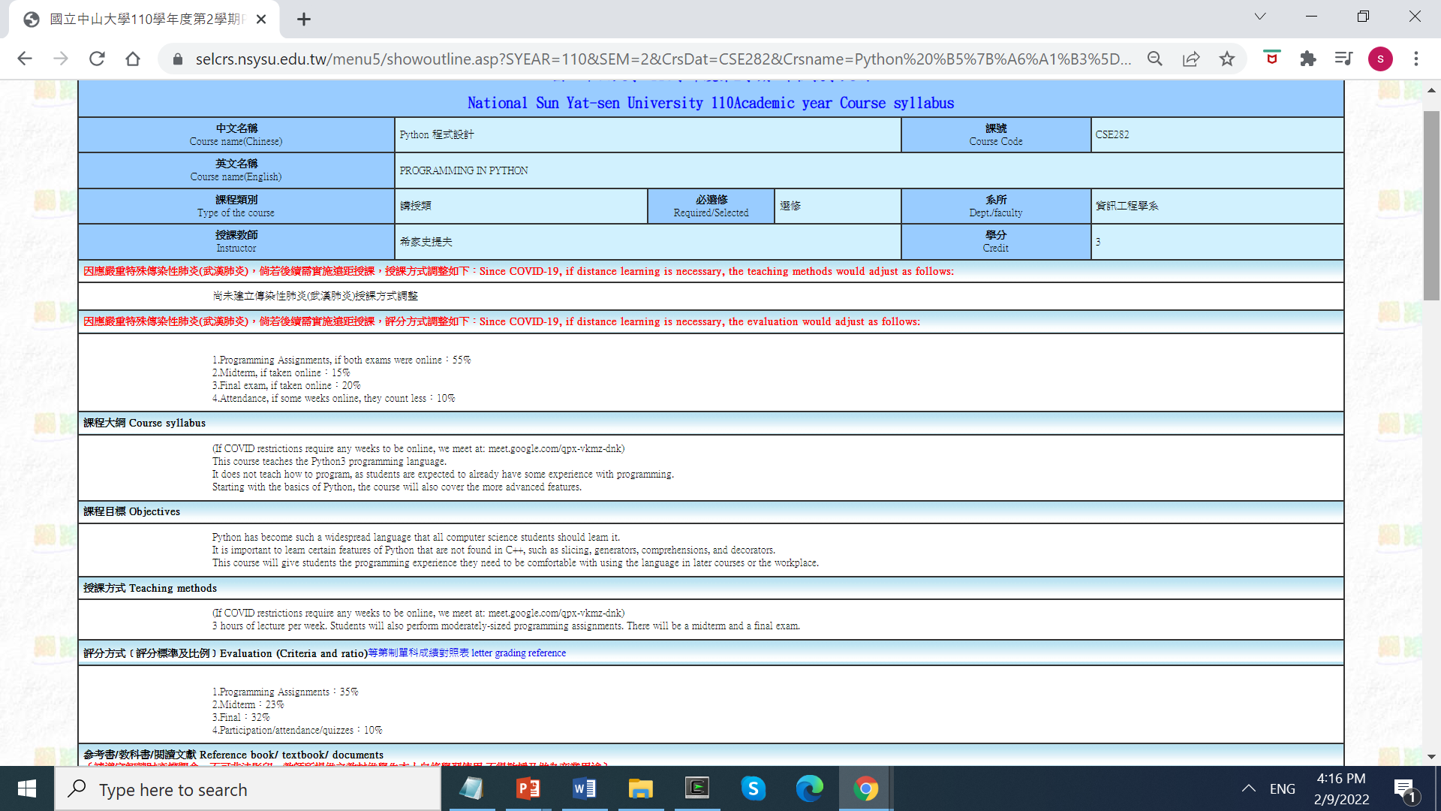
This is our course number: CSE282.
See how much the programs are worth? So don’t not do them. (And don’t copy them because both the copier and the helper will fail the course.)

Slide 4
Who can take the course?
This is not CSE 101.
Many schools use Python in their intro programming class.
But not NSYSU. We use C++ for that class.
So I’ll sometimes compare to C examples (but won’t test you on C)
This is CSE 282.

Slide 5
Who can take the course?
This is not CSE 101.
Many schools use Python in their intro programming class.
But not NSYSU. We use C++ for that class.
So I’ll sometimes compare to C examples (but won’t test you on C)
This is CSE 282. (ie, aimed at 2nd year CSE students)
2nd year students know how to program.
If you can’t program, you don’t have enough background.
But, that being said, the programming workload is reasonable.
2nd year students are not expert programmers.
The workload and topics covered are matched to this level.

Slide 6
Who can take the course?
What if you could not register because it is full?
I can open seats, but we are limited by classroom size.
If you have a special consideration, come see me after class.

Slide 7

So how is Python syntax different than C?
vs

Slide 8
Comparing Python to C
Comparing Python to C
The syntax of:
Comments
Separating statements
Multi-statement code blocks
Multi-line statements
Variable (identifier) names

Slide 9
Comparing Python to C
Comparing Python to C
comments
C allows two styles of comments ("//" and "/*…*/"):
a=1; // This is a single-line comment
b=2; /* This is a multi-
line comment */
Python only has one style, the single-line comment ("#"):
a=1; # As you can see, “#” is like C’s “//”
b=2; # The only way to get a multi-line
# comment is to use multiple “#”
But there is an exception for function headers:
Good programming practice is to put a comment at the top of each function, indicating its inputs, outputs, and behavior.
These comments go into something called a docstring. Docstrings can be multi-line.

Slide 10
Comparing Python to C
Comparing Python to C
separating statements
C requires a semicolon ";" after each statement:
a=1;
b=2;
c=3; d=4;
Python only requires ";" to separate statements on same line:
a=1 # Putting no semicolon here is OK.
b=2; # Putting a semicolon here is OK. It is optional.
c=3; d=4 # This semicolon separator is required.
As we can see above, Python allows you to put many statements on one line.
But we’ll find out that this is not always true. In some cases, only one statement is allowed.

Slide 11
Comparing Python to C
Comparing Python to C
multi-statement code blocks
C defines code blocks by offsetting them with curly braces {}:
while (1) {
printf("Hi");
printf("Bye"); }
Python requires proper indentation (縮進) to identify code blocks:
while (1):
print("Hi")
print("Bye")
The number of spaces in the indentation is up to you, but all statements within the block must be indented by the same amount.
Everyone just uses the tab key.

Slide 12
Comparing Python to C
Comparing Python to C
multi-line statements
C generally ignores newline "\n" characters:
a
=
1
;
Python requires a "\" at the end of lines that continue:
a\
=\
1
Except for newlines inside of […], {…}, (…), or '''…'''/"""…""":
a= [1, 2,
3, 4]
b= '''A multiline string'''

Slide 13
Comparing Python to C
Comparing Python to C
Variable (identifier) names
C and Python both have roughly the same rules:
The first character must be a letter or an underscore (_).
Additional characters may be letters, numbers or underscores.
Letters are case-sensitive (大小寫有區別).
Language keywords can’t be used as variable names (eg. for, if, etc).
Although Python has no other rules, it does suggest that you follow certain naming conventions (命名慣例):
First character is an upper case (大寫) letter → A class name
First character is an underscore → An identifier that is meant to be private
First two characters are underscores → An identifier that is strongly private
Last two characters are underscores → A language-defined special name

Slide 14
Comparing Python3 to Python2
Comparing Python to C
(Since we’re on the subject of comparing)
Python3 isn’t backwards compatible to Python2.
For example: Python3 defines print() as a function, whereas it was a keyword in Python2.
This means that Python2 did not require parentheses () after the word “print”, because it wasn’t a function call.
The redefining of print is the smallest difference that there is between the versions:
Because, to update Python2 code, just add parentheses ().
It is also the biggest difference between the versions:
Because it affects almost every Python2 program.

Slide 15

So what is so special about Python?

Slide 16
Design considerations of Python:
Readability (可讀性)
Simpler keywords, programming structures, data types.
Enforced indentation (強制縮排), less punctuation (標點符號)
Learnability (易學性)
Simpler keywords, programming structures, data types.
Many schools use it in their introductory computer courses.
Bug Preventability (預防錯誤)
Enforced indentation prevents misplaced blocks.
Lack of pointers prevents most memory errors.
Type checking prevents misinterpreting data values.
Maintainability, Portability, Scalability, Modularity (模組化)
Many toolsets exist for many application areas.

Slide 17
What is Python?
It is a High Level Language.
That means it’s higher-level than C, C++, Java, etc.
And that means:
☺ It requires less coding to implement an algorithm.
☹ The compiler has to work more to get an executable.

Slide 18
What is Python?
It is a High Level Language.
That means it’s higher-level than C, C++, Java, etc.
And that means:
☺ It requires less coding to implement an algorithm.
☹ The compiler has to work more to get an executable.
And if the compiler does the work, then that means:
☺ It won’t have bugs in those places (I mean, in the places with compiler-generated low-level stuff).
☹ But the executable might be less efficient.

Slide 19
What Is A High Level Language?
1940’s First low-level languages (Assembly)
1950’s First medium-level languages (FORTRAN)
First objects (Lisp)
1960’s First object-oriented languages (Simula 67)
First garbage collection (Lisp)
1970’s First scripting languages (UNIX)
First strong typing
1980’s First high level languages (Perl)
1990’s More high level languages (Python, PHP, Ruby, Visual Basic, etc.)
1940’s First low-level languages (Assembly)
1950’s First medium-level languages (FORTRAN)
First objects (Lisp)
1960’s First object-oriented languages (Simula 67)
First garbage collection (Lisp)
1970’s First scripting languages (UNIX)
First strong typing
1980’s First high level languages (Perl)
1990’s More high level languages (Python, PHP, Ruby, Visual Basic, etc.)
1940’s First low-level languages (Assembly)
1950’s First medium-level languages (FORTRAN)
First objects (Lisp)
1960’s First object-oriented languages (Simula 67)
First garbage collection (Lisp)
1970’s First scripting languages (UNIX)
First strong typing
1980’s First high level languages (Perl)
1990’s More high level languages (Python, PHP, Ruby, Visual Basic, etc.)
Python takes the idea of objects to its limit: everything is an object.
Not just data, but even its functions, are objects.

Slide 20
Python is an interpreted language
Interpreted languages aren’t precompiled (直譯語言不需要事前編譯).
Instead, each line is compiled when it is reached.
But just-in-time (JIT) compilation or precompilation can be used to reduce overhead delays.
Python can be run interactively or in script mode.
Interactive mode (互動模式): type commands as they run.
It is a good way to test things out, especially when learning the language.
Script mode (腳本模式): pass in the commands from a file.

Slide 21
Python in interactive mode
python3
Python 2.7.10 (default, Jun 1 2015, 18:05:38)
[GCC 4.9.2] on
Type "help", "copyright", or "license" for more information.
>>> x=5
>>> print x, x+1
5 6
>>> x="pineapple"
>>> print x, x+1
pineapple
(most recent call last):
File "<>", line 1, in <module>
TypeError: cannot concatenate '' and 'int' objects
%
This is how I run Python, from within UNIX.
I encourage you to bring a laptop, and to follow along with the lecture examples…
Here, we imagine a UNIX terminal with a “%” for the prompt symbol. The blinking cursor indicates that it is waiting for a UNIX command.
Q: But how will you run Python?
A1: Well, you can do it like me: Use Cygwin, a free UNIX emulator (but click the Python box when you install it).
A2: Or you can use any other Python3 software you want. Use google to find out what the options are.

Slide 22
Python in interactive mode
% python3
Python 3.9.10 (main, Jan 20 2022, 21:37:52)
[GCC 11.2.0] on cygwin
Type "help", "copyright", or "license" for more.
x=5
>>>
>>>
I have now written my program’s first command (a variable initialization).
The “>>>” is Python’s interactive prompt. I can now begin programming (but it doesn’t “feel” like programming because it is interactive).

Slide 23
Python in interactive mode
% python3
Python 3.9.10 (main, Jan 20 2022, 21:37:52)
[GCC 11.2.0] on cygwin
Type "help", "copyright", or "license" for more.
>>> x=5
>>> print x, x+1
5 6
>>> x="pineapple"
>>> print x, x+1
pineapple
(most recent call last):
File "<>", line 1, in <module>
TypeError: cannot concatenate '' and 'int' objects
>>>
Python gave no error message. That means it has accepted the command and is waiting for the rest of the program.

Slide 24
Python in interactive mode
% python3
Python 3.9.10 (main, Jan 20 2022, 21:37:52)
[GCC 11.2.0] on cygwin
Type "help", "copyright", or "license" for more.
x=5
print(x, x+1)
5 6
>>>
>>>
>>>
This second command will have an output.
And here is that output.
Now that we are done, how to end the interactive session? Hit Ctrl-d.

Slide 25
Python in interactive mode
% python3
Python 3.9.10 (main, Jan 20 2022, 21:37:52)
[GCC 11.2.0] on cygwin
Type "help", "copyright", or "license" for more.
x=5
print(x, x+1)
5 6
>>>
>>>
>>>
>>>
%
Python is done. We’re back to the UNIX prompt.
Now that we are done, how to end the interactive session? Hit Ctrl-D.

Slide 26
Python in interactive mode
Python in scripted mode
cat script.py
x=5
print x, x+1
for x in range(3):
print x
% python script.py
5 6
0
1
2
%
%
This file has a “.py” extension.
“cat” is a UNIX com- mand to display a file.
All of the example scripts in this lecture are posted to the cyberuniversity.
As was already said, this is how I run Python.

Slide 27
Python in scripted mode
%
%
cat script.py
x=5
print(x, x+1)
python3 script.py
python script.py
5 6
0
1
2
%
So this file is the same as what we had interactively typed a minute ago.
Now we run Python, but this time providing a script name on the command line.

Slide 28
Python in scripted mode
% cat script.py
x=5
print(x, x+1)
% python3 script.py
5 6
%
It produces the same output as before.
We have the “%” prompt. This means Python is done and UNIX is running again. No need to hit Ctrl-D, because Python knows the script has finished.

Slide 29
An interactive display isn't a print
% python3
Python 3.9.10 (main, Jan 20 2022, 21:37:52)
[GCC 11.2.0] on cygwin
Type "help", "copyright", or "license" for more.
a=2;b=-5;c=-3
print(b)
-5
>>> (-b+(b*b-4*a*c)**0.5)/(2*a)
3.0
>>> _
3.0
>>> x=2*_
>>> _+x
9.0
%
>>>
>>>
>>>
Here we've defined three variables on one line.
Yes, the memory location named "b" does hold a -5.

Slide 30
An interactive display isn't a print
% python3
Python 3.9.10 (main, Jan 20 2022, 21:37:52)
[GCC 11.2.0] on cygwin
Type "help", "copyright", or "license" for more.
>>> a=2;b=-5;c=-3
>>> print(b)
-5
>>> a
3.0
>>> _
3.0
>>> x=2*_
>>> _+x
9.0
What is this? It’s not a normal command such as you would expect to see in a program.

Slide 31
An interactive display isn't a print
% python3
Python 3.9.10 (main, Jan 20 2022, 21:37:52)
[GCC 11.2.0] on cygwin
Type "help", "copyright", or "license" for more.
>>> a=2;b=-5;c=-3
>>> print(b)
-5
>>> a
2
>>> (-b+(b*b-4*a*c)**0.5)/(2*a)
3.0
>>> x=2*_
>>> _+x
9.0
Oh. It seems to be a kind of display statement, similar to print().
It is clearly a feature that exists because of the interactive mode.

Slide 32

An interactive display isn't a print
% python3
Python 3.9.10 (main, Jan 20 2022, 21:37:52)
[GCC 11.2.0] on cygwin
Type "help", "copyright", or "license" for more.
>>> a=2;b=-5;c=-3
>>> print(b)
-5
>>> a
2
(-b+(b*b-4*a*c)**0.5)/(2*a)
3.0
>>>
>>> _+x
9.0
>>>
This example shows that you can display the result of complicated expressions. In this case, the quadratic . . equation (二次公式) : ..
It displays the result.
(Sometimes I find it to be useful to use Python interactive mode as a calculator, even when I’m not writing a program.)

Slide 33
An interactive display isn't a print
% python3
Python 3.9.10 (main, Jan 20 2022, 21:37:52)
[GCC 11.2.0] on cygwin
Type "help", "copyright", or "license" for more.
>>> a=2;b=-5;c=-3
>>> print(b)
-5
>>> a
2
>>> (-b+(b*b-4*a*c)**0.5)/(2*a)
3.0
>>> _
3.0
>>>
What is this? It is a special variable that holds the previous value or message displayed. (But this does not include things that were printed.)
Yes, the previous displayed value was 3.0

Slide 34
An interactive display isn't a print
% python3
Python 3.9.10 (main, Jan 20 2022, 21:37:52)
[GCC 11.2.0] on cygwin
Type "help", "copyright", or "license" for more.
>>> a=2;b=-5;c=-3
>>> print(b)
-5
>>> a
2
>>> (-b+(b*b-4*a*c)**0.5)/(2*a)
3.0
>>> _
3.0
x=a*_
>>>
You can use “_” in an expression, just like how you use other variables.

Slide 35
An interactive display isn't a print
Python 3.9.10 (main, Jan 20 2022, 21:37:52)
[GCC 11.2.0] on cygwin
Type "help", "copyright", or "license" for more.
>>> a=2;b=-5;c=-3
>>> print(b)
-5
>>> a
2
>>> (-b+(b*b-4*a*c)**0.5)/(2*a)
3.0
>>> _
3.0
>>> x=a*_
>>>
Although nothing has displayed, something did happen: x got assigned 6.0. And, since this command didn’t display anything, the previously displayed value is still 3.0.
But why didn’t it display the answer (6.0)? It is because this was an assignment statement, not a display command.

Slide 36
An interactive display isn't a print
Python 3.9.10 (main, Jan 20 2022, 21:37:52)
[GCC 11.2.0] on cygwin
Type "help", "copyright", or "license" for more.
>>> a=2;b=-5;c=-3
>>> print(b)
-5
>>> a
2
>>> (-b+(b*b-4*a*c)**0.5)/(2*a)
3.0
>>> _
3.0
>>> x=a*_
_+x
>>>
Although nothing has displayed, something did happen: x got assigned 6.0. And, since this command didn’t display anything, the previously displayed value is still 3.0.
So what will this line do?

Slide 37
An interactive display isn't a print
[GCC 11.2.0] on cygwin
Type "help", "copyright", or "license" for more.
>>> a=2;b=-5;c=-3
>>> print(b)
-5
>>> a
2
>>> (-b+(b*b-4*a*c)**0.5)/(2*a)
3.0
>>> _
3.0
>>> x=a*_
>>> _+x
9.0
Although nothing has displayed, something did happen: x got assigned 6.0. And, since this command didn’t display anything, the previously displayed value is still 3.0.
So what will this line do?

Slide 38
An interactive display isn't a print
Type "help", "copyright", or "license" for more.
>>> a=2;b=-5;c=-3
>>> print(b)
-5
>>> a
2
>>> (-b+(b*b-4*a*c)**0.5)/(2*a)
3.0
>>> _
3.0
>>> x=a*_
>>> _+x
9.0
>>>
Although nothing has displayed, something did happen: x got assigned 6.0. And, since this command didn’t display anything, the previously displayed value is still 3.0.
So what will this line do?
3+6.

Slide 39
An interactive display isn't a print
Type "help", "copyright", or "license" for more.
>>> a=2;b=-5;c=-3
>>> print(b)
-5
>>> a
2
>>> (-b+(b*b-4*a*c)**0.5)/(2*a)
3.0
>>> _
3.0
>>> x=a*_
>>> _+x
9.0
_+_
>>>
What will this give?

Slide 40
An interactive display isn't a print
>>> a=2;b=-5;c=-3
>>> print(b)
-5
>>> a
2
>>> (-b+(b*b-4*a*c)**0.5)/(2*a)
3.0
>>> _
3.0
>>> x=a*_
>>> _+x
9.0
>>> _+_
18.0

Slide 41
An interactive display isn't a print
>>> print(b)
-5
>>> a
2
>>> (-b+(b*b-4*a*c)**0.5)/(2*a)
3.0
>>> _
3.0
>>> x=a*_
>>> _+x
9.0
>>> _+_
18.0
>>>

Slide 42
An interactive display isn't a print
>>> print(b)
-5
>>> a
2
>>> (-b+(b*b-4*a*c)**0.5)/(2*a)
3.0
>>> _
3.0
>>> x=a*_
>>> _+x
9.0
>>> _+_
18.0
print(_+_)
>>>

Slide 43
An interactive display isn't a print
-5
>>> a
2
>>> (-b+(b*b-4*a*c)**0.5)/(2*a)
3.0
>>> _
3.0
>>> x=a*_
>>> _+x
9.0
>>> _+_
18.0
>>> print(_+_)
36.0

Slide 44
An interactive display isn't a print
>>> a
2
>>> (-b+(b*b-4*a*c)**0.5)/(2*a)
3.0
>>> _
3.0
>>> x=a*_
>>> _+x
9.0
>>> _+_
18.0
>>> print(_+_)
36.0
>>>
_

Slide 45
An interactive display isn't a print
2
>>> (-b+(b*b-4*a*c)**0.5)/(2*a)
3.0
>>> _
3.0
>>> x=a*_
>>> _+x
9.0
>>> _+_
18.0
>>> print(_+_)
36.0
>>> _
18.0

Slide 46
An interactive display isn't a print
>>> (-b+(b*b-4*a*c)**0.5)/(2*a)
3.0
>>> _
3.0
>>> x=a*_
>>> _+x
9.0
>>> _+_
18.0
>>> print(_+_)
36.0
>>> _
18.0
>>>

Slide 47
An interactive display isn't a print
Judging by the name, it sounds like this Python script will use a "_".
cat scriptUsesUnderscore.py
a=2;b=-5;c=-3
print(b)
a
(-b+(b*b-4*a*c)**0.5)/(2*a)
_
x=a*_
_+x
_+_
print(_+_)
_
python3 ScriptUsesUnderscore.py
-5
Traceback (most recent call last):
File "ScriptUsesUnderscore.py", line 5, in <module>
NameError: name '_' is not defined
%
%
%
This script looks familiar. It contains all of the commands the we used interactively, on the previous slide.
“cat” is just the UNIX command to display a file.
And, yes, it does use a "_".

Slide 48
An interactive display isn't a print
cat scriptUsesUnderscore.py
a=2;b=-5;c=-3
print(b)
a
(-b+(b*b-4*a*c)**0.5)/(2*a)
_
x=a*_
_+x
_+_
print(_+_)
_
python3 ScriptUsesUnderscore.py
-5
Traceback (most recent call last):
File "ScriptUsesUnderscore.py", line 5, in <module>
NameError: name '_' is not defined
%
%
%
This line executed, printing this -5 (which is the value of b).

Slide 49
An interactive display isn't a print
cat scriptUsesUnderscore.py
a=2;b=-5;c=-3
print(b)
a
(-b+(b*b-4*a*c)**0.5)/(2*a)
_
x=a*_
_+x
_+_
print(_+_)
_
python3 ScriptUsesUnderscore.py
-5
Traceback (most recent call last):
File "ScriptUsesUnderscore.py", line 5, in <module>
NameError: name '_' is not defined
%
%
%
This line executed, printing this -5 (which is the value of b).
This line executed, but it isn't a command, so there was no output (it was ignored).

Slide 50
An interactive display isn't a print
cat scriptUsesUnderscore.py
a=2;b=-5;c=-3
print(b)
a
(-b+(b*b-4*a*c)**0.5)/(2*a)
_
x=a*_
_+x
_+_
print(_+_)
_
python3 ScriptUsesUnderscore.py
-5
Traceback (most recent call last):
File "ScriptUsesUnderscore.py", line 5, in <module>
NameError: name '_' is not defined
%
%
%
This line executed, printing this -5 (which is the value of b).
This line executed, but it isn't a command, so there was no output (it was ignored).
No output for this line either.

Slide 51
An interactive display isn't a print
cat scriptUsesUnderscore.py
a=2;b=-5;c=-3
print(b)
a
(-b+(b*b-4*a*c)**0.5)/(2*a)
_
x=a*_
_+x
_+_
print(_+_)
_
python3 ScriptUsesUnderscore.py
-5
Traceback (most recent call last):
File "ScriptUsesUnderscore.py", line 5, in <module>
NameError: name '_' is not defined
%
%
%
This line executed, printing this -5 (which is the value of b).
This line executed, but it isn't a command, so there was no output (it was ignored).
No output for this line either.
But when it hit this line, it crashed the program, because the "_" variable is allowed only in interactive mode.

Slide 52
An interactive display isn't a print
cat scriptUsesUnderscore.py
a=2;b=-5;c=-3
print(b)
a
(-b+(b*b-4*a*c)**0.5)/(2*a)
_
x=a*_
_+x
_+_
print(_+_)
_
python3 ScriptUsesUnderscore.py
-5
Traceback (most recent call last):
File "ScriptUsesUnderscore.py", line 5, in <module>
NameError: name '_' is not defined
%
%
%
This line executed, printing this -5 (which is the value of b).
This line executed, but it isn't a command, so there was no output (it was ignored).
No output for this line either.
But when it hit this line, it crashed the program, because the "_" variable is allowed only in interactive mode.
These lines never executed.

Slide 53
Most Languages Have Dynamic Value Binding:
(動態的)
(數值)
(連結)
(動態
(連結的)
數值)

Slide 54
Most Languages Have Dynamic Value Binding:
% cat cube.cpp
#include <iostream>
using namespace std;
int main()
{ int i;
for (i=0;i<39;i++) cout<<"*";
cout<<"\n* Example Program to Compute the Cube *\n";
for (i=0;i<39;i++) cout<<"*";
cout<<"\nEnter a number: ";
cin>>i;
cout<<i<<"**3 = "<<i*i*i<<endl;
}
%
Here is a C++ program...

Slide 55
Most Languages Have Dynamic Value Binding:
% cat cube.cpp
#include <iostream>
using namespace std;
int main()
{ int i;
for (i=0;i<39;i++) cout<<"*";
cout<<"\n* Example Program to Compute the Cube *\n";
for (i=0;i<39;i++) cout<<"*";
cout<<"\nEnter a number: ";
cin>>i;
cout<<i<<"**3 = "<<i*i*i<<endl;
}
% g++ -o cube.x cube.cpp
Here is a C++ program...
Let’s compile it (if this were Python, we could skip this step).

Slide 56
Most Languages Have Dynamic Value Binding:
#include <iostream>
using namespace std;
int main()
{ int i;
for (i=0;i<39;i++) cout<<"*";
cout<<"\n* Example Program to Compute the Cube *\n";
for (i=0;i<39;i++) cout<<"*";
cout<<"\nEnter a number: ";
cin>>i;
cout<<i<<"**3 = "<<i*i*i<<endl;
}
% g++ -o cube.x cube.cpp
% ./cube.x
Let’s run it.
%

Slide 57
Most Languages Have Dynamic Value Binding:
using namespace std;
int main()
{ int i;
for (i=0;i<39;i++) cout<<"*";
cout<<"\n* Example Program to Compute the Cube *\n";
for (i=0;i<39;i++) cout<<"*";
cout<<"\nEnter a number: ";
cin>>i;
cout<<i<<"**3 = "<<i*i*i<<endl;
}
% g++ -o cube.x cube.cpp
% ./cube.x
***************************************

Slide 58
Most Languages Have Dynamic Value Binding:
int main()
{ int i;
for (i=0;i<39;i++) cout<<"*";
cout<<"\n* Example Program to Compute the Cube *\n";
for (i=0;i<39;i++) cout<<"*";
cout<<"\nEnter a number: ";
cin>>i;
cout<<i<<"**3 = "<<i*i*i<<endl;
}
% g++ -o cube.x cube.cpp
% ./cube.x
***************************************
* Example Program to Compute the Cube *

Slide 59
Most Languages Have Dynamic Value Binding:
{ int i;
for (i=0;i<39;i++) cout<<"*";
cout<<"\n* Example Program to Compute the Cube *\n";
for (i=0;i<39;i++) cout<<"*";
cout<<"\nEnter a number: ";
cin>>i;
cout<<i<<"**3 = "<<i*i*i<<endl;
}
% g++ -o cube.x cube.cpp
% ./cube.x
***************************************
* Example Program to Compute the Cube *
***************************************

Slide 60
Most Languages Have Dynamic Value Binding:
for (i=0;i<39;i++) cout<<"*";
cout<<"\n* Example Program to Compute the Cube *\n";
for (i=0;i<39;i++) cout<<"*";
cout<<"\nEnter a number: ";
cin>>i;
cout<<i<<"**3 = "<<i*i*i<<endl;
}
% g++ -o cube.x cube.cpp
% ./cube.x
***************************************
* Example Program to Compute the Cube *
***************************************
Enter a number:
It’s waiting for a number.

Slide 61
Most Languages Have Dynamic Value Binding:
for (i=0;i<39;i++) cout<<"*";
cout<<"\n* Example Program to Compute the Cube *\n";
for (i=0;i<39;i++) cout<<"*";
cout<<"\nEnter a number: ";
cin>>i;
cout<<i<<"**3 = "<<i*i*i<<endl;
}
% g++ -o cube.x cube.cpp
% ./cube.x
***************************************
* Example Program to Compute the Cube *
***************************************
Enter a number: 5
It’s waiting for a number.
Let’s give it ‘5’.

Slide 62
Most Languages Have Dynamic Value Binding:
cout<<"\n* Example Program to Compute the Cube *\n";
for (i=0;i<39;i++) cout<<"*";
cout<<"\nEnter a number: ";
cin>>i;
cout<<i<<"**3 = "<<i*i*i<<endl;
}
% g++ -o cube.x cube.cpp
% ./cube.x
***************************************
* Example Program to Compute the Cube *
***************************************
Enter a number: 5
125

Slide 63
Most Languages Have Dynamic Value Binding:
for (i=0;i<39;i++) cout<<"*";
cout<<"\nEnter a number: ";
cin>>i;
cout<<i<<"**3 = "<<i*i*i<<endl;
}
% g++ -o cube.x cube.cpp
% ./cube.x
***************************************
* Example Program to Compute the Cube *
***************************************
Enter a number: 5
5**3 = 125
%
So it works. Of course.
But let’s look at that program again...

Slide 64
Most Languages Have Dynamic Value Binding:
for (i=0;i<39;i++) cout<<"*";
cout<<"\nEnter a number: ";
cin>>i;
cout<<i<<"**3 = "<<i*i*i<<endl;
}
% g++ -o cube.x cube.cpp
% ./cube.x
***************************************
* Example Program to Compute the Cube *
***************************************
Enter a number: 5
5**3 = 125
% cat cube.cpp
But let’s look at that program again...

Slide 65
Most Languages Have Dynamic Value Binding:
cout<<"\nEnter a number: ";
cin>>i;
cout<<i<<"**3 = "<<i*i*i<<endl;
}
% g++ -o cube.x cube.cpp
% ./cube.x
***************************************
* Example Program to Compute the Cube *
***************************************
Enter a number: 5
5**3 = 125
% cat cube.cpp
#include <iostream>

Slide 66
Most Languages Have Dynamic Value Binding:
cin>>i;
cout<<i<<"**3 = "<<i*i*i<<endl;
}
% g++ -o cube.x cube.cpp
% ./cube.x
***************************************
* Example Program to Compute the Cube *
***************************************
Enter a number: 5
5**3 = 125
% cat cube.cpp
#include <iostream>
using namespace std;

Slide 67
Most Languages Have Dynamic Value Binding:
cout<<i<<"**3 = "<<i*i*i<<endl;
}
% g++ -o cube.x cube.cpp
% ./cube.x
***************************************
* Example Program to Compute the Cube *
***************************************
Enter a number: 5
5**3 = 125
% cat cube.cpp
#include <iostream>
using namespace std;
int main()

Slide 68
Most Languages Have Dynamic Value Binding:
}
% g++ -o cube.x cube.cpp
% ./cube.x
***************************************
* Example Program to Compute the Cube *
***************************************
Enter a number: 5
5**3 = 125
% cat cube.cpp
#include <iostream>
using namespace std;
int main()
{ int i;

Slide 69
Most Languages Have Dynamic Value Binding:
% g++ -o cube.x cube.cpp
% ./cube.x
***************************************
* Example Program to Compute the Cube *
***************************************
Enter a number: 5
5**3 = 125
% cat cube.cpp
#include <iostream>
using namespace std;
int main()
{ int i;
for (i=0;i<39;i++) cout<<"*";

Slide 70
Most Languages Have Dynamic Value Binding:
% ./cube.x
***************************************
* Example Program to Compute the Cube *
***************************************
Enter a number: 5
5**3 = 125
% cat cube.cpp
#include <iostream>
using namespace std;
int main()
{ int i;
for (i=0;i<39;i++) cout<<"*";
cout<<"\n* Example Program to Compute the Cube *\n";

Slide 71
Most Languages Have Dynamic Value Binding:
***************************************
* Example Program to Compute the Cube *
***************************************
Enter a number: 5
5**3 = 125
% cat cube.cpp
#include <iostream>
using namespace std;
int main()
{ int i;
for (i=0;i<39;i++) cout<<"*";
cout<<"\n* Example Program to Compute the Cube *\n";
for (i=0;i<39;i++) cout<<"*";

Slide 72
Most Languages Have Dynamic Value Binding:
* Example Program to Compute the Cube *
***************************************
Enter a number: 5
5**3 = 125
% cat cube.cpp
#include <iostream>
using namespace std;
int main()
{ int i;
for (i=0;i<39;i++) cout<<"*";
cout<<"\n* Example Program to Compute the Cube *\n";
for (i=0;i<39;i++) cout<<"*";
cout<<"\nEnter a number: ";

Slide 73
Most Languages Have Dynamic Value Binding:
***************************************
Enter a number: 5
5**3 = 125
% cat cube.cpp
#include <iostream>
using namespace std;
int main()
{ int i;
for (i=0;i<39;i++) cout<<"*";
cout<<"\n* Example Program to Compute the Cube *\n";
for (i=0;i<39;i++) cout<<"*";
cout<<"\nEnter a number: ";
cin>>i;

Slide 74
Most Languages Have Dynamic Value Binding:
Enter a number: 5
5**3 = 125
% cat cube.cpp
#include <iostream>
using namespace std;
int main()
{ int i;
for (i=0;i<39;i++) cout<<"*";
cout<<"\n* Example Program to Compute the Cube *\n";
for (i=0;i<39;i++) cout<<"*";
cout<<"\nEnter a number: ";
cin>>i;
cout<<i<<"**3 = "<<i*i*i<<endl;

Slide 75
Most Languages Have Dynamic Value Binding:
5**3 = 125
% cat cube.cpp
#include <iostream>
using namespace std;
int main()
{ int i;
for (i=0;i<39;i++) cout<<"*";
cout<<"\n* Example Program to Compute the Cube *\n";
for (i=0;i<39;i++) cout<<"*";
cout<<"\nEnter a number: ";
cin>>i;
cout<<i<<"**3 = "<<i*i*i<<endl;
}

Slide 76
Most Languages Have Dynamic Value Binding:
% cat cube.cpp
#include <iostream>
using namespace std;
int main()
{ int i;
for (i=0;i<39;i++) cout<<"*";
cout<<"\n* Example Program to Compute the Cube *\n";
for (i=0;i<39;i++) cout<<"*";
cout<<"\nEnter a number: ";
cin>>i;
cout<<i<<"**3 = "<<i*i*i<<endl;
}
%

Slide 77
Most Languages Have Dynamic Value Binding:
% cat cube.cpp
#include <iostream>
using namespace std;
int main()
{ int i;
for (i=0;i<39;i++) cout<<"*";
cout<<"\n* Example Program to Compute the Cube *\n";
for (i=0;i<39;i++) cout<<"*";
cout<<"\nEnter a number: ";
cin>>i;
cout<<i<<"**3 = "<<i*i*i<<endl;
}
%
The program only declares one variable, ‘i’.

Slide 78
Most Languages Have Dynamic Value Binding:
% cat cube.cpp
#include <iostream>
using namespace std;
int main()
{ int i;
for (i=0;i<39;i++) cout<<"*";
cout<<"\n* Example Program to Compute the Cube *\n";
for (i=0;i<39;i++) cout<<"*";
cout<<"\nEnter a number: ";
cin>>i;
cout<<i<<"**3 = "<<i*i*i<<endl;
}
%
Notice that ‘i’ does dynamically change its value.
The program only declares one variable, ‘i’.

Slide 79
Most Languages Have Dynamic Value Binding:
% cat cube.cpp
#include <iostream>
using namespace std;
int main()
{ int i;
for (i=0;i<39;i++) cout<<"*";
cout<<"\n* Example Program to Compute the Cube *\n";
for (i=0;i<39;i++) cout<<"*";
cout<<"\nEnter a number: ";
cin>>i;
cout<<i<<"**3 = "<<i*i*i<<endl;
}
%
Notice that ‘i’ does dynamically change its value.
Is ‘i’ still the same variable, when its used in a new loop?

Slide 80
Most Languages Have Dynamic Value Binding:
And that’s the point: most languages let you reuse previously-declared variables for a new purpose. (Of course the old value is overwritten and lost.)
% cat cube.cpp
#include <iostream>
using namespace std;
int main()
{ int i;
for (i=0;i<39;i++) cout<<"*";
cout<<"\n* Example Program to Compute the Cube *\n";
for (i=0;i<39;i++) cout<<"*";
cout<<"\nEnter a number: ";
cin>>i;
cout<<i<<"**3 = "<<i*i*i<<endl;
}
%
Is ‘i’ still the same variable, when its used in a new loop?
Well it is definitely a different variable now: it’s not even a loop index anymore.

Slide 81
Most Languages Have Dynamic Value Binding:
Most Languages Don’t Have Dynamic Type Binding:
But notice: even though we repurposed ‘i’, it remained an integer. Why is that?
And that’s the point: most languages let you reuse previously-declared variables for a new purpose. (Of course the old value is overwritten and lost.)
It is because C++ does not have dynamic type binding (which is just another way of saying that what it does have is static type binding).
% cat cube.cpp
#include <iostream>
using namespace std;
int main()
{ int i;
for (i=0;i<39;i++) cout<<"*";
cout<<"\n* Example Program to Compute the Cube *\n";
for (i=0;i<39;i++) cout<<"*";
cout<<"\nEnter a number: ";
cin>>i;
cout<<i<<"**3 = "<<i*i*i<<endl;
}
%
Well it is definitely a different variable now: it’s not even a loop index anymore.

Slide 82
Most Languages Don’t Have Dynamic Type Binding:
% cat broken.cpp
#include <iostream>
using namespace std;
int main()
{ int i;
i = 5;
i = "Hello";
cout<<i;
}
% g++ broken.cpp
broken.cpp:6:6: error: invalid conversion from ‘const char*’ to ‘int’ [-fpermissive]
%

Slide 83
Most Languages Don’t Have Dynamic Type Binding:
% cat broken.cpp
#include <iostream>
using namespace std;
int main()
{ int i;
i = 5;
i = "Hello";
cout<<i;
}
% g++ broken.cpp
broken.cpp:6:6: error: invalid conversion from ‘const char*’ to ‘int’ [-fpermissive]
%
See? You can’t change its type. (And that is because you can’t undo the original declaration.)

Slide 84
Most Languages Don’t Have Dynamic Type Binding:
% cat broken.cpp
#include <iostream>
using namespace std;
int main()
{ int i;
i = 5;
i = "Hello";
cout<<i;
}
% g++ broken.cpp
broken.cpp:6:6: error: invalid conversion from ‘const char*’ to ‘int’ [-fpermissive]
%
See? You can’t change its type. (And that is because you can’t undo the original declaration.)

Slide 85
But Python Does Have Dynamic Type Binding:
% python3
Python 3.9.10 (main, Jan 20 2022, 21:37:52)
[GCC 11.2.0] on cygwin
Type "help", "copyright", or "license" for more information.
x=5
print(x, x+1)
5 6
x="Hello"
print(x)
Hello x="pineapple
>>>
>>>
>>>
>>>
>>>
This is an integer.
Let’s use it like an integer.
Yep. It’s an integer.
We can give x a new type of data, because Python uses dynamic type binding.
There was no error message. So x can change its type.

Slide 86
Analyzing the RHS of the "=" to determine the new variable's type
% python3
Python 3.9.10 (main, Jan 20 2022, 21:37:52)
[GCC 11.2.0] on cygwin
Type "help", "copyright", or "license" for more information.
x=5
print(x, x+1)
5 6
x="Hello" x="pineapple“
print(x)
Hello x="pineapple
>>>“
>>>
>>>
>>>
>>>
When it sees an =

Slide 87
Analyzing the RHS of the "=" to determine the new variable's type
% python3
Python 3.9.10 (main, Jan 20 2022, 21:37:52)
[GCC 11.2.0] on cygwin
Type "help", "copyright", or "license" for more information.
x=5
print(x, x+1)
5 6
x="Hello" x="pineapple“
print(x)
Hello x="pineapple
>>>“
>>>
>>>
>>>
>>>
When it sees an =
it looks on the right-hand side (RHS)
to infer (推斷) the type.
Is
the first
character a
digit (0到9中
的任一)
?
Does the number contain a decimal
point?
Y
Y
Then it’s a number
…
N
N
It’s some other data type
It’s an INTEGER

Slide 88
Analyzing the RHS of the "=" to determine the new variable's type
% python3
Python 3.9.10 (main, Jan 20 2022, 21:37:52)
[GCC 11.2.0] on cygwin
Type "help", "copyright", or "license" for more information.
x=5
print(x, x+1)
5 6
x="Hello" x="pineapple“
print(x)
Hello x="pineapple
>>>“
>>>
>>>
>>>
>>>
When it sees an =
it looks on the right-hand side (RHS)
to infer (推斷) the type.
It’s an INTEGER
It’s an INTEGER

Slide 89
Analyzing the RHS of the "=" to determine the new variable's type
% python3
Python 3.9.10 (main, Jan 20 2022, 21:37:52)
[GCC 11.2.0] on cygwin
Type "help", "copyright", or "license" for more information.
x=5
print(x, x+1)
5 6
x="Hello" x="pineapple“
print(x)
Hello x="pineapple
>>>“
>>>
>>>
>>>
>>>
It’s an INTEGER
When it sees an =

Slide 90
Analyzing the RHS of the "=" to determine the new variable's type
% python3
Python 3.9.10 (main, Jan 20 2022, 21:37:52)
[GCC 11.2.0] on cygwin
Type "help", "copyright", or "license" for more information.
x=5
print(x, x+1)
5 6
x="Hello" x="pineapple“
print(x)
Hello x="pineapple
>>>“
>>>
>>>
>>>
>>>
It’s an INTEGER
When it sees an =
it looks on the right-hand side (RHS)
to infer (推斷) the type.

Slide 91
Analyzing the RHS of the "=" to determine the new variable's type
% python3
Python 3.9.10 (main, Jan 20 2022, 21:37:52)
[GCC 11.2.0] on cygwin
Type "help", "copyright", or "license" for more information.
x=5
print(x, x+1)
5 6
x="Hello" x="pineapple“
print(x)
Hello x="pineapple
>>>“
>>>
>>>
>>>
>>>
Is
the first
character a
digit (0到9中
的任一)
?
Y
It’s an INTEGER
Then it’s a number
N
Is the first character a quote ?
Y
It’s some other data type
It’s a STRING
When it sees an =
it looks on the right-hand side (RHS)
to infer (推斷) the type.

Slide 92
Analyzing the RHS of the "=" to determine the new variable's type
% python3
Python 3.9.10 (main, Jan 20 2022, 21:37:52)
[GCC 11.2.0] on cygwin
Type "help", "copyright", or "license" for more information.
x=5
print(x, x+1)
5 6
x="Hello" x="pineapple“
print(x)
Hello x="pineapple
>>>“
>>>
>>>
>>>
>>>
It’s an INTEGER
It’s a STRING
It’s a STRING
When it sees an =
it looks on the right-hand side (RHS)
to infer (推斷) the type.

Slide 93
Analyzing the RHS of the "=" to determine the new variable's type
% python3
Python 3.9.10 (main, Jan 20 2022, 21:37:52)
[GCC 11.2.0] on cygwin
Type "help", "copyright", or "license" for more information.
x=5
print(x, x+1)
5 6
x="Hello" x="pineapple“
print(x)
Hello x="pineapple
“print(x, x+1)
>>>
>>>
>>>
>>>
>>>
See that we’ve run this line before, and it worked. But what will it do now?

Slide 94
Analyzing the RHS of the "=" to determine the new variable's type
% python3
Python 3.9.10 (main, Jan 20 2022, 21:37:52)
[GCC 11.2.0] on cygwin
Type "help", "copyright", or "license" for more information.
x=5
print(x, x+1)
5 6
x="Hello" x="pineapple“
print(x)
Hello x="pineapple
>>>“print(x, x+1)
Hello
>>>
>>>
>>>
>>>
See that we’ve run this line before, and it worked. But what will it do now?

Slide 95
Analyzing the RHS of the "=" to determine the new variable's type
Python 3.9.10 (main, Jan 20 2022, 21:37:52)
[GCC 11.2.0] on cygwin
Type "help", "copyright", or "license" for more information.
>>> x=5
>>> print(x, x+1)
5 6
>>> x="Hello" x="pineapple“
>>> print(x)
Hello x="pineapple
>>>“print(x, x+1)
Hello
Traceback (most recent call last):
See that we’ve run this line before, and it worked. But what will it do now?

Slide 96
Analyzing the RHS of the "=" to determine the new variable's type
[GCC 11.2.0] on cygwin
Type "help", "copyright", or "license" for more information.
>>> x=5
>>> print(x, x+1)
5 6
>>> x="Hello" x="pineapple“
>>> print(x)
Hello x="pineapple
>>>“print(x, x+1)
Hello
Traceback (most recent call last):
File "<stdin>", line 1, in <module>
See that we’ve run this line before, and it worked. But what will it do now?

Slide 97
Analyzing the RHS of the "=" to determine the new variable's type
Type "help", "copyright", or "license" for more information.
>>> x=5
>>> print(x, x+1)
5 6
>>> x="Hello" x="pineapple“
>>> print(x)
Hello x="pineapple
>>>“print(x, x+1)
Hello
Traceback (most recent call last):
File "<stdin>", line 1, in <module>
TypeError: cannot concatenate 'str' and 'int' objects
See that we’ve run this line before, and it worked. But what will it do now?

Slide 98
Analyzing the RHS of the "=" to determine the new variable's type
But it did print the value of x, before it crashed.
In fact, such errors always are caught.
In other words: strong typing.
information.
>>> x=5
>>> print(x, x+1)
5 6
>>> x="Hello" x="pineapple“
>>> print(x)
Hello x="pineapple
>>>“print(x, x+1)
Hello
Traceback (most recent call last):
File "<stdin>", line 1, in <module>
TypeError: cannot concatenate 'str' and 'int' objects
>>>
We got an error message. Because you can’t add one (+1) to a string.
See that we’ve run this line before, and it worked. But what will it do now?

Slide 99
Dynamic (動態的) type binding:
As the earlier examples showed, a variable's type can dynamically change.
This is because you get a new memory location with the new data type.
Strong typing:
Although a variable's type can change, you can only use that variable in ways appropriate to its new type.
This is because Python checks its type before performing any operation on it.

Slide 100
How Variables Are Stored
Variables are nothing more than reserved memory locations to store values.

Slide 101
How Variables Are Stored
At least we choose to think of it this way. If we looked at the technical details,
we might find that the interpreter
saves time by reusing the memory
space that a variable previously had.
Variables are nothing more than reserved memory locations to store values.
In languages that use declarations (eg, C++):
Declaring a variable reserves a space in memory.
The declared data type of the variable determines how much memory will be allocated.
In languages without declarations (eg, Python):
Assigning to a variable reserves its space in memory.
What is being assigned determines its type and size.

Slide 102
How Variables Are Stored
At least we choose to think of it this way. If we looked at the technical details,
we might find that the interpreter
saves time by reusing the memory
space that a variable previously had.
Variables are nothing more than reserved memory locations to store values.
In languages that use declarations (eg, C++):
Declaring a variable reserves a space in memory.
The declared data type of the variable determines how much memory will be allocated.
In languages without declarations (eg, Python):
Assigning to a variable reserves its space in memory.
What is being assigned determines its type and size.
Maybe the interpreter saves time this way. But we choose to think of each assignment as reserving a new space in memory.

Slide 103
How Variables Are Stored
Variables are nothing more than reserved memory locations to store values.
In languages that use declarations (eg, C++):
Declaring a variable reserves a space in memory.
The declared data type of the variable determines how much memory will be allocated.
In languages without declarations (eg, Python):
Assigning to a variable reserves its space in memory.
What’s being assigned determines its type and thus, size.

Slide 104
How Variables Are Stored
Variables are nothing more than reserved memory locations to store values.
In languages that use declarations (eg, C++):
Declaring a variable reserves a space in memory.
The declared data type of the variable determines how much memory will be allocated.
In languages without declarations (eg, Python):
Assigning to a variable reserves its space in memory.
What’s being assigned determines its type and thus, size.
This means the interpreter analyzes the right-hand side (RHS) of the equals sign to determine the type.

Slide 105
Five ways to interact with a variable:
You can set aside a memory location for it.
You can fill up that memory location with data.
You might even do this at the same time as you allocate the memory location, if there are already data that you want to give it.
You can partially modify some of that data.
You can look at what's in that memory location, without modifying it.
You can delete that variable, thereby freeing up its memory location.
Some languages will do this for you.
Allocate
Assign
Initialize
Update
Access
Delete
Garbage Collection

Slide 106
Assigning Values to Variables:
Python variables do not have to be explicitly declared to reserve memory space. The declaration happens automatically when you assign a value to a variable. The equal sign (=) is used to assign values to variables:
counter = 100 # An integer assignment
miles = 1000.0 # A floating point
name = "John" # A string
print (counter)
print (miles)
print (name)

Slide 107
Assigning Values to Variables:
Assigning a completely new value to an existing variable doesn’t update it; it creates a new variable.
If its the same type (or even if not) it could end up in the same memory location. Nonetheless, it is a new variable.

Slide 108
Updating the Values of Variables:
Assigning Values to Variables:
Assigning a completely new value to an existing variable doesn’t update it; it creates a new variable.
If its the same type (or even if not) it could end up in the same memory location. Nonetheless, it is a new variable.
But there are multi-value variables. Assigning to one value is different than assigning to the whole variable.

Slide 109
Which Data Types are Updatable?
Updating the Values of Variables:
Assigning a completely new value to an existing variable doesn’t update it; it creates a new variable.
If its the same type (or even if not) it could end up in the same memory location. Nonetheless, it is a new variable.
But there are multi-value variables. Assigning to one value is different than assigning to the whole variable.
Python divides its types into two categories:
Numbers, strings, and tuples are immutable.

Slide 110
Which Data Types are Updatable?
Assigning a completely new value to an existing variable doesn’t update it; it creates a new variable.
If its the same type (or even if not) it could end up in the same memory location. Nonetheless, it is a new variable.
But there are multi-value variables. Assigning to one value is different than assigning to the whole variable.
Python divides its types into two categories:
Numbers, strings, and tuples are immutable.
Lists, sets, and dictionaries are mutable.
not • change • able: “cannot be changed”
im: a prefix meaning “not”
mute: a root meaning “change”
able: a suffix meaning “able”

Slide 111
Which Data Types are Updatable?
..Some C-style pseudocode might help explain this...
Numbers cannot change?!? Then how do you explain this:
OK, I will explain it. The second assignment has created a new variable while also causing the first variable to die.
Assigning a completely new value to an existing variable doesn’t update it; it creates a new variable.
If its the same type (or even if not) it could end up in the same memory location. Nonetheless, it is a new variable.
But there are multi-value variables. Assigning to one value is different than assigning to the whole variable.
Python divides its types into two categories:
Numbers, strings, and tuples are immutable.
Lists, sets, and dictionaries are mutable.
>>> x=5
>>> print (x)
5
>>> x=6
>>> print (x)
6
>>>
The memory location holding ‘5’ has become garbage which can be collected and thrown away.
It dies because Python
knows it can never
again be accessed
(since the name that
had been used to
access it has now
been reused to access
something else).

Slide 112
Which Data Types are Updatable?
..Some C-style pseudocode might help explain this...
Numbers cannot change?!? Then how do you explain this:
if (ItIsAnAssignment) { v =getNameOnLHS()
t =inferTypeOnRHS()
if ( ItExistsAlready(v))
free(&v)
a =malloc(sizeof(t))
*a=getValueOfRHS()
}
True
Assigning a completely new value to an existing variable doesn’t update it; it creates a new variable.
If its the same type (or even if not) it could end up in the same memory location. Nonetheless, it is a new variable.
But there are multi-value variables. Assigning to one value is different than assigning to the whole variable.
Python divides its types into two categories:
Numbers, strings, and tuples are immutable.
Lists, sets, and dictionaries are mutable.
>>> x=5
>>> print (x)
5
>>> x=6
>>> print (x)
6
>>>
x
int
False
x
Some new address
4
int))
5

Slide 113
Which Data Types are Updatable?
..Some C-style pseudocode might help explain this...
Numbers cannot change?!? Then how do you explain this:
if (ItIsAnAssignment) { v =getNameOnLHS()
t =inferTypeOnRHS()
if ( ItExistsAlready(v))
free(&v)
a =malloc(sizeof(t))
*a=getValueOfRHS()
}
False
Assigning a completely new value to an existing variable doesn’t update it; it creates a new variable.
If its the same type (or even if not) it could end up in the same memory location. Nonetheless, it is a new variable.
But there are multi-value variables. Assigning to one value is different than assigning to the whole variable.
Python divides its types into two categories:
Numbers, strings, and tuples are immutable.
Lists, sets, and dictionaries are mutable.
>>> x=5
>>> print (x)
5
>>> x=6
>>> print (x)
6
>>>

Slide 114
Which Data Types are Updatable?
..Some C-style pseudocode might help explain this...
Numbers cannot change?!? Then how do you explain this:
if (ItIsAnAssignment) { v =getNameOnLHS()
t =inferTypeOnRHS()
if ( ItExistsAlready(v))
free(&v)
a =malloc(sizeof(t))
*a=getValueOfRHS()
}
True
Assigning a completely new value to an existing variable doesn’t update it; it creates a new variable.
If its the same type (or even if not) it could end up in the same memory location. Nonetheless, it is a new variable.
But there are multi-value variables. Assigning to one value is different than assigning to the whole variable.
Python divides its types into two categories:
Numbers, strings, and tuples are immutable.
Lists, sets, and dictionaries are mutable.
>>> x=5
>>> print (x)
5
>>> x=6
>>> print (x)
6
>>>
x
int
True
x
Old address dies
Some new address
4
int))
6
We choose to think of it this way. If we looked at the technical details,
we might find the Python interpreter
saves time by reusing the memory
space the variable previously had.

Slide 115
Which Data Types are Updatable?
..Some C-style pseudocode might help explain this...
Numbers cannot change?!? Then how do you explain this:
if (ItIsAnAssignment) { v =getNameOnLHS()
t =inferTypeOnRHS()
if ( ItExistsAlready(v))
free(&v)
a =malloc(sizeof(t))
*a=getValueOfRHS()
}
False
Assigning a completely new value to an existing variable doesn’t update it; it creates a new variable.
If its the same type (or even if not) it could end up in the same memory location. Nonetheless, it is a new variable.
But there are multi-value variables. Assigning to one value is different than assigning to the whole variable.
Python divides its types into two categories:
Numbers, strings, and tuples are immutable.
Lists, sets, and dictionaries are mutable.
>>> x=5
>>> print (x)
5
>>> x=6
>>> print (x)
6
>>>

Slide 116
So Yes, Numbers Are Immutable
Numbers cannot change?!? Then how do you explain this:
Assigning a completely new value to an existing variable doesn’t update it; it creates a new variable.
If its the same type (or even if not) it could end up in the same memory location. Nonetheless, it is a new variable.
But there are multi-value variables. Assigning to one value is different than assigning to the whole variable.
Python divides its types into two categories:
Numbers, strings, and tuples are immutable.
Lists, sets, and dictionaries are mutable.
>>> x=5
>>> print (x)
5
>>> x=6
>>> print (x)
6
>>>

Slide 117
Data Types:
Python has six standard data types:
Number (integer/float/complex/bool)
String
List
Tuple
Set
Dictionary
. . .
frozenset, byte sequence, byte array, range types, etc. will be covered later…

Slide 118
Data Types:
Python has six standard data types:
Number (integer/float/complex/bool)
String
List
Tuple
Set
Dictionary

Slide 119
1. Numbers
Numbers are immutable, which means that changing the value results in the allocation of a new object.
Number objects are created when they are assigned:
>>> var1 = 1
>>> var2 = 10.5
>>> var3 = 5
You can also delete the reference to a number object or objects by using the del statement:
>>> del var1
>>> del var2, var3

Slide 120

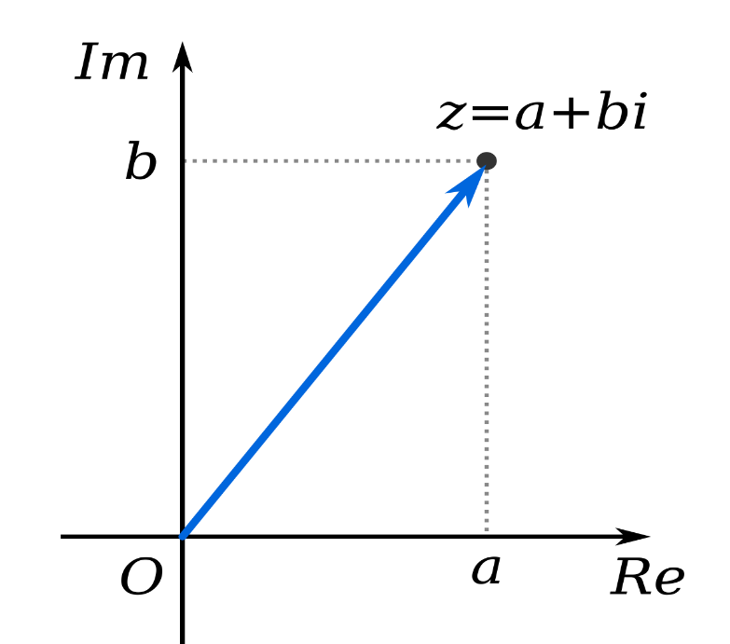
1. Numbers
strikethrough indicates a Python 2.x-only topic. (Python 3 no longer has the “long” type, since integers are now unbounded in size!) (Python3整數不會有溢位的問題)
Python supports four (five) kinds of numbers:
int (signed integers)
bool (a binary number)
long (long integers)
float (floating point real values)
complex (complex numbers)
You do know complex numbers? Mathematics use the symbol i for the imaginary number, i = .
However, in engineering (and in Python) the symbol used is j.
j
j
int | bool | long | float | complex
0 | False | 51924361L | .0 | 3.14j
100 | True | -0x19323L | 15.2 | 45.j
-786 |  | 0122L | -21.9 | 9.322e-36j
80 |  | 0xDEFABCECBDAECBFBAEl | 32.3e+18 | 0.876j
-490 |  | 535633629843L | +90.0 | -.6545+0J
-0x260 |  | -052318172735L | -3.25E101 | 3e+26J
0x69 |  | -4721885298529L | 70.2E-12 | 4.53e-7j

Slide 121
1. Numbers
Python supports four (five) kinds of numbers:
int (signed integers)
bool (a binary number)
long (long integers)
float (floating point real values)
complex (complex numbers)
Python supports four kinds of numbers:
int (signed integers)
bool (a binary number)
float (floating point real values)
complex (complex numbers)
int | bool | long | float | complex
0 | False | 51924361L | .0 | 3.14j
100 | True | -0x19323L | 15.2 | 45.j
-786 |  | 0122L | -21.9 | 9.322e-36j
80 |  | 0xDEFABCECBDAECBFBAEl | 32.3e+18 | 0.876j
-490 |  | 535633629843L | +90.0 | -.6545+0J
-0x260 |  | -052318172735L | -3.25E101 | 3e+26J
0x69 |  | -4721885298529L | 70.2E-12 | 4.53e-7j
int | bool | float | complex
0 | False | .0 | 3.14j
100 | True | 15.2 | 45.j
-786 |  | -21.9 | 9.322e-36j
80 |  | 32.3e+18 | 0.876j
-490 |  | +90.0 | -.6545+0J
-0x260 |  | -3.25E101 | 3e+26J
0x69 |  | 70.2E-12 | 4.53e-7j
int | bool
0 | False
100 | True
-786
80
-490
-0x260
0x69
float | complex
.0 | 3.14j
15.2 | 45.j
-21.9 | 9.322e-36j
32.3e+18 | 0.876j
+90.0 | -.6545+0J
-3.25E101 | 3e+26J
70.2E-12 | 4.53e-7j

Slide 122
Using Big Numbers
>>>
>>>
>>>
>>>
>>>
>>>
>>>
>>>
>>>
>>>
USdebt=31553589789120 # No number is too big
Usdebt#Let’s see if the number saved correctly:
31553589789120
USdebt=31,553,589,789,120 # Can we use commas?
#It didn’t give an error. So maybe it worked?
USdebt#Actually, no. It made 5 separate numbers:
(31, 553, 589, 789, 120)
#But there is a way to do it. Use “_”, not “,”:
USdebt=31_553_589_789_120; print(Usdebt)
31553589789120
#By the way, Python also can print with commas:
print(f"${USdebt:,d}") # We’ll learn this syntax
$31,553,589,789,120

Slide 123
Python Arithmetic Operators:
Operator | Description | Example
+ add | Adds the two operands | 10 + 20 ⇒ 30
- subtract | Subtracts the right-hand operand from left-hand one | 10 - 20 ⇒ -10
* multiply | Multiplies the two operands | 10 * 20 ⇒ 200
/ divide | Divides the first operand by the second one, with the result being a float (or, possibly, complex) | 10 / 20 ⇒ 0.5
% modulus | Yields the remainder resulting from dividing the first operand by the second one | 10 % 20 ⇒ 10
** exponent | Raises the first operand to the power of the second one | 9**.5 ⇒ 3.0
// floor divide | Yields the whole-number portion of the result of dividing the first operand by the second one | 9//2 ⇒ 4 9.0//2.0 ⇒ 4.0
Present in C++, but behaves differently
Not in C++
Not in C++

Slide 124
Python Assignment Operators:
Operator | Description | Example
= | Assigns the value(s) from right side operand(s) to left side operand(s) | c = a + b
+= | Adds the right operand to the left operand and assigns the result to left operand | c+=a ⇒ c=c+a
-= | Subtracts the right operand from the left operand and assigns the result to left operand | c-=a ⇒ c=c-a
*= | Multiplies the right operand with the left operand and assigns the result to left operand | c*=a ⇒ c=c*a
/= | Divides the left operand with the right operand and assigns the result to left operand | c/=a ⇒ c=c/a
%= | Performs a modulus using the two operands and assigns the result to the left operand | c%=a ⇒ c=c%a
**= | Raises the left operand with the right operand and assigns the result to left operand | c**=a ⇒ c=c**a
//= | Divides the left operand with the right operand and assigns the result to left operand | c//=a ⇒ c=c//a
There is no difference to C++, except for those new or modified operators (**, //, and /): these new/modified operators will, of course, have corresponding new assignment operators.
Yes, just like in C++,
you can simplify
i=i+1 into i+=1.
But, unlike in C++,
you cannot simplify
i+=1 into i++.

Slide 125
Python Comparison Operators:
Operator | Description | Example
== | Yields True if the value of two operands are equal | (10 == 20) ⇒ False
!= | Yields True if the value of two operands are not equal | (10 != 20) ⇒ True
> | Yields True if the left operand’s value is greater than the right operand’s value | (10 > 20) ⇒ False
< | Yields True if the left operand’s value is less than the right operand’s value | (10 < 20) ⇒ True
>= | Yields True if the left operand’s value is ≥ the right operand’s value | (10 >= 20) ⇒ False
<= | Yields True if the left operand’s value is ≤ the right operand’s value | (10 <= 20) ⇒ True
Python3’s comparison operators are the same as C++’s.

Slide 126
Python Comparison Operators:
Operator | Description | Example
== | Yields True if the value of two operands are equal | (10 == 20) ⇒ False
!= | Yields True if the value of two operands are not equal | (10 != 20) ⇒ True
> | Yields True if the left operand’s value is greater than the right operand’s value | (10 > 20) ⇒ False
< | Yields True if the left operand’s value is less than the right operand’s value | (10 < 20) ⇒ True
>= | Yields True if the left operand’s value is ≥ the right operand’s value | (10 >= 20) ⇒ False
<= | Yields True if the left operand’s value is ≤ the right operand’s value | (10 <= 20) ⇒ True
“False” and “True” are aliases for the integers “0” and “1”, respectively.
Python3’s comparison operators are the same as C++’s.
print(True,False,True+0,False+0)
True False 1 0
>>> print(true)
Traceback (most recent call last):
File "<stdin>", line 1, in <module>
NameError: name 'true' is not defined
>>>
print(True,False,True+0,False+0)
True False 1 0
print(true)
Traceback (most recent call last):
File "<stdin>", line 1, in <module>
NameError: name 'true' is not defined
>>>
>>>
>>>

Slide 127
Python Bitwise Logic Operators:
Operator | Description | Example
& binary AND | Places a bit in the result if it exists in both operands | (60 & 13) → 12 which is 0000 1100
| binary OR | Places a bit in the result if it exists in either operand | (60 | 13) → 61 which is 0011 1101
^ binary XOR | Places a bit in the result if it is set in one operand but not both | (60 ^ 13) → 49 which is 0011 0001
~ binary FLIP | Places a bit in the result if it is not set in the operand (on the right-hand) | (~60 ) → -61 which is …1100 0011
<< left shift | The left operand’s value moves left by the number of bits indicated by the right operand | 60 << 2 → 240 which is 1111 0000
>> right shift | The left operand’s value moves right by the number of bits indicated by the right operand | 60 >> 2 → 15 which is 0000 1111
These operators are the same as C++’s.

Slide 128
Python Logic Operators:
Operator | Description | Example
and | If both the operands are nonzero then then condition becomes True. | (True and 0) → False
or | If either of the two operands are non zero then then condition becomes True. | (True or 0) → True
not | If the operand is nonzero, then the condition becomes False. Otherwise, it becomes True. | not 7 → False not 0 → True not "hello" → False not False → True
These operations are identical to C++, but Python uses words, rather than the &&, ||, ! symbols.

Slide 129
Python Operator Precedence (优先权)
Operator | Description
** | Exponentiation
~ + - | Bitwise NOT, Positive (unary +), Negative (unary -)
* / % // | Multiply and divide-based operations
+ - | Addition and subtraction
>> << | Shifts
& | Bitwise AND
^ | Bitwise XOR
| | Bitwise OR
<= < > >= == != in, not in, is, is not | Comparison tests, including tests for membership and identity
not | Boolean NOT
and | Boolean AND
or | Boolean OR

Slide 130
Python Operator Precedence (优先权)
Operator | Description
** | Exponentiation
~ + - | Bitwise NOT, Positive (unary +), Negative (unary -)
* / % // | Multiply and divide-based operations
+ - | Addition and subtraction
>> << | Shifts
& | Bitwise AND
^ | Bitwise XOR
| | Bitwise OR
<= < > >= == != in, not in, is, is not | Comparison tests, including tests for membership and identity
not | Boolean NOT
and | Boolean AND
or | Boolean OR
We haven’t talked about these yet, because they aren't used for numbers (and, so far, we’ve only been talking about numbers).

Slide 131
Data Types:
Python has six standard data types:
Number (integer/float/complex/bool)
String
List
Tuple
Set
Dictionary

Slide 132
Data Types:
Python has six standard data types:
Number (integer/float/complex/bool)
String
List
Tuple
Set
Dictionary

Slide 133
String Operators: in & not in
>>>
>>>
>>>
>>>
>>>
You can search for substrings (including single characters) in strings:
>>> print("I" not in "team")
True
>>> print("me" in "team")
False
>>> print("table" in "immutable")
True
>>> print("mule" in "immutable")
False

Slide 134
Notable Features of Python Strings
Python Strings are immutable.
In C++, this is legal: string S="Hello"; S[0]='J'; In Python, it is illegal.
The characters in Python3 strings are unicode.
There is no separate data type for character.
To get a character, just make a string of length 1.
Strings are defined by putting quotes around a string of characters.
You can use single quotes ('…'), double quotes ("…"), or triple quotes ('''…''' or """…""")
The single & double quote are each 1 keyboard character.
The triple quote is 3 keyboard characters (either 3 " or 3 ' ).

Slide 135
Different Ways to Define Strings
In providing many types of quotes, Python lets you include quotes inside of your string, by defining that string with a different quote:
>>> x="There's no problem here."
>>> y='And I said, "I agree."'
>>> z='''She said, "He said, 'OK'"'''
Triple quotes can make multi-line strings without \n.
>>> x="""Quotes("/') work. Line endings are remembered ->
... Escape codes like newline (\n) & tab (\t) also work"""
>>>
>>>

Slide 136
Different Ways to Define Strings
In providing many types of quotes, Python lets you include quotes inside of your string, by defining that string with a different quote:
>>> x="There's no problem here."
>>> y='And I said, "I agree."'
>>> z='''She said, "He said, 'OK'"'''
Triple quotes can make multi-line strings without \n.
>>> x="""Quotes("/') work. Line endings are remembered ->
... Escape codes like newline (\n) & tab (\t) also work"""
>>> print(x)
Quotes("/') work. Line endings are remembered ->
Escape codes like newline (
) & tab ( ) also work
>>>
>>>

Slide 137
Defining Raw Strings
Raw strings don't treat the backslash as a special character. Every character in the string stays the way you wrote it:
print('C:\\Users\\Me\n')
C:\Users\Me
print(r'C:\\Users\\Me\n')
C:\\Users\\Me\n
>>>
>>>
>>>

Slide 138
Defining Formatted Strings
Python lets you define strings like a C-style printf.
The syntax is: "format string"%(argument list)

Slide 139
Defining Formatted Strings
Python lets you define strings like a C-style printf.
The syntax is: "format string"%(argument list)
The “%” is the key part of this syntax.

Slide 140
Defining Formatted Strings
Python lets you define strings like a C-style printf.
The syntax is: "format string"%(argument list)
The “%” is the key part of this syntax.
Note the argument list is inside of parentheses.
(As you’ll see soon, that means it is a tuple)

Slide 141
Defining Formatted Strings
Python lets you define strings like a C-style printf.
The syntax is: "format string"%(argument list)
The “%” is the key part of this syntax.
Note the argument list is inside of parentheses.
(As you’ll see soon, that means it is a tuple)
Here are examples:
print("***%s there %d***"%("Hi",4))
***Hi there 4***
print("%d hours at $%.2f an hour = $%.2f"%
(8,10.5,8*10.5))
8 hours at $10.50 an hour = $84.00
When the command from the previous line was incomplete, then Python uses a "..." to indicate that you still need to type the rest of that command.
%s = string
%d = integer
%d = integer
%f = float
%f = float
>>>
>>>
...
>>>

Slide 142
Formatting Symbols for "..."%()
(very similar to C’s printf symbols)
unlike C, this auto-converts
Format Symbol | Conversion
%c | character
%s | string conversion via str() prior to formatting
%i | signed decimal integer
%d | signed decimal integer
%u | unsigned decimal integer
%o | octal integer
%x | hexadecimal integer (lowercase letters)
%X | hexadecimal integer (UPPERcase letters)
%e | exponential notation (with lowercase 'e')
%E | exponential notation (with UPPERcase 'E')
%f | floating point real number
%F | floating point real number
%g | the shorter of %f and %e
%G | the shorter of %f and %E
unlike C, %i is an alias of %d

Slide 143
Defining Formatted Strings
Python also has non-C-style formatted strings.
The syntax is: f"A string with {__:_} in it."
We already used one of these earlier, in the slide about big numbers…

Slide 144
Using Big Numbers
>>>
>>>
>>>
>>>
>>>
>>>
>>>
>>>
>>>
>>>
USdebt=31553589789120 # No number is too big
Usdebt#Let’s see if the number saved correctly:
31553589789120
USdebt=31,553,589,789,120 # Can we use commas?
#It didn’t give an error. So maybe it worked?
USdebt#Actually, no. It made 5 separate numbers:
(31, 553, 589, 789, 120)
#But there is a way to do it. Use “_”, not “,”:
USdebt=31_553_589_789_120; print(Usdebt)
31553589789120
#By the way, Python also can print with commas:
print(f"${USdebt:,d}") # We’ll learn this syntax
$31,553,589,789,120

Slide 145
Formatting Symbols for f"{:...}"
Format Symbol | Conversion
:< | Left aligns the result (within the available space)
:> | Right aligns the result (within the available space)
:^ | Center aligns the result (within the available space)
:= | Places the sign at leftmost position
:+ | Use a plus sign to indicate if the result is positive or negative
:- | Use a minus sign for negatives only
: | Use ": " to put a " " before positive numbers (and a "-" before negatives)
:, | Use a "," as a thousand separator
:_ | Use a "_" as a thousand separator
:b | Binary format
:c | Convert value to a unicode character
Format Symbol | Conversion
:d | Decimal format
:e | Scientific format, with lower case e
:E | Scientific format, with upper case E
:f | Fix point number format
:F | Fix point number format, uppercase (show inf and nan as INF and NAN)
:g | General format
:G | General format (using a upper case E for scientific notations)
:o | Octal format
:x | Hex format, lower case
:X | Hex format, upper case
:n | Number format
:% | Percentage format
For example, notice :,
For example, notice :d

Slide 146
Using Big Numbers
>>>
>>>
>>>
>>>
>>>
>>>
>>>
>>>
>>>
>>>
USdebt=31553589789120 # No number is too big
Usdebt#Let’s see if the number saved correctly:
31553589789120
USdebt=31,553,589,789,120 # Can we use commas?
#It didn’t give an error. So maybe it worked?
USdebt#Actually, no. It made 5 separate numbers:
(31, 553, 589, 789, 120)
#But there is a way to do it. Use “_”, not “,”:
USdebt=31_553_589_789_120; print(Usdebt)
31553589789120
#By the way, Python also can print with commas:
print(f"${USdebt:,d}") # We’ll learn this syntax
$31,553,589,789,120
For example, notice :,
For example, notice :d

Slide 147
Homework (Due Feb 21, 2pm)
Install Python3 on whichever computer you plan to use.
Many free Python options exist.
In my view, the easiest-to-use is to install it along with Cygwin.
Cygwin will also be useful if you later take my UNIX course.
When installing, make sure that you select these options:
Under “Shells,” select to install tcsh
Under “Utils,” select to install ncurses & dos2unix
Under “Editors,” select to install emacs & nano
Under “Devel,” select to install gcc-core, gcc-g++, make, & python
Software such as Spyder are too fancy, so they can complicate the interface of how to use interactive mode.
As a result, I've seen students just not using interactive mode.
But interactive mode is helpful for learning Python behavior, since any mistakes you type give you instant-feedback error messages.
Cygwin's interface is simple, so you don't need to click any buttons:
1. Just type "python3" and you are in interactive mode. Note: Don't forget the "3", because "python" means Python2.
2. Type whatever you want to test. (The up-arrow lets you retype earlier commands. What do I mean? Give it a try, and you'll see.)
3. Then hit "Ctrl-d" to leave Python and return to the Unix prompt.

Slide 148
Homework (Due Feb 21, 2pm)
Install Python3 on whichever computer you plan to use.
Many free Python options exist.
In my view, the easiest-to-use is to install it along with Cygwin.
Cygwin will also be useful if you later take my UNIX course.
When installing, make sure that you select these options:
Under “Shells,” select to install tcsh
Under “Utils,” select to install ncurses & dos2unix
Under “Editors,” select to install emacs & nano
Under “Devel,” select to install gcc-core, gcc-g++, make, & python
Create the Python program described on the next slide.
Run your program in Python3.
There is nothing to submit. This program is just a test.

Slide 149
The place you need to save to is the directory/folder located at: C:\cygwin64\home\<yourLogin>
Homework (Due Feb 21, 2pm)
Create a Python program file that does the following:
Creates 3 variables with the values of a=“one”, b=2.0, and c=3
Prints the values of these 3 variables, all on one line.
Swaps the variable values, to become: a=3, b=“one”, and c=2.0.
Here, you are allowed to introduce a new variable, but you are not allowed to use any literal values.
What this means is that every RHS must be a variable name. ("RHS" means the right-hand side of an assignment statement).
Prints the values of these 3 variables, all on one line.
Note, if you are creating the program file in Cygwin:
You can create the file in UNIX, using an editor like emacs or nano.
But you may not know UNIX. In that case you can just use Notepad.
But how to use it with Cygwin? Well you must know where to save files to, so that you can access them from within Cygwin.
Notepad is a Windows program for creating text files (such as, in this case, a Python script).

Slide 150
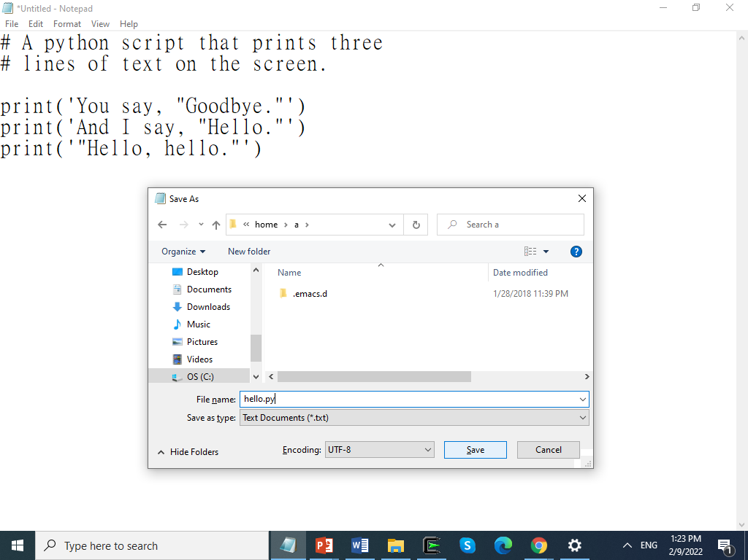
The place you need to save to is the directory/folder located at: C:\cygwin64\home\<yourLogin>
The place you need to save to is the directory/folder located at: C:\cygwin64\home\<yourLogin>
Homework (Due Feb 21, 2pm)
Create a Python program file that does the following:
Creates 3 variables with the values of a=“one”, b=2.0, and c=3
Prints the values of these 3 variables, all on one line.
Swaps the variable values, to become: a=3, b=“one”, and c=2.0.
Here, you are allowed to introduce a new variable, but you are not allowed to use any literal values.
What this means is that every RHS must be a variable name. ("RHS" means the right-hand side of an assignment statement).
Prints the values of these 3 variables, all on one line.
Note, if you are creating the program file in Cygwin:
You can create the file in UNIX, using an editor like emacs or nano.
But you may not know UNIX. In that case you can just use Notepad.
But how to use it with Cygwin? Well you must know where to save files to, so that you can access them from within Cygwin.
Notepad is a Windows program for creating text files (such as, in this case, a Python script).
The file is saved as "hello.py"
But Notepad always adds a ".txt"

Slide 151
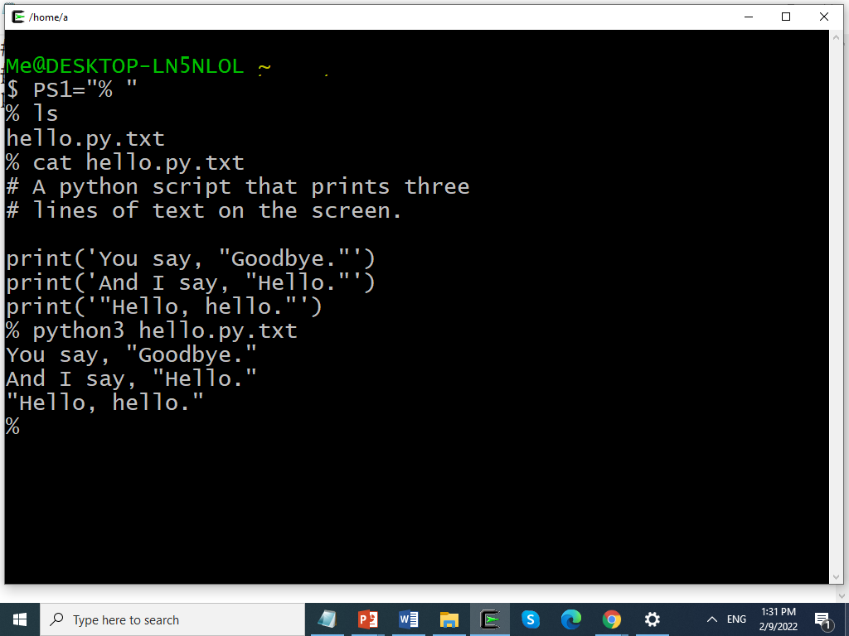
You can type this, if you want to make your UNIX prompt match with what you see in the examples in my slides.
The extra ".txt" isn't a problem,
because we can see from this output that Python was still able to run the file.
The file is saved as "hello.py"
But Notepad always adds a ".txt"
The file is saved as "hello.py"
But Notepad always adds a ".txt"

