Slide 1
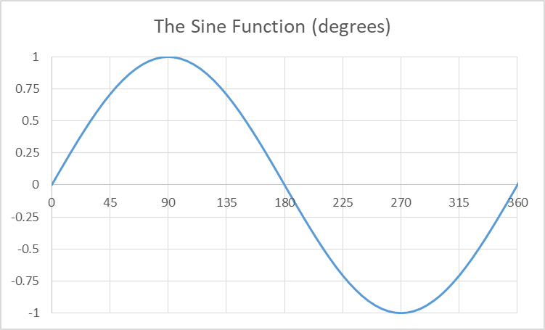

A mapping is a concept from math
Your typical mathematical function is written as: y = f(x)
But what is f( )? Any function. Perhaps sin(). In that case, we write: y = sin(x)
Here the sine function maps a value, x, to a new value, y. For example: y=sin(0°) ⇒ y=0, or y=sin(90°) ⇒ y=1.
You can look at an x value, move your finger vertically to
intersect the line, then horizontally to find the mapped-to value.
Your typical mathematical function is written as: y = f(x)
But what is f( )? Any function. Perhaps sin(). In that case, we write: y = sin(x).
Here the sine function maps a value, x, to a new value, y. For example: if x=90°, then y=sin(90°) ⇒ y=1.
You can look at an x value,
intersect the line,

Slide 2
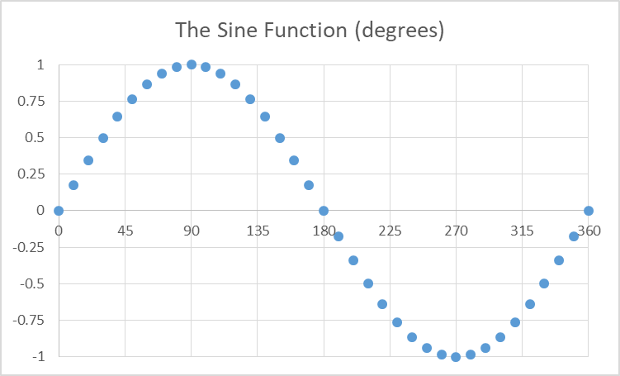
A mapping is a concept from math
sin(90°)=1 is a mapping for just one value.
But what is the mapping, for all values?
That would be the set of all mappings.

Slide 3
A mapping is a concept from math
sin(90°)=1 is a mapping for just one value.
But what is the mapping, for all values?
That would be the set of all mappings.
Think of it as a look-up table:
Think of it as a look-up table:
Q:How to make a table like this?
A:With map()
0° → 0.00000
10° → 0.17365
20° → 0.34202
30° → 0.50000
40° → 0.64279
... → ...

Slide 4
A mapping is a concept from math
Think of it as a look-up table:
Q:How to make a table like this?
A:With map()
0° → 0.00000
10° → 0.17365
20° → 0.34202
30° → 0.50000
40° → 0.64279
... ...
Think of it as a look-up table:
Q:How to make a table like this?
A:With map()
0° → 0.00000
10° → 0.17365
20° → 0.34202
30° → 0.50000
40° → 0.64279
... → ...
→
The sin( ) function takes one number and returns another one number. One number. So it cannot understand a list:
>>> from math import sin, radians
>>> sin([0,radians(10), radians(20)])
Traceback (most recent call last):
File "<stdin>", line 1, in <module>
TypeError: must be real number, not list
>>> # Use map() to apply a mapping to a list:
>>> list(map(sin,[0,radians(10), radians(20)]))
[0.0, 0.17364817766693033, 0.3420201433256687]

Slide 5
A mapping is a concept from math
Think of it as a look-up table:
Q:How to make a table like this?
A:With map()
0° → 0.00000
10° → 0.17365
20° → 0.34202
30° → 0.50000
40° → 0.64279
... ...
→
\
>>> # Use map() to apply a mapping to a list:
>>> list(map(sin,[0,radians(10), radians(20)]))
[0.0, 0.17364817766693033, 0.3420201433256687]
>>> # Use map() to apply a mapping to a list:
>>> list(map(sin,[0,radians(10), radians(20)]))
[0.0, 0.17364817766693033, 0.3420201433256687]
>>> #Can you ever have too many maps(), really?
>>> dict(zip(range(0,91,10),map(lambda x:x/100000, ... map(round, map(lambda x: 100000*x,(map(sin, ... map(radians, range(0,91,10)))))))))
{0: 0.0, 10: 0.17365, 20: 0.34202, 30: 0.5, 40: 0.64279, 50: 0.76604, 60: 0.86603, 70: 0.93969, 80: 0.98481, 90: 1.0}
>>>

Slide 6
map applies a given function to each element
>>> from math import factorial, gamma
>>> factorial(range(0,10)) #This won’t work
Traceback (most recent call last):
File "<stdin>", line 1, in <module>
TypeError:an integer is required (got type range)
>>> list(map(factorial,range(0,10)))#map fixes it
[1, 1, 2, 6, 24, 120, 720, 5040, 40320, 362880]
>>> gamma(range(1,11))#This generalizes factorial
Traceback (most recent call last):
File "<stdin>", line 1, in <module>
TypeError: must be real number, not range
>>> list(map(gamma,range(1,11)))#But it needs map
[1.0, 1.0, 2.0, 6.0, 24.0, 120.0, 720.0, 5040.0, 40320.0, 362880.0]
>>> list(map(int,map(gamma,range(1,11))))#cleaner
[1, 1, 2, 6, 24, 120, 720, 5040, 40320, 362880]
>>>
>>>
The math module has the "n!" (factorial 階乘) function.
It also has the "Γ" (gamma) function.
This relates to factorial by the formula: n! = Γ(n + 1)
>>>
>>>
>>>
>>>

Slide 7
Data Types:
Python has six standard data types:
Number
String
List
Tuple
Set
Dictionary

Slide 8
Python Tuples:
A tuple is similar to a list.
But whereas lists are enclosed in brackets [ ], tuples are enclosed in parentheses ( ) .
Also tuples are immutable (cannot update).
So tuples can be thought of as read-only lists.
And, for that matter, strings can be thought of as tuples of characters.

Slide 9
Python Tuples:
% cat tupleOperations.py
tupl = ('abcd', 786, 2.23, 'john', 70.2)
ttup = (123, 'john')
print (tupl) # Prints complete tuple
print (tupl[-2]) # Prints the second-from-back element
print (tupl[1:4]) # Prints elements from 2nd(ie 1th) to 4th
print (tupl[2:]) # Prints elements starting at 3rd(ie 2th)
print (ttup * 2) # Prints the tuple two times
print (tupl+ttup) # Prints concatenated tuples
% python3 tupleOperations.py
('abcd', 786, 2.23, 'john', 70.2)
'john'
(786, 2.23, 'john')
(2.23, 'john', 70.2)
(123, 'john', 123, 'john')
('abcd', 786, 2.23, 'john', 70.2, 123, 'john')
%

Slide 10
Creating Singleton Tuples
You can create a tuple with any number of entries, including zero:
tup1=('phys','chem',2017,2019); tup2=()

Slide 11
Creating Singleton Tuples
You can create a tuple with any number of entries, including zero:
tup1=('phys','chem',2017,2019); tup2=()
But a tuple with one value (mathematically, this is called a singleton) has a problem, because numerical expressions use parentheses too:
x = (2+3*(4+1))

Slide 12
Creating Singleton Tuples
You can create a tuple with any number of entries, including zero:
tup1=('phys','chem',2017,2019); tup2=()
But a tuple with one value (mathematically, this is called a singleton) has a problem, because numerical expressions use parentheses too:
x = (2+3*(4+1))
But an expression can be as simple as just a number:
x = (50); print (x*2)
100
# (50)*2 == 100 tells us (50) is a number
>>>
>>>

Slide 13
Creating Singleton Tuples
You can create a tuple with any number of entries, including zero:
tup1=('phys','chem',2017,2019); tup2=()
But a tuple with one value (mathematically, this is called a singleton) has a problem, because numerical expressions use parentheses too:
x = (2+3*(4+1))
But an expression can be as simple as just a number:
x = (50); print (x*2)
100
# (50)*2 == 100 tells us (50) is a number
The solution is for tuple singletons to use a comma at the end:
x = (50,); print (x*2)
(50, 50)
# Clearly (50,) was treated like a tuple
>>>
>>>
>>>
>>>

Slide 14
Creating Singleton Tuples
You can create a tuple with any number of entries, including zero:
tup1=('phys','chem',2017,2019); tup2=()
But a tuple with one value (mathematically, this is called a singleton) has a problem, because numerical expressions use parentheses too:
x = (2+3*(4+1))
But an expression can be as simple as just a number:
x = (50); print (x*2)
100
# (50)*2 == 100 tells us (50) is a number
The solution is for tuple singletons to use a comma at the end:
x = (50,); print (x*2)
(50, 50)
# Clearly (50,) was treated like a tuple
Non-singletons have no problem, because “,” isn’t used in expressions.
List singletons have no problem, because “[” isn’t used in expressions.
>>>
>>>
>>>
>>>

Slide 15
If There’s No Enclosing [ ] or ( ) Symbol
Any set of comma-separated objects, written without identifying symbols, defaults to a tuple:
X = 'ab', -4.24e93, 7+6.6j, 'xyz'
print ("X => ", X)
X => ('ab', -4.24e93, 7+6.6j, 'xyz')
>>>
(Of course, if there is also no comma or quote, then it defaults to a number):
X = 1; Y = 1,
print ("X => ", X, "; Y => ", Y)
X => 1 ; Y => (1,)
>>>
>>>
>>>
>>>
>>>

Slide 16
Tuple Operators
Tuples are similar to lists, so we won’t talk about their operators (which are the same).
Well, yes, the operators are the same, but… you cannot update or delete tuple elements.

Slide 17
Updating Tuples
Tuples are immutable so you can’t modify them.
But you can create a new tuple from a modified existing tuple:
tup1 = ('abc', 'xyz', 12, 34.56, 7j)
tup2 = tup1[:2];
('abc', 'xyz')
>>> tup3 = tup1[-1:]*3 + tup2;
>>> print(tup3)
(7j, 7j, 7j, 'abc', 'xyz')
>>>
>>>
>>>
print(tup2)

Slide 18
Updating Tuples
Tuples are immutable so you can’t modify them.
But you can create a new tuple from a modified existing tuple:
tup1 = ('abc', 'xyz', 12, 34.56, 7j)
tup2 = tup1[:2];
('abc', 'xyz’)
tup3 = tup1[-1:]*3 + tup2;
>>> print(tup3)
(7j, 7j, 7j, 'abc', 'xyz')
>>>
>>>
>>>
>>>
print(tup2)

Slide 19
Updating Tuples
Tuples are immutable so you can’t modify them.
But you can create a new tuple from a modified existing tuple:
tup1 = ('abc', 'xyz', 12, 34.56, 7j)
tup2 = tup1[:2];
('abc', 'xyz’)
tup3 = tup1[-1:]*3 + tup2; print(tup3)
>>>
>>>
>>>
print(tup2)

Slide 20
Updating Tuples
Tuples are immutable so you can’t modify them.
But you can create a new tuple from a modified existing tuple:
tup1 = ('abc', 'xyz', 12, 34.56, 7j)
tup2 = tup1[:2];
('abc', 'xyz’)
tup3 = tup1[-1:]*3 + tup2;
(7j, 7j, 7j, 'abc', 'xyz')
= tup1[-1]*3 + tup2;
>>>
>>>
>>>
>>>
print(tup2)
print(tup3)

Slide 21
Updating Tuples
Tuples are immutable so you can’t modify them.
But you can create a new tuple from a modified existing tuple:
tup1 = ('abc', 'xyz', 12, 34.56, 7j)
tup2 = tup1[:2];
('abc', 'xyz’)
tup3 = tup1[-1:]*3 + tup2;
(7j, 7j, 7j, 'abc', 'xyz’)
tupX = tup1[-1]*3 + tup2;
Traceback (most recent call last):
File "<stdin>", line 1, in <module>
TypeError: unsupported operand type(s) for +: 'complex' and 'tuple'
>>>
>>>
>>>
>>>
print(tup2)
print(tup3)

Slide 22
Updating Tuples
Tuples are immutable so you can’t modify them.
But you can create a new tuple from a modified existing tuple:
tup1 = ('abc', 'xyz', 12, 34.56, 7j)
tup2 = tup1[:2];
('abc', 'xyz’)
tup3 = tup1[-1:]*3 + tup2;
(7j, 7j, 7j, 'abc', 'xyz’)
tupX = tup1[-1]*3 + tup2;
Traceback (most recent call last):
File "<stdin>", line 1, in <module>
TypeError: unsupported operand type(s) for +: 'complex' and 'tuple'
>>>
>>>
>>>
>>>
print(tup2)
print(tup3)

Slide 23
Updating Tuples
But this one wasn’t complex. It was a one-element tuple (and that element was complex).
Tuples are immutable so you can’t modify them.
But you can create a new tuple from a modified existing tuple:
tup1 = ('abc', 'xyz', 12, 34.56, 7j)
tup2 = tup1[:2];
('abc', 'xyz’)
tup3 = tup1[-1:]*3 + tup2;
(7j, 7j, 7j, 'abc', 'xyz’)
tupX = tup1[-1]*3 + tup2;
Traceback (most recent call last):
File "<stdin>", line 1, in <module>
TypeError: unsupported operand type(s) for +: 'complex' and 'tuple'
>>>
>>>
>>>
>>>
print(tup2)
If we had said
“(tup1[-1],)*3 + tup2”
it would’ve worked.
print(tup3)

Slide 24
Updating Tuples
But this one wasn’t complex. It was a one-element tuple (and that element was complex).
Tuples are immutable so you can’t modify them.
But you can create a new tuple from a modified existing tuple.
By the way, that new tuple could even have the same name (and it would still be new):
>>> tup1 = ('abc', 'xyz', 12, 34.56, 7j)
>>> tup1 = ('ABC',)+tup1[1:]
>>> print(tup1)
('ABC', 'xyz', 12, 34.56, 7j)
>>>
If we had said
“(tup1[-1],)*3 + tup2”
it would’ve worked.

Slide 25
Updating Tuples
Tuples are immutable so you can’t modify them.
But you can create a new tuple from a modified existing tuple.
By the way, that new tuple could even have the same name (and it would still be new).
By the additional way, the same thing can be said for strings (which are also immutable):
>>> S = "Hello"; print(S)
Hello
>>> S = "J" + S[1:]; print(S)
Jello
>>>

Slide 26
Deleting Tuple Elements
You can’t remove individual tuple elements.
But you can put together a new tuple, while
choosing to leave out the undesired elements:
>>> tup = ('phys', 'chem', 2017, 2019)
>>> tup = tup[:1]+tup[-1:]#can even reuse name
>>> tup
('phys', 2019)
>>>
>>>

Slide 27
Deleting Tuple Elements
You can’t remove individual tuple elements.
But you can put together a new tuple, while
choosing to leave out the undesired elements:
>>> tup = ('phys', 'chem', 2017, 2019)
>>> tup = tup[:1]+tup[-1:]#can even reuse name
>>> tup
('phys', 2019)
>>>
You can delete the entire tuple, however:
>>> del tup;
>>> print (tup)
Traceback (most recent call last):
File "<stdin>", line 1, in <module>
NameError: name 'tup' is not defined
>>>
>>>

Slide 28
Lists Can Combine Together
>>> L=[1,2,3,4]
>>> print (L+L)
[1, 2, 3, 4, 1, 2, 3, 4]
>>>

Slide 29
Tuples Can Combine Together
>>> L=[1,2,3,4]
>>> print (L+L)
[1, 2, 3, 4, 1, 2, 3, 4]
>>> T=(5,6,7,8)
>>> print (T+T)
(5, 6, 7, 8, 5, 6, 7, 8)
>>>

Slide 30
Lists and Tuples Can’t Combine
>>> L=[1,2,3,4]
>>> print (L+L)
[1, 2, 3, 4, 1, 2, 3, 4]
>>> T=(5,6,7,8)
>>> print (T+T)
(5, 6, 7, 8, 5, 6, 7, 8)
>>> print (L+T)
Traceback (most recent call last):
File "<stdin>", line 1, in <module>
TypeError: can only concatenate list (not "tuple") to list
>>>

Slide 31
To Combine, First Type Cast:
>>> L=[1,2,3,4]
>>> print (L+L)
[1, 2, 3, 4, 1, 2, 3, 4]
>>> T=(5,6,7,8)
>>> print (T+T)
(5, 6, 7, 8, 5, 6, 7, 8)
>>> print (L+T)
Traceback (most recent call last):
File "<stdin>", line 1, in <module>
TypeError: can only concatenate list (not "tuple") to list
>>> print (L+list(T))
[1, 2, 3, 4, 5, 6, 7, 8]
>>>

Slide 32
Lists Can Be Written To
>>> L=L+['5','6']
>>> print(L)
[1, 2, 3, 4, '5', '6']
>>>]='X'
>>> print(L)
[1, 'X', 3, 4, '5', '6']
>>> T[1]='X'
'tuple' object does not support item assignment

Slide 33
Can Tuples Be Written to?
>>> L=L+['5','6']
>>> print(L)
[1, 2, 3, 4, '5', '6']
>>> T=T+('5','6')
>>> print(T)
(5, 6, 7, 8, '5', '6')
>>> L[1]='X'
>>> print(L)
[1, 'X', 3, 4, '5', '6']
>>> T[1]='X'
'tuple' object does not support item assignment

Slide 34
Q: Didn’t we say, just a few slides back, that tuples are read-only?
>>> L=L+['5','6']
>>> print(L)
[1, 2, 3, 4, '5', '6']
>>> T=T+('5','6')
>>> print(T)
(5, 6, 7, 8, '5', '6')
>>> L[1]='X'
>>> print(L)
[1, 'X', 3, 4, '5', '6']
>>> T[1]='X'
'tuple' object does not support item assignment
Actually, T is not being updated – it is being overwritten. I mean: Python dynamically creates variables when they are first assigned, right? So the old T was read from and was used to create a brand-new, read-only variable (which just-so-happens to also be named T (and therefore kills the old T)).

Slide 35
Tuples Cannot Be Written to
>>> L=L+['5','6']
>>> print(L)
[1, 2, 3, 4, '5', '6']
>>> T=T+('5','6')
>>> print(T)
(5, 6, 7, 8, '5', '6')
>>> T[1]='X'
Traceback (most recent call last):
File "<stdin>", line 1, in <module>
TypeError: 'tuple' object does not support item assignment
>>> L[1]='X'
>>> print(L)
[1, 'X', 3, 4, '5', '6']
If we try changing what is truly the existing T, we will find that we cannot.

Slide 36
But Lists Can Be Written To
>>> L=L+['5','6']
>>> print(L)
[1, 2, 3, 4, '5', '6']
>>> T=T+('5','6')
>>> print(T)
(5, 6, 7, 8, '5', '6')
>>> T[1]='X'
Traceback (most recent call last):
File "<stdin>", line 1, in <module>
TypeError: 'tuple' object does not support item assignment
>>> L[1]='X'
>>> print(L)
[1, 'X', 3, 4, '5', '6']
>>>

Slide 37
Data Types:
Python has six standard data types:
Number
String
List
Tuple
Set
Dictionary

Slide 38
Data Types:
Python has six standard data types:
Number
String
List
Tuple
Set
Dictionary

Slide 39
The Notation (符號) for Sets
Defining a set
In Math (數學), you use the {…} symbols for a set.
Python uses the same notation: >>> S = {1, 2, 3}
Operating on a set
Python uses keyboard equivalents to the math symbols:
Math: Union (∪), Intersection (∩), Xor (⊕), Remove subset (-)
Python: Union (|), Intersection (&), Xor (^), Remove subset (-)
Comparing a set
Again, Python uses keyboard equivalents:
Math: Equals (=), Contains (⊆), Is contained (⊇) Python: Equals (==), Contains (>=), Is contained (<= or: in (if 1 element) )

Slide 40
Python Sets
Python sets are unordered.
One implication (其中一個意義) of this is that you cannot use order-based syntax:
>>> a={1,5,3}; print(a[1]) #an error
Another implication is comparisons ignore order:
>>> {1, 2, 3} == {3, 2, 1}
True
Another implication is elements don’t repeat:
>>> {1, 5, 3, 2, 1, 5, 3, 4, 1, 1, 1}
{1, 2, 3, 4, 5}
But lists are ordered, and can repeat:
>>> [1, 5, 3, 2, 1, 5, 3, 4, 1, 1, 1]
[1, 5, 3, 2, 1, 5, 3, 4, 1, 1, 1]

Slide 41
Set Elements
Python set elements must be immutable.
Even though the set, itself, is mutable.
This limitation exists as a consequence of the requirement that set elements must be unique:
If you were to allow those elements to be changed after they’ve been added, like so:
>>> L=[1,2];S={[ ],L};L.clear();len(S)#Is len=1 or 2?

Slide 42
Set Elements
Python set elements must be immutable.
Even though the set, itself, is mutable.
This limitation exists as a consequence of the requirement that set elements must be unique:
If you were to allow those elements to be changed after they’ve been added, like so:
>>> L=[1,2];S={[ ],L};L.clear();len(S)#Is len=1 or 2?
then you’d need checks whenever mutables change,
or you’d just tell programmers to not change them.
But this is unsafe, so its not the way of Python.

Slide 43
Set Elements
Python set elements must be immutable.
Even though the set, itself, is mutable.
This limitation exists as a consequence of the requirement that set elements must be unique:
If you were to allow those elements to be changed after they’ve been added, like so:
>>> L=[1,2];S={[ ],L};L.clear();len(S)#Is len=1 or 2?
then you’d need checks whenever mutables change,
or you’d just tell programmers to not change them.
But this is unsafe, so its not the way of Python.
It follows that you can’t “cheat”, wrapping a mutable element in an immutable one (eg, a tuple), like so:
>>> L=[1,2];S={(L,)} # This won’t work

Slide 44
Union with |
>>>
>>>
>>>
>>> {1,5,4,3} | {2,5}
{1, 2, 3, 4, 5}
{"cat"} | {"bat"}
{'bat', 'cat'}
set("cat") | set("bat")
{'a', 'b', 'c', 't'}
This converts the argument to a set. As we
know, every type has a converter function:
set('5.0')
{'.', '0', '5'}
str(5.0)
'5.0'
int('5.0')
5
list('5.0')
['5', '.', '0']
sorted('5.0')#makes a sorted list
['.', '0', '5']
#This last one is sorted by ASCII value
>>>
>>>
>>>
>>>
>>>
>>>

Slide 45
Union with |
>>> {1,5,4,3} | {2,5}
{1, 2, 3, 4, 5}
>>> {"cat"} | {"bat"}
{'bat', 'cat'}
>>> set("cat") | set("bat")
{'a', 'b', 'c', 't'}
set("cat") | {"b","a","t"}
{'a', 'b', 'c', 't'}
set("cat") | {"bat"}
{'c', 'bat', 't', 'a'}
set("cat").union(set("bat"))
{'a', 'b', 'c', 't'}
set("cat").union("bat")
{'c', 'b', 't', 'a'}
# The last 2 results have the same 4 items,
>>> # but they've printed in a different order.
>>> # It doesn’t matter, as sets are unordered.
>>>
>>>
>>>
>>>
>>>
This is a method of the set object class. In comparison to the | operator, the method updates the object in-place.
Here we see an interesting detail. It didn’t give the same output as the | operator gave.

Slide 46
Union with |
>>> {1,5,4,3} | {2,5}
{1, 2, 3, 4, 5}
>>> {"cat"} | {"bat"}
{'bat', 'cat'}
>>> set("cat") | set("bat")
{'a', 'b', 'c', 't'}
set("cat") | {"b","a","t"}
{'a', 'b', 'c', 't'}
set("cat") | {"bat"}
{'c', 'bat', 't', 'a'}
set("cat").union (set("bat"))
{'a', 'b', 'c', 't'}
set("cat").union ("bat")
{'c', 'b', 't', 'a'}
# The last 2 results have the same 4 items,
>>> # but they've printed in a different order.
>>> # It doesn’t matter, as sets are unordered.
>>>
>>>
>>>
>>>
>>>

Slide 47
Intersection with &
>>> {1,5,4,3} & {2,5}
{5}
>>> {"cat"} & {"bat"}
set( )
>>> set("cat") & set("bat")
{'t', 'a'}
set("cat") & {"b","a","t"}
{'t', 'a'}
set("cat") & {"bat"}
set( )
set("cat").intersection(set("bat"))
{'t', 'a'}
set("cat").intersection("bat")
{'t', 'a'}
These indicate empty sets. (The reason they're not written as “{ }” will be explained on slide 126.)
>>>
>>>
>>>
>>>
>>>

Slide 48
Remove shared items, with -
>>> {1,5,4,3} - {2,5}
{1, 3, 4}
>>> {"cat"} - {"bat"}
{'cat'}
>>> set("cat") - set("bat")
{'c'}
set("cat") - {"b","a","t"}
{'c'}
set("cat") - {"bat"}
{'c', 't', 'a'}
set("cat").difference (set("bat"))
{'c'}
set("cat").difference ("bat")
{'c'}
>>>
>>>
>>>
>>>
>>>

Slide 49
Exclusively in just one set, with ^
>>> {1,5,4,3} ^ {2,5}
{1, 2, 3, 4}
>>> {"cat"} ^ {"bat"}
{'bat', 'cat'}
>>> set("cat") ^ set("bat")
{'c', 'b'}
set("cat") ^ {"b","a","t"}
{'c', 'b'}
set("cat") ^ {"bat"}
{'c', 'bat', 't', 'a'}
set("cat").symmetric_difference(set("bat"))
{'c', 'b'}
set("cat").symmetric_difference("bat")
{'c', 'b'}
>>>
>>>
>>>
>>>
>>>

Slide 50
Sets
The methods are not identical to their symbol-based versions. The methods allow the t object to be various types (such as a list), but the symbol-based versions require t to be a set. This restriction prevents error-prone constructions like set('abc') & 'cbs'. Instead you have to use the more readable set('abc').intersection('cbs').
Method Symbol Result
 | len(s) | Returns the number of elements in set s
 | x in s | Test x for membership in s
x not in s |  | Test if x in s is not true
 | s == t | Test if s and t have exactly the same elements
 | s != t | Test if x == s is not true
s.issubset(t) | s <= t | Test if every element in s is in t
 | s < t | Test if s <= t and s != t
s.issuperset(t) | s >= t | Test if every element in t is in s
 | s > t | Test if s >= t and s != t
s.union(t) | s | t | Returns a new set with elements from either s or t
s.intersection(t) | s & t | Returns a new set with elements common to s and t
s.difference(t) | s - t | Returns a new set with elements in s but not in t
s.symmetric_difference(t) s ^ t . |  | Returns a new set with elements in s or t but not both
s.copy() |  | Returns a new set with a shallow copy of s
Notice also that there is neither a repetition operator, *, nor a slice operator, [ ].
Notice that there is a - operation, but no + operation (use | instead).

Slide 51
Mathematical (數學) Sets
Mathematics (數學) defines two types of sets:
1. Ordered Sets
If you want to visit all elements of an ordered set, then they must be visited in a specific order.
Eg: Dealing a stack of cards off the top of the deck.
The cards always come out the same, regardless of who deals the deck.
2. Unordered Sets
If you want to visit all elements of an unordered set, then the order is unimportant.
Eg: Pulling balls out of a bag.
The balls could come out different each time.

Slide 52
Sets in Computer Languages
1. Ordered Sets
If you want to visit all elements of an ordered set, then they must be visited in a specific order.
Eg: Dealing a stack of cards off the top of the deck.
The cards always come out the same, regardless of who deals the deck.
2. Unordered Sets
If you want to visit all elements of an unordered set, then the order is unimportant.
Eg: Pulling balls out of a bag.
The balls could come out different each time.
Python-style:
Lists, Tuples (immutable lists), Strings (tuples of characters)
C-style:
Arrays, Strings (arrays of characters), Linked lists,etc.
Python-style:
Sets, Dictionaries
C-style: Nothing (speaking strictly of built-in types)
Q: But wait! We know that, mathematically, unordered sets do exist, so how can they be modeled in C?
A: Well, a full-order can be imposed upon a partial order. So a set can be stored into an array or linked list or table.

Slide 53

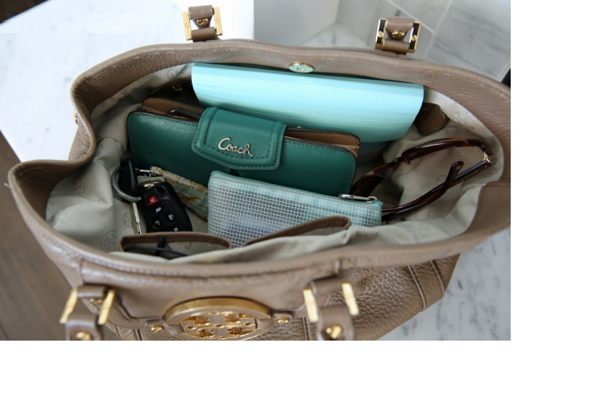
“Let’s pull some items out of our purse!”
“Okay.”
“Which item shall we take out first?”
“Why don’t we take the glasses out first?”
“Done!”
“Let’s get the keys next.”
“Got ‘um!”
“The pencil case is third.”
“Okay!”
“The card case is fourth.”
“Okay.”
“The Coach wallet is fifth.”
“Now the bag is empty.”
4
5
1
2
3

Slide 54
“I’m confused!”
“About what?”
“Aren’t items in a purse just jumbled together?”
“Yes, a purse is a bag. In mathematics, a bag is an unordered set.”
“But the items are ordered: 1)glasses, 2)keys, 3)pencil case, 4)card case, 5)wallet.”
“Well, they get an order when you pull them out, but it doesn’t mean they had an order when in the bag. In math terms (術語), you imposed (強加) order onto an unordered set.”
4
5
1
2
3

Slide 55
“When did I impose an order?”
“When you pulled them out.”
“What do you mean?”
“You had a choice of which item to take first. If it was me, I would’ve taken the wallet first. So my imposed order would’ve been different.”
“Then which one of us got the correct order?”
“Your question is illogical. A bag is an unordered set.”
4
5
1
2
3

Slide 56

“If its illogical to put the items in order, then why did you make me do it?”
“There is no way to take items out, one-at-a-time, without taking them out in some order.”
“Well then let’s just leave them in the bag.”
“But then how can we see what’s in it? Your actions allowed you to write, on paper, a list of contents:
1)glasses,
List of Purse Items
Glasses
4
5
1
1
2
3

Slide 57
“If its illogical to put the items in order, then why did you make me do it?”
“There is no way to take items out, one-at-a-time, without taking them out in some order.”
“Well then let’s just leave them in the bag.”
“But then how can we see what’s in it? Your actions allowed you to write, on paper, a list of contents:
1)glasses, 2)keys,
List of Purse Items
Glasses
Keys
List of Purse Items
Glasses
4
5
1
1
2
2
3

Slide 58
“If its illogical to put the items in order, then why did you make me do it?”
“There is no way to take items out, one-at-a-time, without taking them out in some order.”
“Well then let’s just leave them in the bag.”
“But then how can we see what’s in it? Your actions allowed you to write, on paper, a list of contents:
1)glasses, 2)keys, 3)pencil case,
List of Purse Items
Glasses
Keys
Pencil Case
4
5
1
2
3
3

Slide 59
“If its illogical to put the items in order, then why did you make me do it?”
“There is no way to take items out, one-at-a-time, without taking them out in some order.”
“Well then let’s just leave them in the bag.”
“But then how can we see what’s in it? Your actions allowed you to write, on paper, a list of contents:
1)glasses, 2)keys, 3)pencil case, 4)card case,
List of Purse Items
Glasses
Keys
Pencil Case
Card Case
4
4
5
1
2
3

Slide 60
“If its illogical to put the items in order, then why did you make me do it?”
“There is no way to take items out, one-at-a-time, without taking them out in some order.”
“Well then let’s just leave them in the bag.”
“But then how can we see what’s in it? Your actions allowed you to write, on paper, a list of contents:
1)glasses, 2)keys, 3)pencil case, 4)card case, 5)wallet.”
List of Purse Items
Glasses
Keys
Pencil Case
Card Case
Coach Wallet
4
5
5
1
2
3

Slide 61
“If its illogical to put the items in order, then why did you make me do it?”
“There is no way to take items out, one-at-a-time, without taking them out in some order.”
“Well then let’s just leave them in the bag.”
“But then how can we see what’s in it? Your actions allowed you to write, on paper, a list of contents:
1)glasses, 2)keys, 3)pencil case, 4)card case, 5)wallet.”
“But your own list was different?”
“It had a different order.”
List of Purse Items
Glasses
Keys
Pencil Case
Card Case
Coach Wallet
4
5
1
2
3
Alternative List
Coach Wallet
Keys
Pencil Case
Glasses
Card Case

Slide 62
“Which of our lists was in the correct order?”
“Both were. The order doesn’t matter.”
“Oh, I understand. Lists are unordered sets, too!”
“No, lists are ordered. That’s why I said you imposed an order when you made your list of what was in the bag.”
“Why does a list have to be ordered?”
“Because, to write down words on a piece of paper, you must write them one-by-one.”
List of Purse Items
Glasses
Keys
Pencil Case
Card Case
Coach Wallet
4
5
1
2
3
Alternative List
Coach Wallet
Keys
Pencil Case
Glasses
Card Case

Slide 63
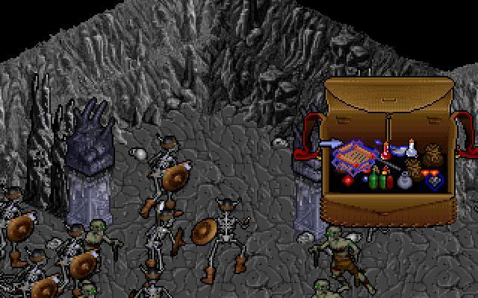
“Imagine I have a bag in a computer game.”
“Okay.”
“Are the items in order?”
“No. It is a bag.”
“Where is the bag, really?”
“It’s not real. It only exists inside the computer.”
“But isn’t the computer’s memory ordered into sequential addresses?”
“Yes.”
“So how do we represent the bag in memory?”
“The contents must be stored. Maybe in a C++ array or a Python List.”

Slide 64
“So an order necessarily gets imposed upon any data stored in memory?”
“Must be.”
“Python stores a set’s items in memory too. So that storage must be in some order.”
“So Python sets are ordered after all!”
“No. Python’s interpreter stores them in memory (thus: in some order), but the data-type being modeled is unordered. As is the bag in this computer game.”

Slide 65
“Let’s try again. What will this C program print?”
“I know the ASCII codes of '1', '2' & '6'. So it prints: 49 50 3 4 5 54.”
“Correct. Now what about this new code?”
“That’s not new code! Rearranging declarations changes nothing. It’s the same program, so it gives the same output.”
“True. But where did these variables store in memory?’’
“Who cares? I just want the program to store the data; the place doesn’t matter.”
#include <stdio.h>
char a='1',b='2';
int c=3,d=4,e=5;
char f='6';
main() {
printf("%d %d %d ", a, b, c);
printf("%d %d %d\n", d, e, f);
}
#include <stdio.h>
int c=3,d=4,e=5;
char a='1',b='2',f='6';
main() {
printf("%d %d %d ", a, b, c);
printf("%d %d %d\n", d, e, f);
}

Slide 66
“Right. The order doesn’t matter, because the set of declared variables is unordered, as far as the compiler is concerned.”
“I agree.”
“But, even though they are an unordered set, they do get memory locations, right?”
“Oh, I see. The compiler has to impose an order onto this unordered set.”
“Yes. And we can see what that order was, if we print their address values. Let’s try that…”
#include <stdio.h>
char a='1',b='2';
int c=3,d=4,e=5;
char f='6';
main() {
printf("%d %d %d ", a, b, c);
printf("%d %d %d\n", d, e, f);
}
#include <stdio.h>
int c=3,d=4,e=5;
char a='1',b='2',f='6';
main() {
printf("%d %d %d ", a, b, c);
printf("%d %d %d\n", d, e, f);
}

Slide 67
#include <stdio.h>
char a='1',b='2';
int c=3,d=4,e=5;
char f='6';
main() {
printf("%d %d %d ", a, b, c);
printf("%d %d %d\n", d, e, f);
}
#include <stdio.h>
int c=3,d=4,e=5;
char a='1',b='2',f='6';
main() {
printf("%d %d %d ", a, b, c);
printf("%d %d %d\n", d, e, f);
}

Slide 68
“What output will these two programs produce?”
“I don’t know, because I don’t know the addresses where the compiler puts global variables.”
“True. So let’s say that the global space starts at address 100 ( = 0x64 ).”
“Then the first program outputs:
And the second outputs:
”
“Yes – but only if you assume that the compiler stores them in the order that you declared them.”
#include <stdio.h>
char a='1',b='2';
int c=3,d=4,e=5;
char f='6';
main() {
printf("%x %x %x ", &a,&b,&c);
printf("%x %x %x\n",&d,&e,&f);
}
64
65
66
6a
6e
72
#include <stdio.h>
int c=3,d=4,e=5;
char a='1',b='2',f='6';
main() {
printf("%x %x %x ", &a,&b,&c);
printf("%x %x %x\n",&d,&e,&f);
}
64
65
66
6a
6e
72
64
68
6c
70
71
72
70
71
64
68
6c
72

Slide 69
“Actually, the compiler might choose to turn the first program into the second, so that variables align better in the cache (eg, if variable ‘e’ is at addresses 6e-71, then that’s in 2 cache lines).”
“But the second program puts ‘e’ at 6c-6f. That aligns well in the cache.”
“Right. So you see: you can try to guess where the variables get stored. And you might guess correctly. But you also might guess wrong. Why is that?”
“Because the variables are an unordered set.”
#include <stdio.h>
char a='1',b='2';
int c=3,d=4,e=5;
char f='6';
main() {
printf("%x %x %x ", &a,&b,&c);
printf("%x %x %x\n",&d,&e,&f);
}
64
65
66
6a
6e
72
#include <stdio.h>
int c=3,d=4,e=5;
char a='1',b='2',f='6';
main() {
printf("%x %x %x ", &a,&b,&c);
printf("%x %x %x\n",&d,&e,&f);
}
64
68
6c
70
71
72

Slide 70
“Yes. They’re an unordered set. So what about this new program?”
“Does it print a ‘1’?”
“Yes. I ran it and it printed a ‘1’.”
“Can you do that?”
“No. It’s a bug – even if it works. You can’t presume to know what order the compiler will impose.”
“But what is you point?”
“My point is: Sets. They are unordered – even if you can guess the order in which items display.”
“How would I guess?”
“Well, consider this…”
% cat BuggyYetWorks.c
#include <stdio.h>
char a='1',b='2';
int main() {
printf("This prints a 1:");
printf("%u\n",
((long unsigned int)&b)–
((long unsigned int)&a));
}
% gcc –o x BuggyYetWorks.c
% ./x
This prints a 1:1
%

Slide 71
>>>
>>>
>>>
>>>
>>>
“See? The items may print out in the order that you created them.”
“Yes.”
“So a student asked me: ‘How can I add a new item at the beginning of the set? When I add the element, it always gets put at the end.’ ’’
“I see. The question makes no sense because sets are unordered – regardless of whether the order in which they print seems predictable (看起來可預測).’’
S={1,2,3,4}
print (S)
{1, 2, 3, 4}
S|={5}
print (S)
{1, 2, 3, 4, 5}

Slide 72
“Correct. And that’s why there is no indexing method for sets.”
“Can you explain?”
“Python Lists, being ordered, do have indexing. See here?”
“Yes. You put an ‘X’ at a specific ordered position.’’
“Correct. But let’s try this again, with a set.”
“I see. No index method is provided because the concept is illogical. There’s no two^{th} position, because there’s no order.”
>>> L = [1,2,3,4]
>>> print(L)
[1, 2, 3, 4]
>>> L[2] = 'X'
>>> print (L)
[1, 2, 'X', 4]
>>>
>>> S={1,2,3,4}
>>> print(S)
{1, 2, 3, 4}
>>> S[2]='X'
Traceback (most recent call last):
File "<stdin>",line 1, in <module>
TypeError: 'set' object does not support item assignment
>>>

Slide 73
Data Types:
Python has six standard data types:
Number
String
List
Tuple
Set
Dictionary

Slide 74
Data Types:
Python has six standard data types:
Number
String
List
Tuple
Set
Dictionary

