Slide 1

Xilinx Vivado Tutorial
2024/10/08
EC5015-VLSILab
黃宥翔 chris900623@gmail.com
郭昱 ivan010517@gmail.com

Slide 2
Outline
Download & Install
Setup License
Create Project
Setting Constraint
Xsim
Synthesis & Implementation
Summary
2

Slide 3
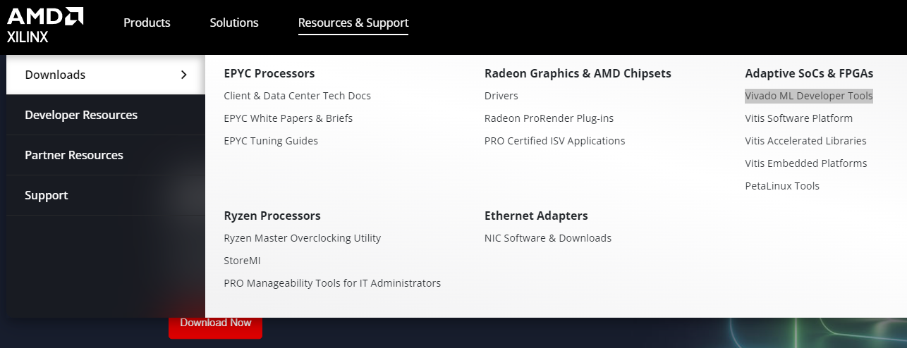
Download & Install (1/12)
連結至Xilinx官網 Website: https://www.xilinx.com/products/design-tools/vivado.html
Resources &Support->Downloads-> Vivado ML Developer Tools
3

Slide 4
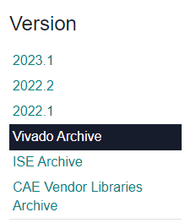
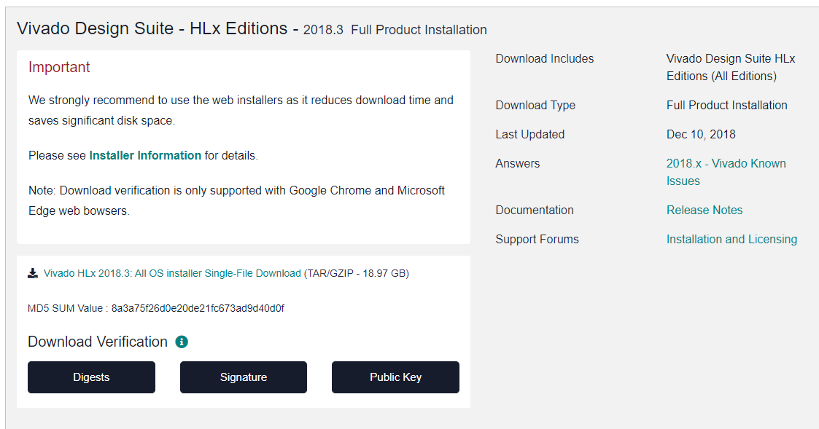
Download & Install (2/12)
選擇Vivado Archive
選擇2018.3並下載Vivado Design Suite - HLx Editions - 2018.3 Full Product Installation裡的All OS installer Single-File Download
點這個
4

Slide 5
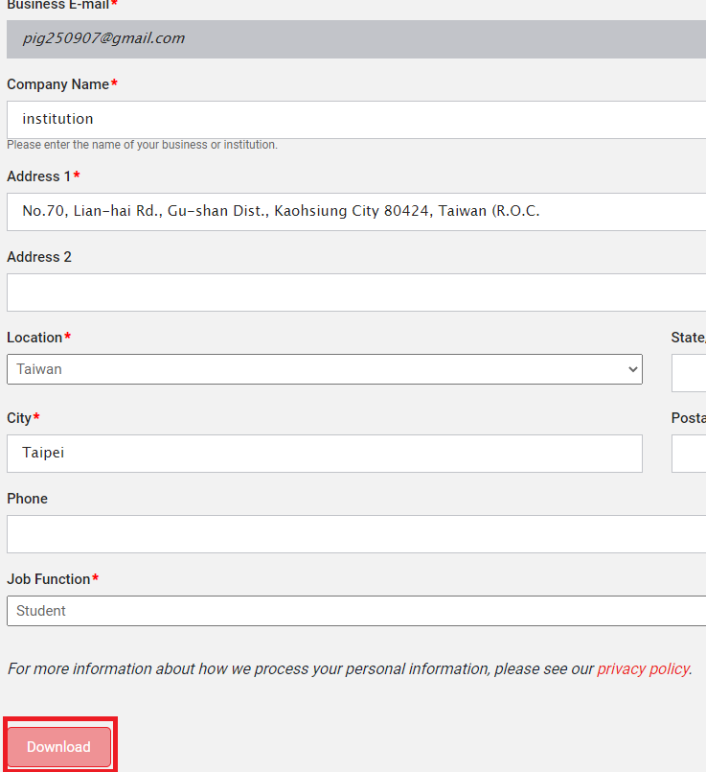

Download & Install (2/12)
註冊一個帳號，此帳號然後之後安裝會用到
辦好後就能下載
5

Slide 6
Download & Install (3/12)
Exunzip vivado.
execute installer
Windows：
Go to folder of vivado
Double-Click xsetup.exe
Linux：
Open terminal
cd <path to folder of vivado>
sudo ./xsetup
6

Slide 7
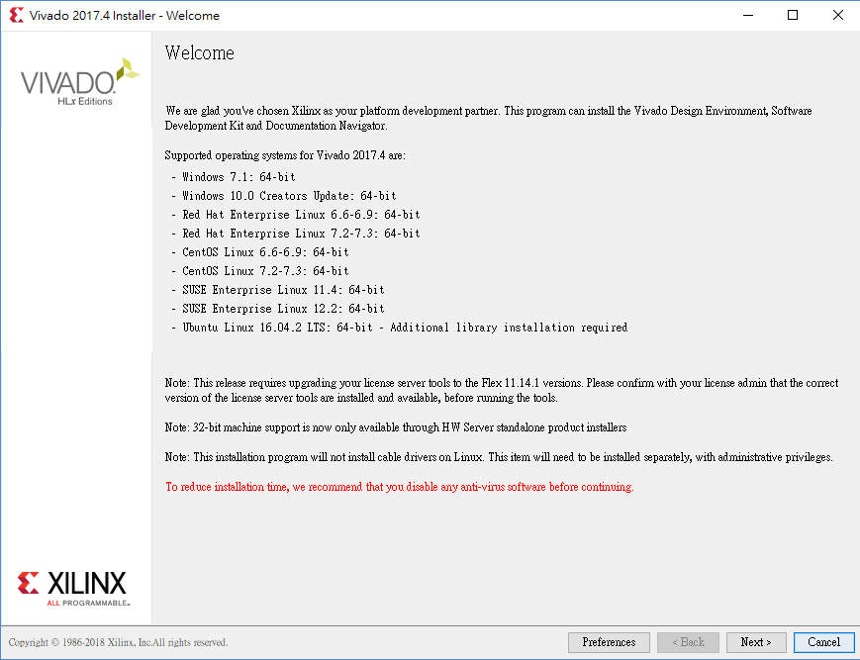
Download & Install (4/12)
1.
7

Slide 8
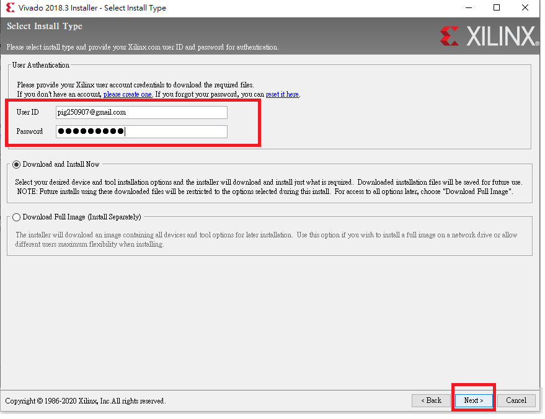
Download & Install (5/12)
1.
輸入剛剛註冊的帳號
2.
8

Slide 9
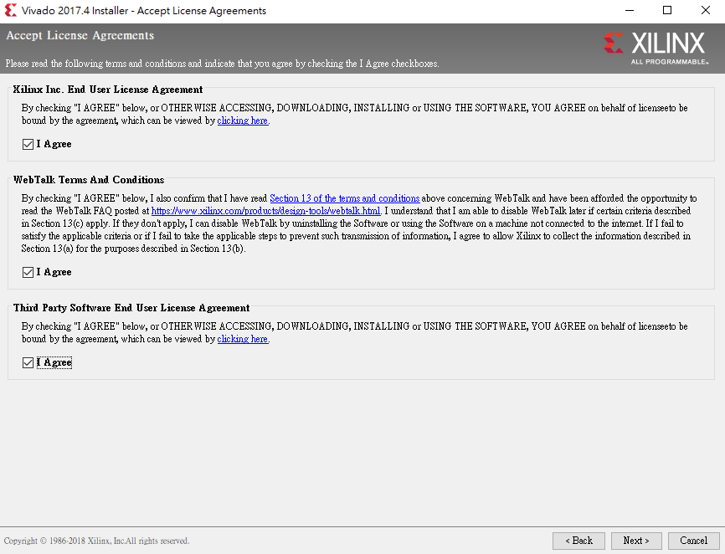
Download & Install (5/12)
1.
2.
9

Slide 10
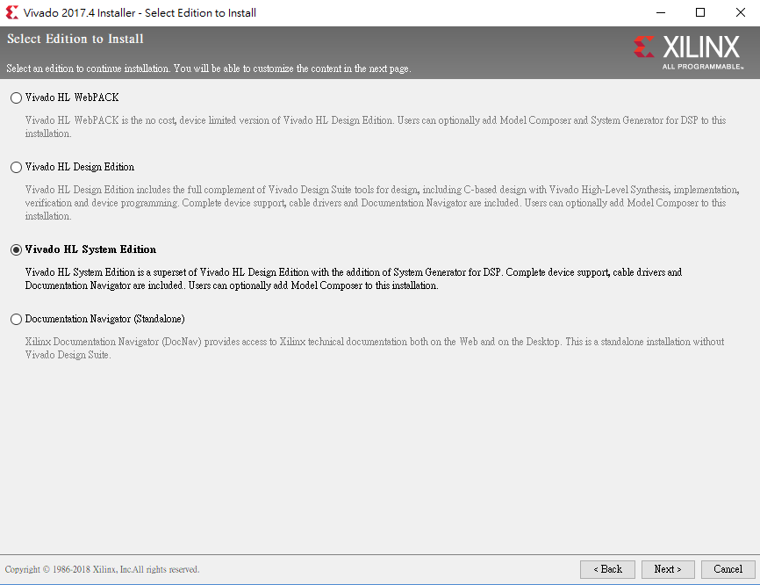
Download & Install (6/12)
1.
2.
10

Slide 11
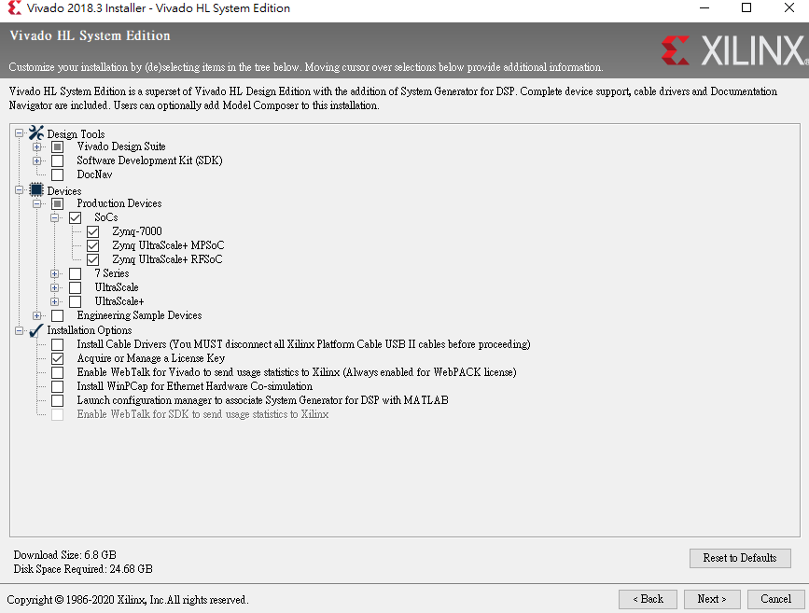
Download & Install (7/12)
1.
2.
11

Slide 12
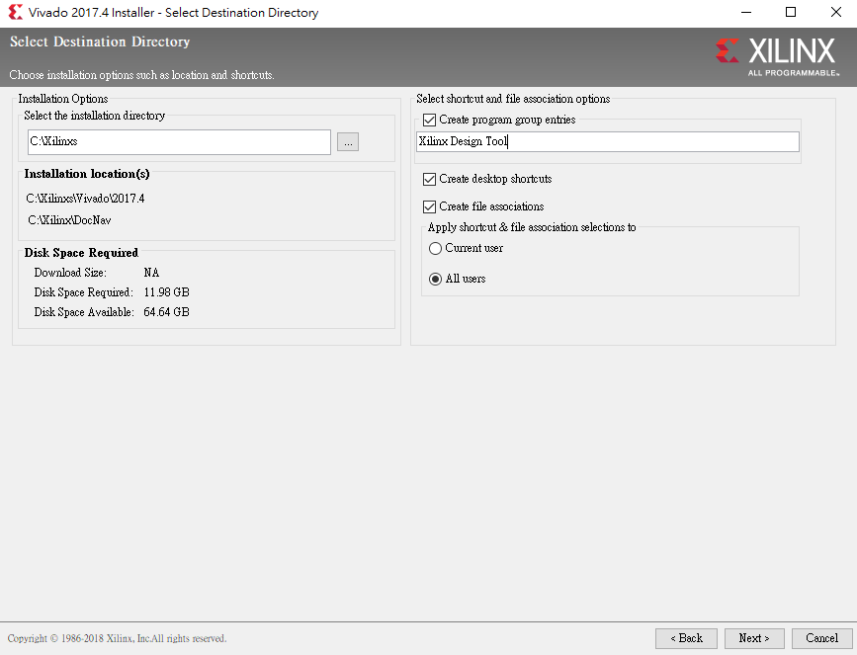
Download & Install (8/12)
1.
If you aren’t windows, please don’t select.
2.
3.
12

Slide 13
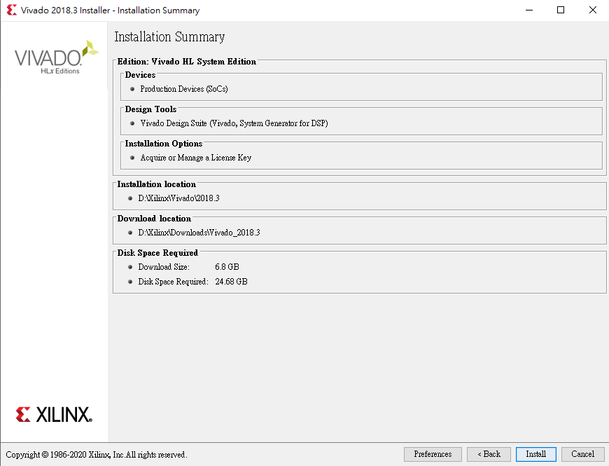
Download & Install (9/12)
如安裝完成後遇到License，可先至18頁設定。
1.

Slide 14
Download & Install (10/12) (Linux
Only)
If you use Linux, you need to set environment variable.
Open terminal
cd ~
gedit ./.bashrc
Paste the following code to blank position
source <path to vivado>/settings64.sh
Save & Exit

Slide 15

Download & Install (11/11)
After installing vivado, you can open vivado by following：
Window：
Double-Click the icon
Linux：
Open terminal
vivado &

Slide 16
Outline
Download & Install
Setup License
Create Project
Setting Constraint
Xsim
Synthesis & Implementation
Summary

Slide 17
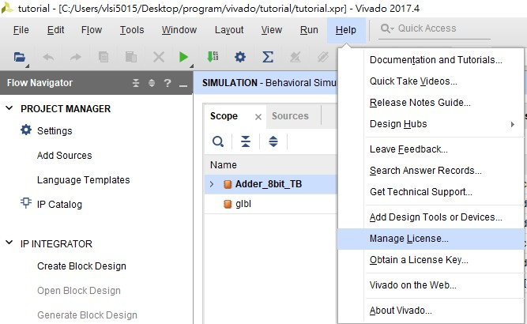
Setup License
(1/4)
1.
2.

Slide 18
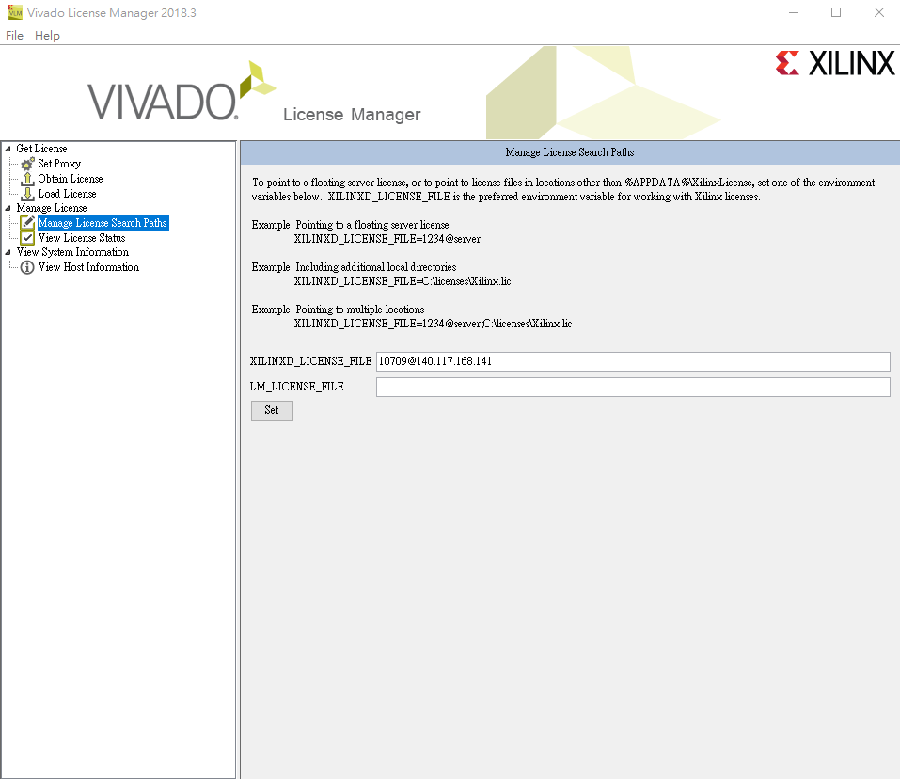
Setup License
(2/4) (Windows)
1.
2.

Slide 19
Setup License
(3/4) (Linux)
Open terminal
cd ~
gedit ./.bashrc
Paste the following code to blank position
export XILINXD_LICENSE_FILE=10709@140.117.168.141
Save & Exit

Slide 20
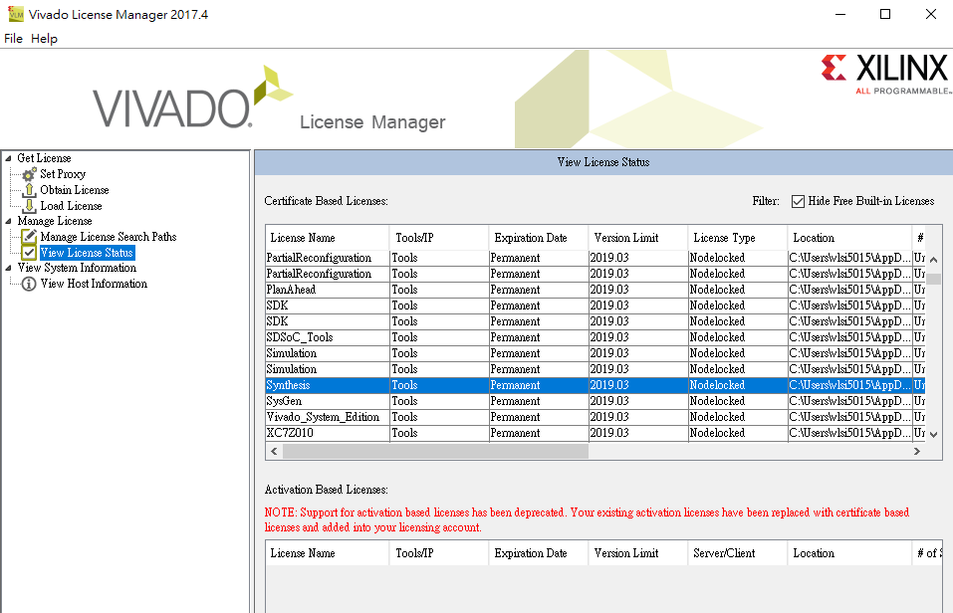
Setup License
(4/4)
2.
1.
3.If you set license successfully, you will see a lot of items in this field.

Slide 21
Outline
Download & Install
Setup License
Create Project
Setting Constraint
Xsim
Synthesis & Implementation
Summary

Slide 22
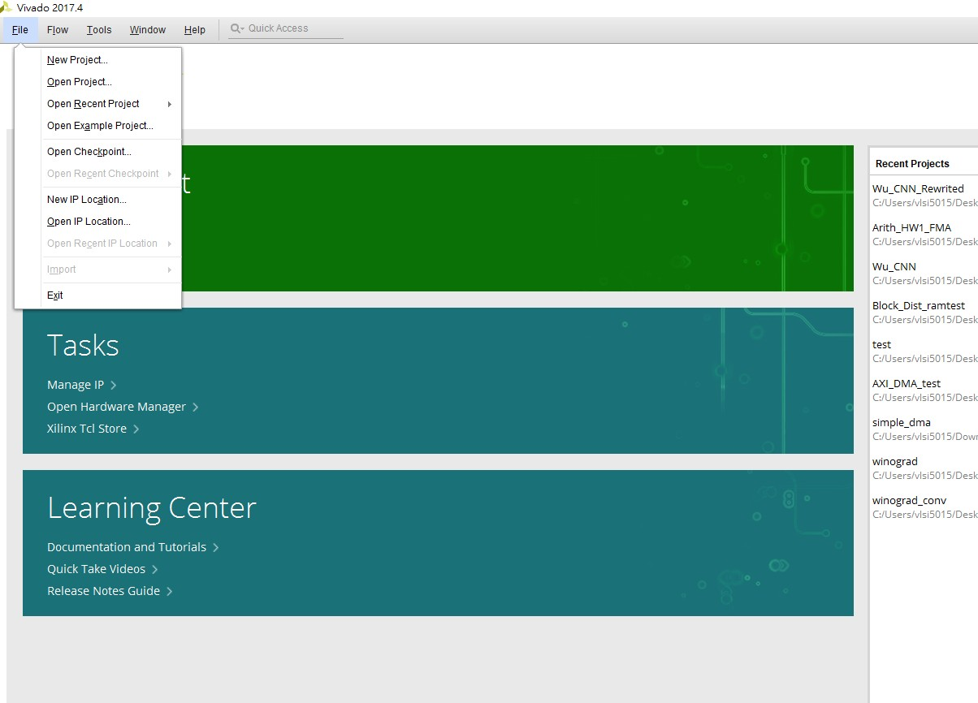
Create Project
(1/8)
1.
2.

Slide 23
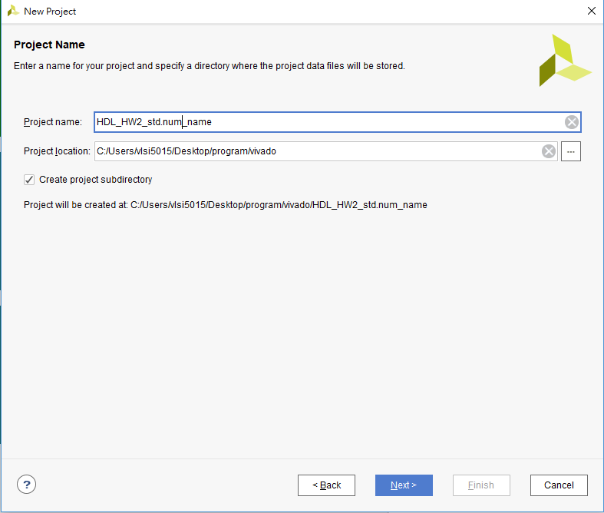
Create Project
(2/8)
1.
2.
3.

Slide 24
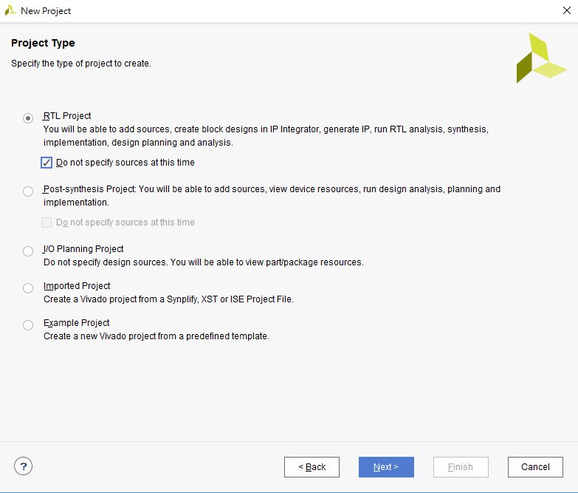
Create Project
(3/8)
1.
We add source codes later
or you can add now by unselecting this option.
2.
3.

Slide 25
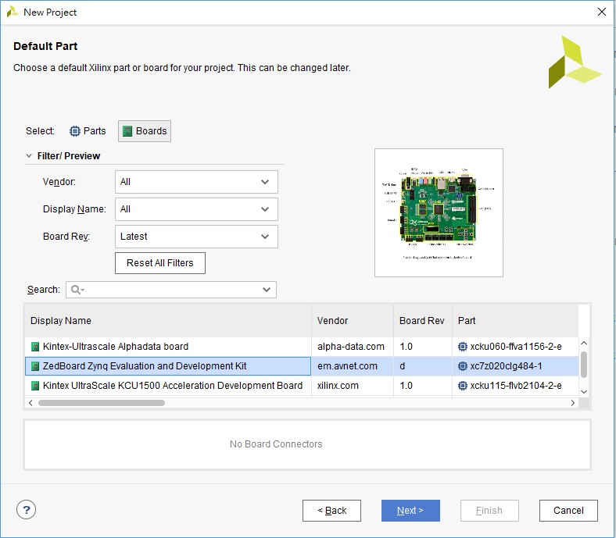
Create Project
(4/8)
1.
2.
3.

Slide 26
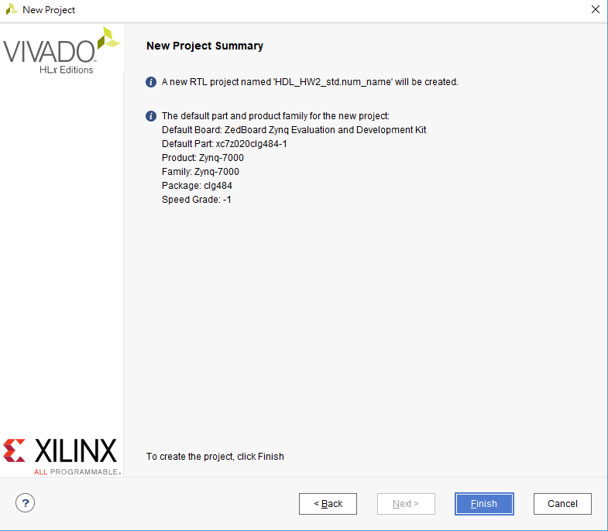
Create Project
(5/8)
1.

Slide 27
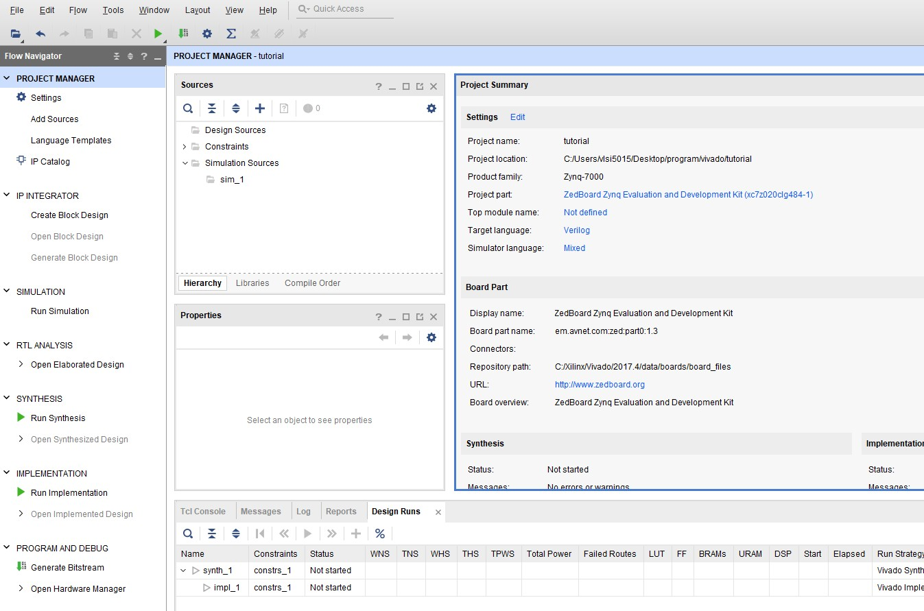
Create Project
(6/8)
1.
1.

Slide 28
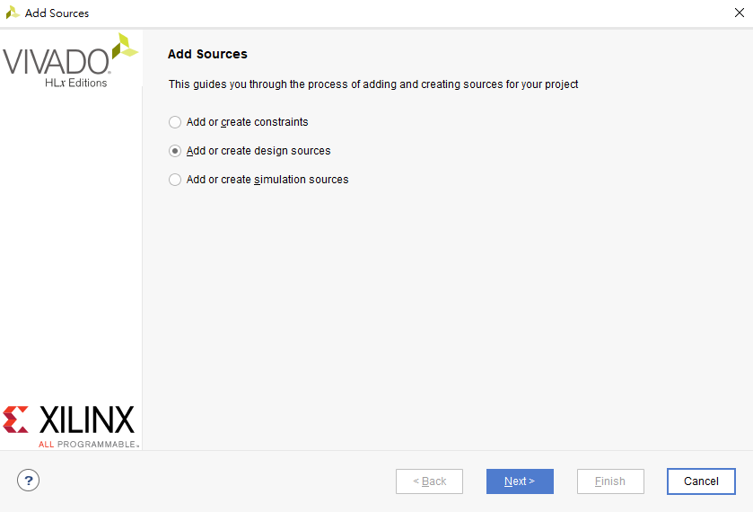
Create Project
(7/8)
1.
Constraint Source code Testbench
2.

Slide 29
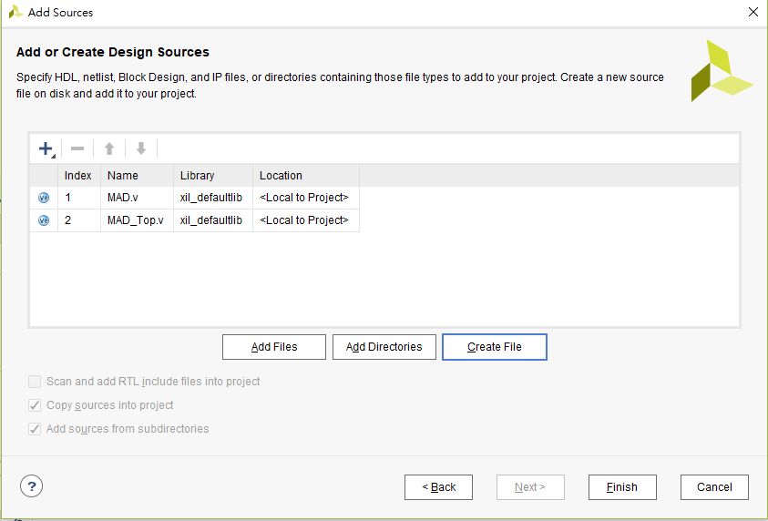
Create Project
(8/8)
1.
2.

Slide 30
Outline
Download & Install
Setup License
Create Project
Setting Constraint
Xsim
Synthesis & Implementation
Summary

Slide 31
Setting Constraint (1/5)
All you have to do is setting clock frequency, because the homework only asks you complete running implementation
There are two ways to set timing constraint
Create .xdc file and write constraint.
Use GUI

Slide 32
Setting Constraint (2/5) (.xdc)
Create xdc file.
Write the below constraint to .xdc file.
create_clock -period 10.000 -name clk -waveform {0.000 5.000} [get_ports clk]
Explain：
Create_clock 2. {0.000 5.000}
3. [get_ports clk]
：Create an independent clock source signal
：posedge at 0.0ns, negedge at 5.0ns
：Send clock signal to clk of Verilog’s input port
31

Slide 33
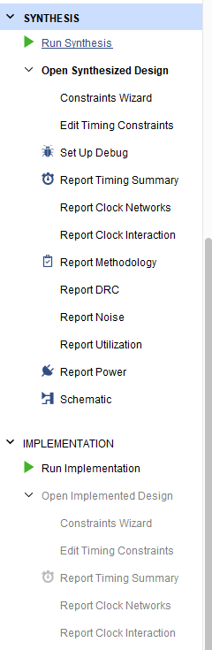
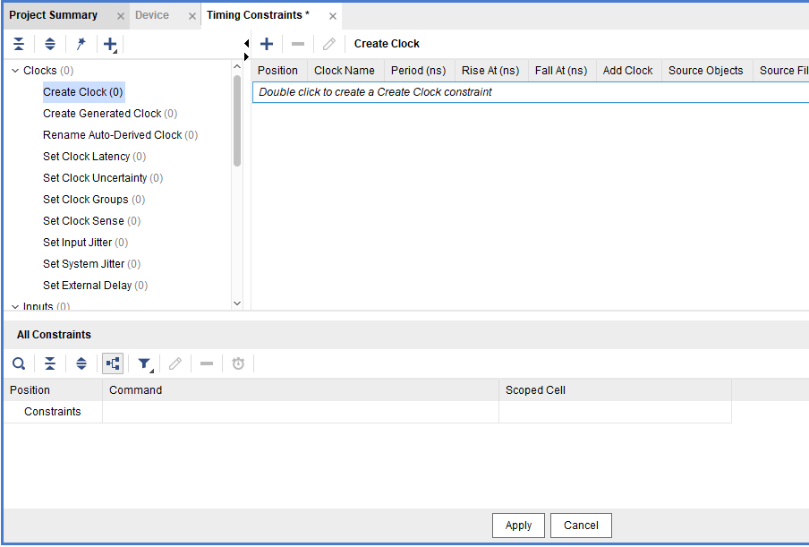
Setting Constraint (3/5) (GUI)
1. You must run synthesis once after creating project.
2.
4.
3.

Slide 34
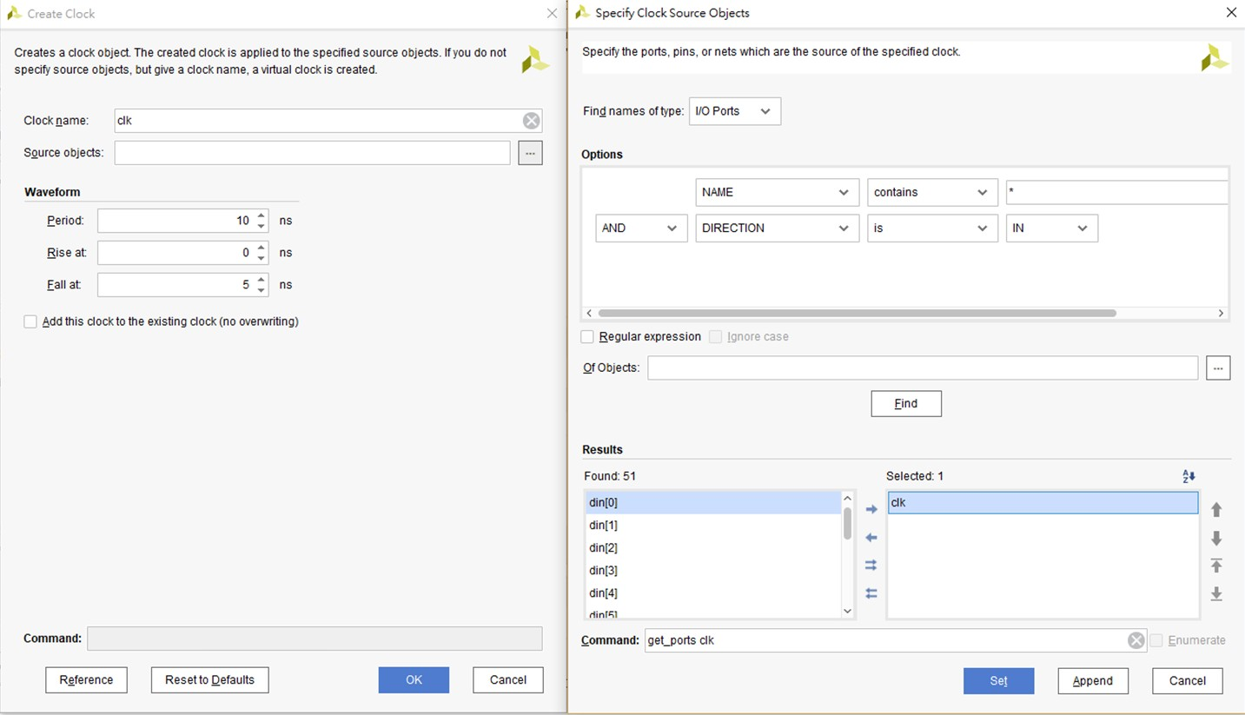
Setting Constraint
(4/5) (GUI)
1.
2.
After Clicking ‘Find’, vivado will show result in the right field
Find clk port and move from left field to right
6.
5.

Slide 35
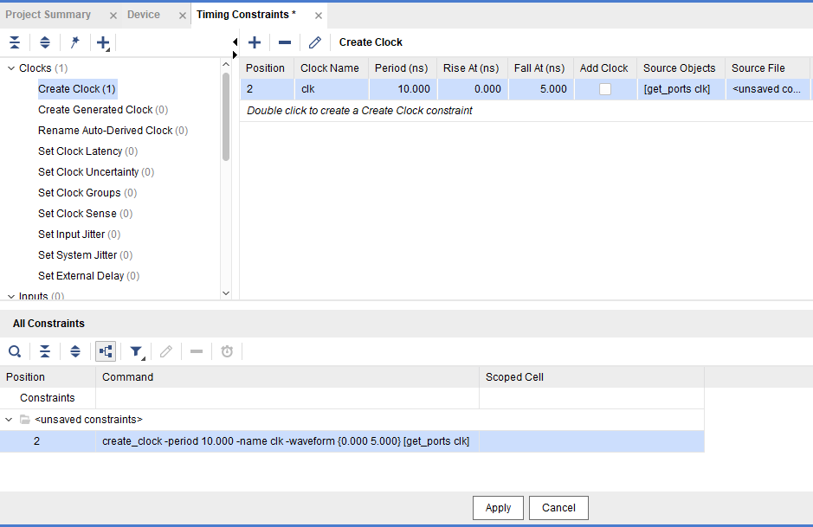
Setting Constraint
(5/5) (GUI)
1.
3. Finally, you have to check the timing constraint written correctly in the .xdc file.
2.
34

Slide 36
Outline
Download & Install
Setup License
Create Project
Setting Constraint
Xsim
Synthesis & Implementation
Summary

Slide 37
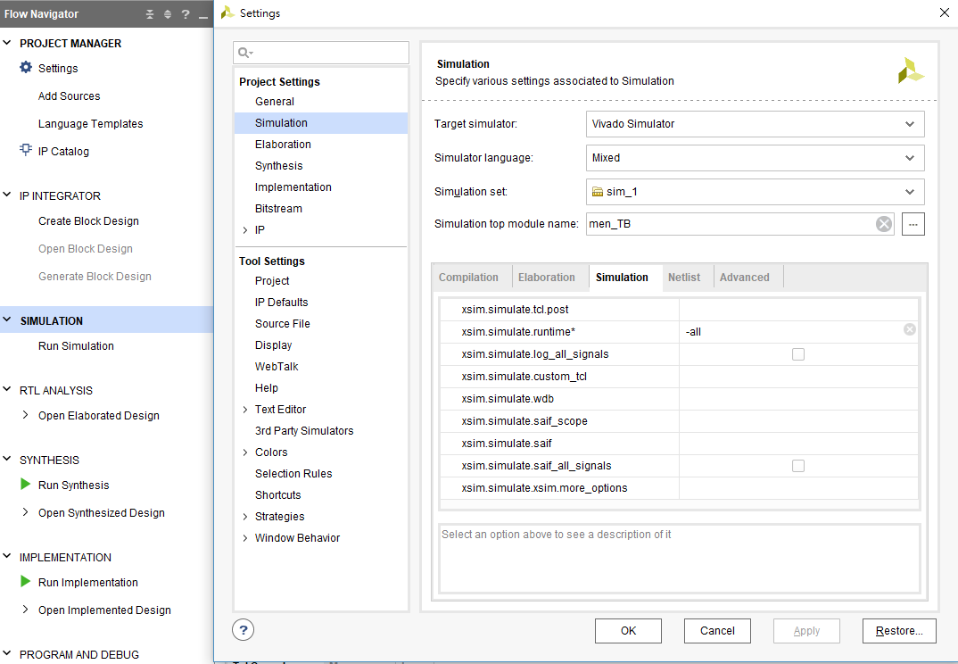
Xsim
(1/7)
1.
2.
3.
Enter -all
4.
5.

Slide 38
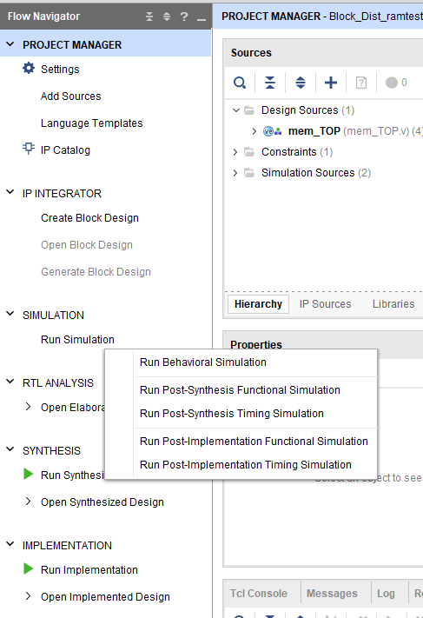
Xsim
(2/7)
We mainly use these two Simulation

Slide 39
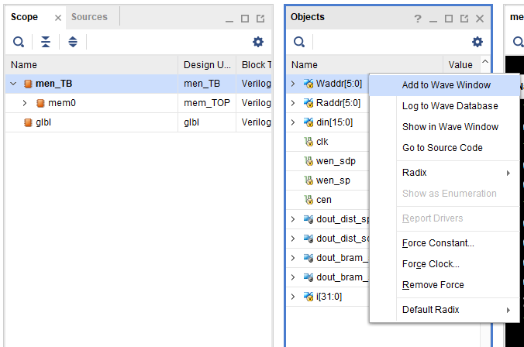
Xsim
(3/7)
You can add some signals which you want to observe.

Slide 40
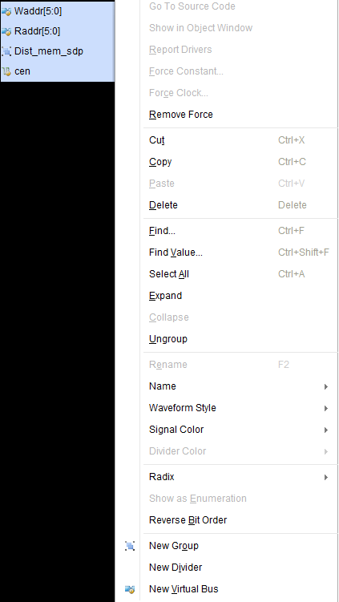
Xsim
(4/7)
There are three ways to help you observe waveform efficiently.
New Group：
Fold serveral signals into one row.
Signal Color： Change color
Radix：
Dec, Hex, etc.

Slide 41

Xsim (5/5)
After you arranged the signals in waveform, you can ‘Save Waveform Configuration’ (.wcfg)

Slide 42
Outline
Download & Install
Setup License
Create Project
Setting Constraint
Xsim
Synthesis & Implementation
Summary

Slide 43
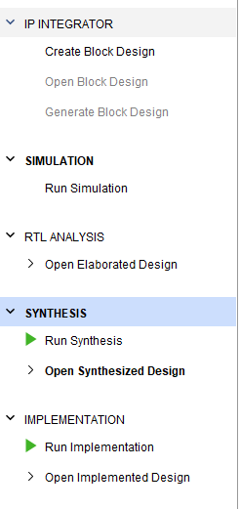
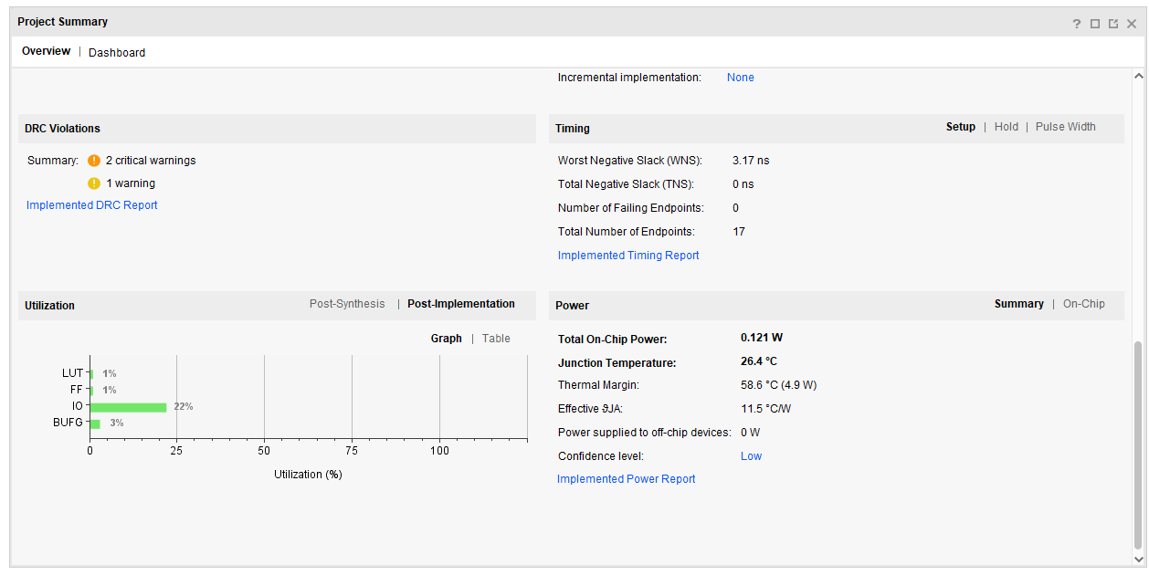
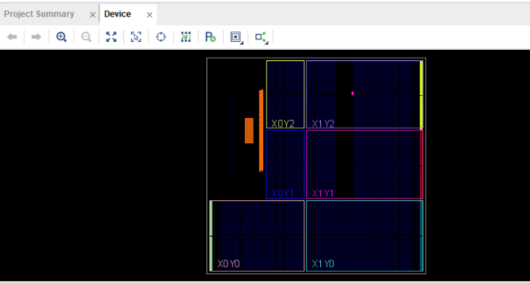
Synthesis & Implementation
(1/3)
If you run implementation, vivado will ask you run synthesis first.

Slide 44
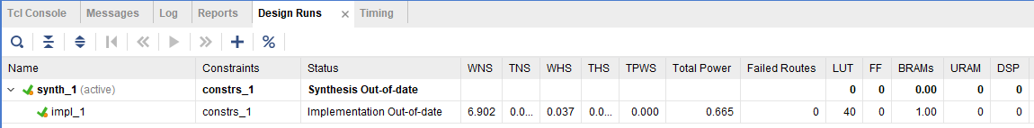
Synthesis & Implementation (2/3)
If all of the value is black font, this means the implementation is successful.
If implementation didn’t success, it will show error part in red font
Please check if timing violation or area is exceeding the limit.

Slide 45
Synthesis & Implementation
(3/3)
Resource：
LUT ：Look-up table Combinational circuit
FF ：Flip-Flop Register of sequential circuit
BRAM/LUTRAM： Memory
DSP：Digital signal processor
Special arithmetic (multiplication, division, etc.)
IO：
Bit number of IO port.
BUFG：
Usually is used by clock source.
46

Slide 46
Outline
Download & Install
Setup License
Create Project
Setting Constraint
Xsim
Synthesis & Implementation
Summary

Slide 47
Summary (1/3)
FPGA Design Flow：
Write Verilog
Behavior Simulation
Setting Constraint
Synthesis
Implementation
Post-Implementation Functional simulation

Slide 48
Summary (2/3)
Design requirement：
Clock frequency at 100MHz.
No error and critical warning after running implementation.
You have to check the warnings will not cause your design
incorrect.
48

Slide 49
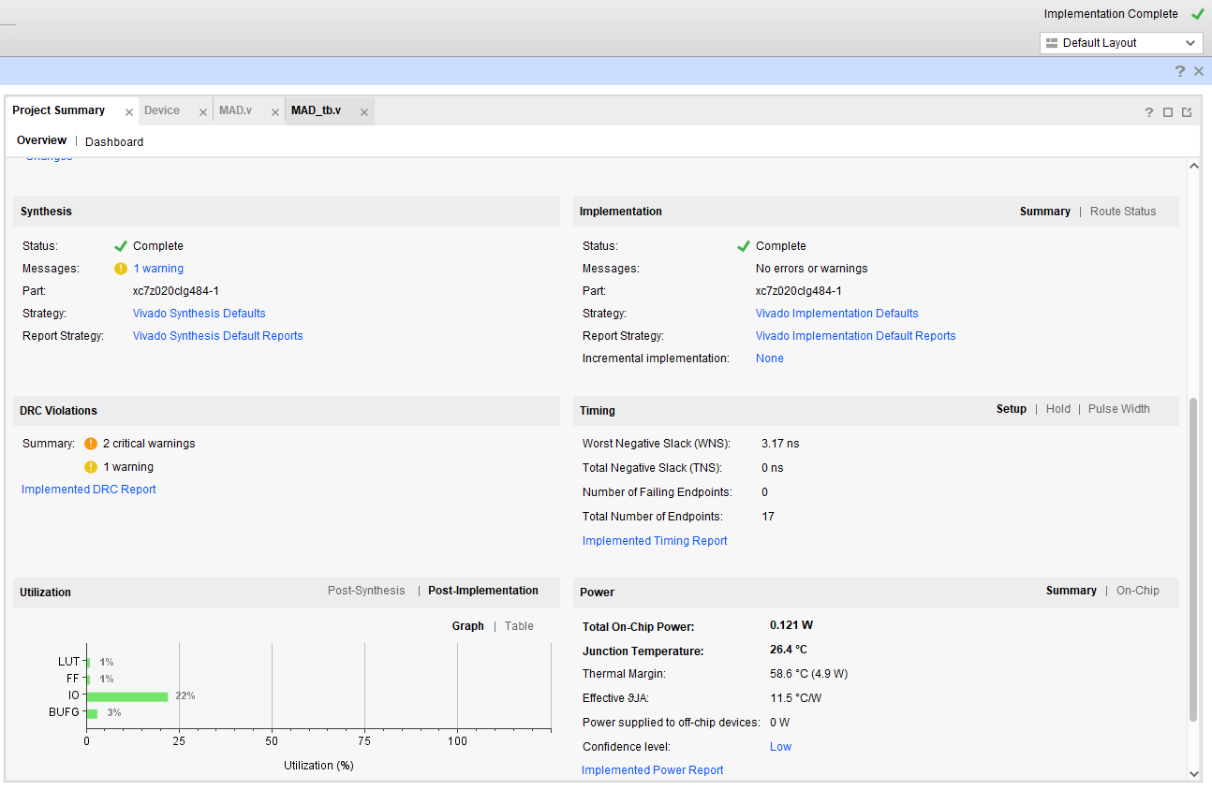
Summary (3/3)

Slide 50
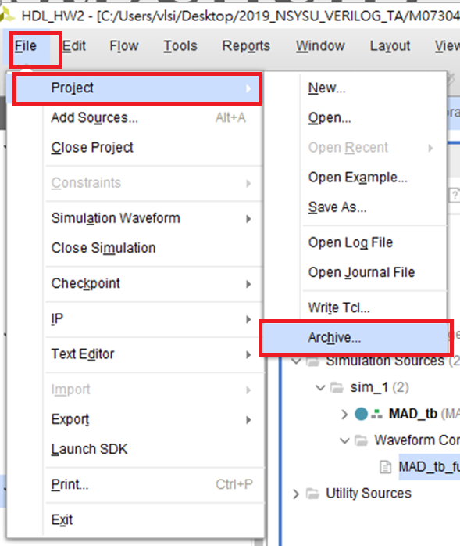
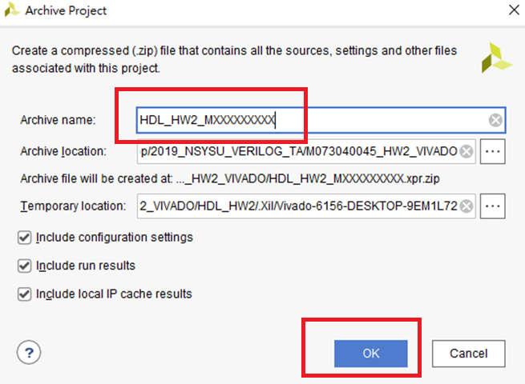
匯出壓縮檔(.xpr.zip)
1.
3.
2.
4.
Project完成後，可如左圖流程直接產生壓縮檔。
在繳交vivado檔案時，請將vivado壓縮檔路徑裡的檔名.wdb 刪除，以免檔案過大，其他同學無法上傳。
該路徑為 project名稱(HDL_HWx_MXXXXXX).sim/sim_1/behav/xsim 以及
(HDL_HWx_MXXXXXX).sim/sim_1/impl/func /xsim
請確保壓縮檔裡的這兩個資料夾裡沒有.wdb檔。
50

