Slide 1
Project Report
Mr. HelpMate AI

Slide 2
Overview
Problem: Insurance policyholders and agents often struggle to locate specific information within complex insurance documents. Traditional keyword searches fail to capture the nuances of insurance terminology and the context of the user's query.
Solution: Mr. HelpMate AI addresses this challenge by combining semantic search with powerful language models to deliver accurate and context-aware answers to user queries from within insurance documents.
Core Features:
PDF processing and text extraction
Semantic search to retrieve relevant insurance document sections
AI-powered question answering to provide direct answers and citations.
Benefits: Streamlines information retrieval, saves time for policyholders and insurance agents, and potentially enhances decision-making based on policy terms.

Slide 3
Objectives
The primary objective of the project should be to effectively implement all below three layers
Embedding Layer: The PDF document needs to be effectively processed, cleaned, and chunked for the embeddings. Here, the choice of the chunking strategy will have a large impact on the final quality of the retrieved results.
Search Layer: Here, you first need to design at least 3 queries against which you will test your system. You need to understand and skim through the document, and accordingly come up with some queries, the answers to which can be found in the policy document. Next, you need to embed the queries and search your ChromaDB vector database against each of these queries. Implementing a cache mechanism is also mandatory. Finally, you need to implement the re-ranking block, and for this you can choose from a range of cross-encoding models on HuggingFace.
Generation Layer: In the generation layer, the final prompt that you design is the major component. Make sure that the prompt is exhaustive in its instructions, and the relevant information is correctly passed to the prompt.

Slide 4
Design
RAG Pipeline
Embedding Layer: Extract text and tables from PDFs, convert them to a data frame, and generate vector representations using OpenAI’s “text-embedding-ada-002” model. Store these embeddings in ChromaDB.
Search and Rank Layer: Perform a semantic similarity search on the knowledge bank based on user queries, retrieving the top K closest documents or chunks.
Generation Layer: Utilize the results from the previous layer, including the original user query and a well-constructed prompt, to generate coherent answers using a language model.

Slide 5
Cache Implementation
Set a threshold of 0.2 for semantic similarity.
Store queries and results in a cache_collection in ChromaDB for easy embedding and searching.
Use ChromaDB's utility functions to add documents, ids, and metadata to the cache_collection.

Slide 6
Implementation
Used Google Collab for development and leveraged libraries such as pdfplumber, tiktoken, OpenAI, ChromaDB, and sentence-transformers for document processing, embedding, and caching.
Implemented functions to extract text and tables from PDFs, created a data frame, generated vector embeddings, and performed semantic searches using the RAG pipeline.
Developed a cache system using ChromaDB to store and retrieve previous queries and their results.

Slide 7
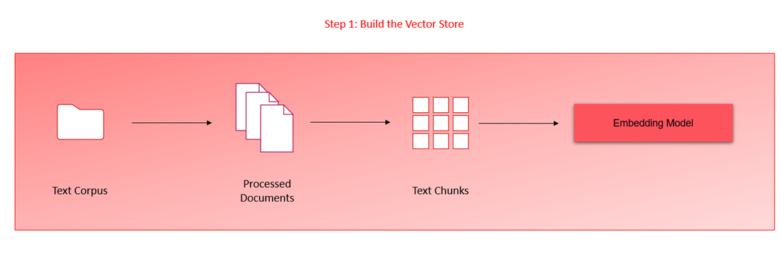
System Diagram
Embedding Layer:

Slide 8
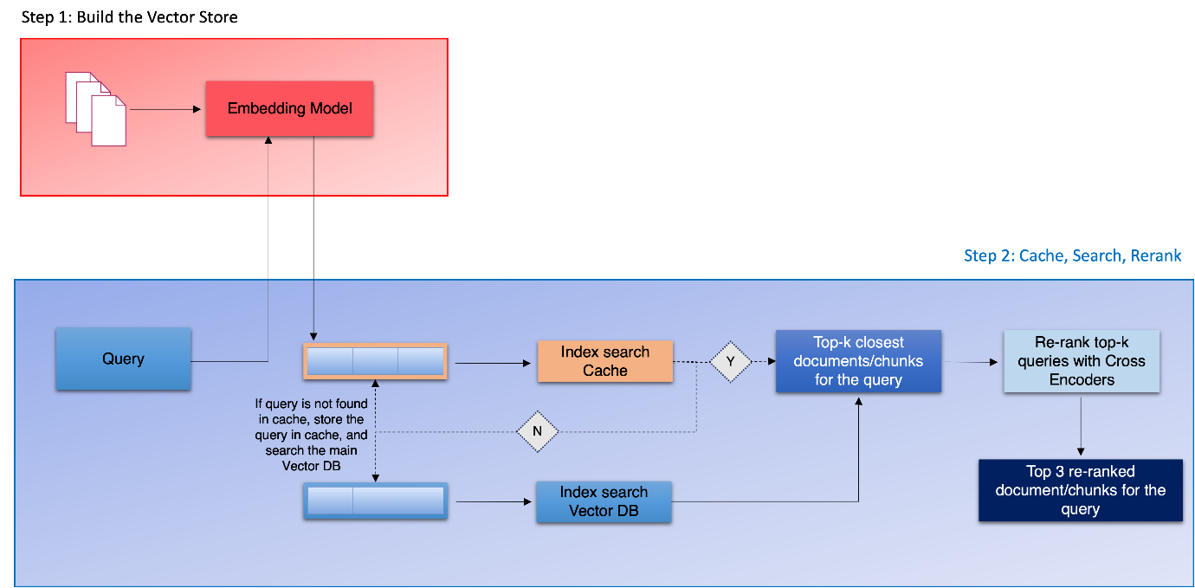
System Diagram
Search and Re-rank Layer:

Slide 9
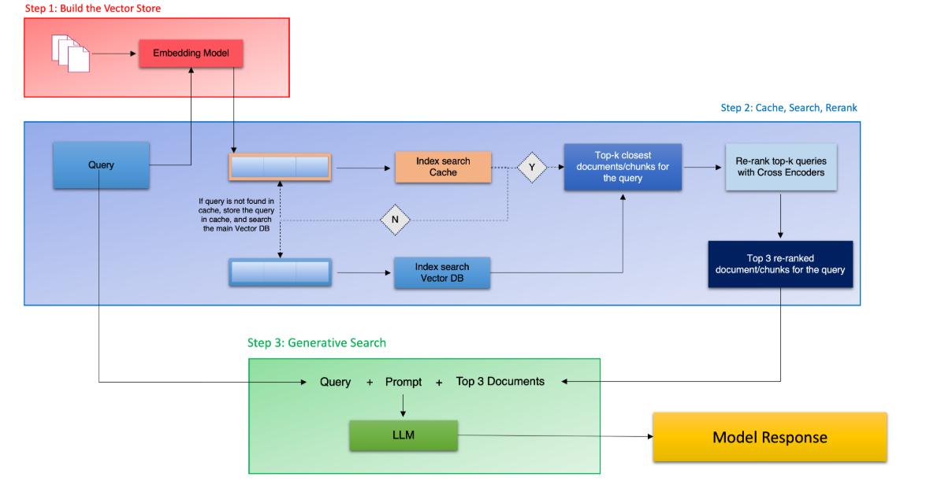
System Diagram
Generation Layer:

Slide 10
Challenges & Lessons Learned
Challenges
Complex PDF Structures: Handling diverse PDF formats.
Insurance-Specific Terminology: Adapting models to insurance vocabulary.
Answer Granularity: Finding the ideal balance in result length.
API Costs: Optimizing usage for cost-effectiveness.
Lessons Learned
Thorough PDF Analysis: Pays off in robust extraction logic.
Domain Adaptation: Crucial for language model accuracy.
Hybrid Retrieval: Can enhance certain query types.
Cost-Effective Architecture: Exploring a mix of APIs and local models.

Slide 11
Conclusion
Mr. HelpMate AI project successfully demonstrates the potential of semantic search and AI-powered question answering to transform how users navigate insurance documents.
The project highlighted the value of PDF preprocessing, embedding-based search, and language model fine-tuning.
The system provides a scalable and efficient solution for document retrieval and information extraction.

