Slide 1
Visualization Zoo
Mersi Stafa

Slide 2
Visualization Zoo is
Technique for visualizing and interacting with diverse data sets
Different visual data representation
Varying types of encoding

Slide 3
Goals of bachelor thesis
Abstract goals
Aid our understanding of data by leveraging the human visual system's highly tuned ability to see patterns, spot trends, and identify outliers
Try to replace cognitive calculations with simple perceptual inferences and improve comprehension, memory, and decision making
Concrete goals
Compare D3 and Vega visualization frameworks
Analyze user interaction with different frameworks on different devices
Calculate and determine best performance
Show the rendering steps (client side as well as server side)

Slide 4
Which data will be represented
Time-Series Data
Index Charts
Stacked Graphs
Small Multiples
Horizon Graphs
Plots
Maps (BOC group challenge)
Hierarchies
Networks
Histograms

Slide 5
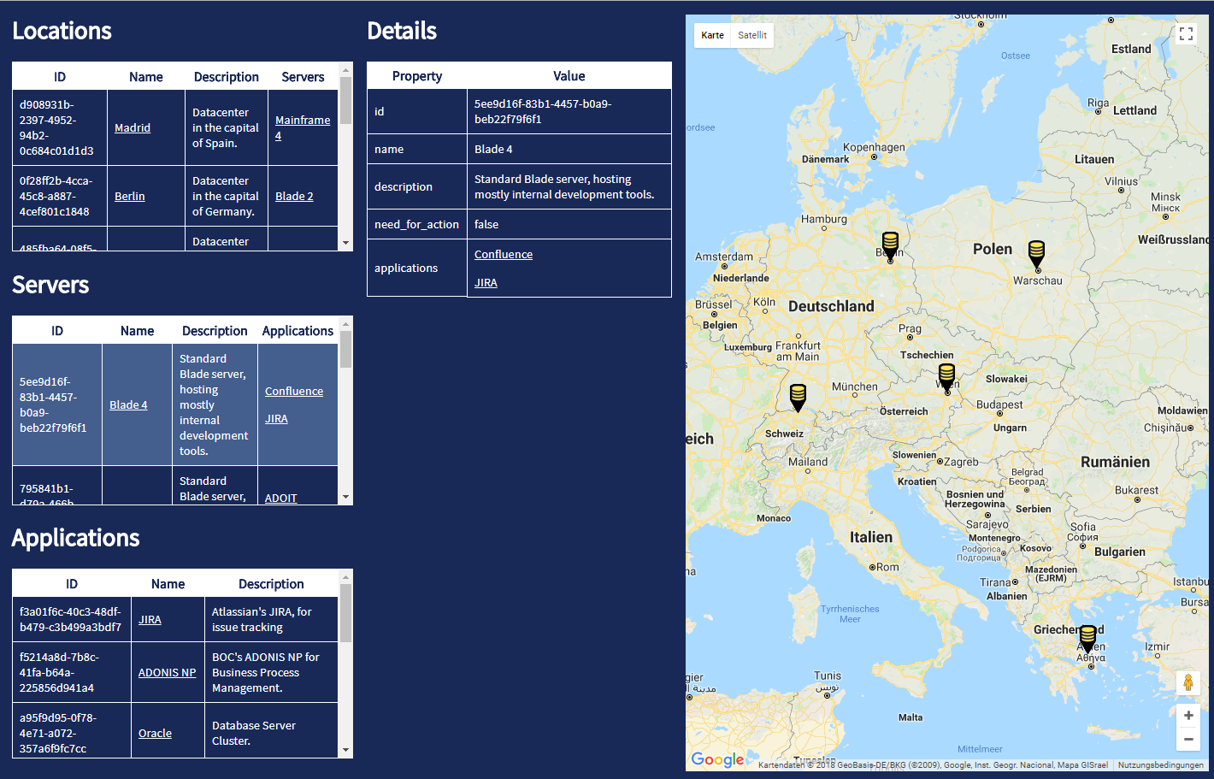
BOC Group challenge
Represent locations on map
Represent servers on map
Get details of chosen data

Slide 6


Technology Stack
D3 Framework
Vega Framework
ReactJS Framework + Redux for frontend
NodeJS for server side rendering
SCSS for styling
Docker container for deployment

Slide 7
What is done
First 1 to 1 comparison between D3 and Vega with different types of charts
First trial with React + Redux framework
First deployment with docker
Demo available here: http://dev.youngfolks.ru

Slide 8
//TODO
Try all types of charts
Try with real data (Stock data)
Implement BOC challange
Make full realtime demo
Spot performance, rendering etc. between two frameworks

Slide 9

Questions?
Demo: http://dev.youngfolks.ru

