Slide 1
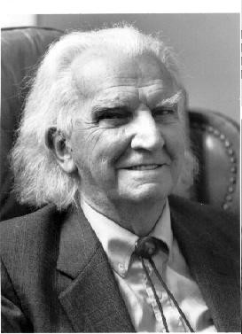
Kenneth Boulding

