Slide 1
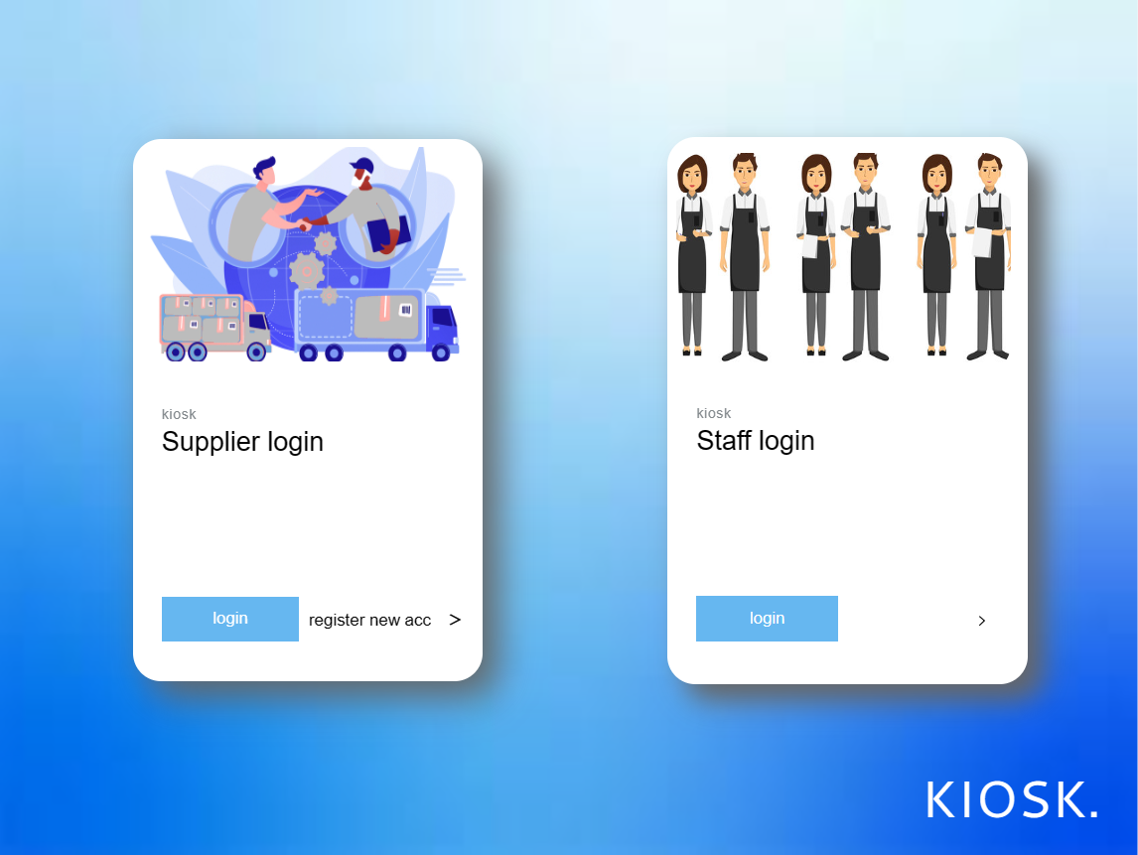
Go to supplier login page
Go to supplier login page
Go to staff login page

Slide 2
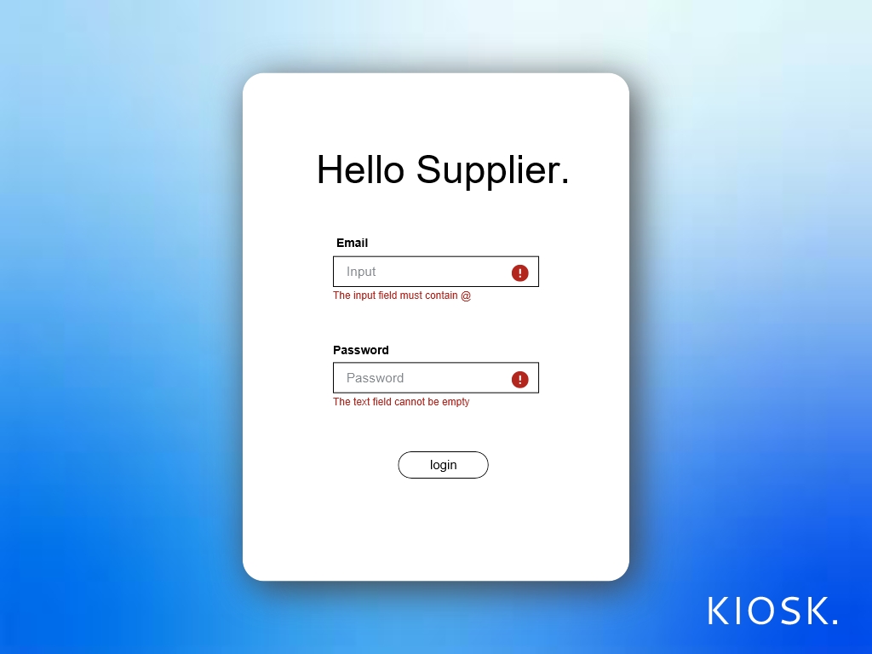

Return to home page
Supplier username
Prompt user when not fulfil requirement
Supplier username password
Prompt user when not fulfil requirement
Proceed to supplier information

Slide 3
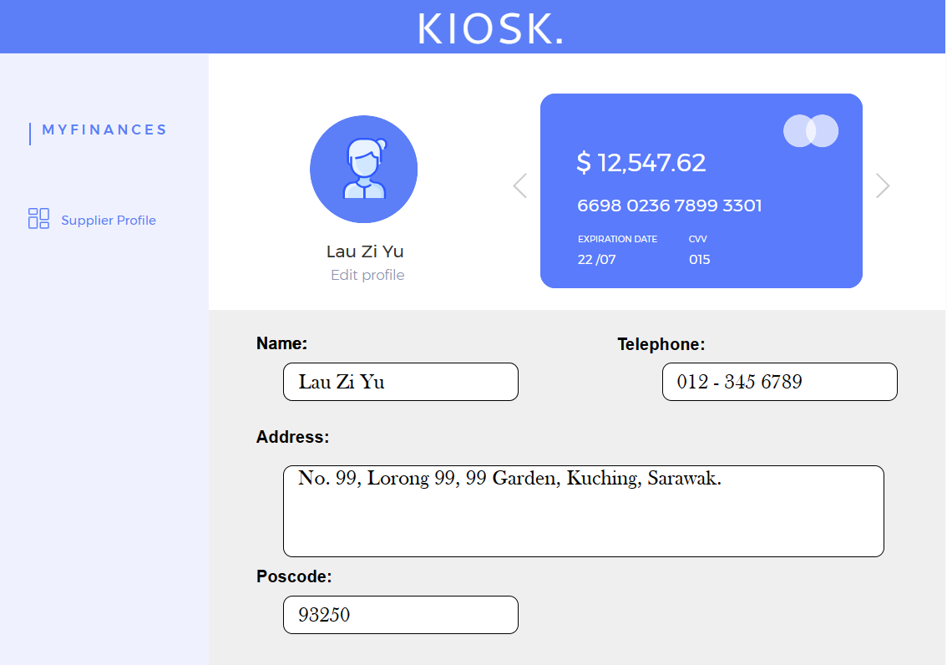
Supplier linked card
Supplier telephone number
Allow supplier edit profile
Supplier name
Supplier address
Supplier address postcode

Slide 4
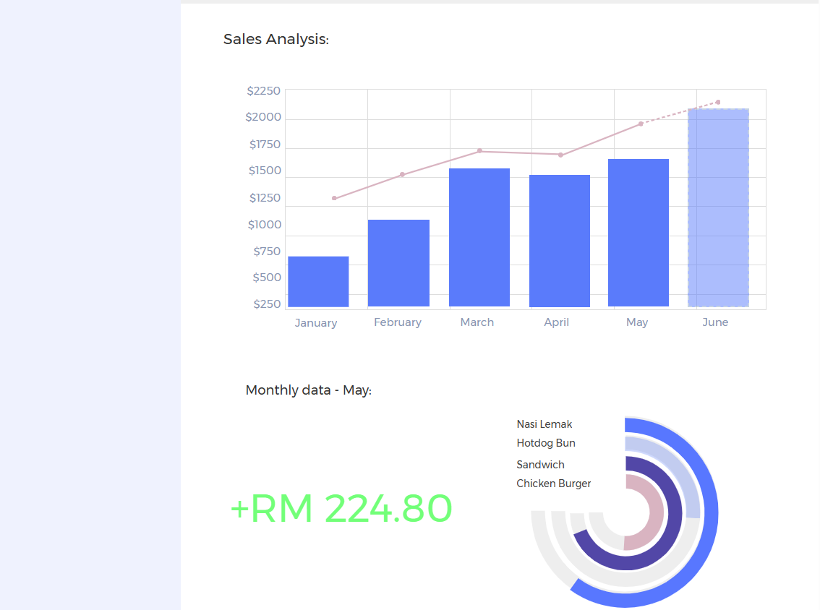

Graph of monthly analysis for food
Shows sales profit
Chart of type of food sales
Proceed to receive payment page

Slide 5
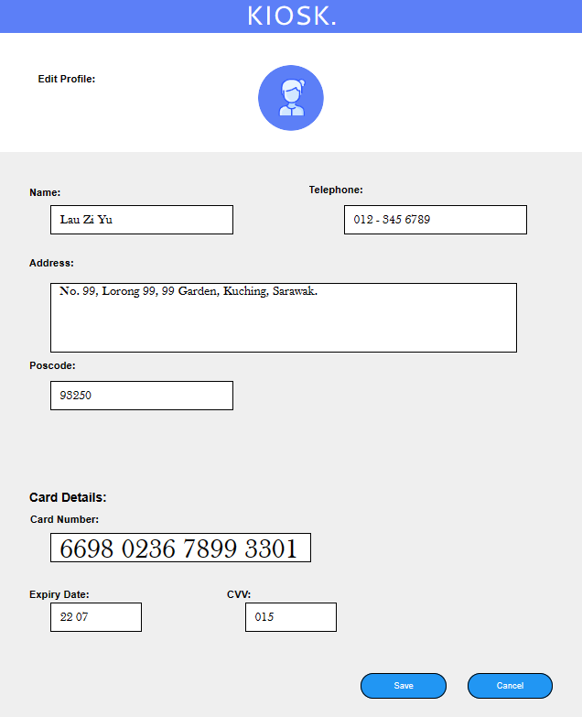
Supplier Telephone Number
Supplier Name
Supplier Address
Supplier Postcode
Supplier Debit Card Number
Supplier Debit Card CVV
Supplier Debit Card Expiry Date
Save the edited Profile
Cancel the changes and return to supplier profile

Slide 6
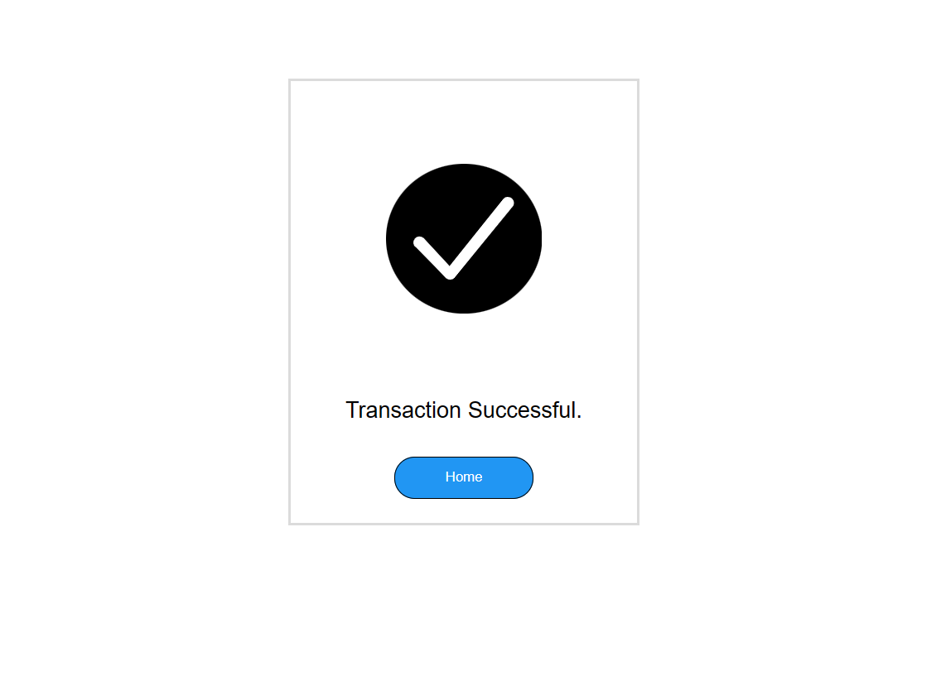
Show transaction is done successfully
Return to supplier profile page

Slide 7
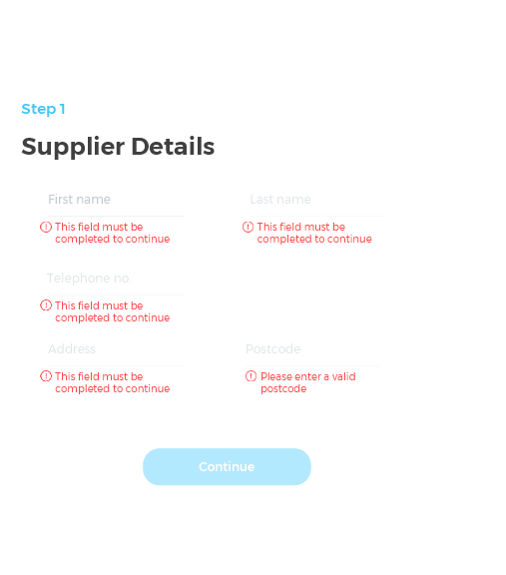
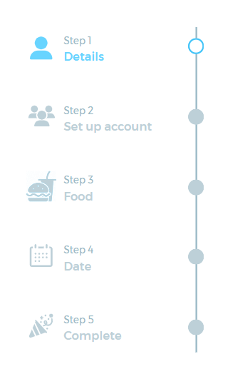
Return to home page
Page of supplier details
Supplier Last name
Supplier First name
Prompt user when requirement not fulfil
Prompt user when requirement not fulfil
Prompt user when requirement not fulfil
Supplier Telephone Number
Supplier Address Postcode
Supplier Address
Prompt user when requirement not fulfil
Prompt user when requirement not fulfil
Proceed To Next Page

Slide 8
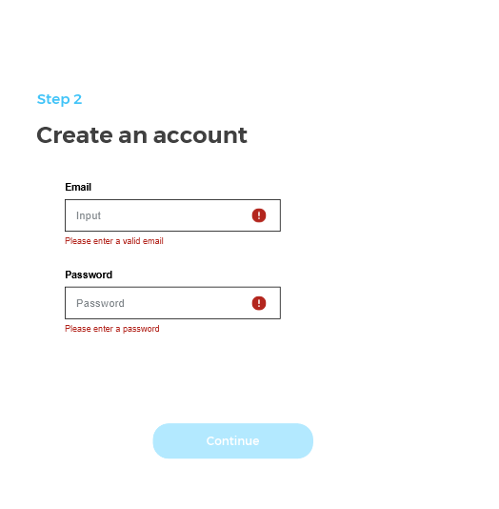
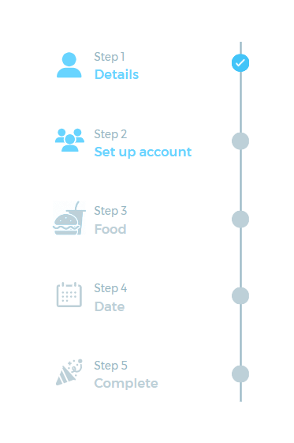
Show page of supplier is done
Return to home page
Page of set up supplier account
Supplier set up username
Prompt user when requirement not fulfil
Supplier create account password
Prompt user when requirement not fulfil
Proceed To Next Page

Slide 9
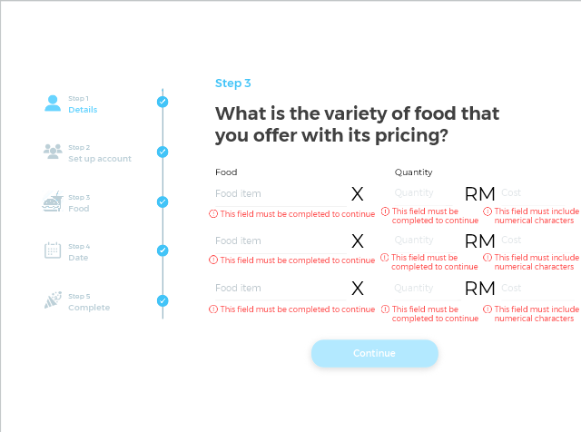
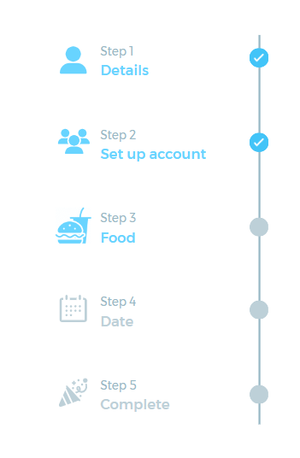
Show page supplier account is done
Return to home page
Quantity of food
Cost of food
Type of food
Prompt user when requirement not fulfil
Proceed To Next Page
Prompt user when requirement not fulfil

Slide 10
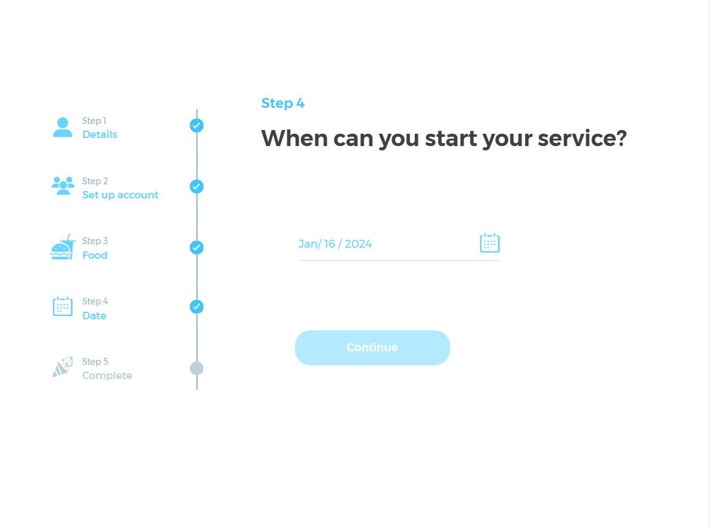
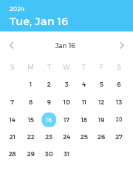
Return to home page
Select a date
Show Calander
Show page food is done
Proceed To Next Page
Prompt user when requirement not fulfil

Slide 11
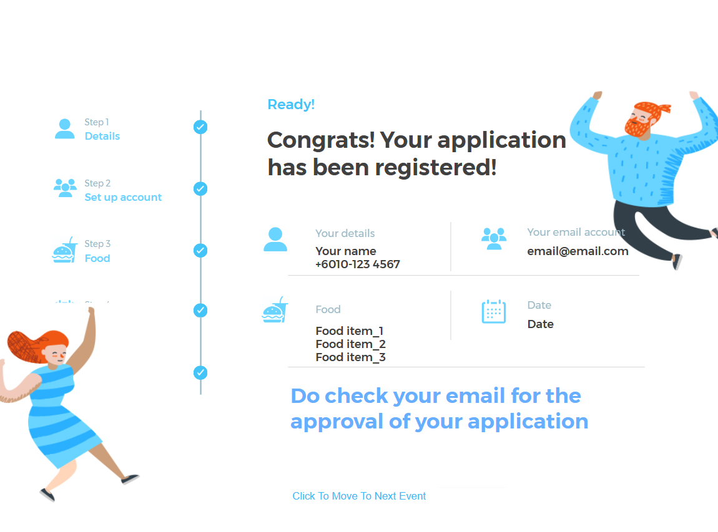
Return to home page
Show the detail of supplier fill in from the previous steps
Refill the form again

Slide 12
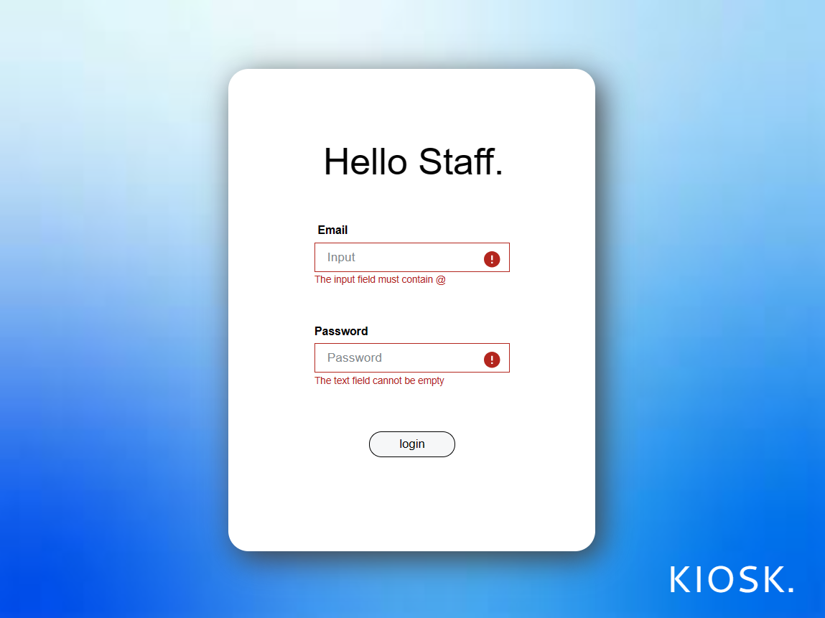
Return to home page
Return to home page
Staff username
Prompt user when not fulfil requirement
Staff username password
Prompt user when not fulfil requirement
Proceed to staff information

Slide 13

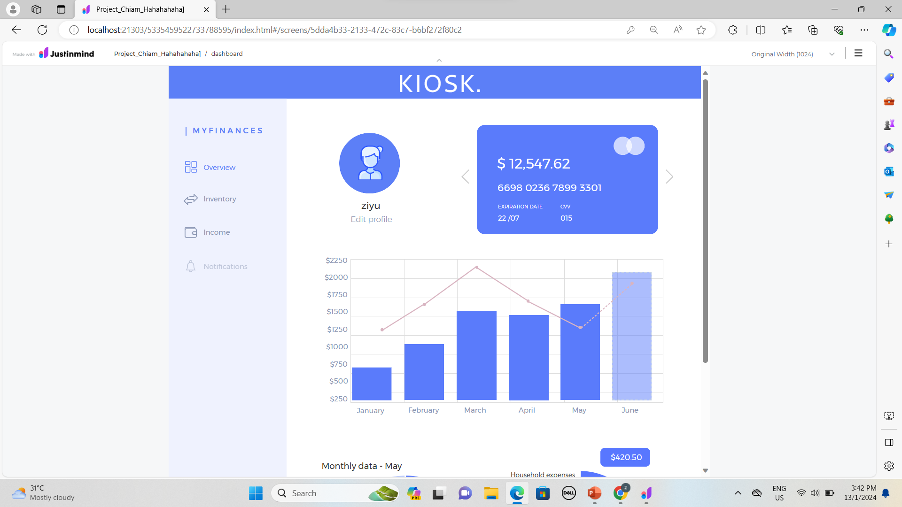
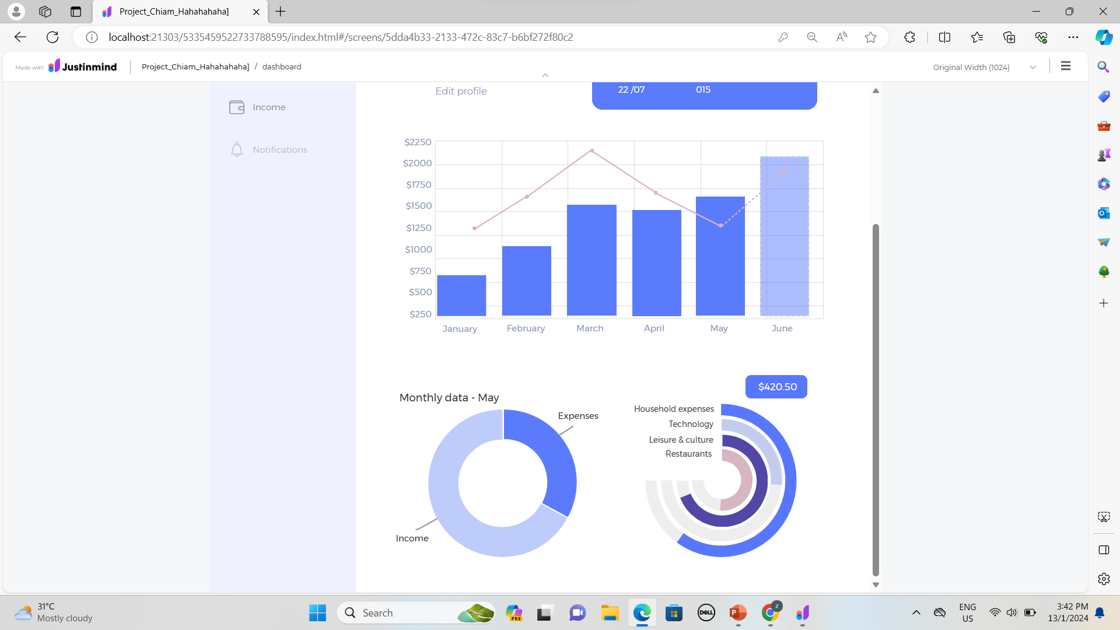
Return to home page
Staff linked card
Proceed to overview page
Proceed to inventory page
Proceed to income page
Staff name
Allow staff edit profile
Proceed to notification page
Graph of month food sales analysis
Chart of monthly data

Slide 14
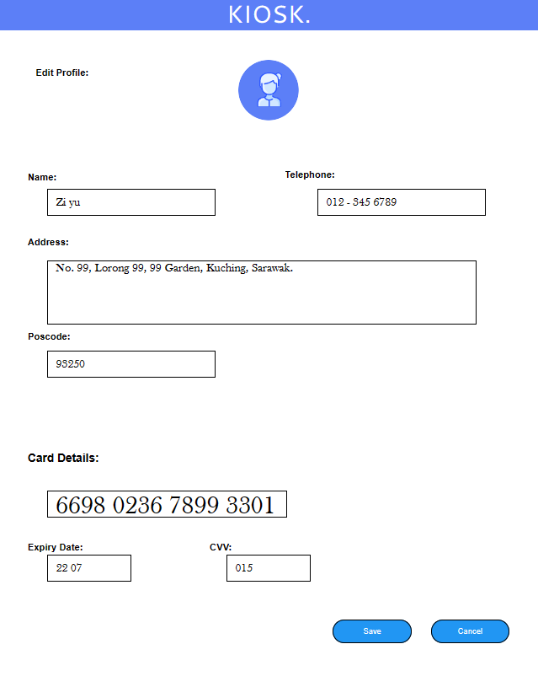
Supplier Name
Supplier Telephone Number
Supplier Address
Supplier Postcode
Supplier Debit Card Number
Supplier Debit Card CVV
Supplier Debit Card Expiry Date
Save the edited Profile
Cancel the changes and return to supplier profile

Slide 15
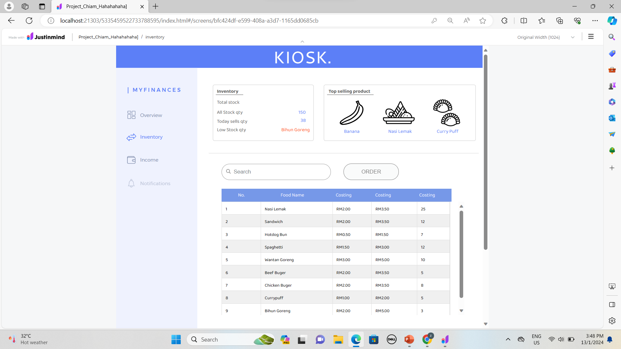
Return to home page
Show information of inventory
Proceed to overview page
Proceed to inventory page
Allow user search items
Proceed to income page
Order food to supplier
Proceed to notification page

Slide 16
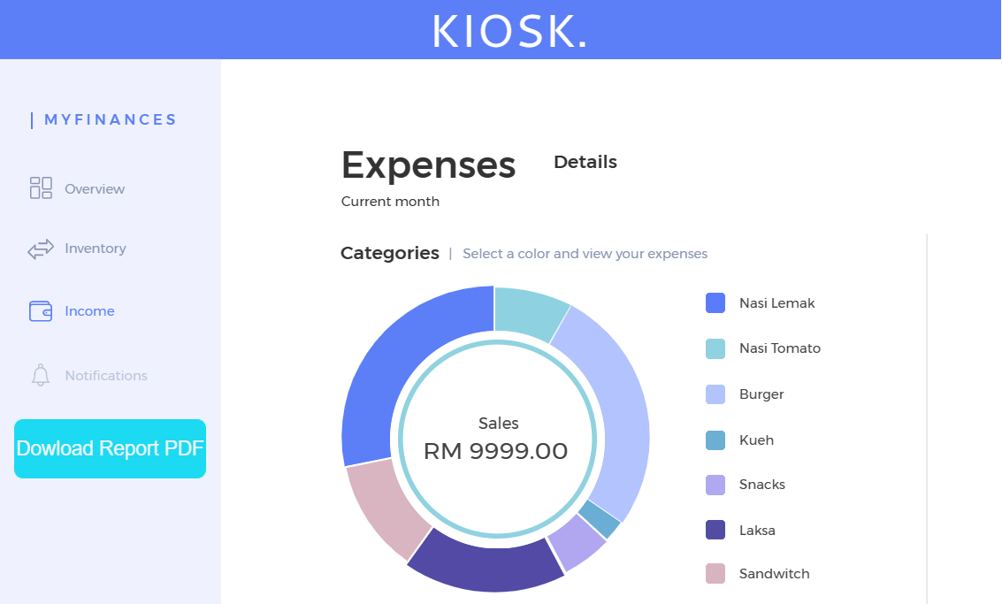
Return to home page
Proceed to overview page
Proceed to inventory page
Proceed to income page
Proceed to notification page
Download report of expenses in PDF form
Chart of expenses analysis

Slide 17
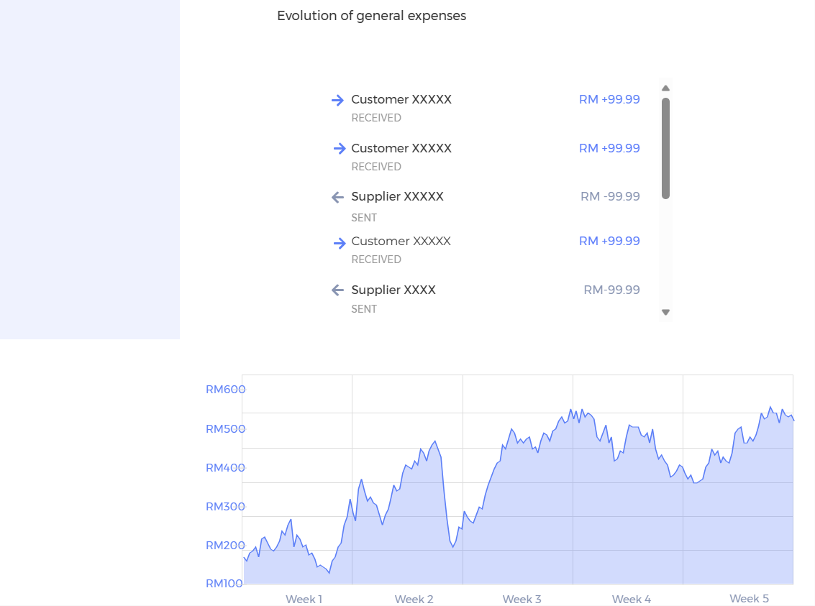
List of evolution of general expenses
Graph of evolution of general expenses

Slide 18
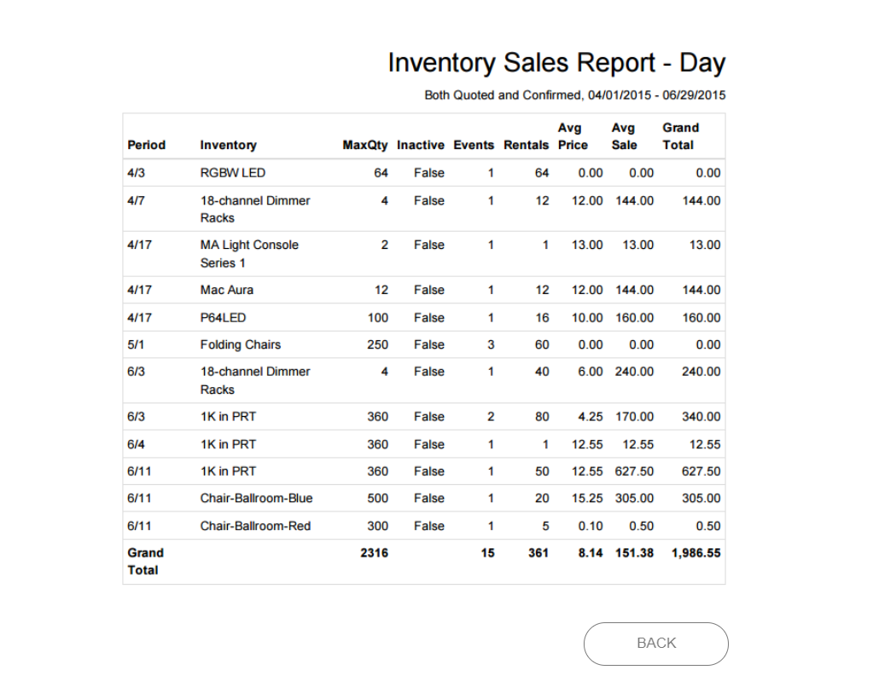
Return to kiosk staff page

Slide 19
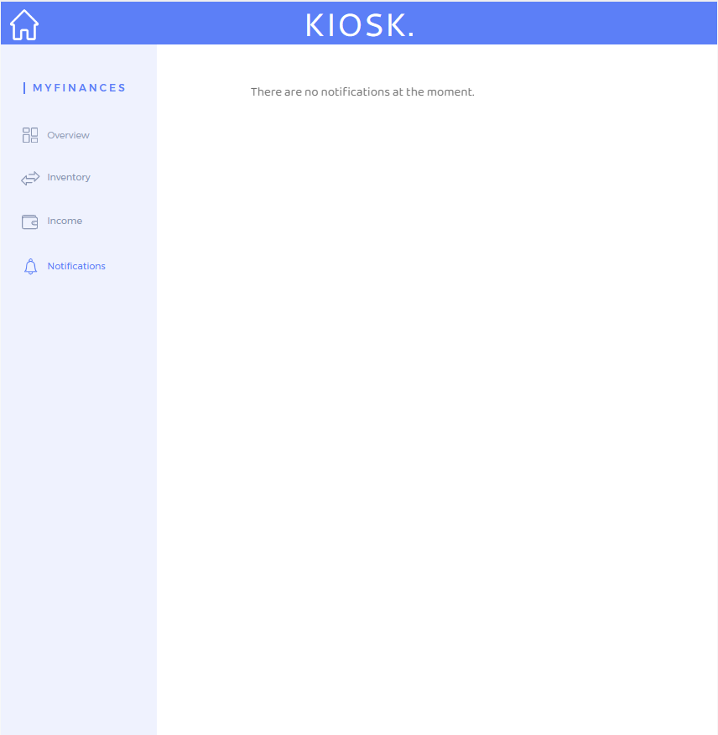
Return to home page
Proceed to overview page
Proceed to inventory page
Proceed to income page
Proceed to notification page

