Slide 1

XGBoost: A Scalable Tree Boosting System
Authors – Tianqi Chen, Carlos Guestrin (University of Washington)
Ashley Lau

Slide 2
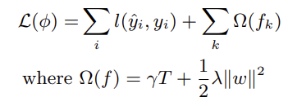

Tree Boosting in a Nutshell
What is tree boosting?
Tree boosting is a supervised machine learning technique that involves the combination of several decision trees to form a single predictive model.
Decision trees are built in sequence, with each new tree attempting to correct the errors made by the previous tree.
Tree boosting can be used for classification and regression.
Regularized Learning Objective
Optimize the objective function using second order approximation

Slide 3
How to prevent overfitting
2 additional techniques to prevent overfitting:
1. Shrinkage reduces the influence of each individual tree and leaves space for future trees to improve the model
2. Column (feature) subsampling aims to reduce the number of features (columns) used in a model by selecting a subset of the features from the training data and using only those features to train the model
Split Finding Algorithms
Exact Greedy algorithm
Find max score amongst all possible splits on all features
Computationally demanding
Approximate algorithm (weighted quantile sketch)
The algorithm proposes splitting points based on feature percentiles, discretizes continuous features into buckets using these points, aggregates statistics, and selects the best solution among proposals.

Slide 4
XGBoost System Design
Sparsity-aware split finding
XGBoost can efficiently handle sparse data by classifying missing values into default directions of tree nodes so that algo focuses on non-missing values only
Column blocking for parallel compute
To reduce time sorting data, XGBoost stores data in compressed column blocks allowing split finding algo to run in parallel
Major time save!!

Slide 5
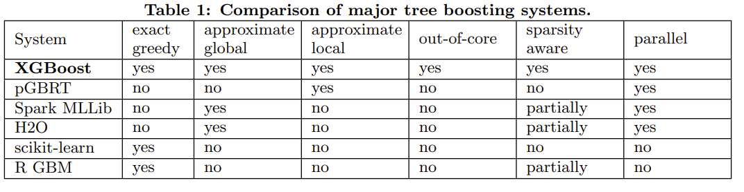
XGBoost System Design
Cache-awareness
Depending on split finding algo used, XGBoost does data prefetching or chooses correct block size to reduce the amount of time that the processor spends waiting for data to be retrieved from main memory
Out-of-core computation
To handle data that does not fit in main memory, data is divided into multiple blocks and stored separately on disks. Disk Reading takes up majority of compute time so 2 techniques are used to combat this:
1. Block Compression
2. Block Sharding

Slide 6
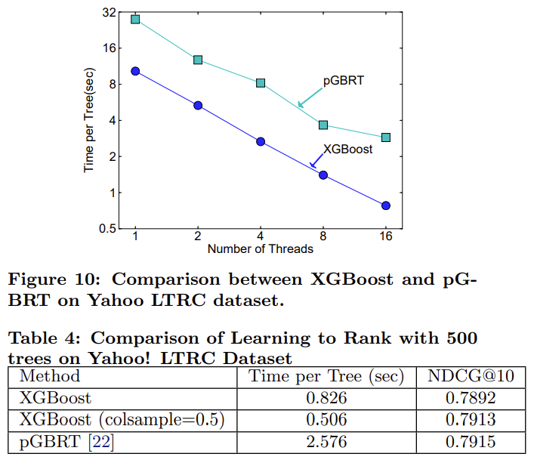
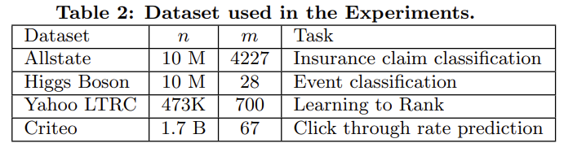
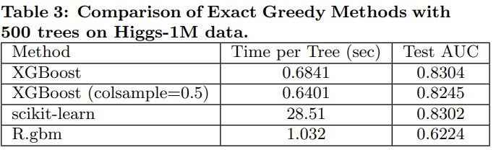
Experimentation

Slide 7
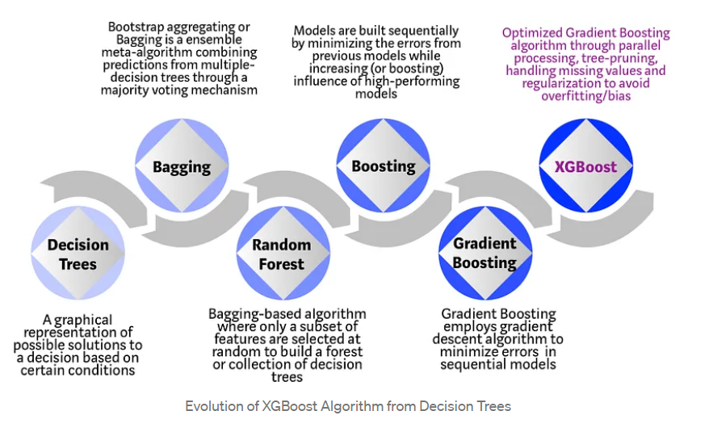
Evolution of Tree Boosting

Slide 8


How does XGBoost enhance field of Deep Learning?
Award-winning algo of choice in previous Kaggle competitions
Widely used across industry
Open-source package: Github link

Slide 9
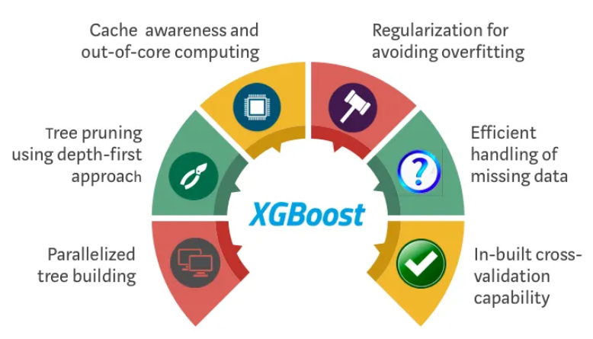
Thank you

Slide 10
Appendix
[1]Chen, Tianqi, and Carlos Guestrin. Arxiv, 2016, XGBoost: A Scalable Tree Boosting System, arxiv.org/pdf/1603.02754.pdf. Accessed 10 Mar. 2023.
[2]Dmlc. “DMLC/Xgboost: Scalable, Portable and Distributed Gradient Boosting (GBDT, GBRT or GBM) Library, for Python, R, Java, Scala, C++ and More. Runs on Single Machine, Hadoop, Spark, Dask, Flink and Dataflow.” GitHub, https://github.com/dmlc/xgboost.
[3]Morde, Vishal. “XGBoost Algorithm: Long May She Reign!” Medium, Towards Data Science, 8 Apr. 2019, https://towardsdatascience.com/https-medium-com-vishalmorde-xgboost-algorithm-long-she-may-rein-edd9f99be63d.

Slide 11
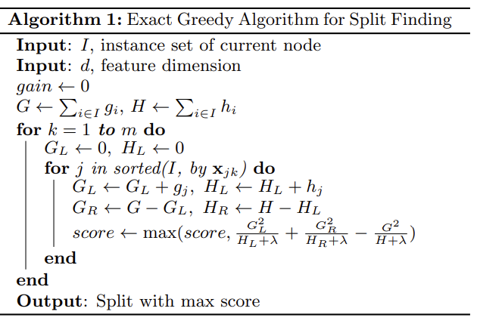
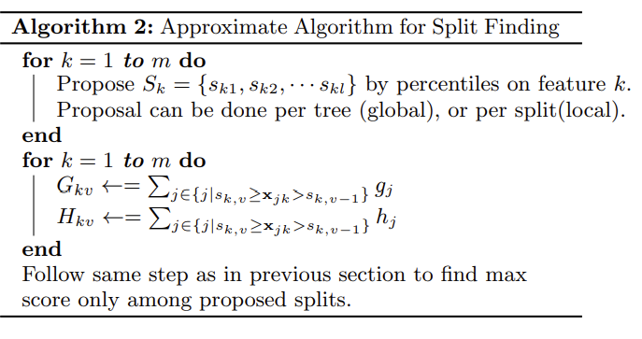
Algorithm Explainations

Slide 12
