Slide 1
Generalized Linear Models
Matt Farr

Slide 2

Models in Science
Science is too complex to understand → must reduce complexity
Describe and predict systems/processes
Model is set of assumptions about scientific systems/processes
Simplification of reality

Slide 3
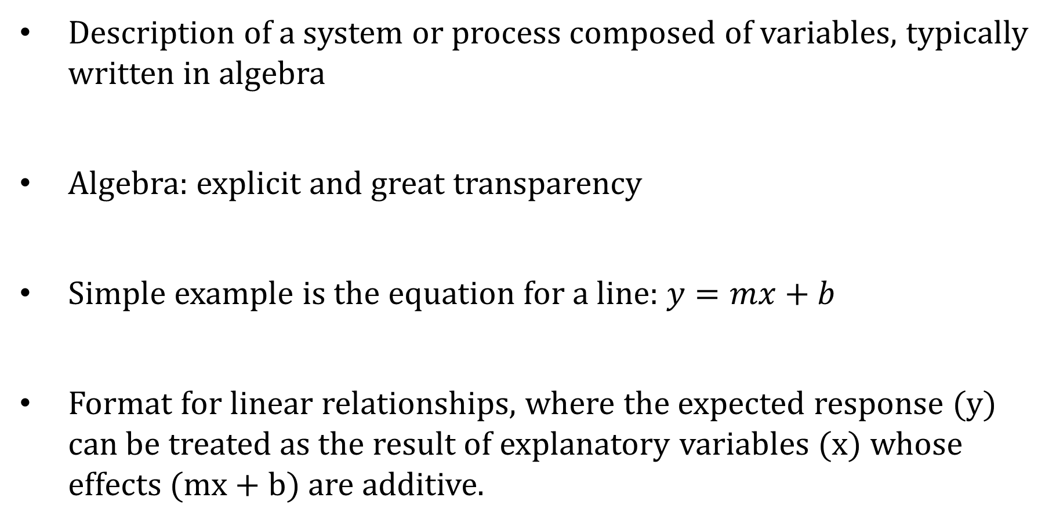
Mathematical Models
Description of a system or process composed of variables, typically written in algebra
Algebra: explicit and great transparency
Simple example is the equation for a line: $y=mx+b$
Format for linear relationships, where the expected response (y) can be treated as the result of explanatory variables (x) whose effects (mx + b) are additive.

Slide 4
Statistical Models
Stochasticity or randomness
Statistical models: a description of a system/process composed of variables but where one or more random variables are related to other variables
Explicitly acknowledge stochasticity in system/processes
Response = deterministic part + stochastic part
Parametric statistical models (generalized linear models): a description of a system/process using probability distributions thought to have produced the data

Slide 5
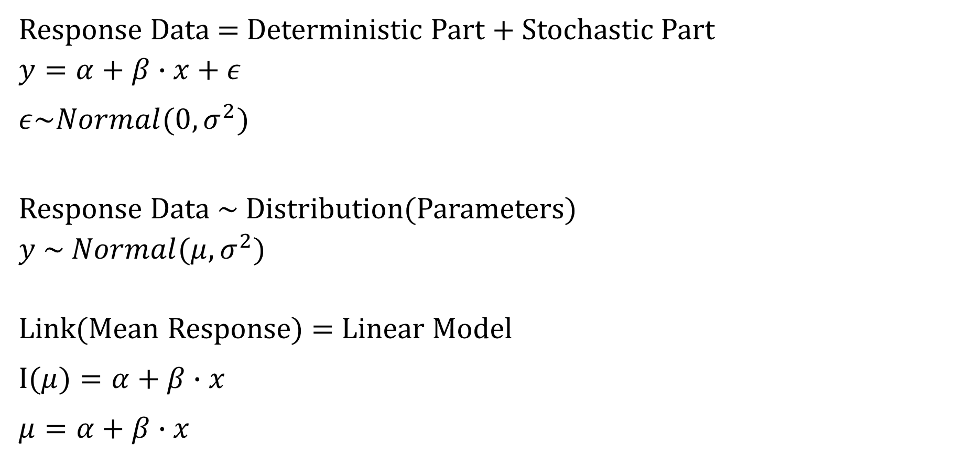
Generalized Linear Model
Response Data = Deterministic Part + Stochastic Part
$$y=α+β∙x+ε$$
$$ε\sim Normal(0,σ^{2})$$
Response Data ~ Distribution(Parameters)
$$y \sim Normal(μ,σ^{2})$$
Link(Mean Response) = Linear Model
$$I(μ)=α+β∙x$$
$$μ=α+β∙x$$

Slide 6
Data Types
Types of responses (y)
Continuous (body mass)
Binary (heads/tails; dead/survived)
Categorical (rolling a die, nationality; geographic location)
Counts (number of birds in a quadrant)

Slide 7
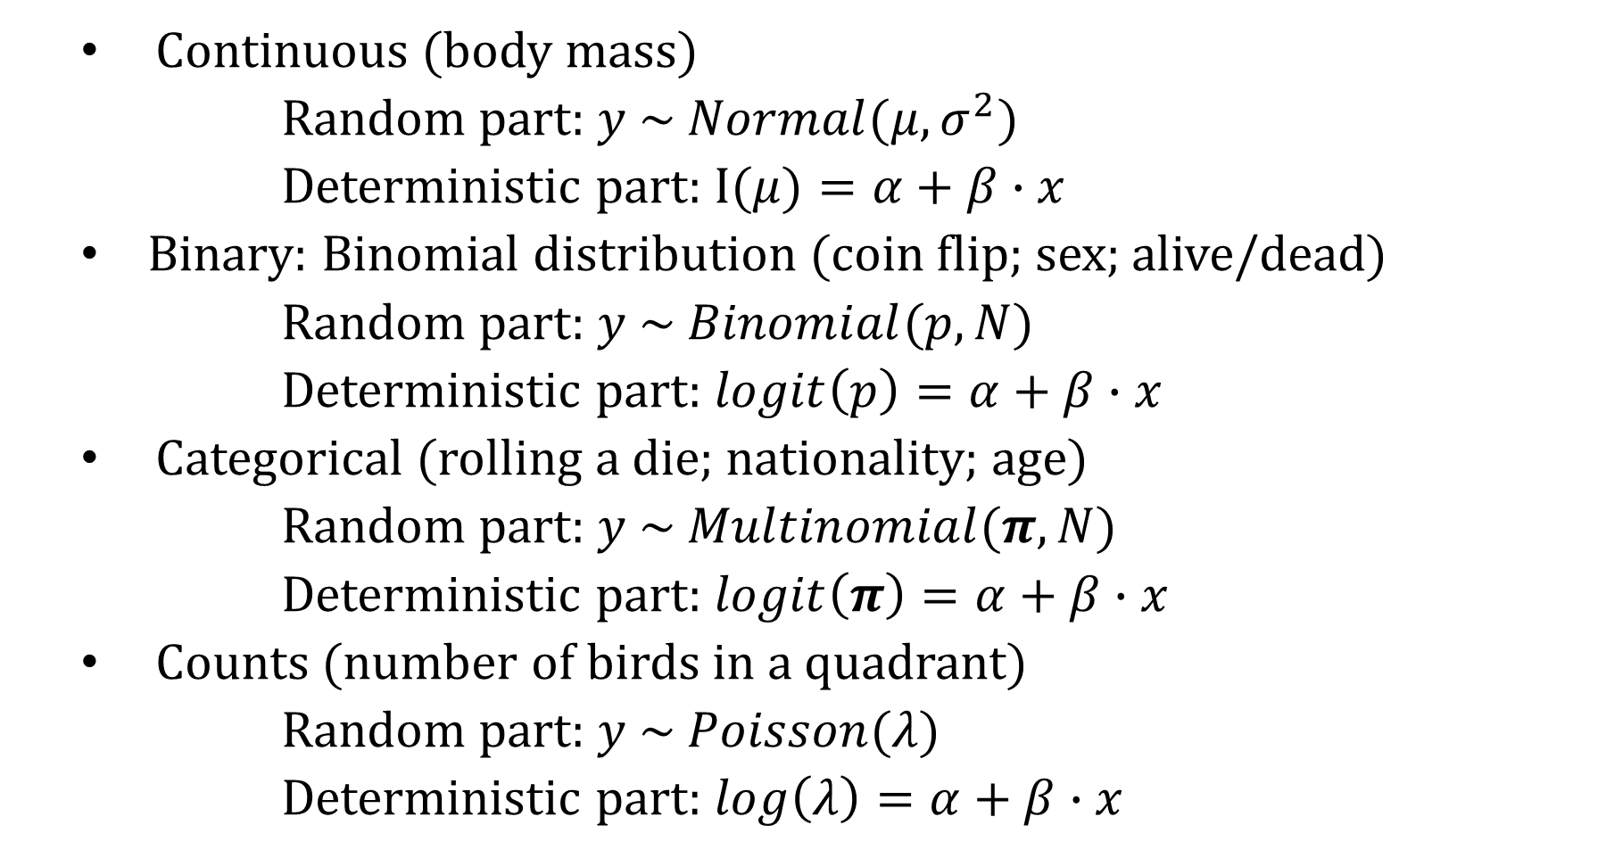
Frequent Distributions
Continuous (body mass)
Random part: $y \sim Normal(μ, σ^{2})$
Deterministic part: $I(μ)=α+β∙x$
Binary: Binomial distribution (coin flip; sex; alive/dead)
Random part: $y \sim Binomial(p, N)$
Deterministic part: $logit\left(p\right)=α+β∙x$
Categorical (rolling a die; nationality; age)
Random part: $y \sim Multinomial(π, N)$
Deterministic part: $logit\left(π\right)=α+β∙x$
Counts (number of birds in a quadrant)
Random part: $y \sim Poisson(λ)$
Deterministic part: $log\left(λ\right)=α+β∙x$

Slide 8
Design Matrix
Deterministic part of the linear model
A matrix of explanatory variables
Manipulation of the design matrix that leads to classical statistical models
Column for each predictor variable
Means parameterization or an effects parameterization (intercept)
Row for each data point (individuals, sites, time period, etc.)

Slide 9

Design Matrix
$$y_{i}\sim Normal(μ_{i},σ^{2})$$
$$I\left(μ_{i}\right)=β_{F}∙{females}_{i}+β_{M}∙{males}_{i}$$
$\left(\begin{matrix}μ_{1} \\ μ_{2} \\ μ_{3} \\ μ_{4} \\ μ_{5} \\ μ_{6}\end{matrix}\right)=\left(\begin{matrix}1 & 0 \\ 1 & 0 \\ 1 & 0 \\ 0 & 1 \\ 0 & 1 \\ 0 & 1\end{matrix}\right)∗\left(\begin{matrix}β_{F} \\ β_{M}\end{matrix}\right)$

Slide 10

Design Matrix
$$y_{i}\sim Normal(μ_{i},σ^{2})$$
$$I\left(μ_{i}\right)=β_{F}∙{females}_{i}+β_{M}∙{males}_{i}$$
$$μ_{1}=β_{F}∙1+β_{M}∙0$$
$$μ_{2}=β_{F}∙1+β_{M}∙0$$
$$μ_{3}=β_{F}∙1+β_{M}∙0$$
$$μ_{4}=β_{F}∙0+β_{M}∙1$$
$$μ_{5}=β_{F}∙0+β_{M}∙1$$
$$μ_{6}=β_{F}∙0+β_{M}∙1$$

Slide 11


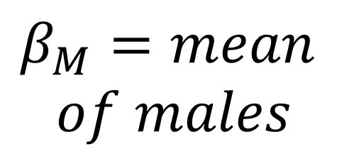
Design Matrix
$$y_{i}\sim Normal(μ_{i},σ^{2})$$
$$I\left(μ_{i}\right)=β_{F}∙{females}_{i}+β_{M}∙{males}_{i}$$
$$μ_{1}=β_{F}$$
$$μ_{2}=β_{F}$$
$$μ_{3}=β_{F}$$
$$μ_{4}=β_{M}$$
$$μ_{5}=β_{M}$$
$$μ_{6}=β_{M}$$
$$β_{F}=mean$$
$$of females$$
$$β_{M}=mean$$
$$of males$$

Slide 12

Design Matrix
$$y_{i}=β_{F}∙{females}_{i}+β_{M}∙{males}_{i}+ε_{i}$$
$$ε_{i}\sim Normal(0,σ^{2})$$
$\left(\begin{matrix}y_{1} \\ y_{2} \\ y_{3} \\ y_{4} \\ y_{5} \\ y_{6}\end{matrix}\right)=\left(\begin{matrix}1 & 0 \\ 1 & 0 \\ 1 & 0 \\ 0 & 1 \\ 0 & 1 \\ 0 & 1\end{matrix}\right)∗\left(\begin{matrix}β_{F} \\ β_{M}\end{matrix}\right)+$ $\left(\begin{matrix}ε_{1} \\ ε_{2} \\ ε_{3} \\ ε_{4} \\ ε_{5} \\ ε_{6}\end{matrix}\right)$

Slide 13

Model of the Mean
$$y_{i}\sim Normal(μ,σ^{2})$$
$$y_{i}=μ+ε_{i}$$
$$ε_{i}\sim Normal(0,σ^{2})$$
$\left(\begin{matrix}y_{1} \\ y_{2} \\ y_{3} \\ y_{4} \\ y_{5} \\ y_{6}\end{matrix}\right)=\left(\begin{matrix}1 \\ 1 \\ 1 \\ 1 \\ 1 \\ 1\end{matrix}\right)∗\left(μ\right)+$ $\left(\begin{matrix}ε_{1} \\ ε_{2} \\ ε_{3} \\ ε_{4} \\ ε_{5} \\ ε_{6}\end{matrix}\right)$

Slide 14
Model Analysis
Parameters are unknown!!
Frequentist analysis
Least-squares (LM function in R)
Maximum likelihood
Method of moments
Bayesian analysis

Slide 15
Modeling Steps
Data Exploration
Response explanation
Model structure & development
Data formatting
Model analysis
Model results & interpretation
Exercise:
https://raw.githubusercontent.com/farrmt/Rworkshop/master/GLMfun.csv

Slide 16
References
Kéry, Marc. 2010. Introduction to WinBUGS for ecologists: A Bayesian approach to regression, ANOVA, mixed models, and related analyses. Academic Press, Boston.

