Slide 1


Data Management & Analysis for Biologists
April 24th, 2018
Asking the right questions
(and how conceptual models can help!)
Wei Perng, PhD MPH
Assistant Professor of Epidemiology
Colorado School of Public Health
Adjunct Assistant Professor of Nutritional Sciences
University of Michigan School of Public Health
Wei.Perng@UCDenver.edu

Slide 2
Outline
Asking the right questions
Developmental origins of health and disease (DOHaD)
DAGs and conceptual models
An exercise
Questions

Slide 3
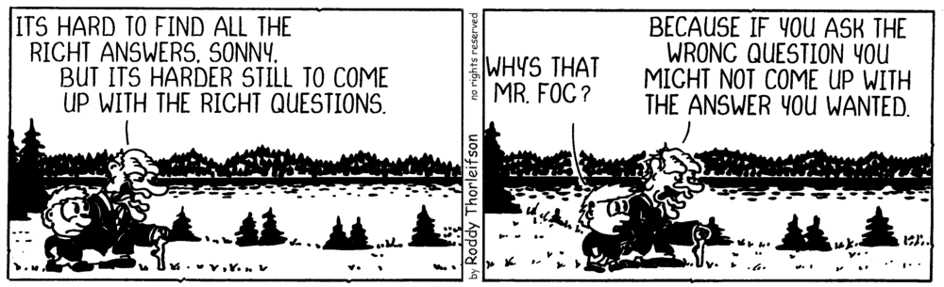
Asking the right questions

Slide 4

An example
A couple wanted to buy wallpaper for their kitchen but did not have time to measure the dimensions. Instead, they ask their neighbor who recently wall-papered his kitchen and has the same kitchen layout:
“How much wallpaper did you buy for your kitchen?”
The neighbor tells them:
“500 sqft.”

Slide 5
The couple bought 500 sqft of wall paper. After finishing the job, they had 200 sqft left over.
“We bought exactly 500 sqft of wallpaper and now we have extra material that we are not able to return,” they said to him angrily.
To which the neighbor responded,
“If you had asked me how much wall paper I used to cover my kitchen, then I would have said 300 sqft.”
Notes:
Investigators do not thoroughly flesh out their research question or the type of answer they are hoping to obtain, leading to inappropriate analytical methods and misinterpretation of results. So, I want you guys to keep this example in the back of your

Slide 6








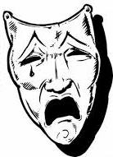
Developmental Origins of Health and Disease
(DOHaD)
Stress
Nutrition
Smoking/pollution
Late childhood/
early teens
Puberty
Early childhood
Pregnancy
Menopause
Toxicants
Social environment
Maternal condition
Notes:
… times when we may have greater phenotypic plasticity, and thus, are more responsive to environmental challenges

Slide 7
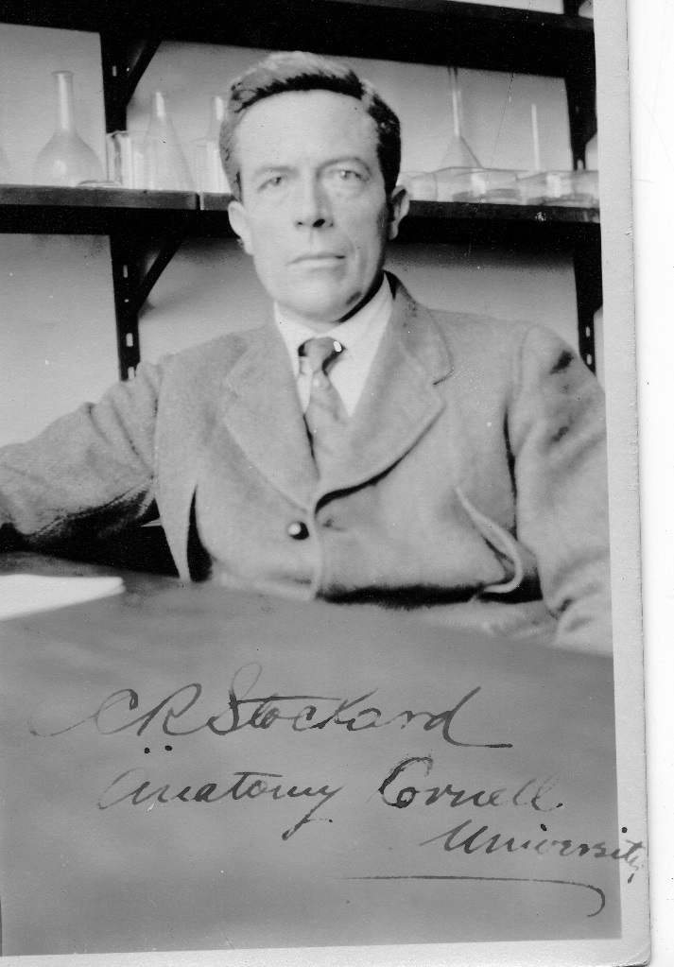
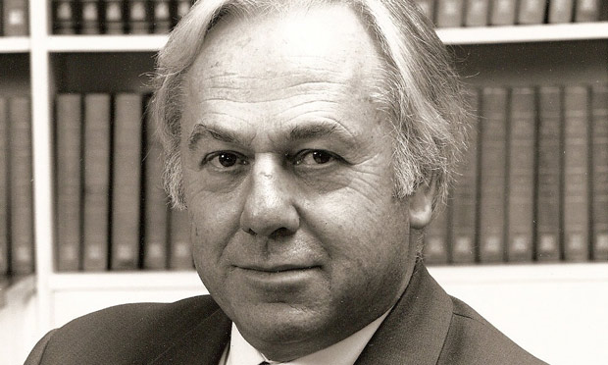
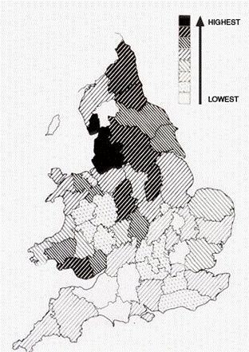
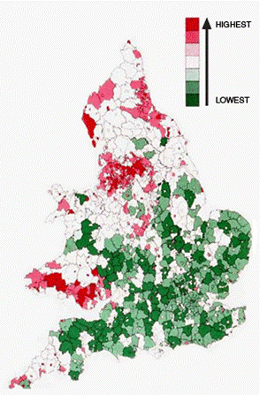
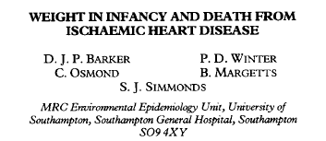
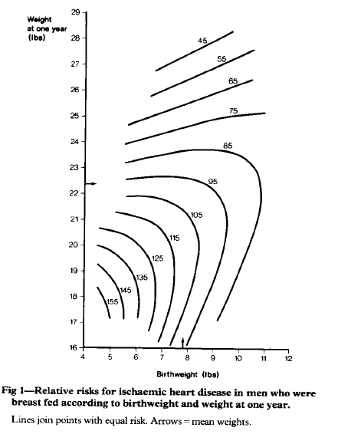
The origins of DOHaD
Heart disease rate in England and Wales 1968-78
Infant mortality rate in England and Wales 1901-10
Standardized Mortality
Ratio = 155
(null SMR = 100)
Lowest weight
at 1 y
David Barker, MD
1938-2013
Charles R. Stockard, PhD
1879-1939
Lowest birthweight
Poor early life environment
Cardiovascular risk in adulthood
Notes:
Even though DOHaD only recently became popular, the concept has been around since the 1920s following a series of experiments that Charles Stockard led, showing that exposure to toxicants during specific embryonic periods led to morphological changes in tadpoles. However, the person who most famously put forth the notion of DOHaD in the realm of human health is…

Slide 8
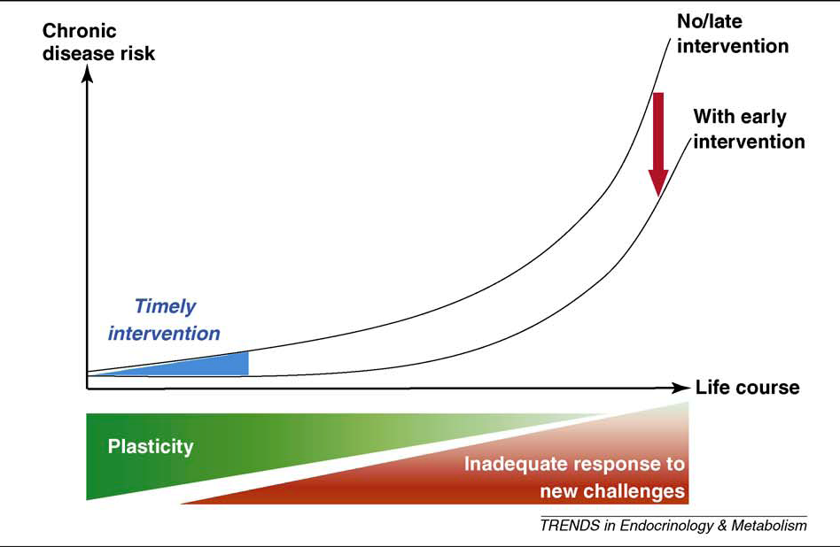
Potential impact of DOHaD
Godfrey et al., Trends Endocrinol Metab 2010 ; 21:199-205
Notes:
The popularity of DOHAd is attributable, in part, to the notion that if early life experiences can shape long-term health, then implementing interventions during these sensitive period of development can markedly reduce chronic disease risk.

Slide 9
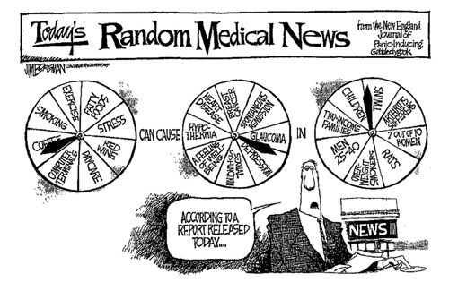
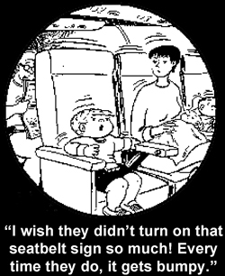
Challenges
Notes:
However, one continued challenge in the field of DOHaD is non-replicability of findings, which is partially related to the long latency period between timing of the exposure, and manisfestation of the health outcome, which provide ample opportunity for unmeasured or time-varying confounding. Another key reason for inconsistent findings has to do with unclear research questions or inappropriate analytical designs that do not reflect the research questions.

Slide 10
Directed acyclic graphs (DAGs)
Exposure
Outcome
Time

Slide 11
DAGs
Confounder
A variable that is associated with the exposure and a predictor of the outcome
Confounder
Exposure
Outcome
Time

Slide 12
DAGs
Confounder example
Mother’s age
Birth order
Down’s syndrome
Time

Slide 13
DAGs
Mediator
A variable on the causal pathway between the exposure and outcome
Mediator
Exposure
Outcome
Time

Slide 14
DAGs
Mediator example
Poor diet
Low family income
Obesity risk
Time

Slide 15
DAGs
Effect modifier
A variable that changes the nature of the relationship between
the exposure and outcome
Effect modifier
Exposure
Outcome
Time

Slide 16
DAGs
Effect modifier example
Gender
Diet
Cardiovascular risk
Time

Slide 17
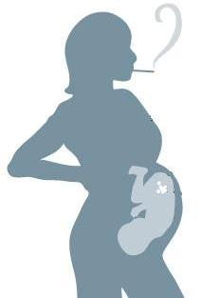

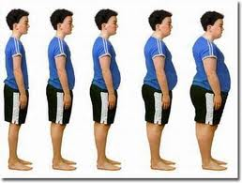


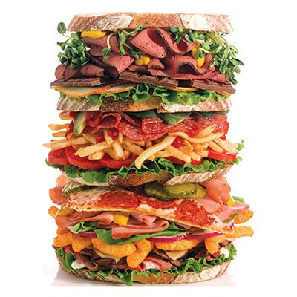
Life course epidemiology conceptual models
“Critical period” models
“Accumulation of risk” models
Notes:
So, this is where conceptual models are very handy, and I would argue, essential to all studies, whether they are DOHaD studies or not.
Life course epidemiology is a methodological framework used to conceptualize and test biological pathways underlying DOHaD phenomena

Slide 18
Life course epidemiology conceptual models
“Critical period” models
“Accumulation of risk” models

Slide 19
Critical Period Models:
“Critical period with no later modifiers”
An exposure acting during a specific timeframe has lifelong effects on physiology that are not altered by later experiences
Bendectin exposure in utero
Infertility
Time
Notes:
Perhaps the easiest model to grasp is the hypothesis that there is a critical period with no later modifiers. In other words, an exposure acting during a specific period, typically in utero for DOHaD studies, has lifelong effects on physiology that is not changed by later experience.
One example is exposure to Bendectin, which is an anti-nausea drug prescribed in the 70s that was thought to cause birth defects to the reproductive system that led to infertility in offspring. In this case, exposure to bendectin in utero led to infertility, regardless of anything that happened after the fact. This is a very extreme example that directly affects offspring form.

Slide 20
Critical Period Models:
“Critical period with modifiers”
An exposure acting during a specific timeframe has lifelong effects on physiology that can be modified by later experiences
Diet
IUGR
Adult T2DM
Time
Notes:
Due to alterations in pancreatic celll development and possible gene expression
Stratify analyses by dietary patternsr

Slide 21

Life course epidemiology conceptual models
“Critical period” models
“Accumulation of risk” models
Notes:
Accumulation of risk with the overarching hypothesis

Slide 22
Accumulation of Risk Models:
“Independent Risk Exposures”
Risk factors for disease are independent and unrelated
Low birthweight
Unemployment
Hypertension
High sodium diet
Time
Notes:
All 3 risk factors vs. each singly should give you similar estimates

Slide 23
Accumulation of Risk Models:
“Risk Clustering”
Risk exposures that are related tend to occur in concert
Etiology
Prediction
Total effect of SES
Direct effect of SES
Total effect of diet
Include exposures to maximize variability in the outcome
Low socioeconomic status
Low birthweight
Low birthweight
Unemployment
Unemployment
High sodium diet
Hypertension
Time
Notes:
1 conceptual model, 2 different statistical models, 3 different research questions

Slide 24
Accumulation of Risk Models:
“Chains of risk”
Chains of risk with additive effects
Each exposure in a chain of risk increases likelihood of subsequent exposures, and may also have an independent additive effect on later disease risk
Chains of risk with trigger effect
Only the final link has a marked effect
Marital Conflict
Physical abuse
Divorce
Unemployment
Marital Conflict
Physical abuse
Divorce
Unemployment
Time
Time
Notes:
**Chains of risk look like pathways models with mediating factors and can be analyzed as such
And then finally, there are the chains of risk hypotheses, where each event predisposes another event, eventually resulting in an adverse outcome. There are two conceptual models for this hypothesis:
The first is chains of risk with additive effects where each exposure in a chain of risk increases risk of subsequent exposure and may also have an independent additive effect on later function or disease. For this example, I am using divorce as the outcome. Low education can lead to marital conflict, which can lead to physical abuse, ultimately leading to divorce. However, each of these exposures may be independent risk factors for divorce without the others.
Contrastingly, the trigger effect posits that each risk factor increases likelihood of the next one happening, but only the last one in the sequence is enough to ‘trigger’ the outcomes. So, for example, it is conceivable that for some people, unemployment and marital conflict are annoying but still reasonable to suffer through. However, as soon as physical abuse takes place, you file for a divorce.

Slide 25

Summary of life course epidemiology conceptual models
Critical Period Models
No later modifiers
Later modifiers
Accumulation of Risk Models
Uncorrelated risk exposures
Risk clustering
Chains of risk with additive effects
Chains of risk with trigger effect
Model selected for your study are based on a priori knowledge.
Models inform data analysis and interpretation of results.
Models are not mutually exclusive.
Notes:
In Summary…
Now, I will say that in theory, you would be able to articulate which model is correct going into your study. However in practice, I’ve found that you can conceptualize the general temporal relationships between your exposures and outcomes, but you might not necessarily know the nature of the relationships between them until after the analysis.
(~13 min)

Slide 26
Exercise
In a population of hyenas, you are interested in the relationships of the following independent variables:
human exposure
gender
body size
social rank
with the outcome aggressive behavior in hyenas.
Some assumptions:
Human exposure affects aggressive behavior of hyenas
Gender is a determinant of a rank
Rank is a determinant of aggression
Rank is acquired at birth, but otherwise, it is not earned or influenced by body size or human exposure status
Notes:
In Summary…
Now, I will say that in theory, you would be able to articulate which model is correct going into your study. However in practice, I’ve found that you can conceptualize the general temporal relationships between your exposures and outcomes, but you might not necessarily know the nature of the relationships between them until after the analysis.
(~13 min)

Slide 27
Exercise
Please draw conceptual models for the following scenarios:
The relationship between human exposure and aggressive behavior, and potential effect modification by gender.
The association of gender with aggressive behavior that does not operate through rank
Interaction between sex and rank, in relation to aggressive behavior
Assumptions:
Human exposure affects hyenas’ aggression
Gender is a determinant of a rank
Rank is a determinant of aggression
Rank is acquired at birth, but otherwise, it is not earned or influenced by body size or human exposure status
Notes:
In Summary…
Now, I will say that in theory, you would be able to articulate which model is correct going into your study. However in practice, I’ve found that you can conceptualize the general temporal relationships between your exposures and outcomes, but you might not necessarily know the nature of the relationships between them until after the analysis.
(~13 min)

