Slide 1
Data for BO for Ben
Melody
March 29, 2024

Slide 2

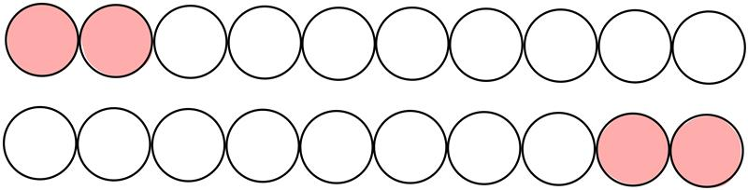
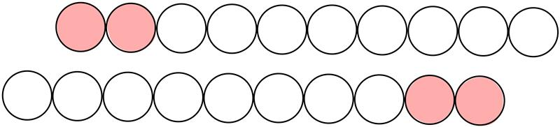
Copolymer-like ligand coated NP
Non-bonded parameters
Bead type | σ (nm) | ε (kJ/mol) | ε (kcal/mol)
C-C | 0.47 | 3.390 | 0.8102
C1-P6 | 0.52 | 2.120 | 0.5067
P-P | 0.47 | 4.990 | 1.1926
C1
P6
bonded parameters
Bead type | Keq(kcal/mol) | Req(kcal/mol)
Center-C (shifted LJ) | 2.9876 | 23.5 (shift)
C-C | 2.9876 | 4.7
C-P | 2.9876 | 4.7
Move x distance (Å)
Other parameters
Diameter (nm) – 0.47 | Center Diameter(nm) – 4.7 | Rcut = 17.5 Å

Slide 3
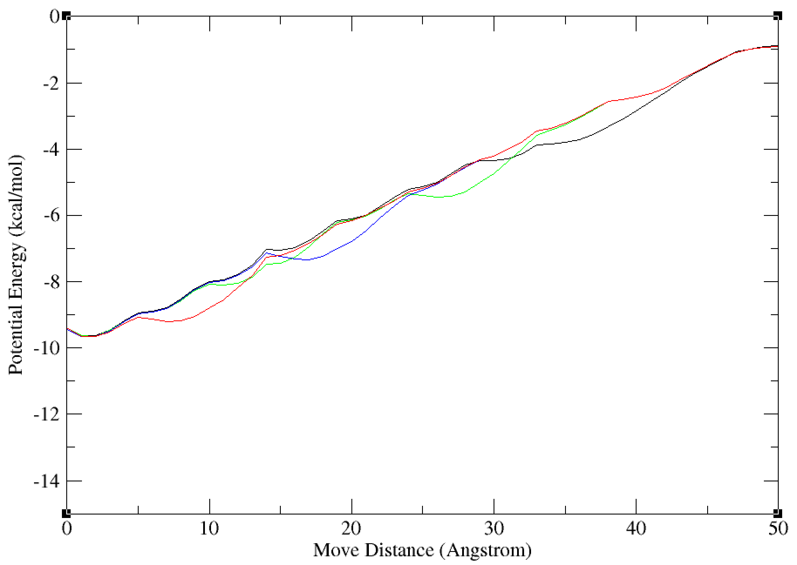
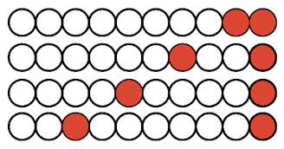
Separating P6 Beads
Credit to Ben Laubach

Slide 4
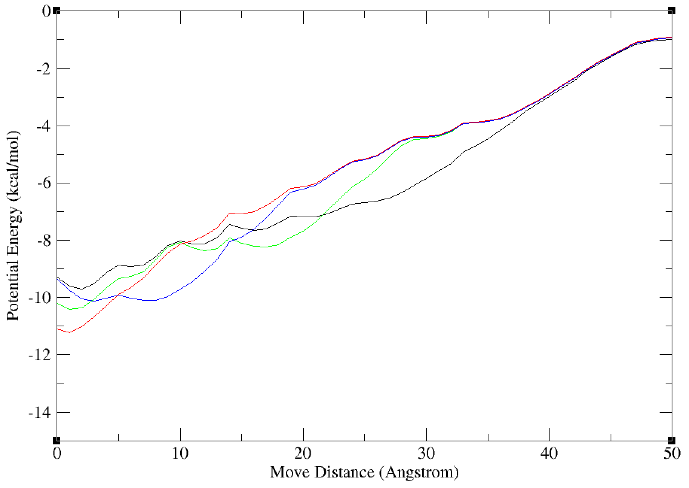
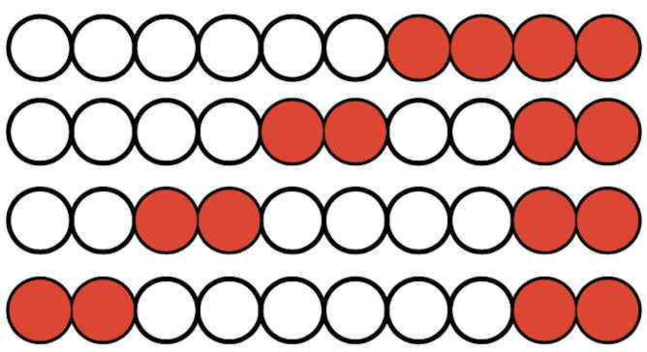
Separating P6 Groups
Credit to Ben Laubach

Slide 5
Separating P6 Groups
Credit to Ben Laubach

Slide 6
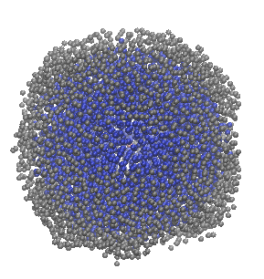
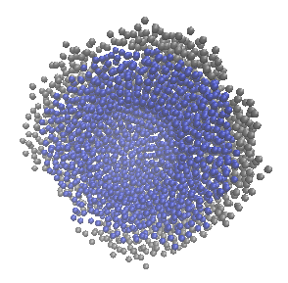
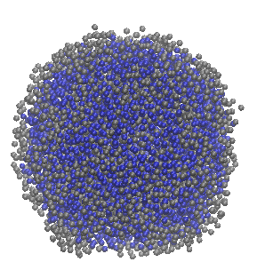
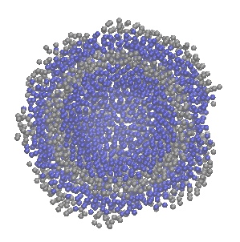
Copolymer-like ligand coated NP
Credit to Ben Laubach

Slide 7
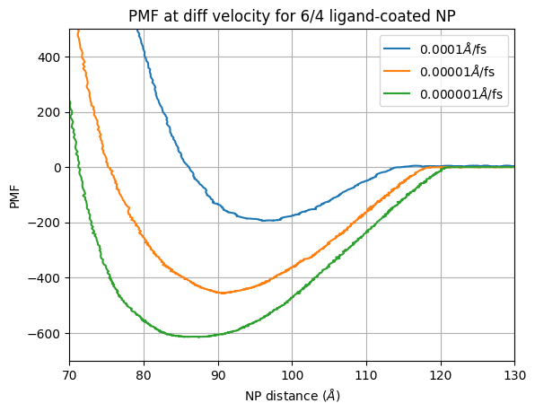
SMD Simulations – Coupled 6/4
Credit to Ben Laubach

Slide 8
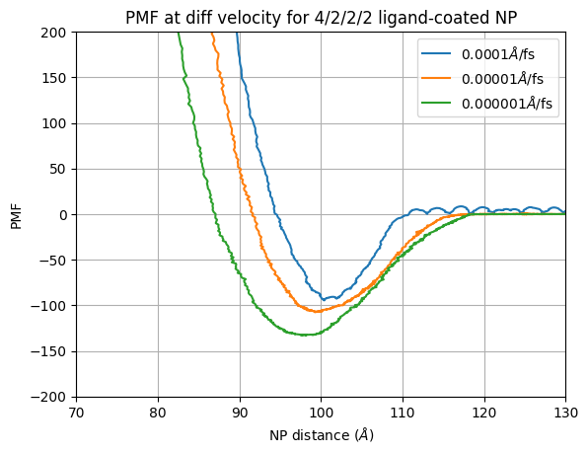
SMD Simulations – Coupled 4/2/2/2
Credit to Ben Laubach

Slide 9
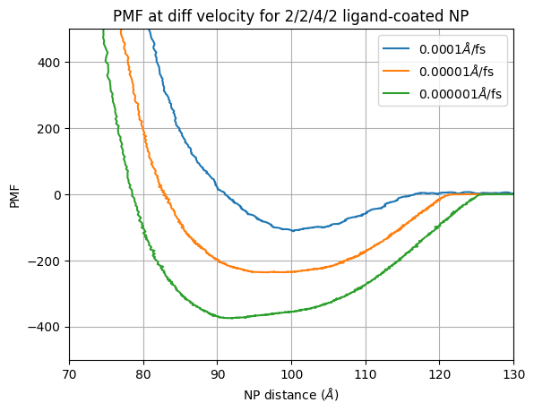
SMD Simulations – Coupled 2/2/4/2
Credit to Ben Laubach

